Slide 1
INCORPORATING DEMOGRAPHIC STRUCTURE AND VARIABLE INTERACTION TYPES INTO COMMUNITY ASSEMBLY MODELS
BY: NAYAN CHAWLA AND AKHIL ALASANDAGUTTI
ADVISOR: DR. PETER ZEE

Slide 2
INTRODUCTION
Theoretical studies allow for simulating any possible community
Constrained by model design
Many different models, comparison of all not possible, look at 2

Slide 3
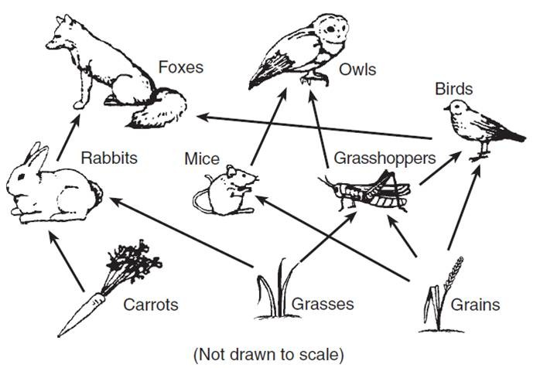
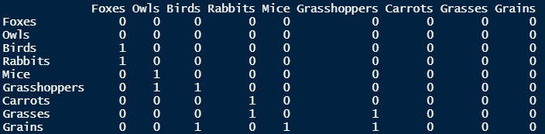
FOOD WEBS

Slide 4
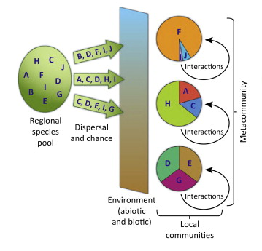
COMMUNITY ASSEMBLY

Slide 5
STAGE STRUCTURED MODEL
Past studies that explored community complexity and robustness of ecological networks have been too simple.
Majority of the models ignore demographic structure of species.
Most species often change diets as they develop from juveniles to adults (V.H.W Rudolf and Kevin D. Lafferty, 2011).
Ontogenetic niche shifts could better predict the species at risk of extinction in real networks.
This study examines the relationship between the complexity of a stage-structured ecological network and its effect on the robustness and diversity during community assembly

Slide 6
VARIABLE INTERACTION MODEL PREMISE
Relationship of diversity & stability with respect to assembly
Previous studies found more complex community, less stable
Networks were singly typed
Multiple types largely unconsidered, mutualisms destabilizing

Slide 7
INTERESTS AND USE OF MUTUALISM
Holling Type 2 nonlinear response solves issues
Study found that varied proportions of interaction types result in stability which scales with varied complexity and diversity (Mougi & Kondoh, 2012)
Examining effects on community assembly
Variable Interaction Types
Variable Connectance and Richness
Determine relationship between proportions of interaction types and features of community assembly

Slide 8
Methods

Slide 9
Stage Structured Model

Slide 10
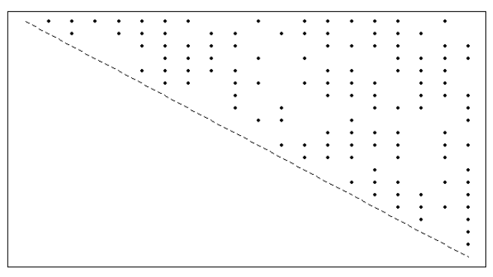
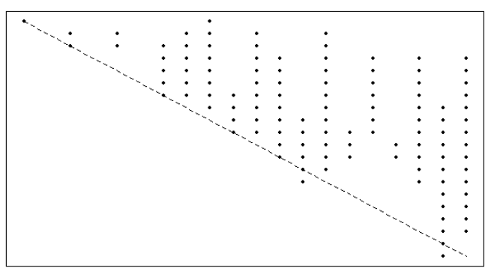
FOOD WEB MATRICES
“Niche Model” – extends previous “Cascade Model” by forcing species to consume grouping of prey in a one-dimensional trophic specialty, or niche.
X Axis represents predators, and Y axis represents prey.
Cannibalistic interactions occur along the diagonal.
Cascade Model
Niche Model

Slide 11
FOOD WEB MATRICES
Inputs:
Species Richness (S) – species population
Links (L) – total number of interactions between species
Output:
2-dimensional matrix representing a Niche Food Web.
Connectance (C) – Number of links expressed as a proportion of total number of links.
C = L/S^2

Slide 12
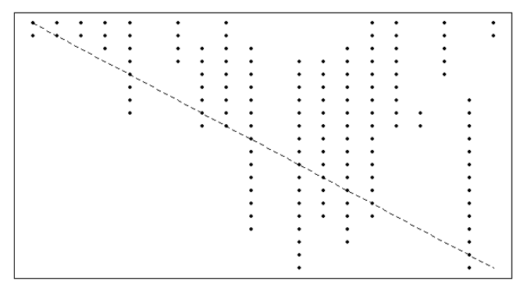
Sample Niche model with 25 species and C=0.3, where points represent interactions, X axis represents predators, and Y axis represents prey. Predators are forced to eat groupings of prey (niche).

Slide 13
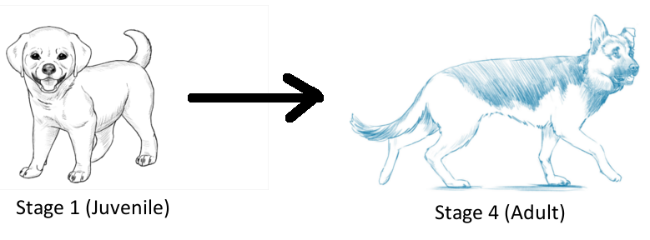
ADDING STAGE STRUCTURE
Random number of life history stages assigned to each species with a range of 1 to 10 .
Reproductive stage threshold that is equal to at least half the total number of the stages present in the species. It represents the minimum stage requirement for a species to be able to reproduce and not go extinct.

Slide 14
STAGE MATRICES
Each Species has its own unique stage matrix.
Not necessarily symmetrical, unlike the food web matrix.
Represents predator-prey relations between the stages of the focal predator species, and the possible prey species.
Prey are not stage dependent, and the predator stage will be able to consume all stages of the prey species.
P value – probability of a stage in the stage matrix consuming a resource.

Slide 15
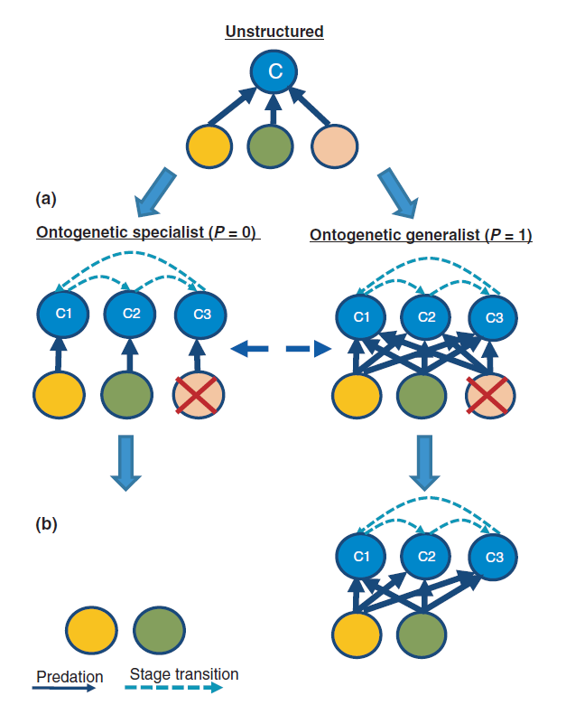

Slide 16
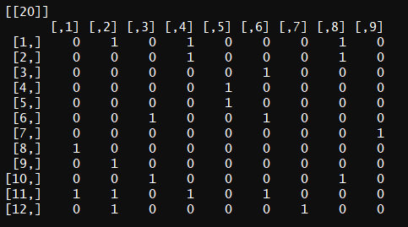
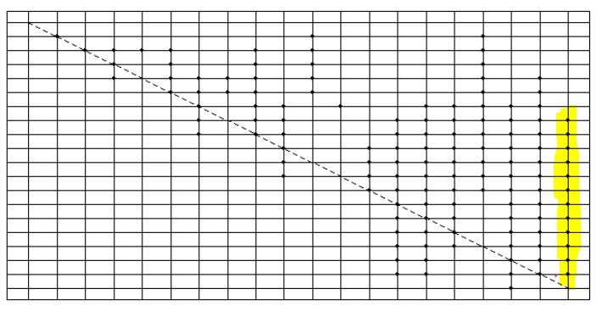
STAGE MATRICES
Example stage matrix of stage-structured species showing links between different stages of a predator species and prey species.
Community matrix corresponding to the figure on the left. Species 20 is able to use Species 8 – 19 as prey, but different stages are each only able to use certain prey (determined by the stage matrix)

Slide 17
MAINLAND AND ISLAND
A Community is represented as a record that contains the predator-prey community matrix, the stage matrices of each species, and the food habit information associated with them.
A Species is considered to be active if its reproductive stage is able to survive off the resources available in the ecosystem.
Mainlands and Islands are different community types that contain the same food network information, but the former always has all the species present, and the latter is initially void of any active species.
We simulate the community assembly from the mainland onto the island as a stochastic process.

Slide 18
MIGRATION
At every constant time t, n species are randomly picked from the Mainland and placed in the Island.
After every event of migration, primary extinctions, and a constant m number of secondary extinctions are calculated.
This process is repeated until the demographics of the Island become identical to that of the Mainland.

Slide 19
REPRODUCTION AND EXTINCTIONS
After every migration, primary and secondary extinctions are computed.
Primary extinctions – species that aren’t capable of surviving in the new ecosystem due to the lack of resources.
Secondary extinctions – extinctions that result due to the primary extinctions.
After the extinctions, reproductive thresholds are checked and species that don’t meet the threshold are culled.

Slide 20
COMPREHENSIVE MIGRATION AND COMPUTATION FOR POPULATION ASSEMBLY
Multiple migrations with variations of Connectance (0.05, 0.1, 0.2, 0.3, 0.4, 0.45) and P (0.1 to 1.0) were run.
Each migration consisted of species migrating from a mainland to 10 islands. Randomly selected species assembled in each of the islands at every time period t.
Each Migration was allowed to run until t = 500, and there were 30 total runs of each migration setting.
All the simulations were run on Mississippi Center for Supercomputing Research’s (MCSR) Maple Cluster in an asynchronous fashion on multiple nodes.

Slide 21
Variable Interaction Model

Slide 22
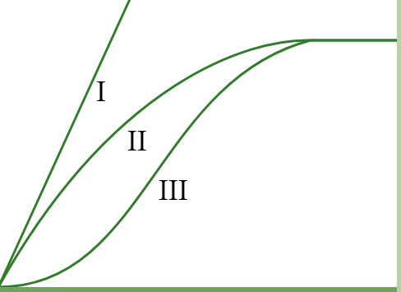
MODEL PREMISE
Random Food Web
Varied Interaction Types
Competitive Interactions Holling Type 1
Others Holling Type 2
Mainland - Island Assembly

Slide 23
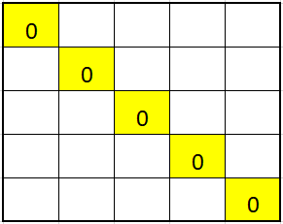
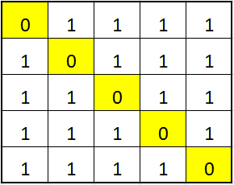
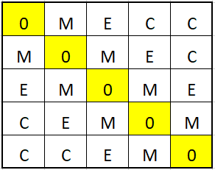
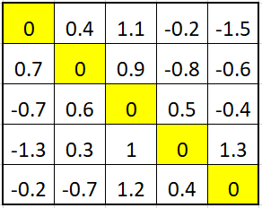
INTERACTION MATRIX CONSTRUCTION
CONNECTANCE AND DUPLICATION
SELF REGULATION
TYPE SELECTION
WEIGHTING
Matrix A

Slide 24
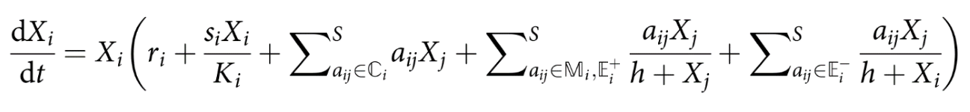
MODEL EQUATION
Xi is population of species i
ri is the intrinsic growth rate
aij is the interaction weight in matrix A between species i and j
h is the half saturation constant of the Type II functional response
si is the negative self-regulation term
Ki is the carrying capacity of the community
C, M, E+, and E- are subset matrices of A
Note that the competitive interaction do not follow the Type II functional response.

Slide 25
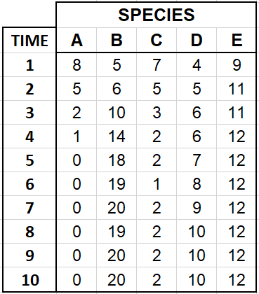
POPULATION DYNAMICS SIMULATION
(Single Mainland)
Initial Densities
lsodar Root Function Integrator
δ Threshold or Time Limit
Extinction threshold e

Slide 26
MAINLAND
M,E,C varied from 0 to 1 by 0.1, with combined sum equivalent to 1.
Minimum 10% chance of Competition maintained.
55 combinations
Connectance varied from 0 to 1 by 0.1
Species Richness varied from 20 to 200 by 20
5,500 possible combinations & 5 replicate mainlands

Slide 27
ISLAND ASSEMBLY
Mainland construction ends, community assembly begins
1 replicate mainland selected for each
Sampling threshold nI = 5
Richness less than nI means mainland extinct
Greater than or equal to nI means 5 replicate islands formed
COMMUNITY
REPLICATES
EXTINCT

Slide 28
ISLAND MIGRATION
nI species selected to form community
Random sampling without replacement
Mainland unaffected
Selected species introduced at xz percent of mainland population size
xz held at 10 percent

Slide 29
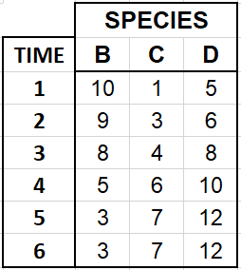
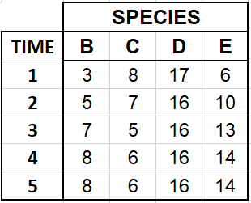
ISLAND POPULATION DYNAMICS
MAINLAND
Dynamics simulated using A, migration repeated
Island assembly simulated independently
Previously selected species increase by xz percent
Repeats until:
Island - Mainland Richness equivalent
kl equilibriums reached
EQ. 2
ISLAND
EQ. 1

Slide 30
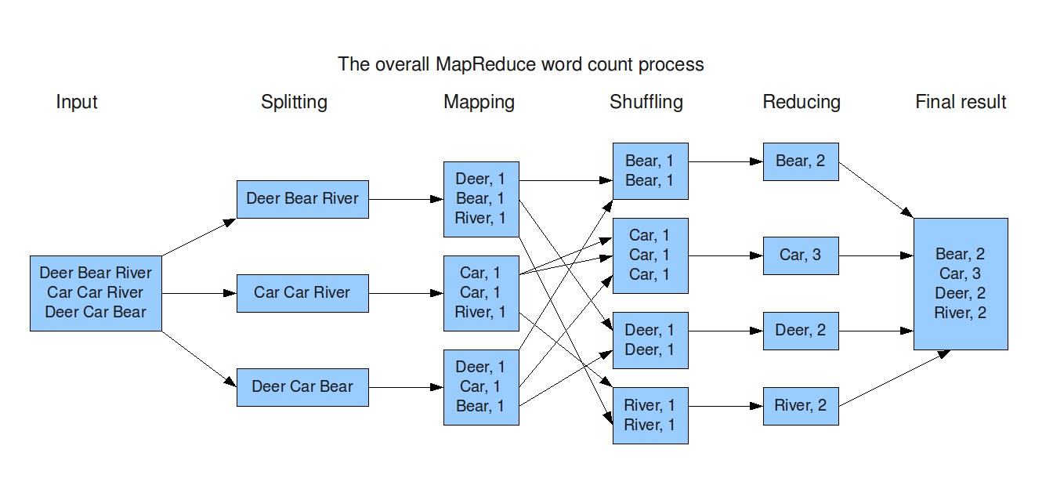
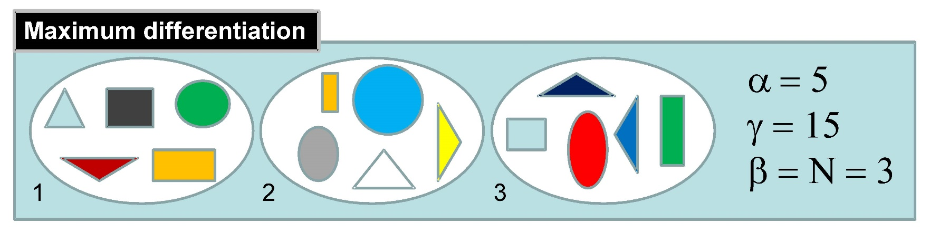
DATA COLLECTION
HPC runtime reduction
Map – Reduce
Descriptive Statistics:
Whitaker Beta Diversity
Balance of Types over Time
Island Max Persistence
Time to Max Persistence
Etc.

Slide 31
Results

Slide 32
Stage Structured Model

Slide 33
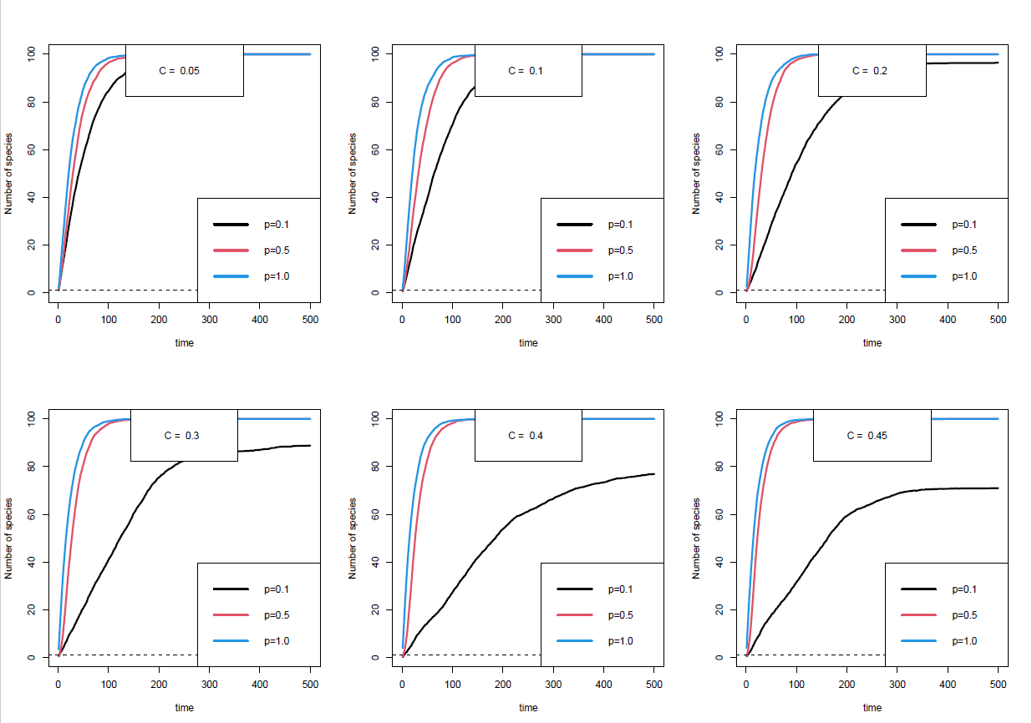
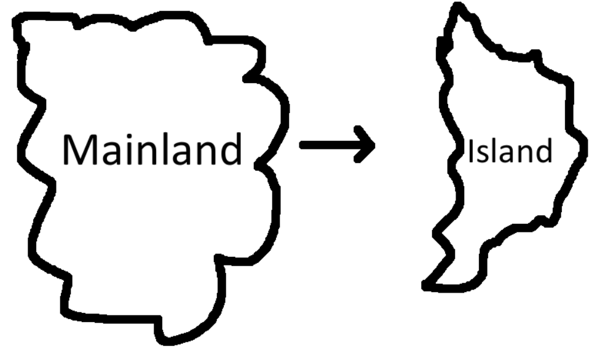
Communities with higher Connectances and p are generally more stable.
The stability of communities with lower p declines with an increase in Connectance and these communities don’t reach peak assembly.
Population Assembly Plots

Slide 34
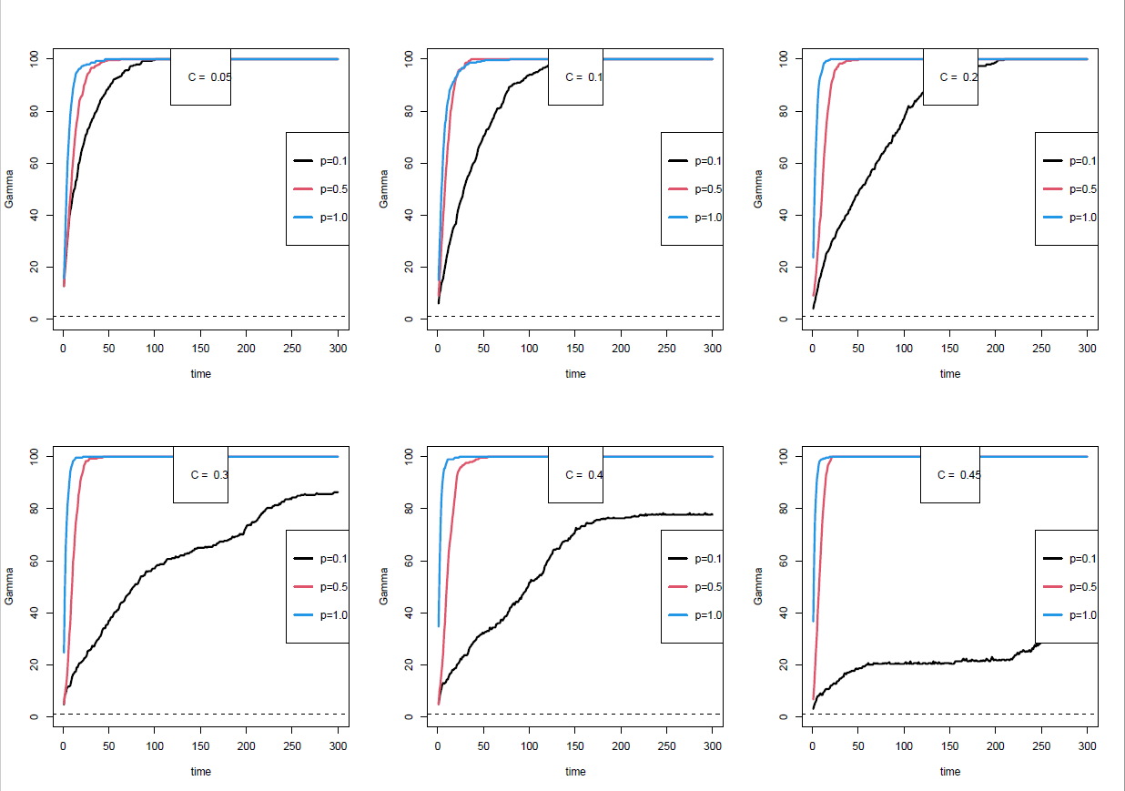
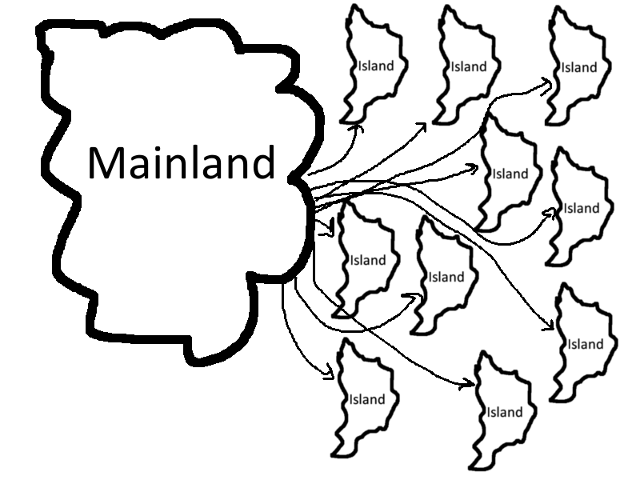
Gamma Diversity represents the overall diversity across all 10 islands.
Gamma increases at the fastest rate in communities with high Connectance and high p.
Gamma increases at the slowest rate, and stagnates in communities with high Connectance and low p.
Gamma Diversity Plots

Slide 35
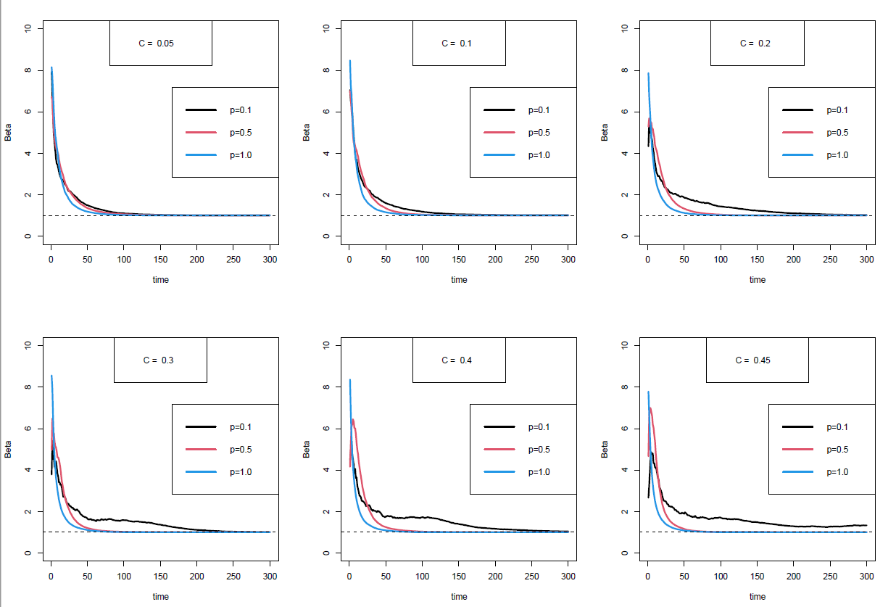
Beta represents the comparison of diversity between the 10 islands.
Beta peaks early in communities with low Connectances with little to no variation due to p.
Beta Diversity peaks relatively later in communities with high connectances with a more visible variation due to p.
Beta also stagnates in communities with the highest Connectance and lowest p.
Beta Diversity Plots

Slide 36
Variable Interaction Model

Slide 37
SIMULATION OUTLINE
Initial Species Richness of 200
Lower levels too small
General trend in diversity:
Mainlands saw significant extinctions
Islands reached similar levels persistence

Slide 38
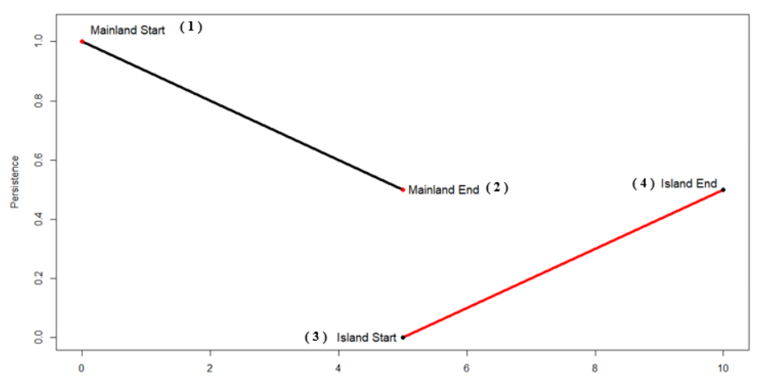
SIMULATION TIMELINE
( 1 ) Initial species introduction
( 2 ) Equilbirum reached
( 3 ) Immigration Start
( 4 ) Island reaches max persistence or time limit

Slide 39
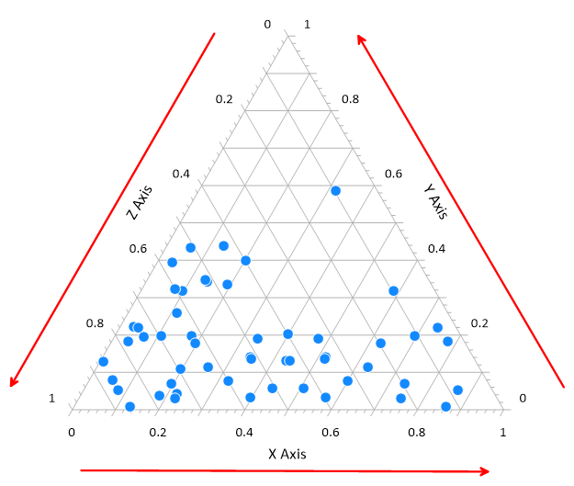
TERNARY HEATMAPS
Remaining figures are ternary plots
Function of three axes equals 1
3 axes are proportions of interaction types
Points at vertices show singly typed communities

Slide 40
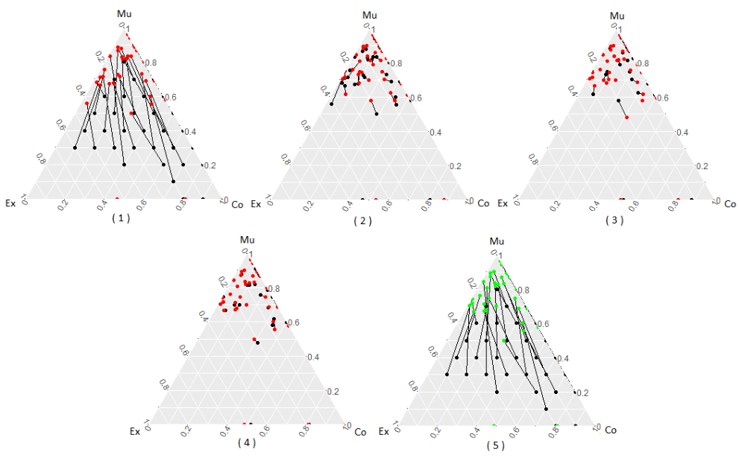
INTERACTION BALANCE SHIFT
Mean shift in interaction types
100% Connectance
Black before, Red after
Mutualistic Shift

Slide 41
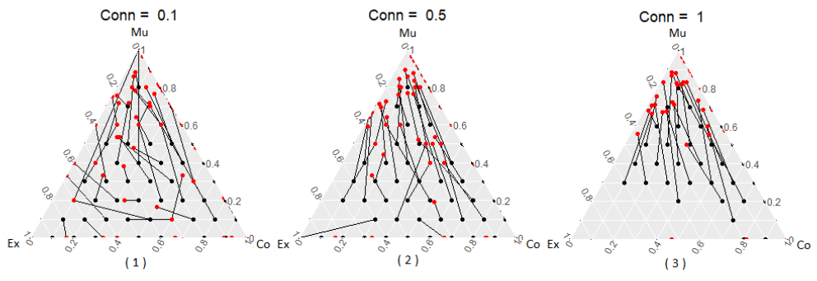
CONNECTANCE AND BALANCE SHIFT
Shift in interactions
Mainland Start to End
Connectance & Mutualism
Highly exploitative communities go extinct
High connectance means extinction

Slide 42
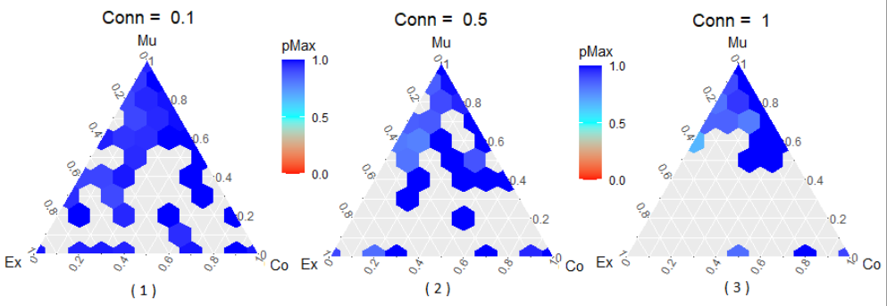
ISLAND MAX PERSISTENCE
Max persistence island end relative to mainland end
Hexagons represent communities in that range
Blank areas means no communities
Connectance and exploitation destabilizing

Slide 43
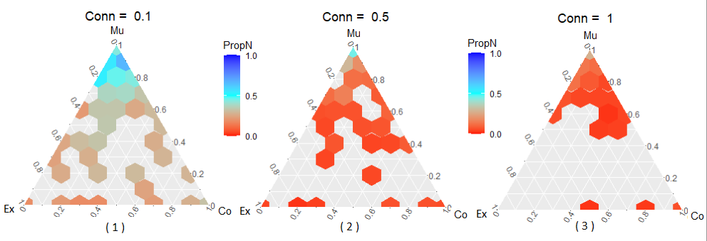
SURVIVAL RATE AND BALANCE SHIFT
Percent species surviving after mainland population dynamics simulated
Connectance overpowered any stability benefits from interactions

Slide 44
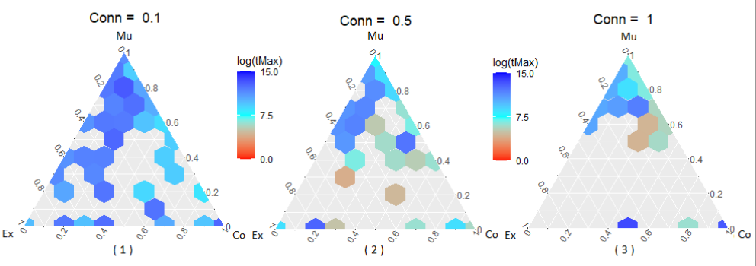
TIME TO MAX PERSISTENCE
Log of Time to Max Persistence for Islands
Smaller community, faster assembly
Similar size communities, interactions make clear impact
Initially competitive cluster consistently faster

Slide 45
Discussion

Slide 46
DISCUSSION OF STAGE MODEL
Complexity of stage structured model challenges findings of unstructured models
Greater interaction complexity doesn’t mean greater stability
Greater niche overlap means faster migration to newer ecosystems
Increasing connectances amplifies instability in lower niche overlap communities
Ontogenetic specialists more robust at lower p value than generalists at higher p value
Findings consistent with Rudolf & Lafferty (2011) stage structured model

Slide 47
DISCUSSION OF INTERACTION MODEL
Mutualistic interactions mean greater internal stability and time to assemble
Competitive interactions decrease assembly time, not severe effect on stability
Exploitative interactions severely destabilizing
Mix of mutualism & competition leads to fast assembly and stable community
Connectance severely destabilizing, supported by May (1972) etc.
Varying richness led to no qualitative differences
In line with findings of Qian and Akcay (2019)

Slide 48
JOINT DISCUSSION
Explore different aspects and stability in different ways
Stage structured model singly typed, only shows exploitation
Differences help understand what changes in each approach will do
Implementing stage structure in the variable interaction model might yield better stability and faster assembly in communities with high connectances and higher niche overlaps.
Introducing variable interaction types to the stage structured model might increase stability and assembly time in communities with lower niche overlap due to the presence of potential mutualistic interactions.

Slide 49
FUTURE WORK
Keystone Prediction and Analysis
Model Combination
Meta – Community Analysis
Application of differing models

Slide 50
THANKS!
Questions?

