Slide 1
Introduction
Past studies that explored community complexity and robustness of ecological networks have been too simple.
Majority of the models ignore demographic structure of species.
Most species often change diets as they develop from juveniles to adults (V.H.W Rudolf and Kevin D. Lafferty, 2011).
Ontogenetic niche shifts could better predict the species at risk of extinction in real networks.
This study examines the relationship between the complexity of a stage-structured ecological network and its effect on the robustness and diversity during community assembly

Slide 2
Methods

Slide 3
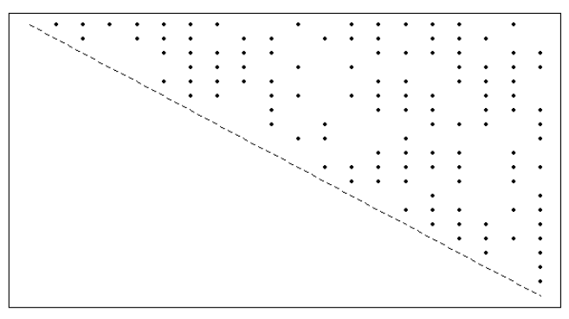
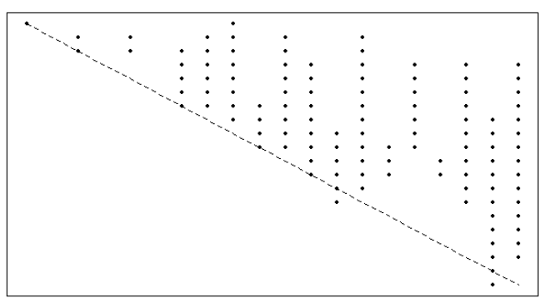
Food Web Matrices
“Niche Model” – extends previous “Cascade Model” by forcing species to consume grouping of prey in a one-dimensional trophic specialty, or niche.
Cascade Model
Niche Model

Slide 4
Food Web Matrices
Inputs:
Species Richness (S), Links (L)
Output:
2-dimensional matrix representing a Niche Food Web.
Connectance (C) – Number of links expressed as a proportion of total number of links.
C = L/S^2
Species with 0 prey are flagged as self-sustaining species.

Slide 5
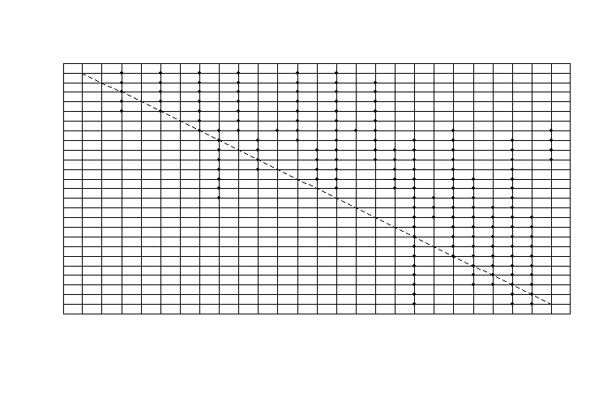
Sample Niche model with 25 species and C=0.3, where points represent interactions and rows and columns are species in the community.

Slide 6
Adding Stage Structure
Random number of life history stages assigned to each species with a range of 1 to 10 .
Reproductive stage threshold that is equal to at least half the total number of the stages present in the species. It represents the minimum stage requirement for a species to be able to reproduce and not go extinct.

Slide 7
Stage Matrices
Each Species has its own unique stage matrix.
Not necessarily symmetrical, unlike the food web matrix.
Represents predator-prey relations between the stages of the focal predator species, and the possible prey species.
Prey are not stage dependent, and the predator stage will be able to consume all stages of the prey species.
P value – probability of a stage in the stage matrix consuming a resource. It is assigned as a state variable of the community, and is immutable.
It is ensured that each predator stage in the stage matrix consumes at least one prey and is also consumed by at least one predator.

Slide 8
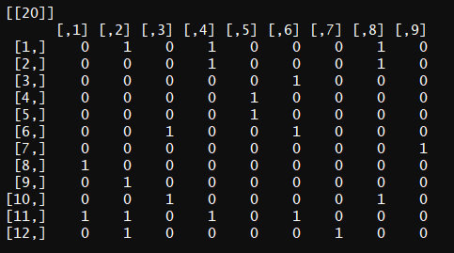
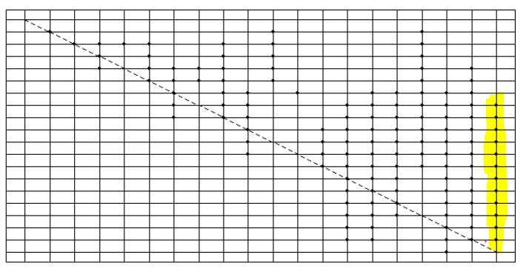
Stage Matrices
Example stage matrix of stage-structured species showing links between different stages of a predator species and prey species.
Community matrix corresponding to the figure on the left. Species 20 is able to use Species 8 – 19 as prey, but different stages are each only able to use certain prey (determined by the stage matrix)

Slide 9
Mainland and Island
A Community is represented as a record that contains the predator-prey community matrix, the stage matrices of each species, and the food habit information associated with them. Also keeps track of the species and their corresponding stages that are actively present in the community.
A Species is considered to be active if its reproductive stage is able to survive off the resources available in the ecosystem.
Mainlands and Islands are different community types that contain the same food network information, but the former always has all the species present, and the latter is initially void of any active species.
We simulate the community assembly from the mainland onto the island as a stochastic process.

Slide 10
Migration
At every constant time t, n species are randomly picked from the Mainland and placed in the Island.
After every event of migration, primary extinctions, and a constant m number of secondary extinctions are calculated.
This process is repeated until the demographics of the Island become identical to that of the Mainland.

Slide 11
Reproduction and Extinctions
After every migration, primary and secondary extinctions are computed.
Primary extinctions – species that aren’t capable of surviving in the new ecosystem due to the lack of resources.
Secondary extinctions – extinctions that result due to the primary extinctions.
After the extinctions, reproductive thresholds are checked and species that don’t meet the threshold are culled.

Slide 13
Results

Slide 14
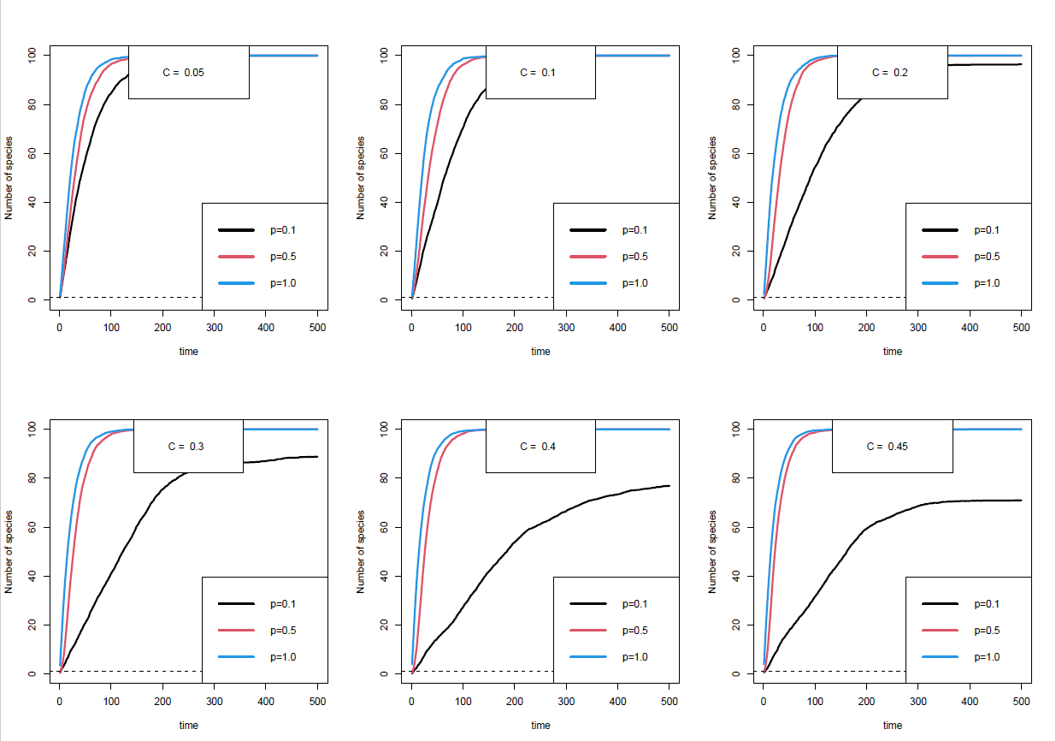
Population Assembly Plots

Slide 15
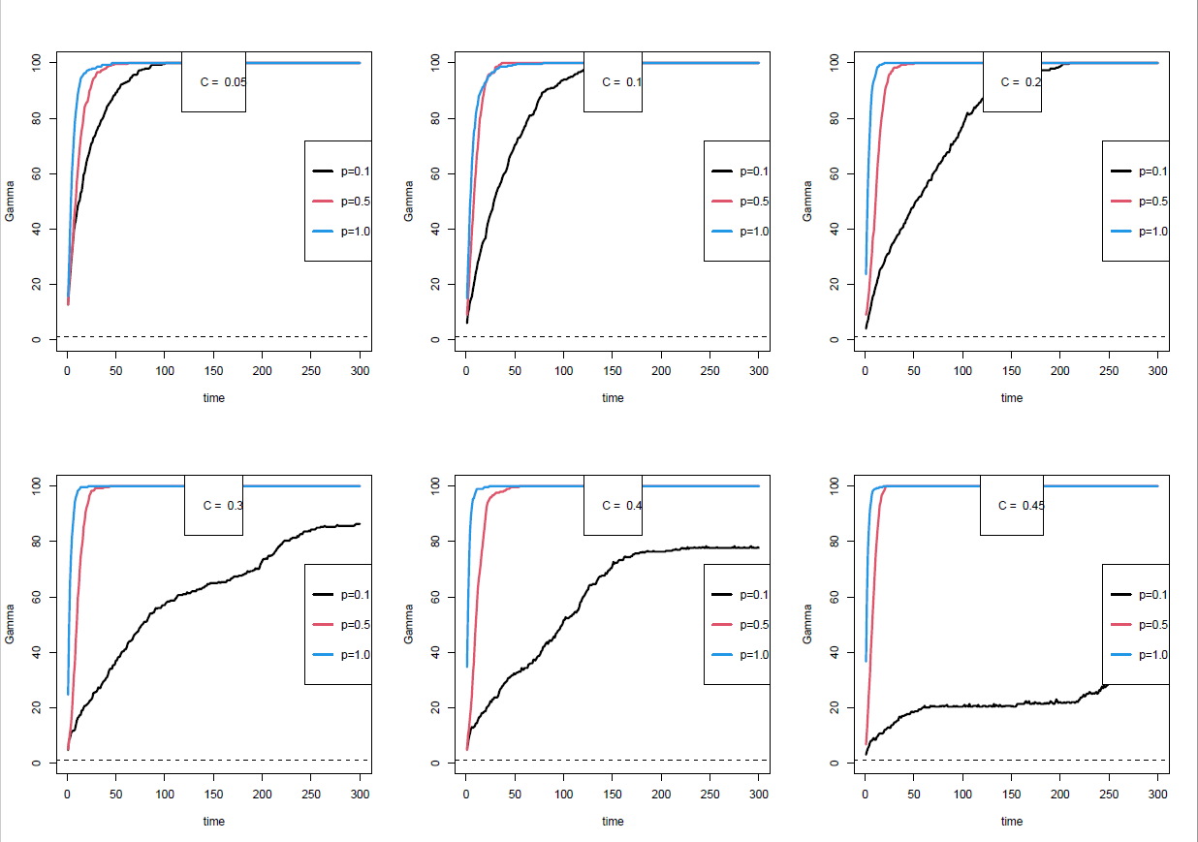
Gamma Diversity Plots

Slide 16
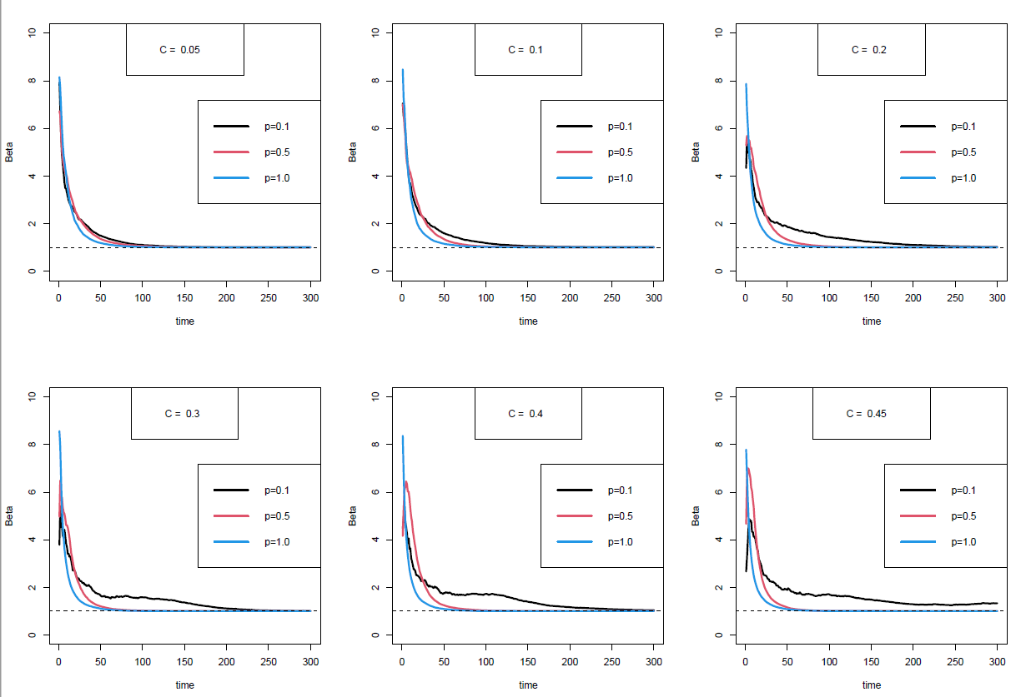
Beta Diversity Plots

