Slide 1




Say it any way, in any language, and it lends a hand
AI COMPANION
Marco listens
Claude understands
The arm does it
ShanHaiWoo Hardware Hackathon · Shanghai · October 21–23, 2026
Notes:
0:00. This is AI Companion. You talk to it the way you talk to a person, in any language, and it lends you a hand. Marco, the little Watcher, listens; Claude understands what you meant; the robot arm does it.

Slide 2


One in five people in China is now over 60
297M
people aged 60 or older at the end of 2023
21.1%
of the whole population
1 in 5
Source: National Bureau of Statistics, reported by Caixin Global, September 5, 2024
Notes:
0:10. One in five people in China is now over sixty: almost three hundred million people. Many of them spend most of the day at home, at a table, and small physical help matters.

Slide 3




Today, the voice in the room can talk, but it can't hand you anything
Smart speaker
Robot arm
AI Companion
Talks and answers
Has hands
Talks back in your language
Understands free speech
Needs an app, menus or exact commands
Has hands
No hands: it can't do anything physical
Usually one language, no dialects
Any wording, slang, dialect or correction
Notes:
0:20. The voice assistants in their homes can talk, but they can't hand anyone anything. The robots that could need apps, menus and one language. Nobody puts the two together for someone who just wants to say it in their own words.

Slide 4
With AI Companion, Marco hears you, Claude understands, the arm does it
Ears: Marco
Brain: Claude
Hands: the arm
A SenseCAP Watcher on the table. Say “Marco” and talk.
Understands slang, dialect and corrections, and plans the movement.
Moves, or shakes “no” and says kindly why it can't.
“Marco, vai tudo pra baixo e acena” → “Claro!” → it bows all the way down, then waves
Portuguese, “all the way” and two moves in a row, understood in one sentence
Notes:
0:35. With AI Companion, Marco listens, Claude understands what you meant, even with slang, dialect or a correction, and the arm does it, or says kindly why it can't.

Slide 5


Where the AI runs and where the hardware sits
Marco
MacBook: the brain
Black arm
SenseCAP Watcher
SO-101, 6 joints, 5 V. Runs today's demo
Wake word “Marco”
Microphone and speaker
USB today; Wi-Fi through its MCP access point
Whisper small, on the Mac
Speech to text in ~0.9 s, detects the language
Fast path | Claude Haiku 5.5
Short commands run instantly; anything else becomes JSON intents + a reply
White arm
Safety layer, 30 times a second
SO-101 + wrist camera; Claude Opus 5.5 sees and plans. Needs a new elbow servo
Safe ranges, contact guard, “stop” always wins
Notes:
0:50. Marco is the ears, the arm is the hands, the camera is the eyes, and the brain runs on this laptop. Whisper turns speech into text locally, short commands run instantly, everything else goes to Claude, and a safety layer checks every pose thirty times a second before the motors move. Let me show you.

Slide 6
Say it any way, in any language, and it does it or tells you why not
What someone said | Language | What the arm did
向右转一点 | Mandarin | Turns right a little, answers in Mandarin
舉高少少 | Cantonese | Raises a little, answers in Cantonese
gira todo a la derecha | Spanish | Turns all the way right
पूरा दाईं ओर घूमो | Hindi | Turns all the way right
vira tudo pra direita e depois tudo pra esquerda | Portuguese | All the way right, then all the way left
left, no, right | English | Only right: the correction wins
bring me a glass of water | English | Says kindly it can't, shakes “no”
we're having lunch later (side chat) | English | Stays still and silent
Real phrases from our test suites; Cantonese is detected and answered in Cantonese, with Traditional characters
Notes:
Every row here is a phrase from our automated test suite, run against the real model. Note the correction: 'left, no, right' turns only right. And when someone at the table is just chatting, the arm stays still and quiet.

Slide 7
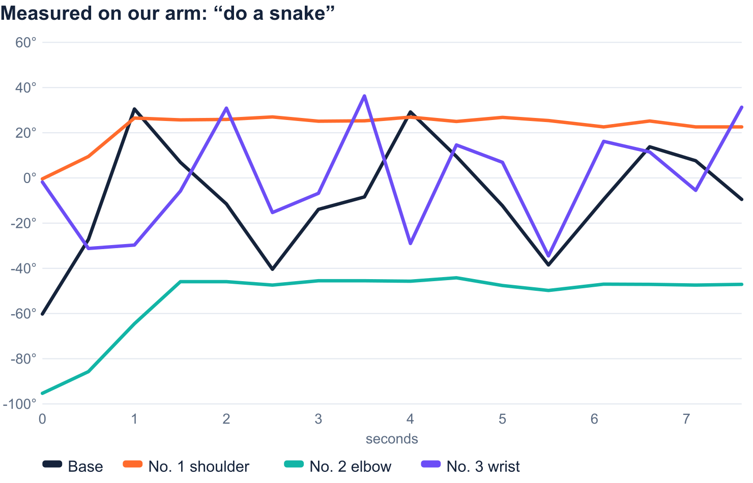
Not a menu of moves: any movement the arm can physically make
B
Base
turns the arm, −95° to +95°
1
Number 1, shoulder
leans back or forward
2
Number 2, elbow
forearm up or down
3
Number 3, wrist bend
−60° to +60°
4
Number 4, wrist turn
−170° to +170°
H
Hand
open or close
“Move number 2 all the way down” · “do a snake” · “draw an 8 in the air” · “bend each joint one at a time”
Notes:
This is the part we're proudest of. It isn't a fixed list of moves. Each joint has a name, base and numbers one to four plus the hand, and Claude writes its own choreography, up to forty poses, which the server clamps to safe ranges. This chart is real data from our arm: someone said 'do a snake' in English. The shoulder leans forward and the elbow stretches out, while the base and the wrist swing back and forth.

Slide 8
Live demo: six things to try in two minutes
“Marco, turn left”, then “go all the way down and wave”
“向右转一点”, then “舉高少少”
1
2
Sequences and “all the way”
Mandarin, then Cantonese
“Left, no, right”
“Do a snake”, then “move number 2 all the way up”
3
4
The correction wins
Free movement, named joints
“Bring me a glass of water”
“Stop!” in the middle of a move
5
6
A kind no, and a head shake
Stop always wins
If Wi-Fi or Marco fails: the hold-to-talk button on the Mac page. If the API fails: short commands still run offline.
Notes:
Keep Marco's volume down so the Mac is the one voice. A teammate does the Mandarin and Cantonese lines. Someone chats beside the arm to show it ignores side conversations. Fallback: hold-to-talk on the Mac page; with no API, short commands still work through the keyword path.

Slide 9




Safe by design: it knows what it can't do
Refuses out loud
“Stop” always wins
Impossible asks get a kind sentence in the speaker's language and a “no” shake. It never pretends.
“Stop”, “para” or “停” cancels any sequence at once, even while Claude is still thinking.
Ignores side conversations
Never reaches the table
Chatting, laughter and speech-recognition junk are marked “not for the robot”: the arm stays still.
Every pose is clamped to safe ranges; a joint that strains without moving freezes in under a second.
Claude decides; the safety layer enforces.
Notes:
Is it safe around elderly people? Low torque limits, a contact guard that freezes the arm, a stop word that always wins, and Claude refuses anything unsafe. It is a small desk arm, not a mobile robot. Claude decides; the safety layer enforces.

Slide 10
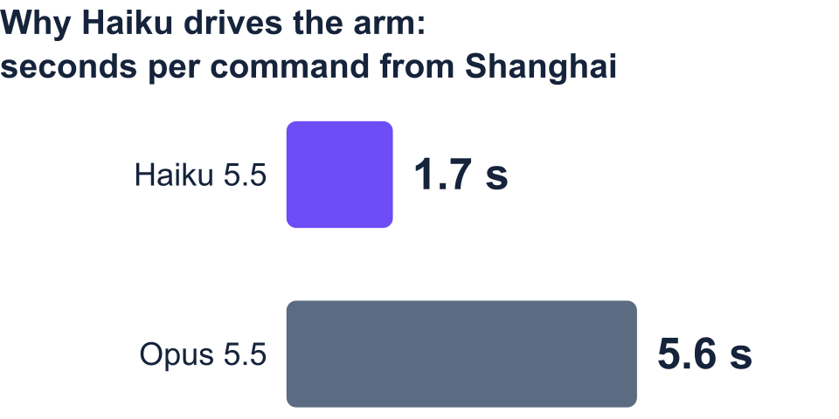
Measured, not promised: real languages, real latency
80/80
12/12
command phrases right in 6 languages
free-movement phrases (snake, figure 8, named joints)
17/17
~1 s
Same intents on our test phrases. Opus 5.5 plans the camera-based picking, where it has time to think.
noise and side-chat tests ignored
for common commands; ~3 s for free speech
Notes:
Every number here we measured ourselves this week. Eighty out of eighty test phrases in Mandarin, Cantonese, English, Portuguese, Spanish and Hindi. We picked the fastest Claude model for the arm because both gave the same answers, and a person waiting for a hand shouldn't wait five seconds.

Slide 11



What broke: the white arm's elbow, and we proved it by measuring
Measure, don't trust the reply
Every move is checked by reading the joint angles before and after.
Base
Shoulder
Elbow
Say so when it can't move
The black arm once said “yes” without moving; now it says out loud that it isn't ready.
Wrist bend
Wrist turn
Gripper
One part from working
Elbow, torque on: the 12 V supply drops to 11.3 V, the joint doesn't move, then the servo stops answering. The other five hold 11.7–12.0 V while moving.
One new STS3215 servo (id 3), and the camera picking code is ready to run.
Notes:
Why two arms? The white arm carries the wrist camera for picking objects; the black arm shows the interaction today. Its elbow servo failed during the hackathon, and we didn't guess: we measured it. Five joints move normally, and the elbow alone pulls the supply down and drops off the bus.

Slide 12





Next: from gestures to fetching things
Hand me the pills
Medication reminders
“Help” palm gesture
New elbow servo, then the wrist camera finds the object and Claude plans the grab.
Marco reminds on time, and the arm points to the right box.
The Watcher's camera sees an open palm and alerts the family.
Rokid glasses
No cable
Off the laptop
Caregivers see what the arm sees, and can guide it from anywhere.
Marco drives the arm over Wi-Fi through its MCP access point (built, tested offline).
The whole brain on a small board next to the arm.
Notes:
What comes next: a new elbow servo turns on camera picking, so 'hand me the pills' really works. Then medication reminders, a palm gesture that alerts the family, Rokid glasses for caregivers, and no cable at all.

Slide 13
Say it any way, and it does it, or tells you why not
AI COMPANION
Claude decides; the safety layer enforces.
Questions?
github.com/mehdi-loup/watcher-hub
Notes:
Repeat in every answer: 'Say it any way, and it does it, or tells you why not.' and 'Claude decides; the safety layer enforces.'
Why not a smart speaker? They have no hands. The value is the physical help: the arm acts.
Is it safe? Low torque limits, a contact guard, a stop word that always wins, and Claude refuses anything unsafe. A small desk arm, not a mobile robot.
Does it work offline? Speech recognition runs on the laptop; common commands work offline; free-form understanding needs the Claude API.
Dialects? Cantonese is detected and answered in Cantonese; Claude also fixes misheard words.
Why two arms? The white arm carries the camera for picking; its elbow servo failed during the hackathon, so the black arm runs the demo.

