Slide 1
Automating Geoprocessing Analysis and Mapping using ArcMap
Murilo Vianna

Slide 2
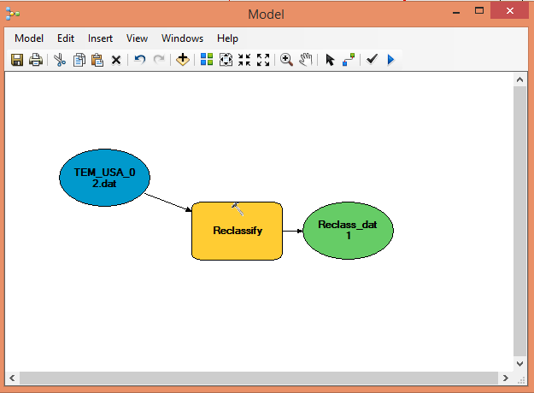

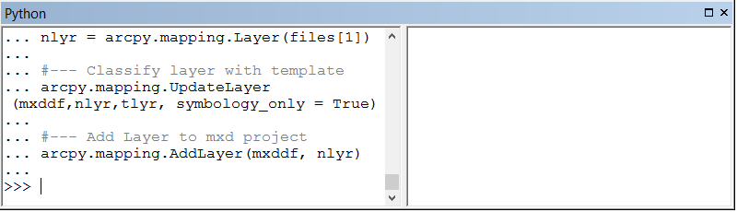

How to Automate?

Slide 3
How to Automate?
Only for Geoprocessing Toolbox

Slide 4
How to Automate?
Full control and access to ArcMap functionalities

Slide 5
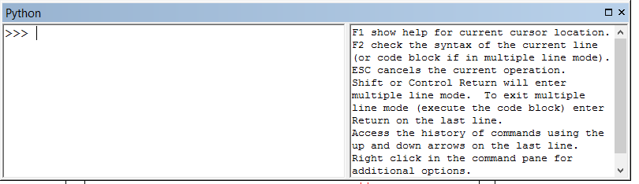
Using python console in ArcMAP
Here you will find support on how write commands
You put your commands here

Slide 6
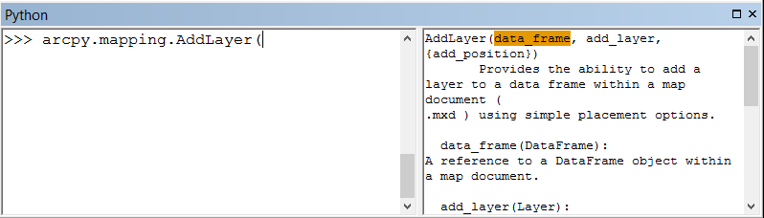
Using python console in ArcMAP
Here is the support informartion
Here is a command to add a new layer

Slide 7
Using python console in ArcMAP
You need to provide two informations:
data_frame
add_layer
Here is a command to add a new layer

Slide 8
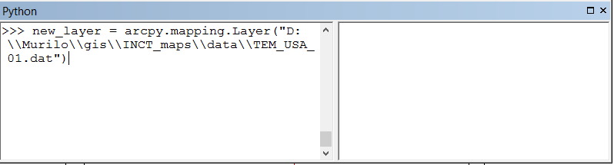
Using python console in ArcMAP
Adding a Layer Example:
1- step: declare the layer you want to open
Command to declare a Layer
File working directory

Slide 9
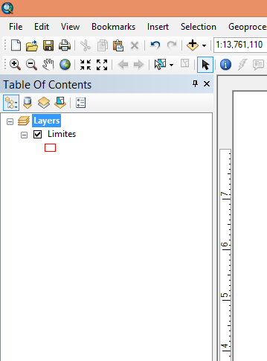
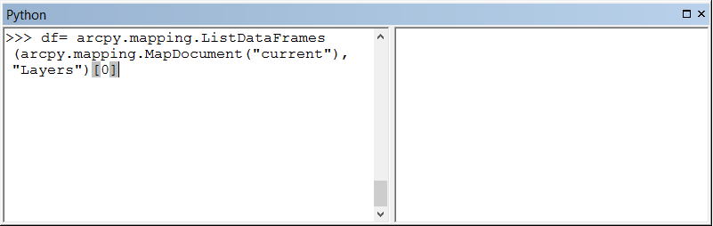
Using python console in ArcMAP
Adding a Layer Example:
2- step: declare the data frame where you want to add the layer
Command to declare a Layer
The mxd project
The data frame name called “Layers”

Slide 10
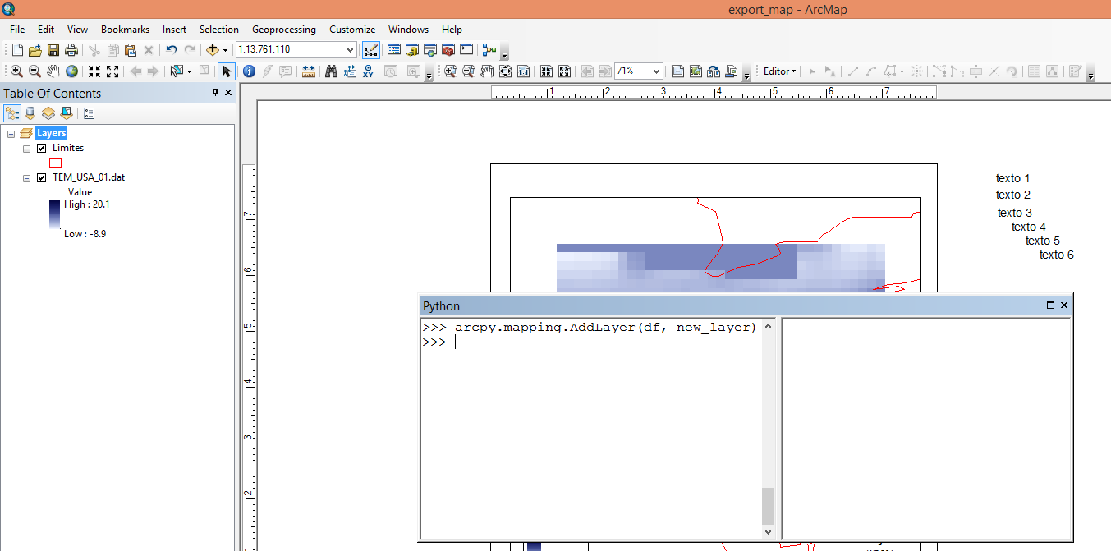
Using python console in ArcMAP
Adding a Layer Example:
3- step: Add the layer to data frame

Slide 11
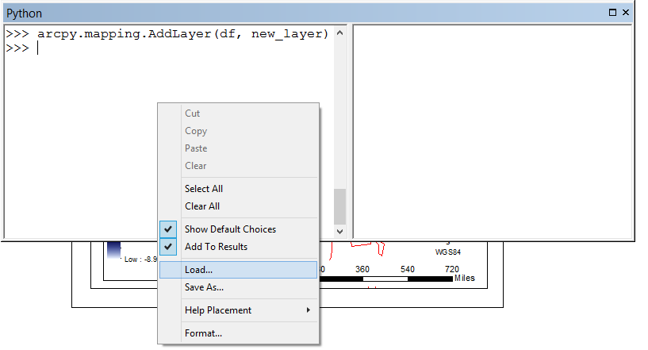
Using python console in ArcMAP
You can load an entire python script by right-clicking -> Load...

Slide 12
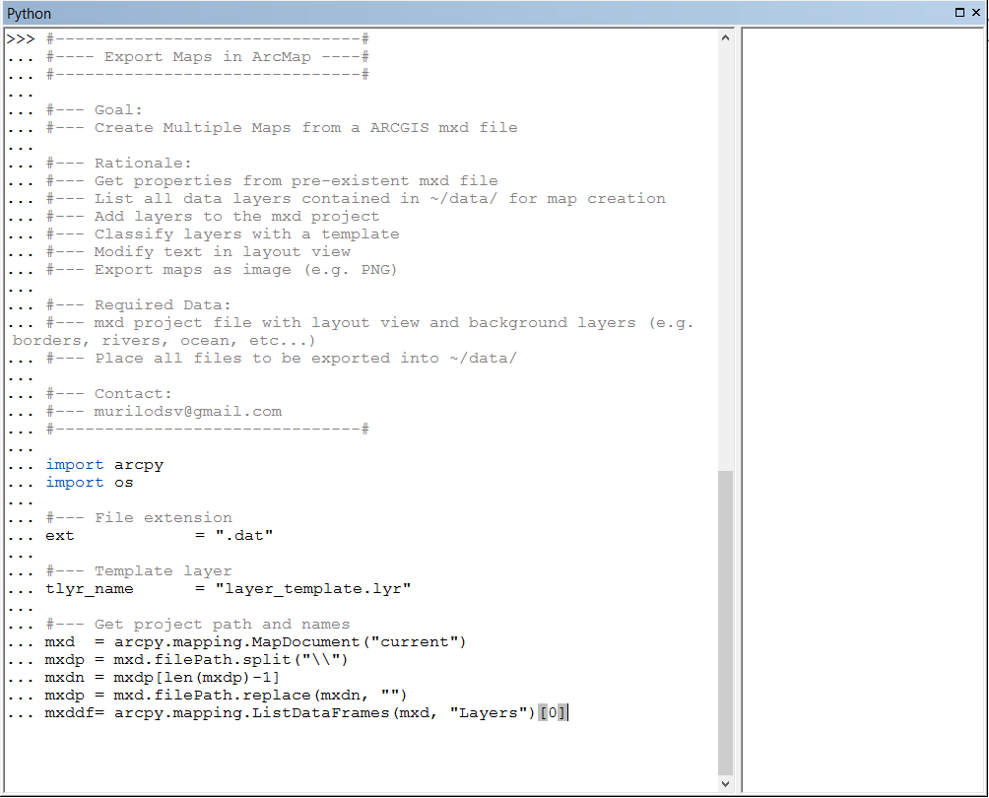
Using python console in ArcMAP
Or simply copy paste an script to command console + ENTER

Slide 13
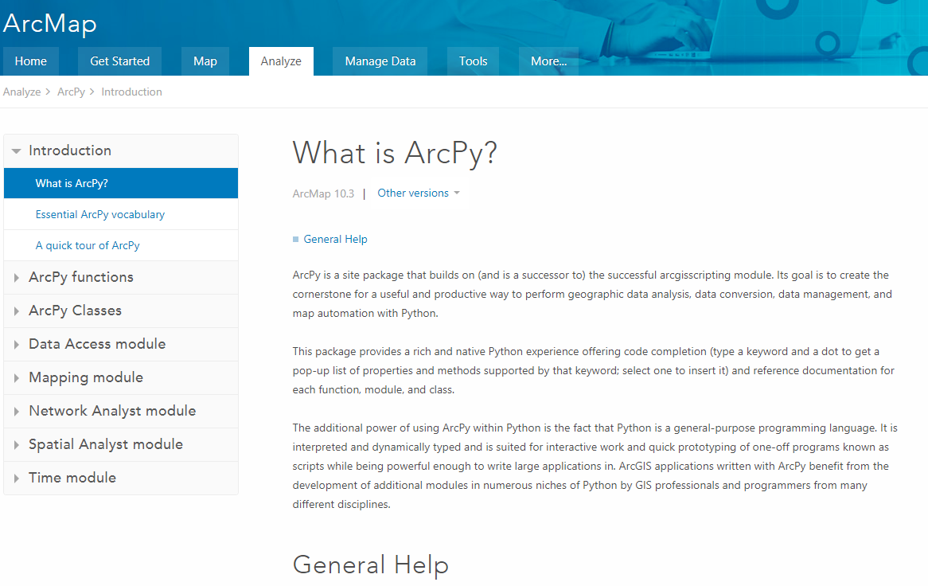
Help?
You can find any help on google or in the ArcPy webpage:
http://desktop.arcgis.com/en/arcmap/10.3/analyze/arcpy/what-is-arcpy-.htm

