Slide 1
Terry Traffic Stops Analysis: Phase 3 Project
Student name: STEPHEN KIMITI
Student pace: PART TIME
Instructor name: ASHA DEEN

Slide 2
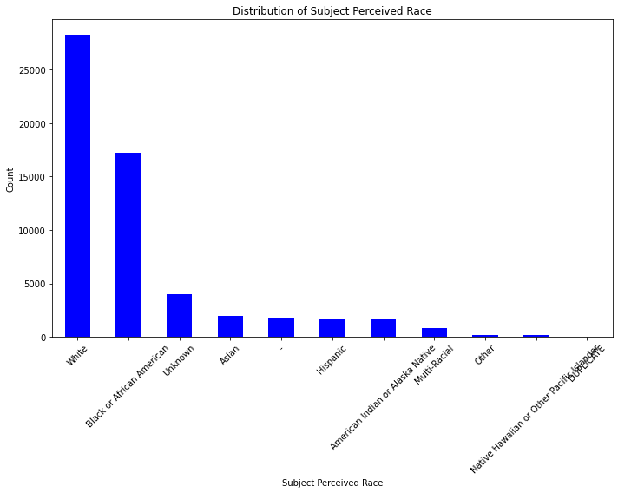
A Graph showing terry stops made based on suspects race.

Slide 3
The population of the area is mostly constituted of white people hence a lot of stops done are of white but from the data it shows that Black or African Americans are stopped a lot. The graph below shows the like hood of a white cop stopping a Black ‘suspect’.
The next graph shows that most suspects are stopped yet they aren’t concealing any weapon.

Slide 4
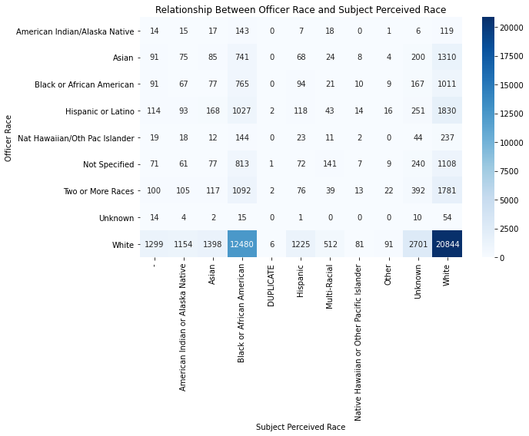
A graph showing relationship between officer race and suspect race.

Slide 5
We used three predictive model to find the best model to be used.
The models are:
1. Logistic regression
2. KNN Classifiers
3. Decision Trees
We settled with KNN Classifier model 2.

Slide 6
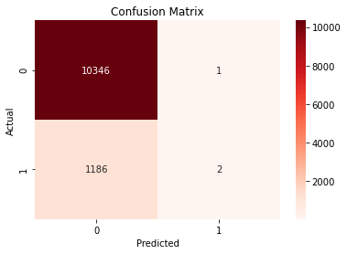
1. Logistic regression.
Train Score: 89.69%
Test Score: 89.70%

Slide 7
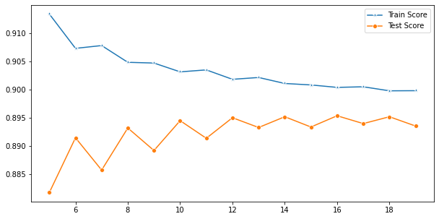
2. KNN CLASSIFIER

Slide 8
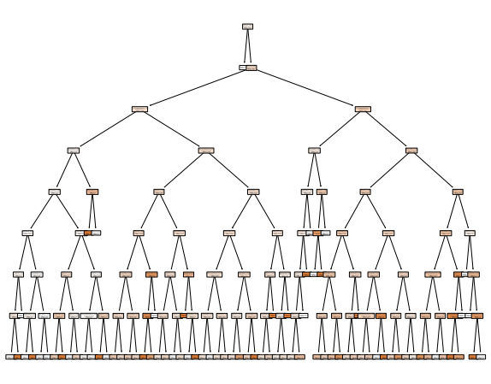
3. Decision trees
This one had a train-test score of 19.13%

Slide 9
CONCLUSION
From the three models, we can see that the scaled KNN model 2 provides the highest accuracy test:
KNN Model with k=16: The KNN model was configured with a value of k=16, which means that it considers the 16 nearest neighbors when making a classification decision.
Accuracy Score: The accuracy score obtained for this KNN model is approximately 89.54%. This score represents how many of the test data points were correctly classified by the model.

Slide 10
Here's an analysis based on the score we got:
The KNN model, with k=16, achieved a relatively high accuracy score, indicating that it performs well in classifying the test data.
An accuracy of around 89.54% suggests that the model correctly predicted the class labels for a substantial portion of the test data.

Slide 11
A higher value of k tends to make the model more robust and can help reduce the impact of noise or outliers in the data.
This shows that with the Terry Stops, there is a high likelihood for a suspect to be stopped based on there race i.e there is a likelihood to be stoppe if you are Not white.

