Slide 1
VIRTUAL CLASS ROOM
UNDER THE GUIDENCE OF:-
PROF. NARASIMHA MURTHY MS Created by:-
Murli kumar Nikhil sharma
Michel Fransis Karn bhusan k yadav

Slide 2
INTRODUCTION
Virtual classroom is the way that supports classroom activities that are conducted by particular academy by the means of Internet.
This supports classroom activity with media and technology that makes study more interesting and easy to understand for the students.
“Virtual Classroom is a concept of supporting current educational organizations by the means of easy learning , better administration and more technology oriented way of learning with the help of Internet that makes current way of teaching more interesting.”

Slide 3
CURRENT BUSSINESS PROCESS
Currently students need to go to the teaching institutes to pursue their course. At the end of each semester students appear for the final examinations to evaluate their performance.
Similarly, each and every organization provides training to the newly employed candidates. This training is held inside the organization for a fixed time.
The issues in this current process are:-
In current system the academy and Teaching institutes are time bound and are punctual.
In today’s world by the use of technology the learning has become fun by the means of Video lectures, Presentations, E-books, Discussion Forums and many more things across the Internet.
In the current scenario teachers and students can communicate with each other during the working hours only this will lead to the condition that teacher or students are having something that they are willing to share with others and want to discuss after college hours.

Slide 4
BRIEF EXPLAINATION
Virtual Classroom is going to be used by the existing organizations as well as educational institutes that exists in reality and are trying to make their way of learning more strong and interesting for an employee and the student respectively.
This also utilises advanced techniques like video-lectures and query posting forums along with the communication medium that bridges the gap between student/employee and teacher out of the class or organization and provides more flexibility to naïve users.
It also provides a medium to evaluate the learner’s knowledge of a particular course by making them appear for the examination at the end of that course.

Slide 5



ACTORS OF OUR SYSTEM
Tutor
Admin
Student

Slide 6
STUDENT/EMPLOYEE
These are those users of our system who will interact with the system to learn various courses available on this system.
These users will also be able to view live video lectures organized by the teacher and raise doubts for any query.
At the end of each course these users are expected to appear for the examination which will evaluate their performance.

Slide 7
TEACHER/TUTOR
These users will be able to upload presentations , seminars , E-books and assignments which can be viewed and solved by the students.
Teachers will organise live video lectures which can be view by the multiple users who are under going that course.
These users will also be responsible for solving the doubts raised by the students or trainees.
They can also generate tests which students/trainees will appear for.

Slide 8
ADMIN
The main purpose of this user will be to manage the web application as well as manage the users of this application.
They will manage the content which is being uploaded by different users.
They will also manage the database.

Slide 9
MAIN FEATURE
The most important and exiting feature of our system is the live video lecture which will be organised by the teacher.
In this feature multiple students or trainees can attend a live video lectures and raise their doubts for any query which occur in their mind.
A white board will also be provided as a display which will show the users any thing which teacher is writing to explain any concept.
There will also be an option of raising the hands and the main purpose of this will be that a teacher will come to know who has a query and the teacher can solve all those queries in a session which will immediately be held after the video lecture.

Slide 10
MODULES
REGISTRATION:- This is about creation of every type of user and every entity of system including creation of department to subjects and this also includes editing in the details of those entities and even allows to remove them as and when they become useless.
ONLINE LECTURE:-This module refers to the review of lectures and choose the appropriate videos that can help student learn from home via internet.
OFFLINE LECTURE:-Offline Lectures are the features of the system and are needed to be managed either by teacher or admin. This also empowers user with privilege to share anything they think can be useful to his/her class and will help the students for the studies.

Slide 11
CONT…
FORUM:-Forum module includes chat and doubt forum to discuss the particular thing that student want to ask in general and can be answered by anyone from teacher to his classmate.
ASSESSMENT/EXAMINATION:-It includes two types that are evaluations using assignments and examinations. Assignments are the tasks where students are expected to analyse or search the answer. In the examination students are graded for their skills over that course which they are taking after its completion.

Slide 12
FLOW OF THE SYSTEM
STUDENT
TEACHER
ADMIN
SIGNUP
LOGIN
SIGNUP
LOGIN
MANAGE USERS AND DATABASE
SELECT COURSE
UPLOAD CONTENT
VIEW CONTENT
ASSIGN VIDEO LECTURE TIME
VIEW OFFLINE/ ONLINE LECTURE
VIEW VIDEO
ORGANIZE VIDEO LECTURES
RAISE DOUBTS
GENERATE REPORT
SOLVE DOUBTS
SOLVE ASSIGNMENTS
SEND SCORES
GENERATE TESTS
GIVE TEST
EVALUATE PERFORMANCE
GIVE TESTS

Slide 13
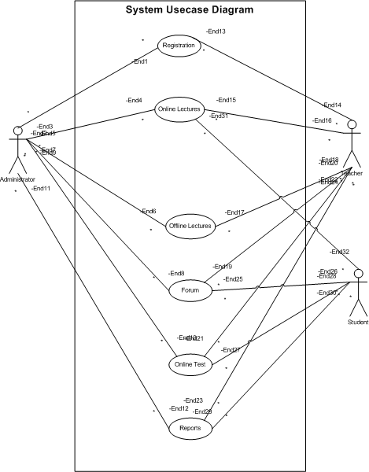
SYSTEM USECASE

Slide 14
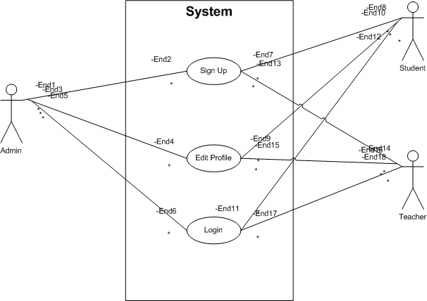
REGISTRATION USECASE

Slide 15
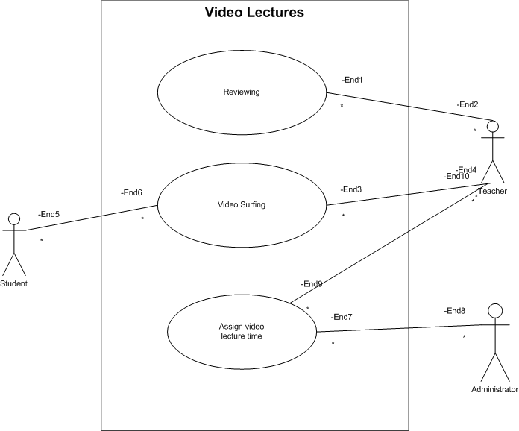
ONLINE LECTURES

Slide 16
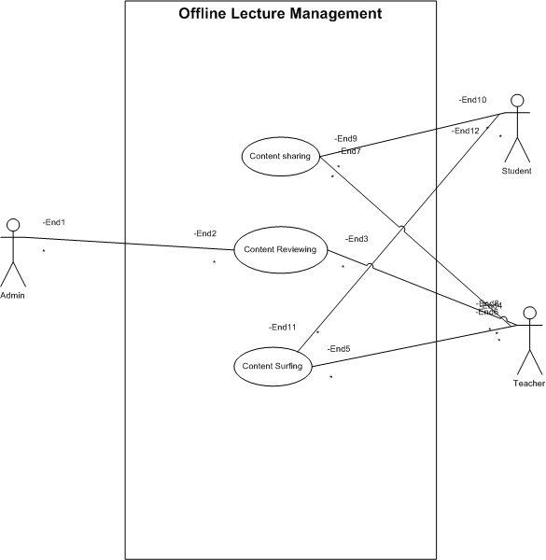
OFFLINE LECTURES

Slide 17
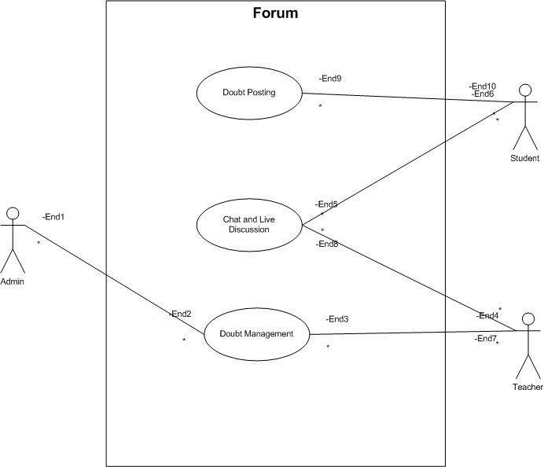
FORUM USECASE

Slide 18
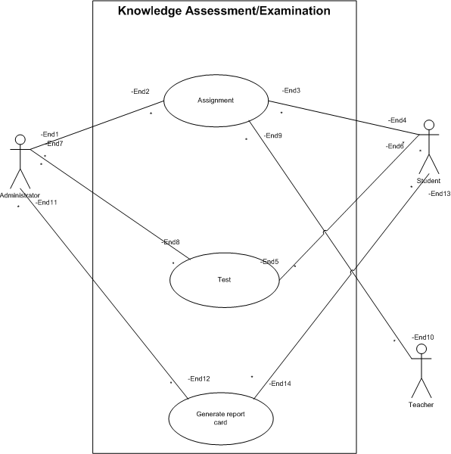
ASSESSMENT/EXAMINATION USECASE

Slide 19
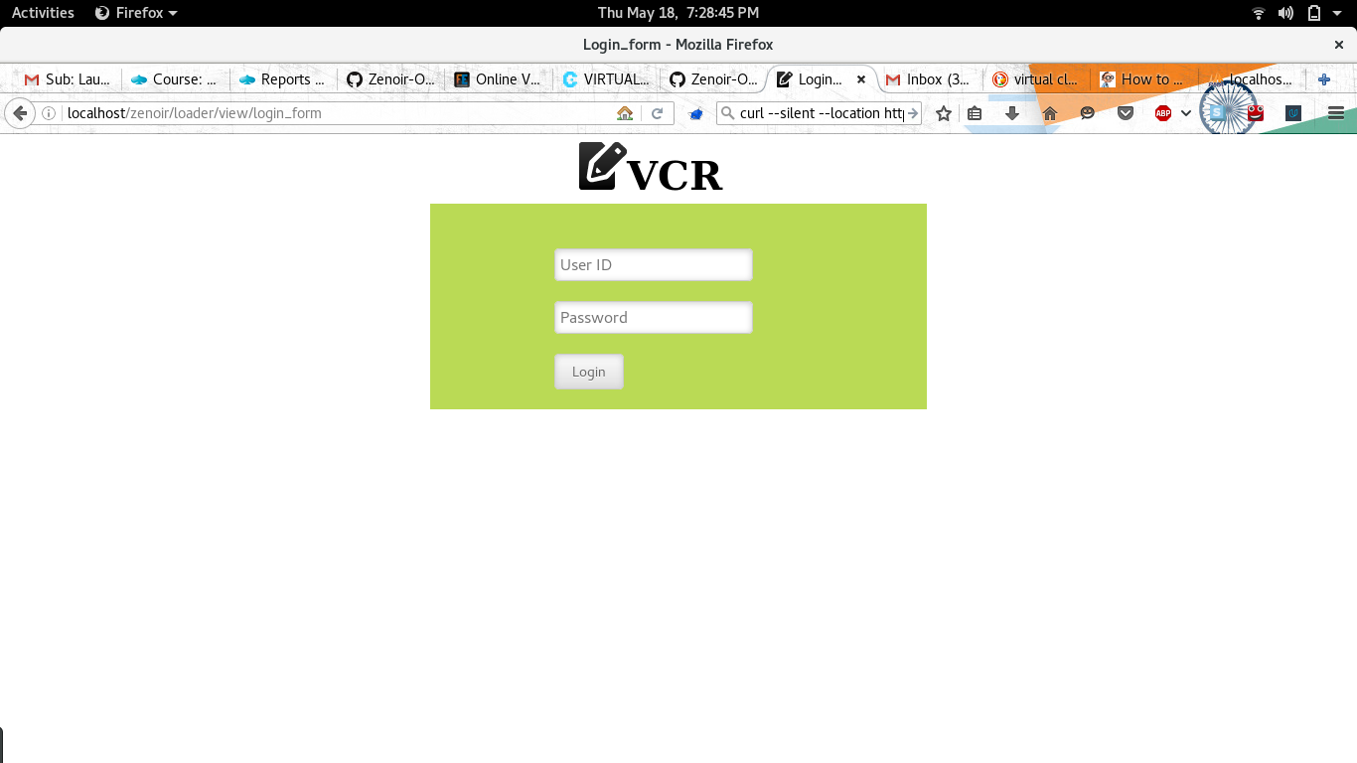
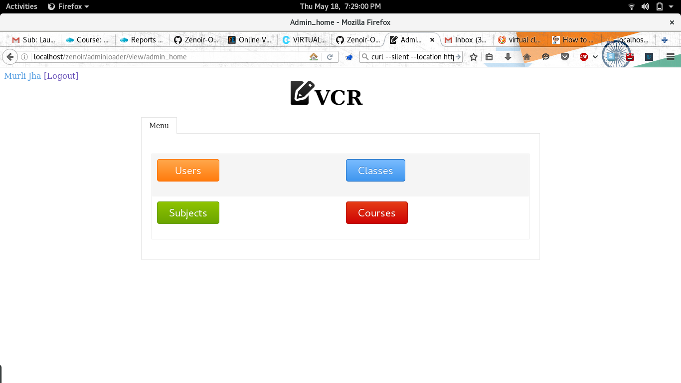
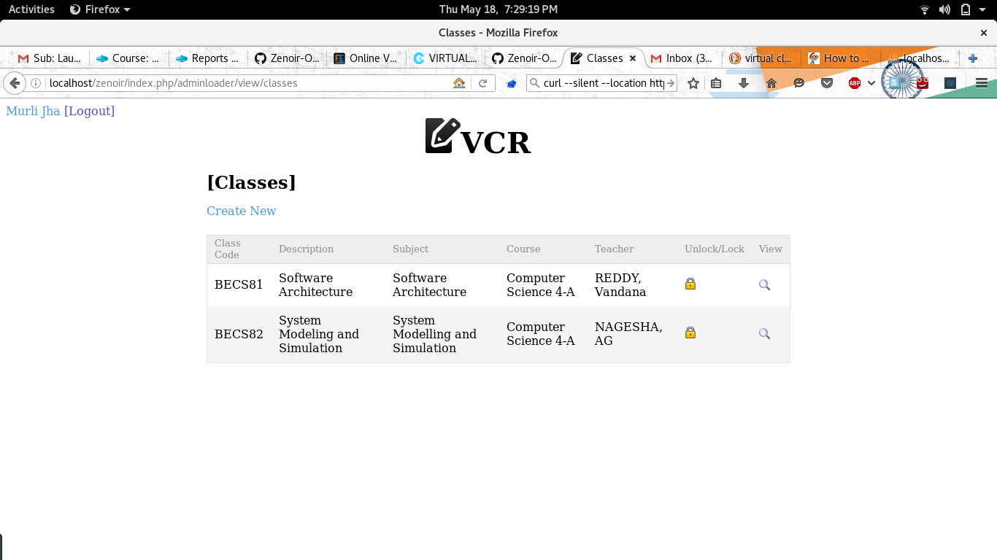
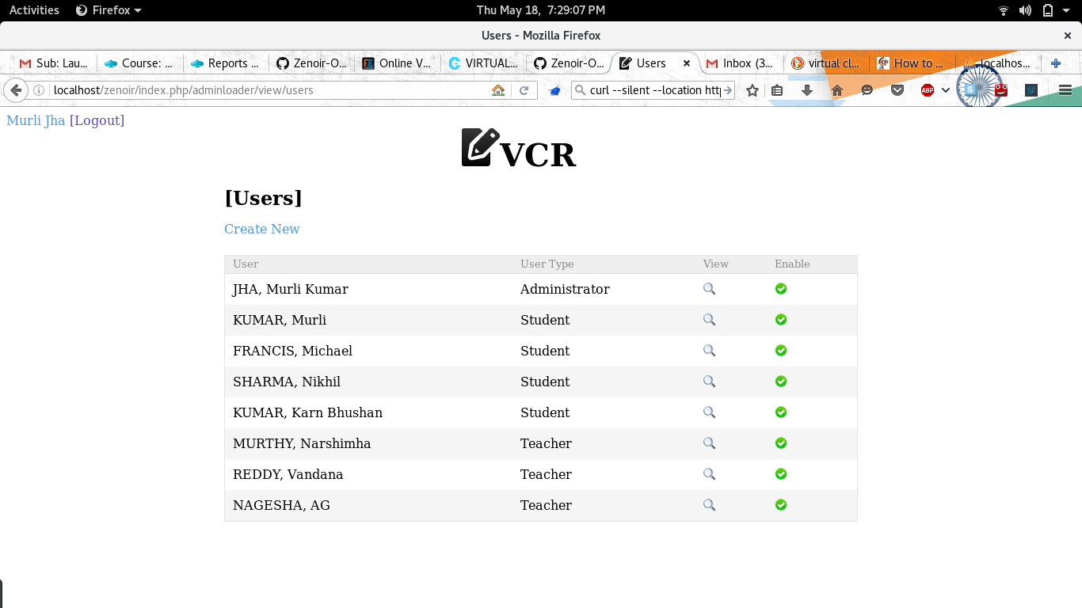
EXPECTED OUTPUT

Slide 20
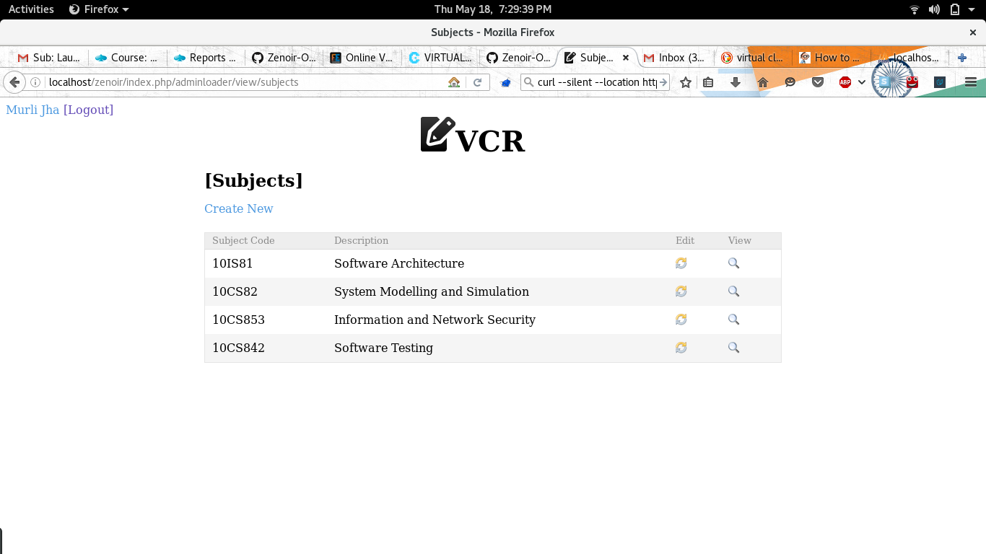
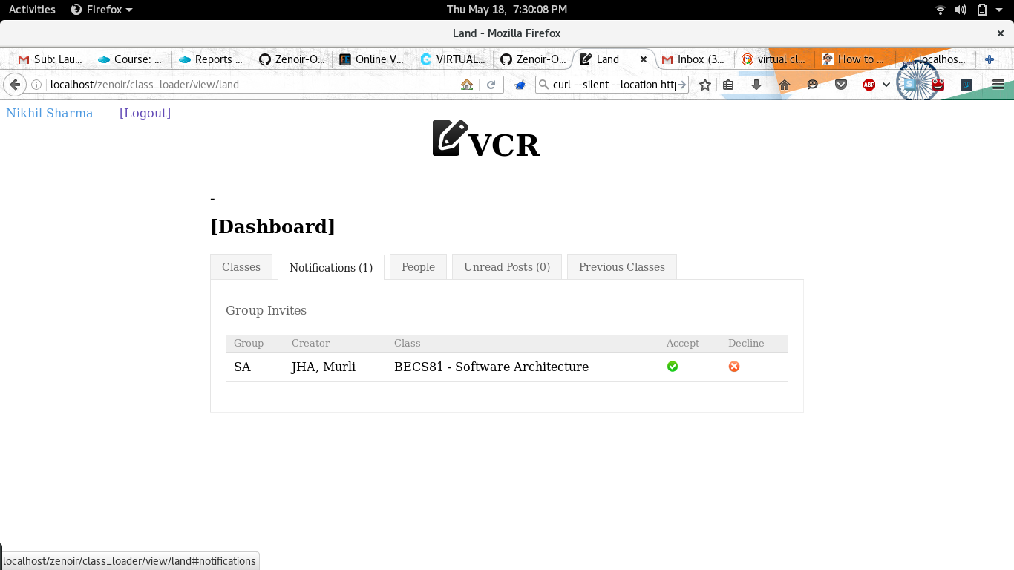
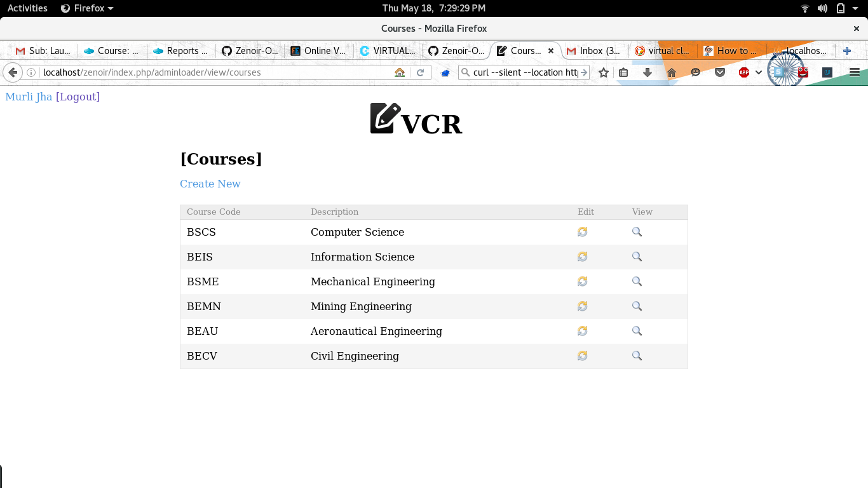
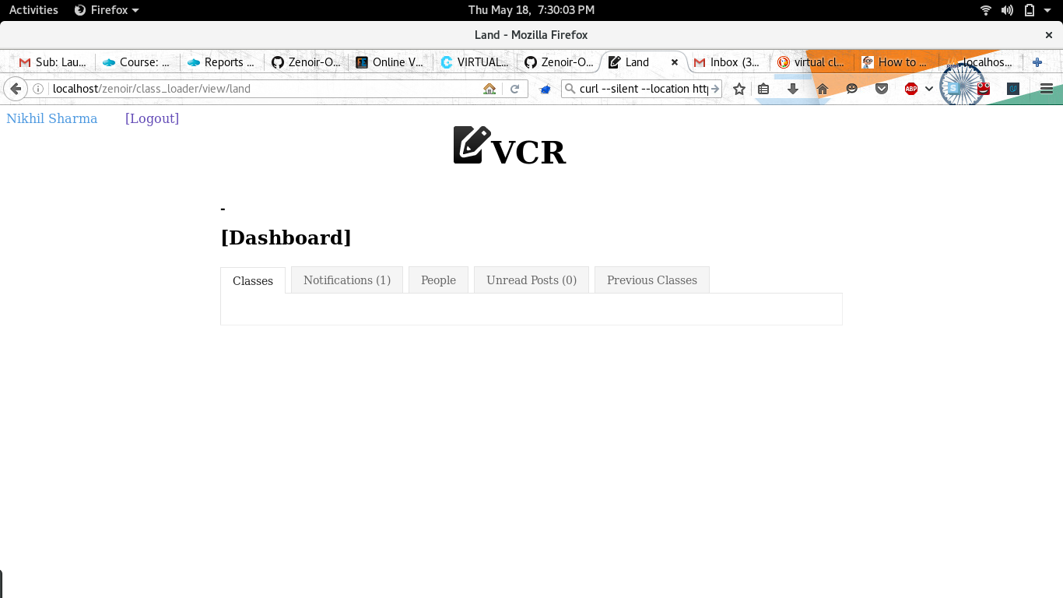

Slide 21
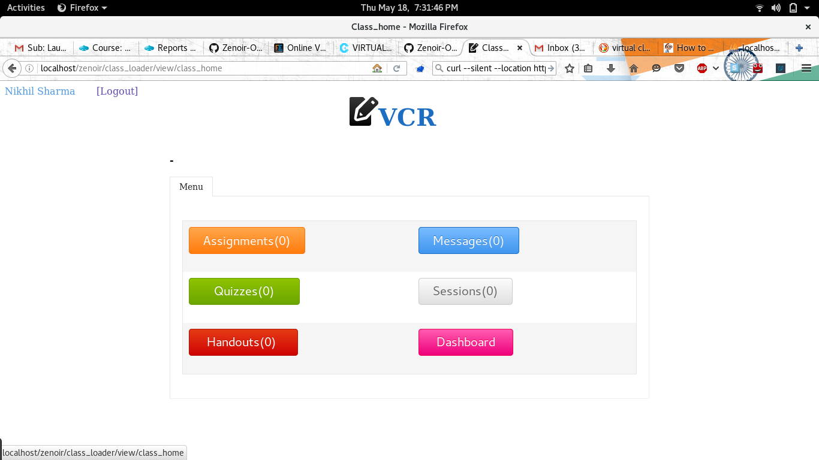
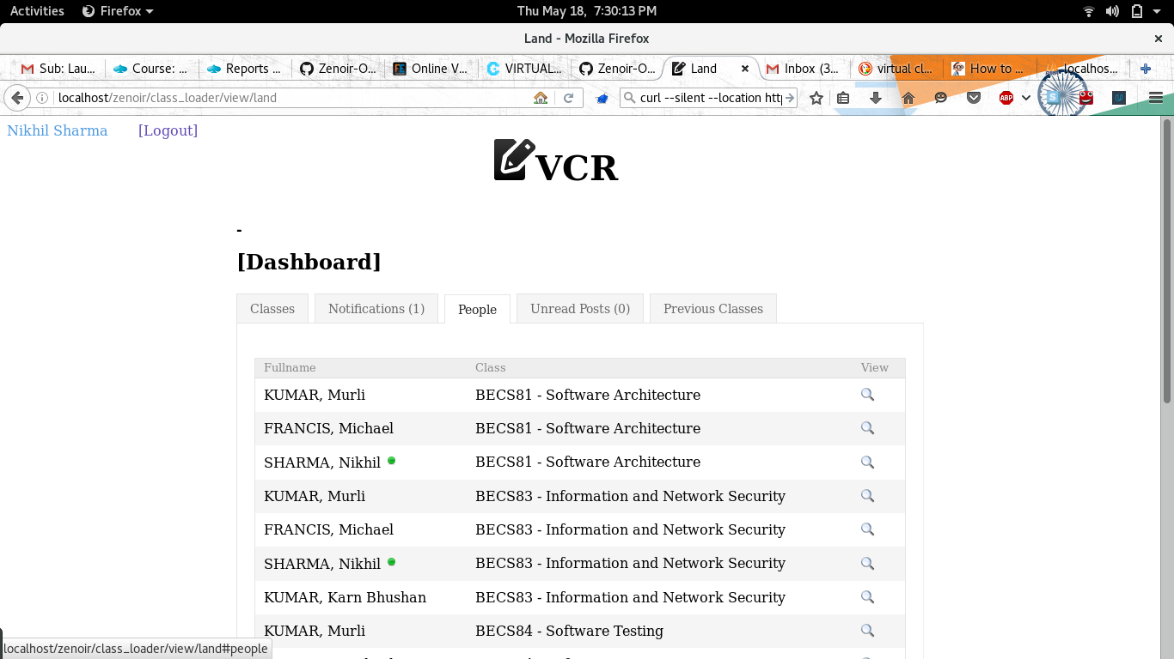

Slide 22
FRONT-END,BACK-END,REQUIREMENTS
FRONT END
BACK END
REQUIREMENTS
HTML5,
CSS3,
Bootstrap,
Angular JS,
Materialized CSS.
SQL SERVER
MINIMUM 512MB RAM
OPERATING SYSTEM SUPPORTED:- WINDOWS XP,WINDOWS-7/8/8.1/10
WEBCAM
FAST INTERNET SPEED

Slide 23
THANK YOU

