Slide 1
INFO6105 Fianl Project
Hongting Chen

Slide 2
Problem
As the internet continues to grow in both scale and complexity, cyberattacks have been rising rapidly.
Traditional intrusion detection systems that rely on predefined rules or manually set thresholds often struggle to identify new attacks,and they also tend to generate a high number of false alarms.
My goal is to use machine learning algorithms to help identify attack behavior.(0 for normal, 1 for attack)

Slide 3
DataSet Overview
Dataset: cybersecurity_intrusion_data.csv
The dataset is sourced from Kaggle.
9537 records
Features: session_id, network_packet_size, protocol_type, login_attempts, session_duration, encryption_used, ip_repuattion_score, failed_logins, bowser_type, unusual_time_access.
Target:attack_detected(0 for normal, 1 for attack)

Slide 4
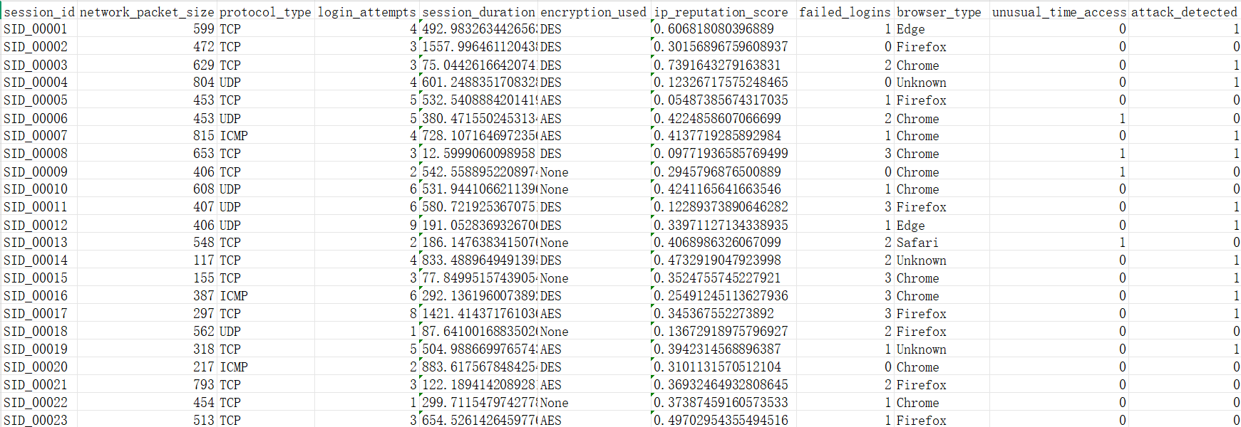

Slide 5
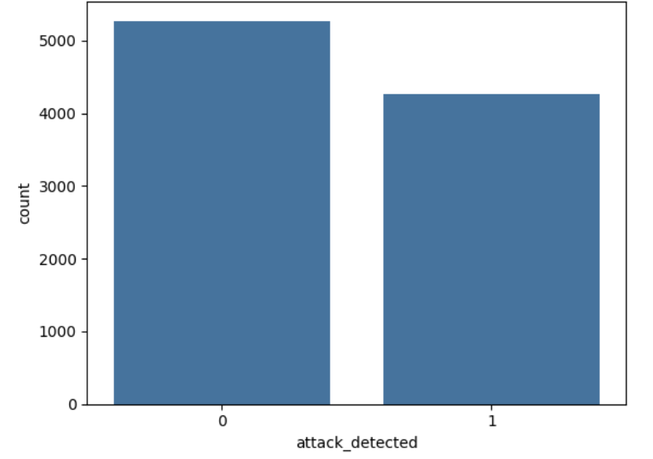

Slide 6
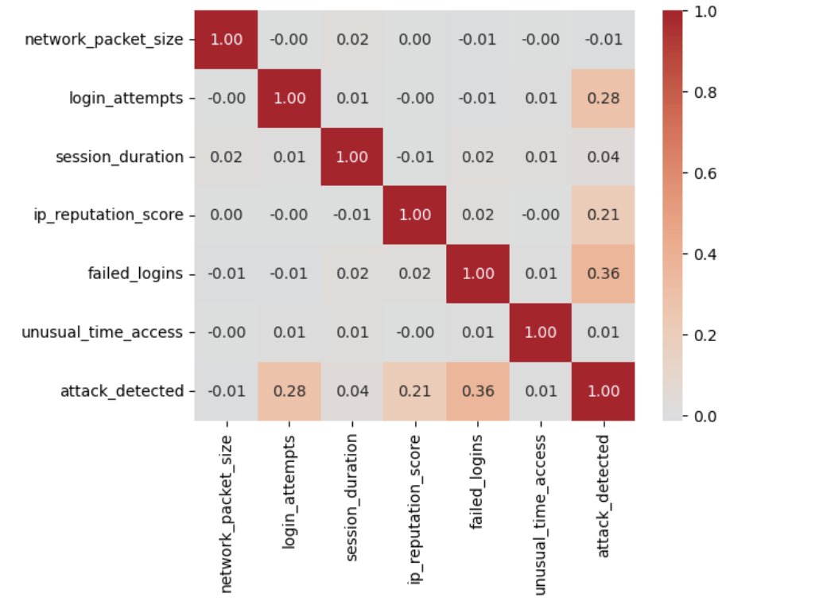

Slide 7

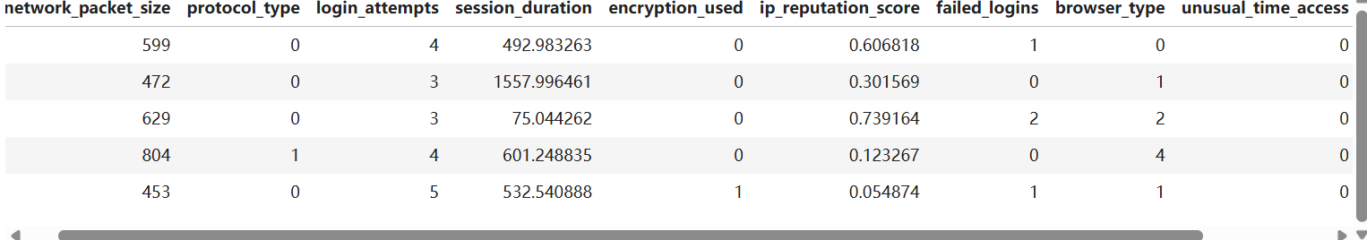
Data Processing
Dropped session_id
Applied label encoding to protocol_type, encryption_used, and browser_type.

Slide 8
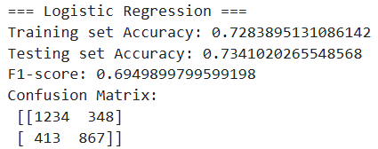
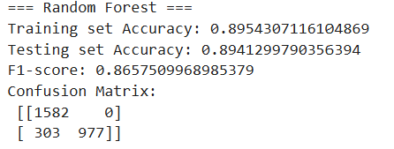
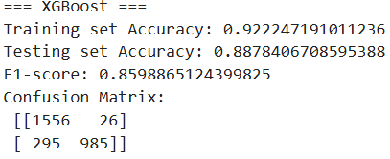
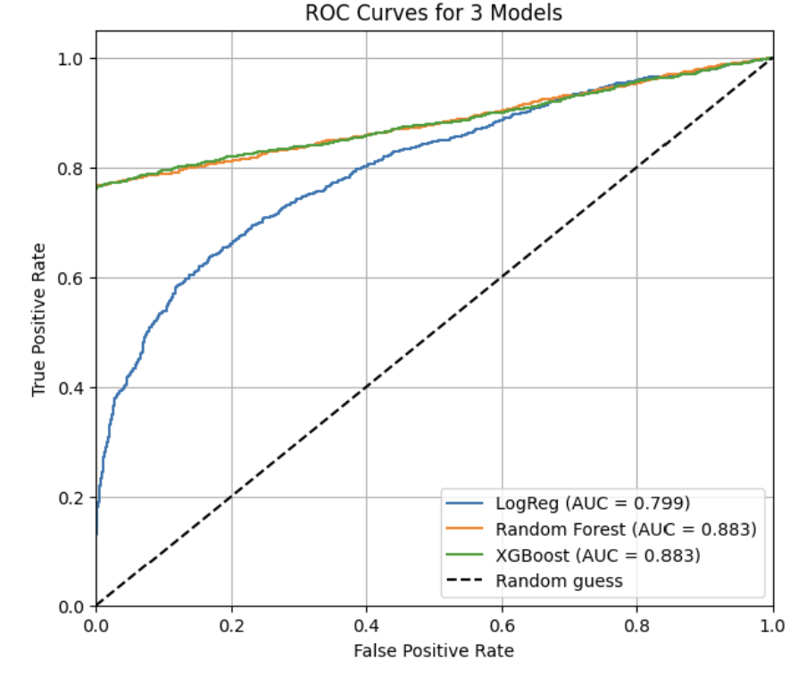
Model Performance

Slide 9
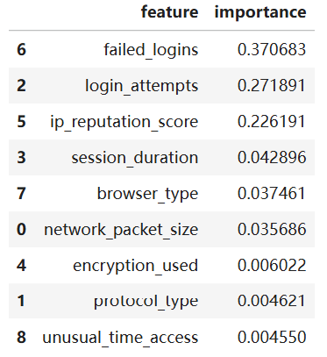
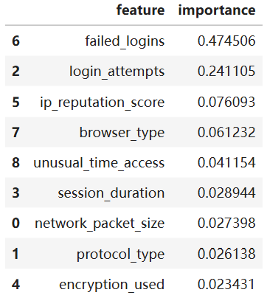
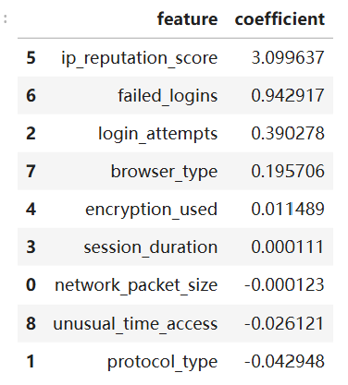
Logistic Regression
Random Forest
XGboost

Slide 10
Future Work
Data Improvements
Collect larger and more realistic network traffic datasets
Add more useful features to improve the model
Model Improvements
Try More Advanced Models
Model parameter tuning

