Slide 1
How to approach code quest problems
3.2

Slide 2
Patterns in problems
Most code quest problems will have patterns which you can follow to tell what you need to use to solve the problems
Knowing these patterns and what they mean is the key to quickly solving problems in code quest

Slide 3
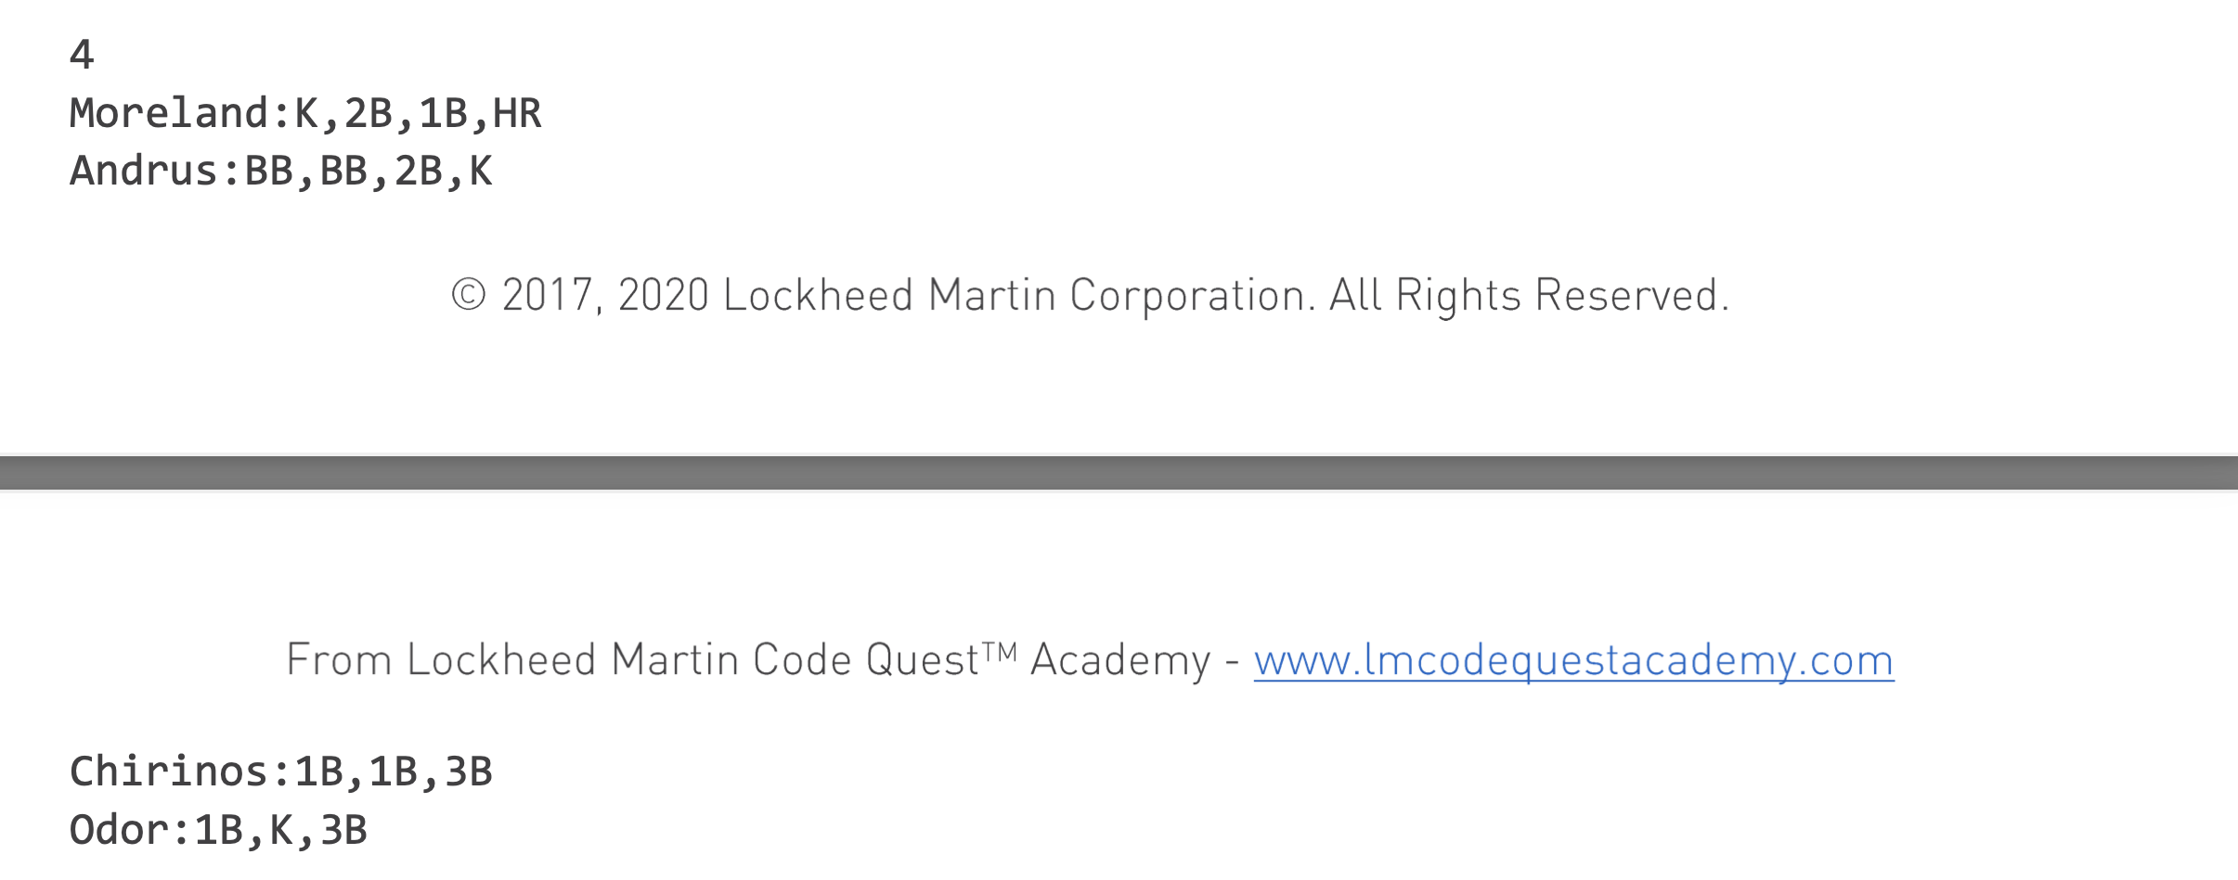
Pattern 1- Splitting
In code quest when you have a problem where the sample inputs are seperated by a specific character you will typically want to split between those characters
Heres an example from the Batter Up practice problem
In this example we can see that the inputs name is seperated by a ":" character and the statistics are seperated by a "," character
For this problem we can tell we are going to want to use these characters to split in a way that seperates out all the data

Slide 4
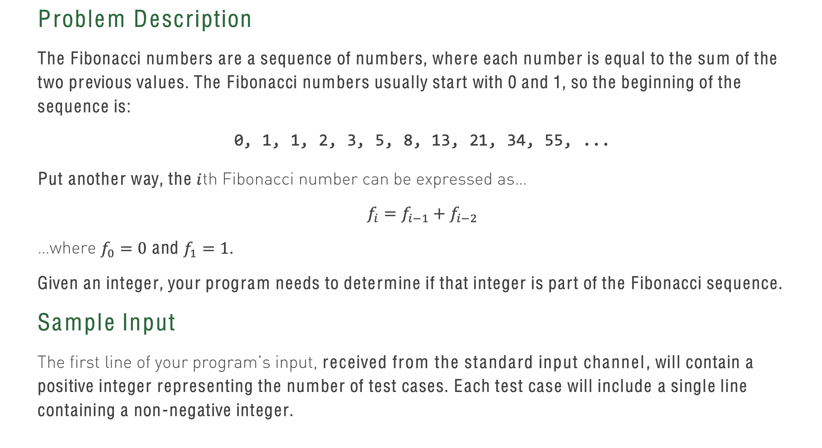
Pattern 2- Loops
When you are given a problem where you have a near infinite number of inputs you can be given or a very large number of possible input you should be thinking about where you can use a list to create an algorithm
Look at the example from the Fibing Fibonachi Byteman problem
In this problem we are asked to print true or false based on if an input is in the Fibonacci sequence
We are given the equation to find if a number is in the sequence but in order to make the problem easier we should use a list to speed up the process

Slide 5
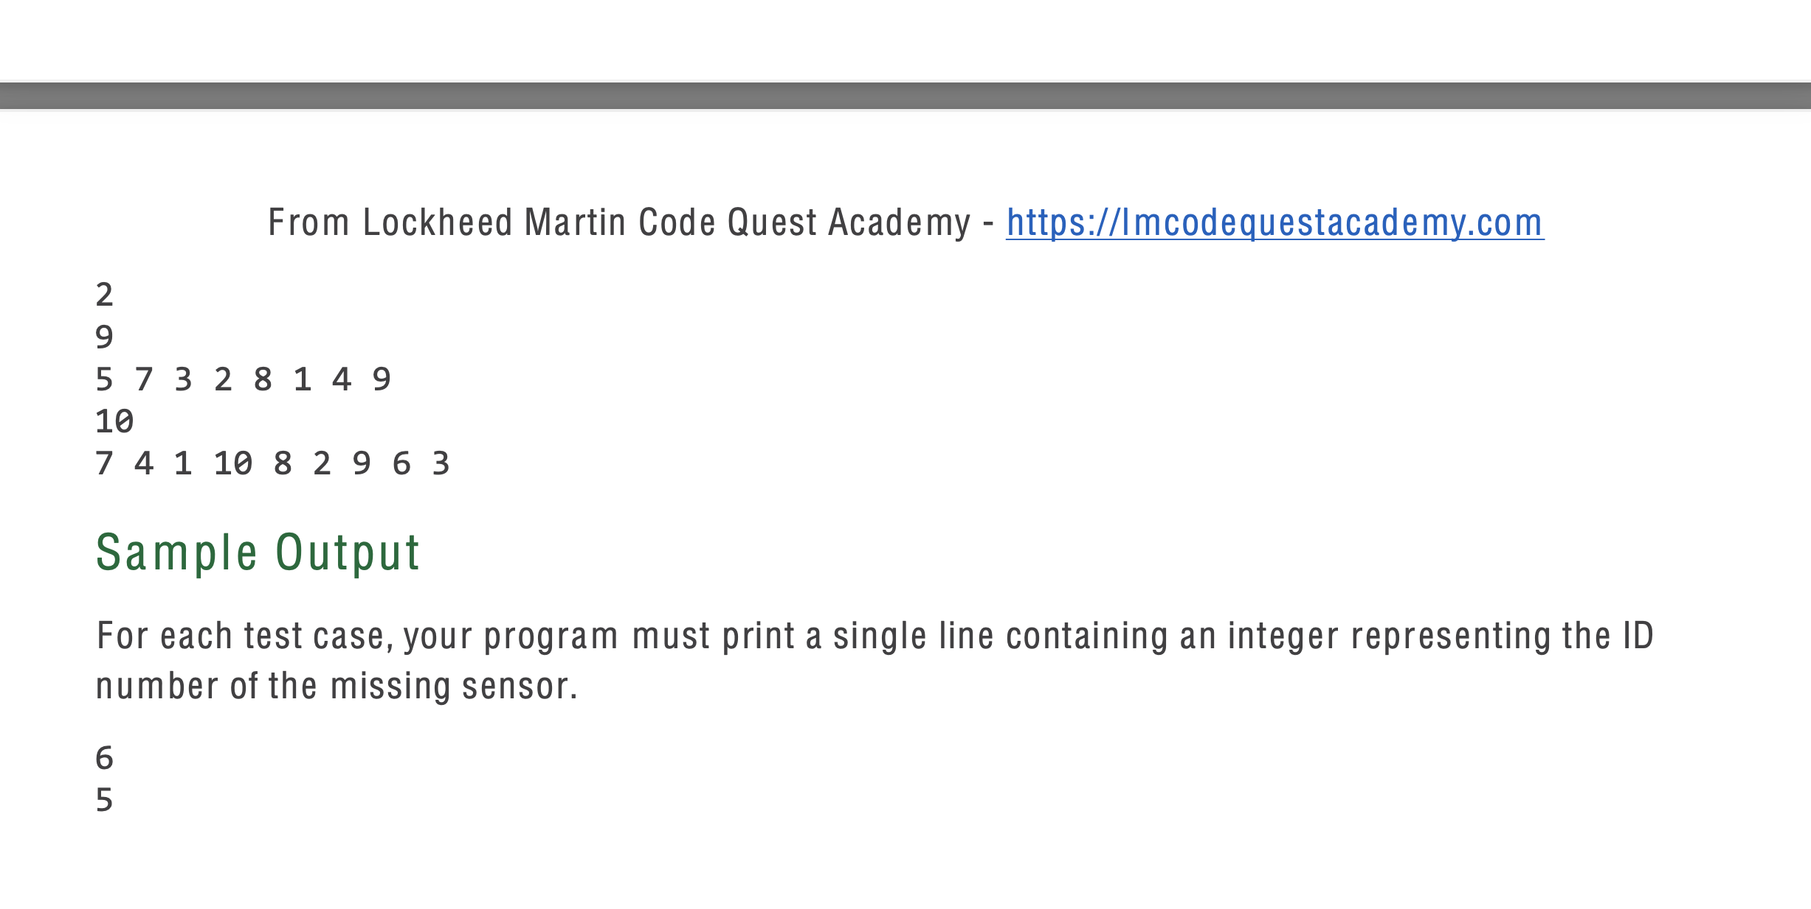
Pattern 3- Arrays
When you see a question that relates to multiple related pieces of data it is important that you keep in mind that a list could be the best solution to the program
Heres an example of a problem that you should use a list on ->
In this problem you are tasked with finding the missing number between one and the number given
To solve this you can use a list coupled with the sort method to quickly solve the problem

Slide 6
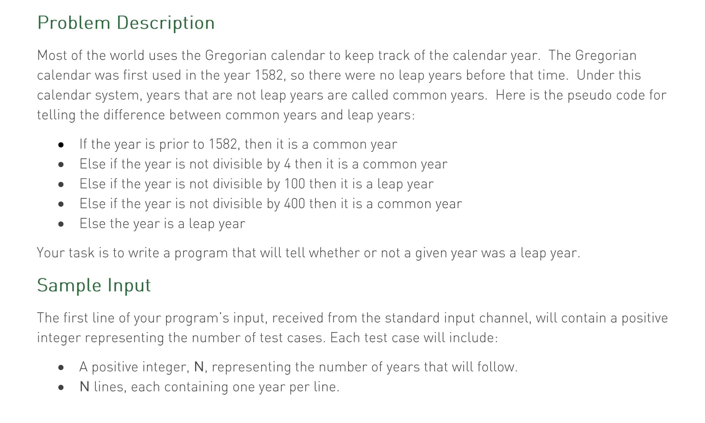
Pattern 4- if statement
Keep in mind if statements should be used as sparingly as possible
If you find yourself using more than 10~ if statements in a problem you are probably doing the problem in an inefficient way
Here is an example of a problem which you will have to use if statements
As a rule of thumb if a question specifically mentions two different outputs or if the only outputs are true and false you are probably going to have to use an if statement

Slide 7
Thinking Like a Programmer
In order to do the best in the competition being able to tell which tools you must use in a question is super important
The only way to get better at knowing what you have to use is by PRACTICING
At this point you should have all the tools your should need and it is just up to you to know how they work and how to utilize them

