Slide 1
Bellabeat Smart Device Usage
How the findings can guide marketing
Presented by: Mursal Omar Adan, Junior Data Analyst, Bellabeat Marketing Analytics Team.
Last Updated: 4 November 2026

Slide 2
Table of Contents
Business Task
Objective
Average Minutes per Day
Average steps per day
Average Calories per Day
Average asleep per night
Recommendations
Limits and next steps
Conclusion
Appendix

Slide 3
Business Task
How can smart device usage trends guide Bellabeat’s marketing strategy?

Slide 4
Objective
What are some trends in smart device usage?
How could these trends apply to Bellabeat customers?
How could these trends help influence Bellabeat’s marketing strategy?

Slide 5
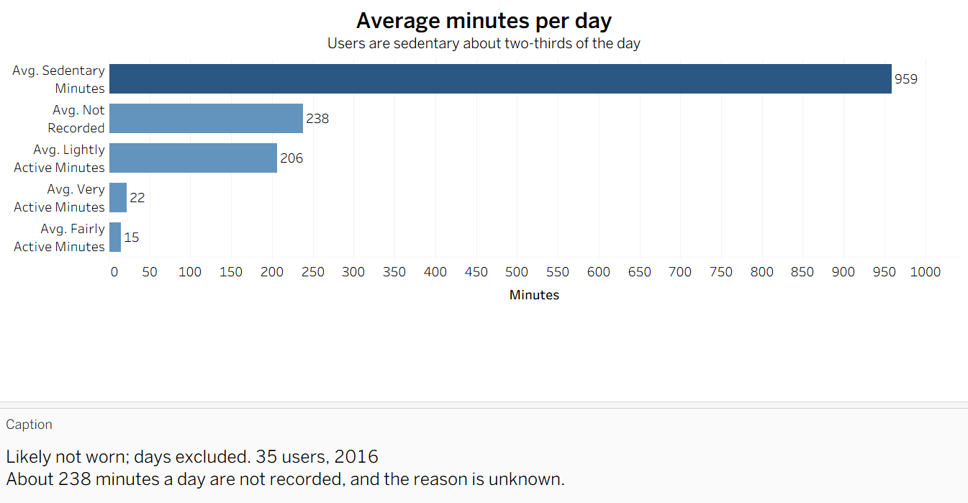
Average Minutes per Day
Users are sedentary about two-thirds of the day (959 minutes)
Only about 37 minutes are fairly or very active
Light activity is the largest active share (206 minutes)
Recommendation: send short reminders to move. Test first.

Slide 6
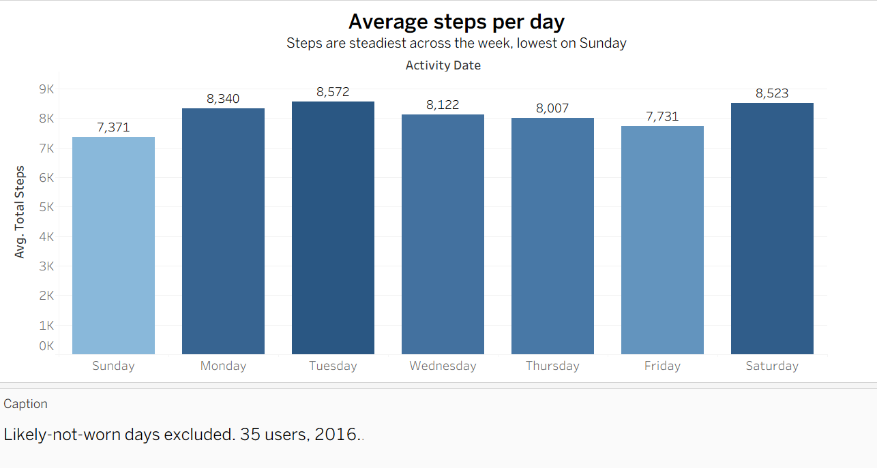
Average Steps per Day
Average steps are fairly steady across the week
Sunday is the lowest (7,371), and Tuesday is the highest (8,572)
The difference between days is small, about 1,200 steps
Recommendation: no action needed. Sunday could be a good day to test reminders.

Slide 7
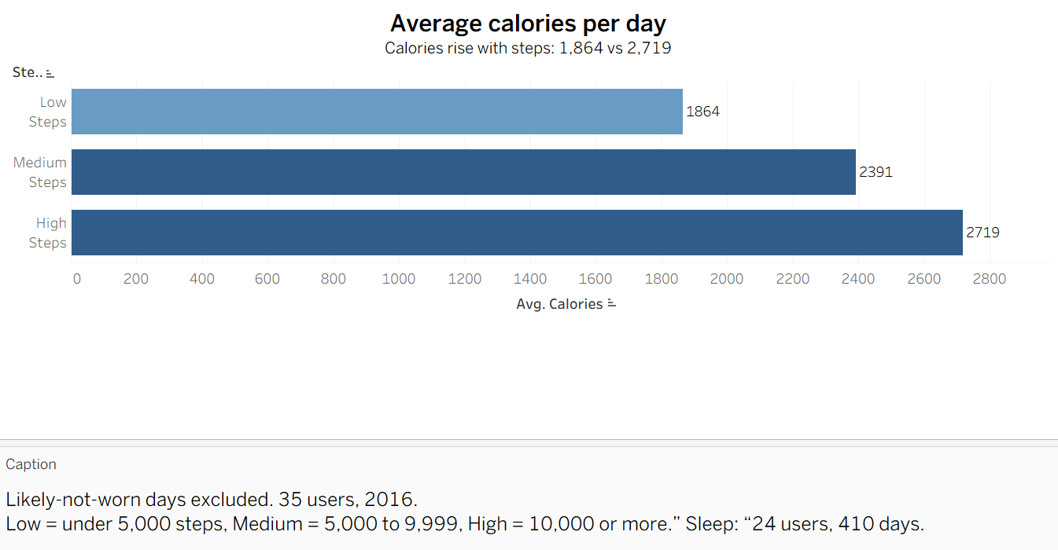
Average Calories per Day
Calories rise as steps rise
About 1,864 for low-step days and 2,719 for high-step days
Steps and calories go together, but this does not prove cause
Recommendation: show activity and calories together in the app.

Slide 8
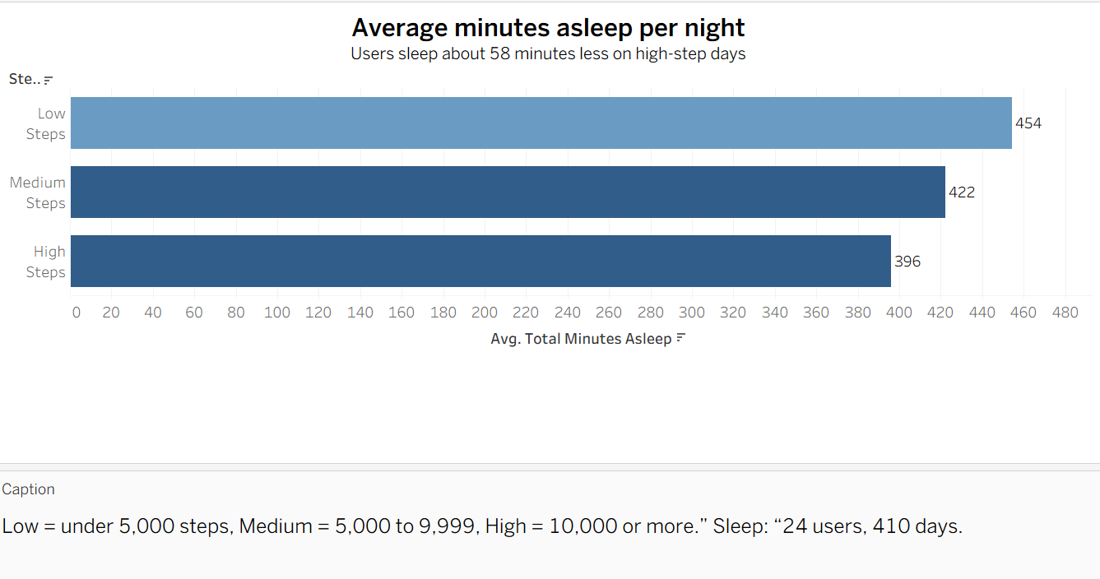
Average Asleep per Night
Users sleep less on high-step days
About 396 minutes, compared with 454 on low-step days
This is a link, not a cause, and sleep data covers only 24 users
Recommendation: show sleep with activity in the app, and explore further.

Slide 9
Top three recommendations (Bellabeat app)
1. Send movement reminders
Users are sedentary about 959 minutes a day, with only about 37 minutes fairly or very active.
Send short, friendly reminders to move after long periods of inactivity.
2. Show activity, calories, and sleep together
Calories rise with steps (1,864 to 2,719), and users sleep about 58 minutes less on high-step days.
Show all three on one screen, so users see how their habits connect.
3. Find out why the device is not worn
About 9% of days (122 of 1,373) show the device was likely not worn.
Ask a small group of users why, and send gentle wear reminders.
Note: Ideas to test. Data from 35 Fitbit users in 2016, not Bellabeat customers.

Slide 10
limits and next steps
Limits of the data
Only 35 users, from 2016, over about two months
Sleep data for one month and 24 users
122 of 1,373 days (about 9%) likely not worn, so they were excluded from averages
24 partial-day rows removed, so some activity is not counted
Not used
Hourly, minute-level, heart rate, and weight files. They take much more work, and the daily data answers the business task.
Next steps
Add the hourly data to see when in the day users are active
Test the reminders with real Bellabeat users

Slide 11
Conclusions
1
2
3
Sedentary time is high: about two-thirds of the day (959 minutes), with only about 37 minutes fairly or very active.
More steps go with more calories (1,864 to 2,719) and less sleep (454 to 396 minutes).
These trends point to app opportunities: movement reminders, one screen for activity, calories, and sleep, and encouraging users to wear the device.
Note: This does not mean causation. The data are from 35 Fitbit users in 2016. Further analysis is needed.

Slide 12
Data cleaning summary
Step | What I did
Load and rename | 3 files loaded. Column names made consistent.
Dates | Converted text dates to datetime.
Flags | Marked 133 zero-step days and 122 likely-not-worn days (excluded from averages).
Duplicates | Removed 3 sleep duplicates (413 to 410 rows).
Overlap | Removed 24 partial-day rows from 12 April (1,397 to 1,373 rows).
Database | Loaded into MySQL and checked the row counts.
Note: Full cleaning log in CHANGELOG.md on GitHub.

Slide 13
Thank you

