Slide 1

College of Engineering Trivandrum
Dept. of Computer Applications
PHISHING WEBSITE DETECTION USING MACHINE LERANING
Faculty in charge Divya S K
Assistant Professor
Dept. of Computer Applications
Submitted by Abdulla Murshid K V
TVE19MCA001

Slide 2

2. Introduction
Phishing websites are present all over internet.
Massive financial loss.
Sensitive data stolen
Introducing a system to detect phishing using ML algorithm
If website is phishing, extract all the links from the site
Can find the IP address and location of the server

Slide 3
3. Motivation
Phishing websites easily developed by extracting original images and texts from original websites.
E-Mail phishing is the common attack.
User may not be able to identify website URL’s by eyes
By using machine learning algorithms, we can create models to detect phishing URL’s.

Slide 4
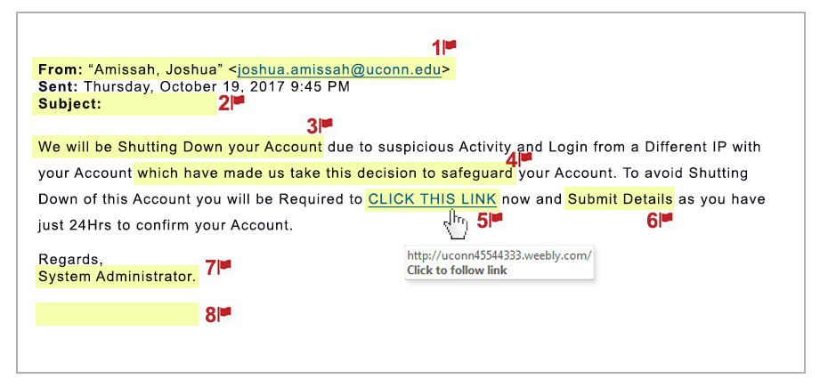
3. Example of phishing website
Here is an example of how phishing website is targeting people.

Slide 5
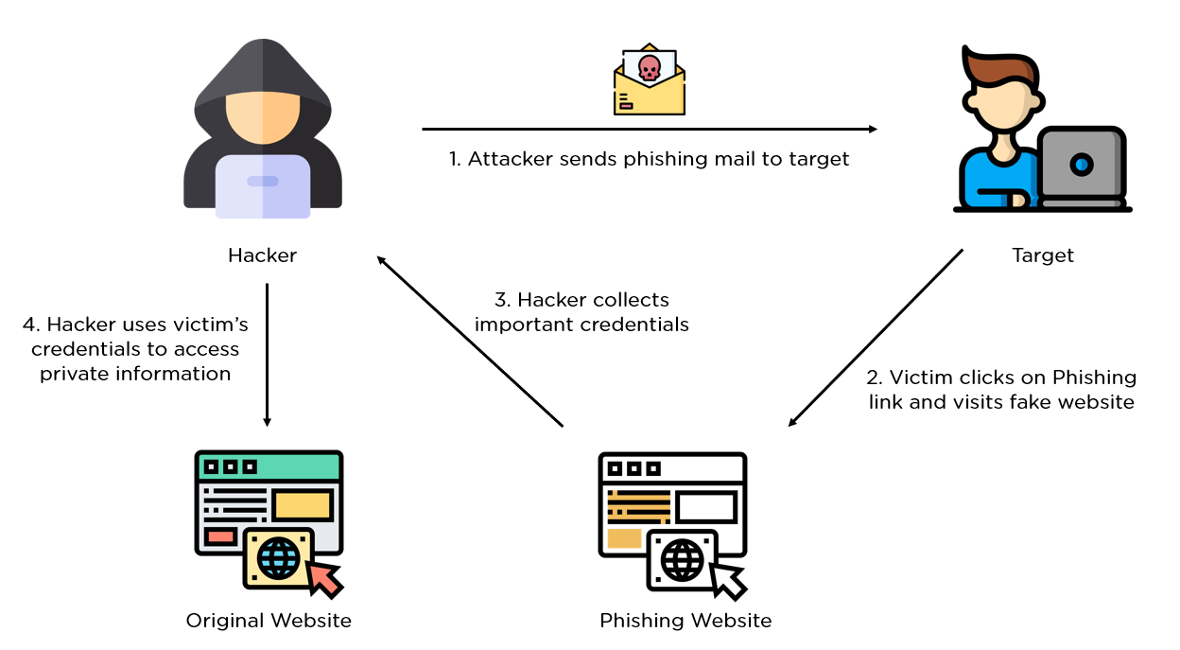
3. Visualization
This is how an intruder hacks using phishing websites

Slide 6
4. Objectives
Detect whether the website is phishing or not
Extract the links associated with the website if it is phishing
Find out the location of hosted server

Slide 7
5. Literature review
Year | Author | Title | Method
2019 | Amani Alswailem, Norah Alrumayh, Bashayr Alabdullah, Dr.Aram Alsedrani | Detecting Phishing Websites Using Machine Learning | Machine Learning, Algorithm : Random Forest classification algorithm
2020 | Mohammed Hazim Alkawaz, Stephanie Joanne Steven, Asif Iqbal Hajmaydeen | Detecting Phishing Websites using AUP | Agile Unified Process.
2020 | Maria Sameen, Kyunghyun Han, Seong Oun Hwang | PhishHaven—An Efficient Real-Time AI Phishing URLs Detection System | Lexical analysis, URL HTML Encoding,

Slide 8
6. Existing System
There are mechanisms to detect phishing websites. But they doesn’t have features like extraction of links from the detected websites
Also generation of new phishing websites only be caught by up to dated system

Slide 9
6. Proposed System
Accurately predict the given website is Phishing or not
Extract all the links from the detected website
More than 5 lakhs URL’s for the creation of the model
Tracking of IP address and location of the hosted system
Better user interface

Slide 10
6. Algorithms Used
Multinomial Naïve Bayes
Logistic Regression

Slide 11
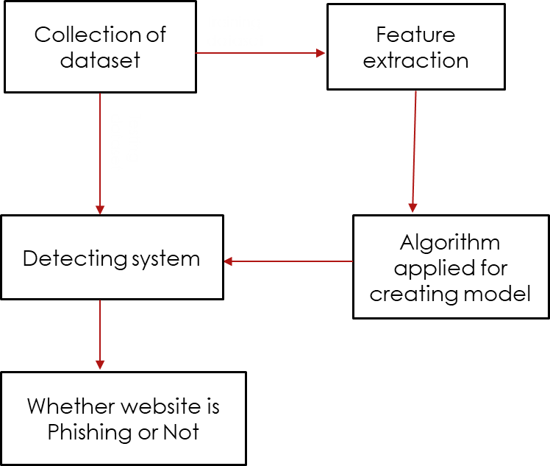
6. System Design

Slide 12
7. Tools and technologies
Used Google Colab for creating the model
Important libraries used :
Pandas
Numpy
Seaborn
Matplotlib
Sklearn
RegExpTokenizer
SnowballStemmer

Slide 13
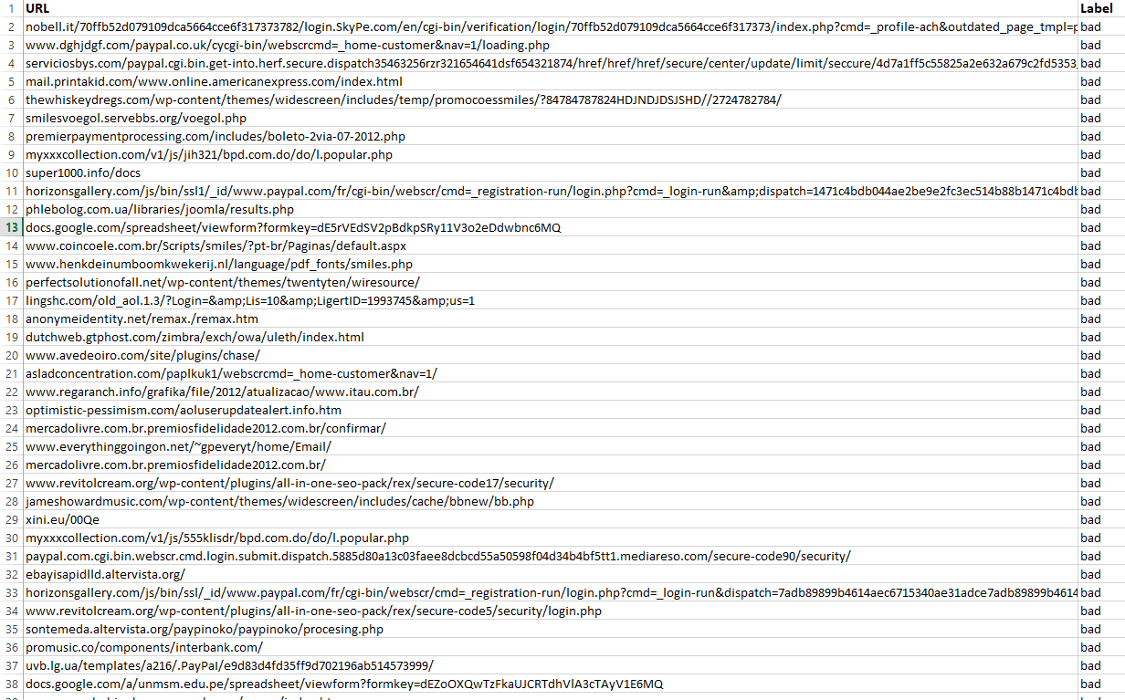
9. Data Sets
Labeled URL’s

Slide 14
9. Implementation
Collection of datasets for both good and bad URL’s.
Pre-processing of datasets (labeling, Splitting into keywords).
Trained various machine learning models with the above datasets.
Compared the accuracy of various machine learning models and fixed Logistic Regression model with 96% accuracy over Multinomial Naïve Bayes model with 95% accuracy.
Designed templates for User Interface and added module for location tracking.

Slide 15
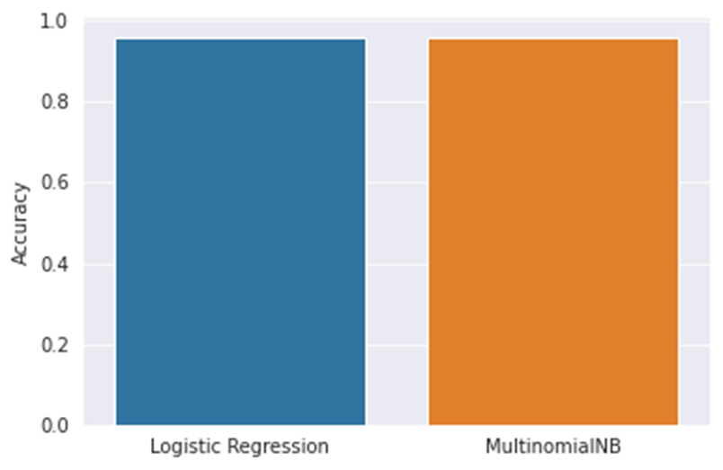
9. Accuracy Comparison

Slide 16

8. User Interface
Home Page

Slide 17
Detected Good

Slide 18

Detected Bad

Slide 19
8. Challenges faced
Collection of dataset
Dealing with code
Integration of modules

Slide 20
8. Conclusion
This system will help user to detect phishing websites
It uses the URL of the websites for the analysis
The system can identify most common words in the phishing URL’s and recognize other as phishing or not based on these keywords
Can detect the IP address and location of the system of phishing website
So, it helps to prevent losing of sensitive data and information
Better results obtained with larger datasets

Slide 21
8. Future Scope
Can increase the accuracy by creating model with larger datasets
Can add a functionality to report phishing websites detected using the system

Slide 22
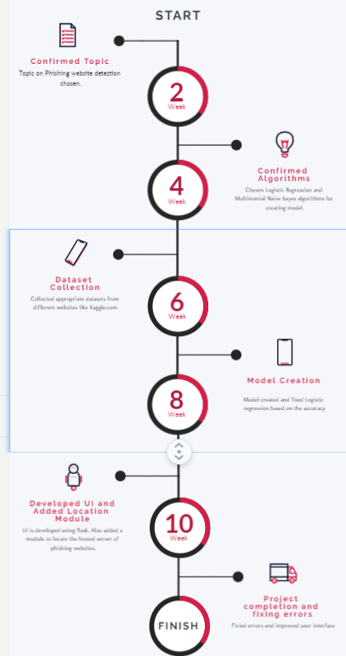
8. Timeline

Slide 23
8. References
M. H. Alkawaz, S. J. Steven and A. I. Hajamydeen, "Detecting Phishing Website Using Machine Learning," 2020 16th IEEE International Colloquium on Signal Processing & Its Applications (CSPA), 2020, pp. 111-114, doi: 10.1109/CSPA48992.2020.9068728.
A. Alswailem, B. Alabdullah, N. Alrumayh and A. Alsedrani, "Detecting Phishing Websites Using Machine Learning," 2019 2nd International Conference on Computer Applications & Information Security (ICCAIS), 2019, pp. 1-6, doi: 10.1109/CAIS.2019.8769571.
M. Sameen, K. Han and S. O. Hwang, "PhishHaven—An Efficient Real-Time AI Phishing URLs Detection System," in IEEE Access, vol. 8, pp. 83425-83443, 2020, doi: 10.1109/ACCESS.2020.2991403.

Slide 24


