Slide 1


Chatbot for Legal Information
Professional Readiness for Innovation, Employability and Entrepreneurship
19 .05.2024
Team Member 1 : Mathavan S
Team Member 2 : Murshid Ahmed S
Team Member 3 : Madesh A
MENTOR : Dr. K. Ananthajothi

Slide 2
ABSTRACT
This project aims to develop a chatbot tailored to provide legal information and guidance specifically designed for marginalized communities. In many societies, marginalized groups face significant barriers when seeking legal assistance, including lack of access to resources, systemic discrimination, and unfamiliarity with legal processes. This chatbot serves as a bridge, leveraging natural language processing and AI technology to offer easily accessible, culturally sensitive, reliable legal information and in all regional languages. To enhance its effectiveness, the chatbot will be equipped with multilingual capabilities and cultural sensitivity training, acknowledging the diverse linguistic and cultural backgrounds of its users. Additionally, it will feature personalized recommendations and referrals to legal aid organizations, community resources, and pro bono services, further empowering marginalized individuals to assert their rights and navigate the legal system effectively.

Slide 3
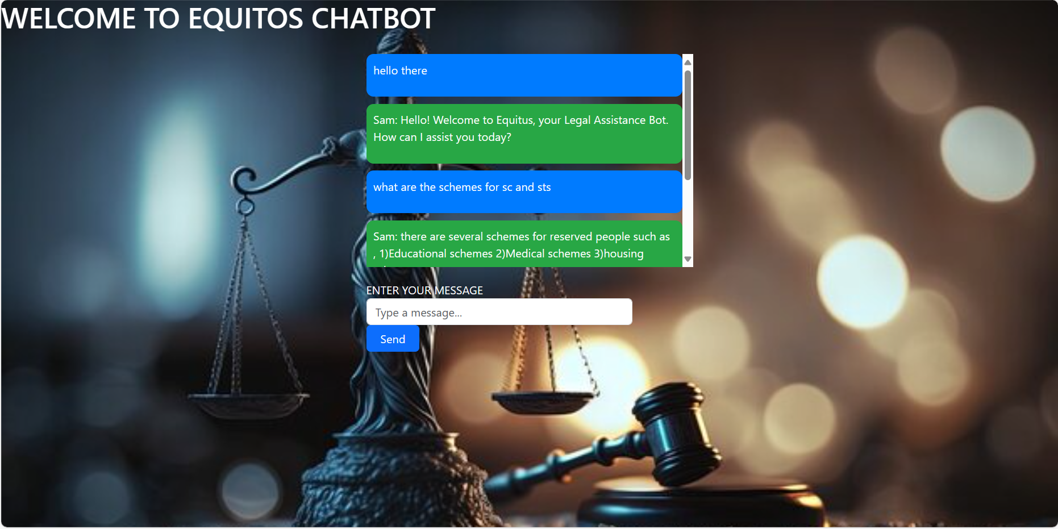
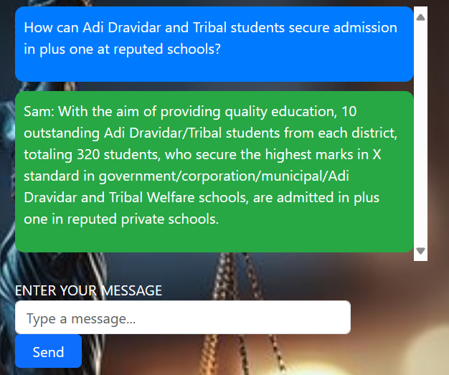
PROPOSED SOLUTION

Slide 4
TECHNOLOGY USED
The project employs a powerful technological stack to deliver a seamless user experience and robust functionality. React.js, a popular JavaScript library for building dynamic user interfaces, forms the foundation of the frontend. Its component-based architecture facilitates modularity and reusability, allowing for the creation of interactive and responsive user interfaces. On the backend, Python's PyTorch framework takes center stage, providing cutting-edge capabilities for deep learning and artificial intelligence tasks. Leveraging PyTorch's intuitive syntax and extensive library of neural network modules, the system can efficiently process complex data and deliver sophisticated machine learning functionalities. This integration of React for frontend development and PyTorch for backend processing ensures a harmonious blend of user-centric design and advanced computational capabilities, resulting in a robust and scalable solution. It has been blended well using neural network.

Slide 5
NOVELTY
Our project stands out from existing solutions in several key ways. Firstly, while there are various legal information resources available, they often lack accessibility and cultural relevance for marginalized communities. Our chatbot specifically targets this gap by offering tailored legal information and guidance designed to meet the unique needs of these communities. This personalized approach ensures that users receive accurate and culturally sensitive information that resonates with their experiences.
Secondly, the integration of advanced technologies sets our project apart. By utilizing React.js for the frontend, we prioritize user experience and interface design, ensuring that the chatbot is intuitive and easy to navigate. Additionally, the incorporation of PyTorch in the backend enables us to leverage state-of-the-art machine learning capabilities, allowing the chatbot to provide more sophisticated responses and personalized recommendations based on user interactions and preferences.
Furthermore, our project emphasizes inclusivity and empowerment. In addition to providing legal information, the chatbot offers guidance on navigating the legal system, accessing resources, and asserting rights. By empowering marginalized individuals with knowledge and resources, our solution aims to foster greater equity and justice within the legal landscape

Slide 6
SOCIAL RELEVANCE
Access to Legal Information: Marginalized communities often face barriers when seeking legal information due to factors such as economic constraints, language barriers, and lack of familiarity with legal processes. By providing a user-friendly and accessible platform for legal information dissemination, our chatbot breaks down these barriers and ensures that individuals from diverse backgrounds have access to the information they need to navigate the legal system effectively.
Empowerment: Knowledge is power, especially when it comes to legal rights and processes. By equipping marginalized individuals with accurate legal information, our chatbot empowers them to advocate for their rights, make informed decisions, and take appropriate action in legal situations. 3.Efficiency and Cost-effectiveness: Traditional legal assistance can be costly and time-consuming, making it inaccessible to many individuals, particularly those from marginalized communities. Our chatbot offers a cost-effective and efficient alternative, providing instant access to legal information and guidance without the need for expensive legal consultations or lengthy wait times. This not only saves time and resources for users but also alleviates the burden on legal aid organizations and pro bono services.
4.Community Support: Our project fosters a sense of community support by connecting users with relevant resources, support networks, and legal aid organizations.

Slide 7
REFERENCES
https://www.mdpi.com/2078-2489/14/6/307
https://researchers.cdu.edu.au/en/publications/the-ethical-chatbot-a-viable-solution-to-socio-legal-issues
https://thestudentlawyer.com/2023/08/21/legal-tech-transformation-how-ai-chatbots-are-revolutionizing-access-to-justice/
Start Locally | PyTorch

Slide 8
THANK YOU

