Slide 1
Railway Station
By Name:Ahmed
Abdulhadi
Fahad
Mohamed
ID :4110911- 4110834 - 4110649 - 4120580
YUC KSA

Slide 2
Overview
Phase I
Conceptual DB Design
Phase II
Logical DB Design
Requirements
Normalization
Entities & Attributes
Loading data
ERD
Presentation
YUC KSA
Slide 2

Slide 3
Overview
This system is concerned with online ordering of railway tickets to the passengers.
In this project we are going to show how a reservation is done.
Store and retrieve information about the transactions related to rail travel.
Maintain records of passengers.
YUC KSA
Slide 3

Slide 4
Overview
Phase I
Conceptual DB Design
Phase II
Logical DB Design
Requirements
Normalization
Entities & attributes
Loading data
ERD
Presentation
YUC KSA
Slide 4

Slide 5
Requirements Collection and Analysis
Overview
As database designers, we interviewed prospective database users to understand and document their data requirements. The result of this step is a concisely written set of users’ requirements. The COMPANY database keeps track of a company’s employees, departments, and projects.
YUC KSA
Slide 5

Slide 6
Requirements Collection and Analysis
User Requirements (1/7)
In this part we are covering on how the employees are working in reservation section of railways.
YUC KSA
Slide 6

Slide 7
Requirements Collection and Analysis
User Requirements (2/7)
Stations in our project has some attributes which will be used for telling some important details related to the railway database management.
YUC KSA
Slide 7

Slide 8
Course Project
Requirements Collection and Analysis
User Requirements (3/7)
Train tables in this project are important since it is a main part of railway station.
YUC KSA
Slide 8

Slide 9
Requirements Collection and Analysis
User Requirements (4/7)
We want to keep track of the passengers which are going to ride on a train and who is the employee who let them in and also the ticket will show the time of the travel and type of the class of the passenger.
YUC KSA
Slide 9

Slide 10
Requirements Collection and Analysis
User Requirements (5/7)
Tickets table will contain the main part of the tickets such as ticket number and the source , destination, class_ id and train_id.
YUC KSA
Slide 10

Slide 11
Requirements Collection and Analysis
User Requirements (6/7)
Class table has different types of classes like 1st class, business class, and general class
YUC KSA
Slide 11

Slide 12
Requirements Collection and Analysis
User Requirements (7/7)
Time table contains some important details such as ref_no , der_time arrive_time, Train_id, and station_id which will be helpful in the customer's ticket.
YUC KSA
Slide 12

Slide 13
Course Project
Overview
Phase I
Conceptual DB Design
Phase II
Logical DB Design
Requirements
Normalization
Entities & Attributes
Loading data
ERD
Presentation
YUC KSA
Slide 13

Slide 14
Course Project
Extractions of Entities and Attributes
salary
FNAME
E_ID
E_name
LNAME
employee
Preliminary design of entity types for the COMPANY database. Some of the shown attributes will be refined into relationships.
Address
gender
salary
PH_Number
Construct each entity on a separate slide.
YUC KSA
Slide 14

Slide 15
Course Project
Extractions of Entities and Attributes
PH_NUMBER
GENDER
SEAT_NO
PASSENGER
Preliminary design of entity types for the COMPANY database. Some of the shown attributes will be refined into relationships.
RES_STATUS
E_ID
P_ID
P_NAME
Construct each entity on a separate slide.
YUC KSA
Slide 15

Slide 16
Course Project
Extractions of Entities and Attributes
DESTINATION
TRAIN_ID
TICKET
Preliminary design of entity types for the COMPANY database. Some of the shown attributes will be refined into relationships.
CLASS_ID
TICKET_NO
SOURCE
Construct each entity on a separate slide.
YUC KSA
Slide 16

Slide 17
Course Project
Extractions of Entities and Attributes
NO_OF_PLATFORM
STATION
NO_OF_LINES
STATION_ID
STATION_NAME
YUC KSA
Slide 17

Slide 18
Course Project
Extractions of Entities and Attributes
STATION_ID
TRAIN_ID
TRAIN
TRN_NAME
Construct each entity on a separate slide.
YUC KSA
Slide 18

Slide 19
Course Project
Extractions of Entities and Attributes
CLASS_ID
CLASS
JOURNY_DATE
TRAIN_ID
NO_OF_SEATS
Construct each entity on a separate slide.
YUC KSA
Slide 19

Slide 20
Course Project
Extractions of Entities and Attributes
STATION_ID
DEP_TIME
TIME
Preliminary design of entity types for the COMPANY database. Some of the shown attributes will be refined into relationships.
REF_NO
TRAIN_ID
ARR_TIME
YUC KSA
Slide 20

Slide 21
Course Project
Overview
Phase I
Conceptual DB Design
Phase II
Logical DB Design
Requirements
Normalization
Entities & attributes
Loading data
ERD
Presentation
YUC KSA
Slide 21

Slide 22
ERD
JOURNY_DATE
TRAIN_ID
STATION_ID
NO_OF_PLATFORM
CLASS_ID
CLASS
STATION
NO_OF_LINES
NO_OF_SEATS
STATION_NAME
STATION_ID
REF_NO
STATION_ID
TRAIN_ID
DEP_TIME
TIME
TRAIN
TRN_NAME
TRAIN_ID
ARR_TIME
YUC KSA
Slide 22

Slide 23
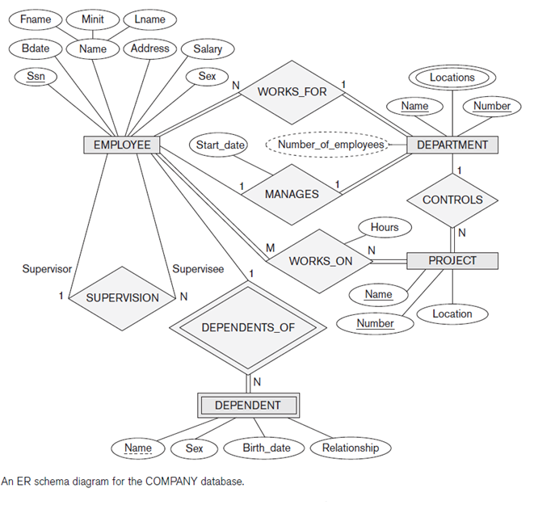
ERD
Composite
attribute
YUC KSA
Slide 23

Slide 24
Course Project
Overview
Phase I
Conceptual DB Design
Phase II
Logical DB Design
Requirements
Normalization
Entities & attributes
Loading data
ERD
Presentation
YUC KSA
Slide 24

Slide 25
Course Project
Normalizing Employee Relation
1NF: Remove composite attributes:
Employee |  |  |  |  |  |  |  | UNF
SSN | Name |  |  | Salary | Supervisor | Address | Birthdate | Dept | Sex
 | Fname | Minit | Lname
Employee |  |  |  |  |  |  |  | 1NF
SSN | Fname | Minit | Lname | Salary | Supervisor | Address | Birthdate | Dept | Sex
YUC KSA
Slide 25

Slide 26
Course Project
Normalizing Dependent Relation
Check
1NF: Remove multivalues-there are none.
2NF: Remove partial dependencies-there are none, both PK attributes must be identified to uniquely identify a tuple.
3NF: Remove dependencies on non-key -all attributes depend only on the key.
The Dependent relation above is in 3NF.
Dependent
Essn* | Dep_name | Sex | Bdate | Relationship
YUC KSA
Slide 26

Slide 27
Course Project
Overview
Phase I
Conceptual DB Design
Phase II
Logical DB Design
Requirements
Normalization
Entities & attributes
Loading data
ERD
Presentation
YUC KSA
Slide 27

Slide 28
Course Project
Loading Data
The following tables have been created using Oracle, and tested to work for various database operations, such as querying and joining tables.
Create 3 records per relation.
YUC KSA
Slide 28

Slide 29
Course Project
Tables List
Employee
Department
Project
Dependent
YUC KSA
Slide 29

Slide 30
Course Project
Employee
Fname | Minit | Lname | Ssn | Bdate | Address | Sex | Salary | Super_ssn | Dno
John | B | Smith | 123456789 | 1965-01-09 | 731 Fondren | M | 30000 | 333445555 | 5
Franklin | T | Wong | 333445555 | 1955-12-08 | 638 Voss | M | 40000 | 888665555 | 5
Alicia | J | Zelaya | 999887777 | 1968-01-19 | 3321 Castle | F | 25000 | 987654321 | 4
Jennifer | S | Wallace | 987654321 | 1941-06-20 | 291 Berry | F | 43000 | 888665555 | 4
Ramesh | K | Narayan | 66688444 | 1962-09-15 | 975 Fire Oak | M | 38000 | 333445555 | 5
Joyce | A | English | 453453453 | 1972-07-31 | 5631 Rice | F | 25000 | 333445555 | 5
Ahmad | V | Jabbar | 987987987 | 1969-03-29 | 980 Dallas | M | 25000 | 987654321 | 4
James | E | Borg | 888665555 | 1937-11-10 | 450 Stone | M | 55000 | Null | 1
Construct each relation on a separate slide.
YUC KSA
Slide 30

Slide 31
Course Project
Department
Dname | Dno | Dmgr_ssn | Mgr_start-date
Research | 5 | 333445555 | 1988-05-22
Administration | 4 | 987654321 | 1995-01-01
Headquarters | 1 | 888665555 | 1981-06-19
Construct each relation on a separate slide.
YUC KSA
Slide 31

Slide 32
Course Project
Project
Pname | Pnumber |  | Plocation |  | Dnum
ProductX | 1 |  | Bellaire |  | 5
ProductY | 2 |  | Sugarland |  | 5
ProductZ | 3 |  | Houston |  | 5
Computerization | 10 |  | Stafford |  | 4
Reorganization | 20 |  | Houston |  | 1
Newbenefits | 30 |  | Stafford |  | 4
Construct each relation on a separate slide.
YUC KSA
Slide 32

Slide 33
Course Project
Dependent
Essn | Dependent_name | Sex | Bdate | Relationship
333445555 | Alice | F | 1986-04-05 | Daughter
333445555 | Theodore | M | 1983-10-25 | Son
333445555 | Joy | F | 1958-05-03 | Spouse
987654321 | Abner | M | 1942-02-28 | Spouse
123456789 | Michael | M | 1988-01-04 | Son
123456789 | Alice | F | 1988-12-30 | Daughter
123456789 | Elizabeth | F | 1967-05-05 | Spouse
Construct each relation on a separate slide.
YUC KSA
Slide 33

Slide 34
Course Project
End of Project.
Project policies are next.
YUC KSA
Slide 34

Slide 35
Important Dates
Assigned: Wednesday, October, 2019
Due: Wednesday, December, 2019
No submissions are permitted after due date.
5% deducted for every calendar day past this date. That is five points out of 100. For example, if you are late two calendar days, 10 points are deducted.
YUC KSA
Slide 35

Slide 36
Submission Method
Submission
Upload one PowerPoint file to YUC eLearning Moodle site.
You must use PowerPoint.
Printed files are unacceptable.
YUC KSA
Slide 36

Slide 37
Project Options
Options
Each student must submit his\their own project.
YUC KSA
Slide 37

Slide 38
Course Project
Disqualified Topics
The following topics have been overused and may not be used again.
Education related databases (SIS, etc.)
Book related (warehouse, library, etc.)
Banks, warehouses, hospitals.
The above topics are not acceptable.
YUC KSA
Slide 38

Slide 39
Course Project
Professionalism
All text must be typed, not handwritten.
All diagrams must be original using PowerPoint drawing tools, not an image.
Oracle tables will be screen captured images.
Do not use a scanner.
YUC KSA
Slide 39

Slide 40
Course Project
Plagiarism
Do not submit work from previous terms, from the female campus, other instructors, or from the Internet, as this warrants a zero on the entire project.
YUC KSA
Slide 40

Slide 41
Course Project
Checklist
Write project title and your name on first slide.
Number slides
Use consistent format (same font, font size, etc.)
Save project file as your name
YUC KSA
Slide 41

