Slide 1
QuickLoan
AI Loan Pre-Qualification Assistant — FastFinance India
Agentic AI Engineering · Batch 1 · Launchpad Project Demo
Demo build: git tag s15 · 2026-09-14

Slide 2
OVERVIEW
Agenda
• Problem statement & the one rule that shapes everything
• System architecture — the multi-agent LangGraph
• Security & compliance guardrails
• Data architecture — SQLite + ChromaDB
• Live demo scenarios
• Cloud deployment — Azure (ACR / ACI / Front Door)
• Known gaps & roadmap
QuickLoan | FastFinance India
1

Slide 3
WHY QUICKLOAN
Problem Statement
• Manual pre-qualification is slow. Customers wait on a loan officer just to learn a rate or eligibility criterion.
• Rate/policy info drifts. Static FAQs and PDFs go stale the moment a rate changes.
• Compliance risk in ad-hoc answers. Any assistant that can imply “approved” creates real regulatory exposure.
QuickLoan pre-qualifies only — it never approves or rejects a loan.
Final approval always requires document verification, a credit bureau check, and sometimes a field inspection.
QuickLoan | FastFinance India
2

Slide 4
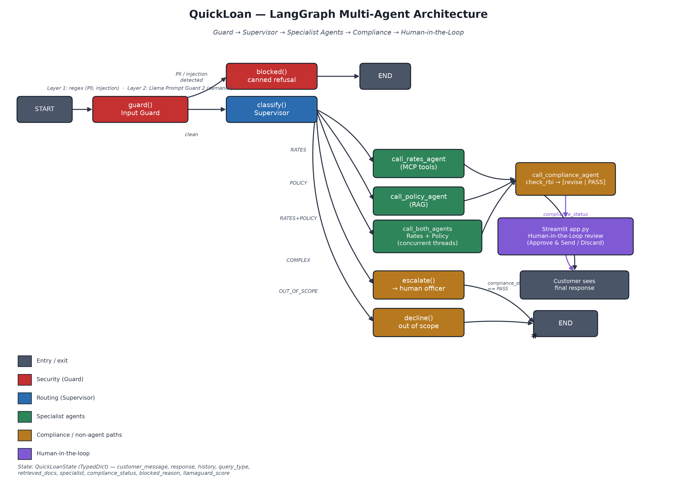
SYSTEM DESIGN
LangGraph Multi-Agent Architecture
QuickLoan | FastFinance India
3

Slide 5
SYSTEM DESIGN
How a Request Flows
• 1. Guard Two-layer screen (regex + semantic Llama Prompt Guard 2) blocks PII and jailbreaks before any main LLM call.
• 2. Supervisor A dedicated classifier model routes into 5 labels: RATES / POLICY / RATES+POLICY / COMPLEX / OUT_OF_SCOPE.
• 3. Specialist agents Rates Agent (live MCP tool calls) and/or Policy Agent (RAG) answer — concurrently for compound questions.
• 4. Compliance Agent Every draft is checked for banned phrases and hallucinated rates against the live database.
• 5. Human-in-the-Loop Any revised response is held for operator approval before it ever reaches the customer.
QuickLoan | FastFinance India
4

Slide 6
TRUST & SAFETY
Security & Compliance Guardrails
Input Guard
Compliance & HITL
• Layer 1a — regex PII detection (Aadhaar, PAN)
• Layer 1b — regex injection/jailbreak patterns
• Layer 2 — Llama Prompt Guard 2 (semantic, catches rephrasings)
• Unicode normalisation strips invisible smuggling characters
• Fails OPEN on guard-model error — an outage never blocks legitimate traffic
• Banned-phrase check — never implies a lending decision
• Hallucinated-rate check — every quoted rate verified live against SQLite
• One automated rewrite pass on failure
• Revised responses held for human approval — never auto-sent
• Fails SAFE to COMPLEX on classifier error — never silently skips escalation
QuickLoan | FastFinance India
5

Slide 7
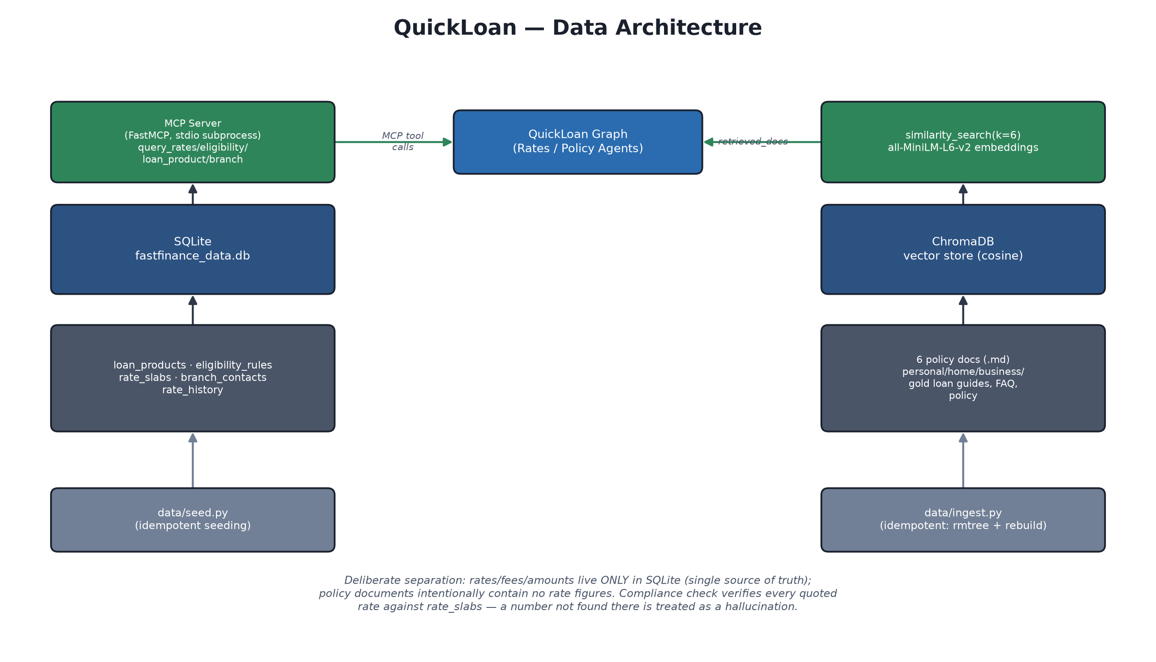
DATA LAYER
Two Data Stores, One Reason
QuickLoan | FastFinance India
6

Slide 8
UNDER THE HOOD
Technology Stack
• Orchestration LangGraph (StateGraph, conditional edges, checkpointers)
• LLM Provider Groq — openai/gpt-oss-120b (agent), groq/compound-mini (classifier), Llama Prompt Guard 2 (guard)
• Tool Protocol Model Context Protocol (MCP) — standalone FastMCP server over stdio
• RAG ChromaDB + HuggingFace all-MiniLM-L6-v2 embeddings
• Structured Data SQLite
• Web UI Streamlit — multi-thread chat, live streaming, HITL review form
• Observability LangSmith tracing
• Deployment Docker (multi-stage) → Azure Container Registry → Azure Container Instances → Azure Front Door
QuickLoan | FastFinance India
7

Slide 9
LIVE DEMO
Scenarios to Show
• 1. Simple rate query “What is the home loan interest rate?” — live MCP tool call, streamed typewriter response.
• 2. Policy / documents query “What documents do I need for a personal loan?” — RAG-grounded answer.
• 3. Compound query “What are business loan rates and what documents are needed?” — both specialist agents run concurrently.
• 4. Guard block A message with an Aadhaar-shaped number — blocked before any LLM call.
• 5. Escalation “Which loan is best for me?” — routed straight to a human officer, no LLM guess.
• 6. Compliance + HITL A response that would imply guaranteed approval — auto-revised, held for operator approval.
QuickLoan | FastFinance India
8

Slide 10
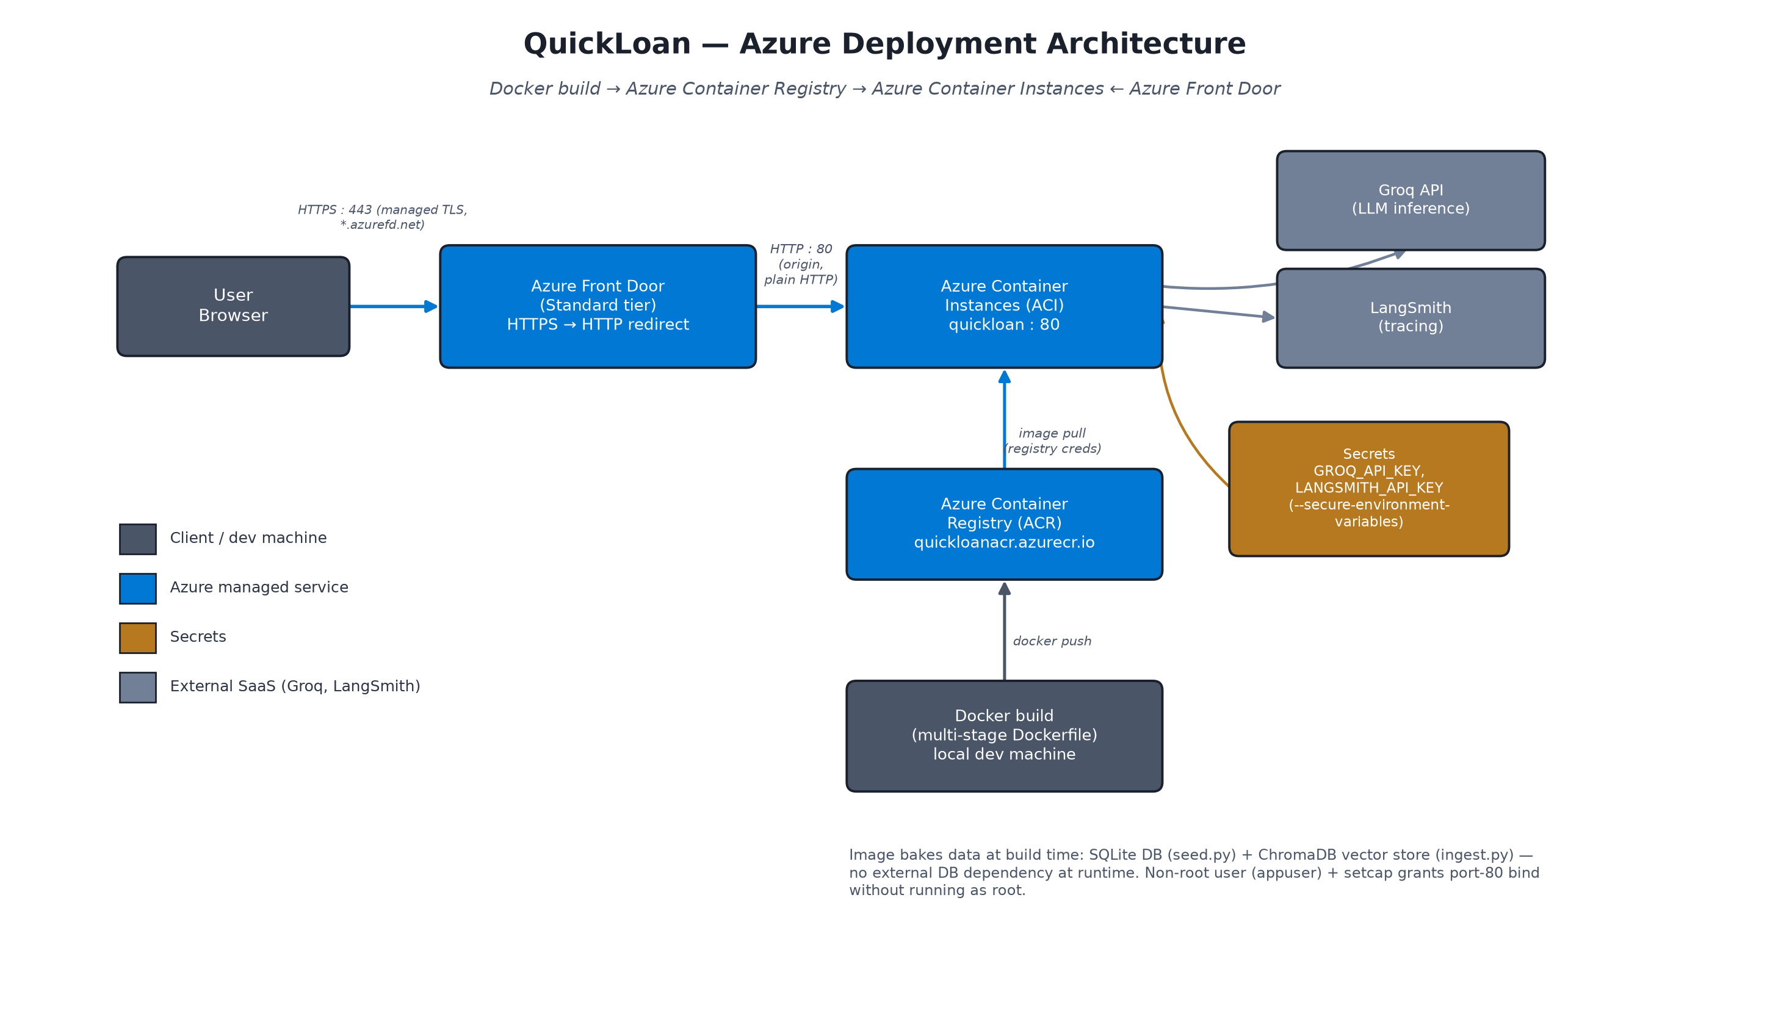
CLOUD DEPLOYMENT
Azure Architecture
QuickLoan | FastFinance India
9

Slide 11
CLOUD DEPLOYMENT
Why ACI + Front Door
• Docker multi-stage build Builder stage compiles dependencies; runtime stage ships only the compiled artefacts — no compiler toolchain in the final image.
• Data baked in at build time SQLite seeding + ChromaDB ingestion run during the image build — zero external DB dependency at container start.
• Non-root, port 80 appuser + setcap grants the CAP_NET_BIND_SERVICE capability so the app can bind port 80 without running as root.
• Azure Container Apps was blocked This subscription hit a hard 0-quota on Container App Environments — pivoted to Azure Container Instances instead.
• Azure Front Door restores managed HTTPS ACI alone only serves plain HTTP; Front Door (Standard tier) adds a free managed TLS cert, HTTP→HTTPS redirect, and proxies to the ACI origin.
QuickLoan | FastFinance India
10

Slide 12
WHAT'S NEXT
Known Gaps & Roadmap
Known gaps
• EMI calculation tool planned in the PRD, not yet implemented
• No automated pytest suite yet
• Golden dataset still labelled with the earlier 3-category routing scheme
• Single-replica deployment — checkpointer isn't externalised for horizontal scale
Roadmap
• Session 16 Advanced evaluation + prompt versioning, including an EMI-calculation regression gate.
• Session 17 Demo Day — QuickLoan presented as the Batch 1 Launchpad project.
QuickLoan | FastFinance India
11

Slide 13
Thank You
Questions & Discussion
QuickLoan | FastFinance India — AI pre-qualifies. Humans decide.

