Slide 1

A Retrospective Look At Covid- 19
Murtatha Alwan, Damla Duman, Iman Malih, John Olton

Slide 2
Questions
Main Query: How did different countries do during the pandemic, and what made these results different? Sub-Queries:
How effective was the vaccination?
Did booster shots have any effect on exposure rates or deaths?
Which countries had the most deaths or most positive tests per population?
Which countries had the lowest fatalities?
What is the median age for those who tested positive?
Is the GDP of countries correlated with their positive tests?
Is there a direct correlation between diabetes and COVID-19 deaths?

Slide 3
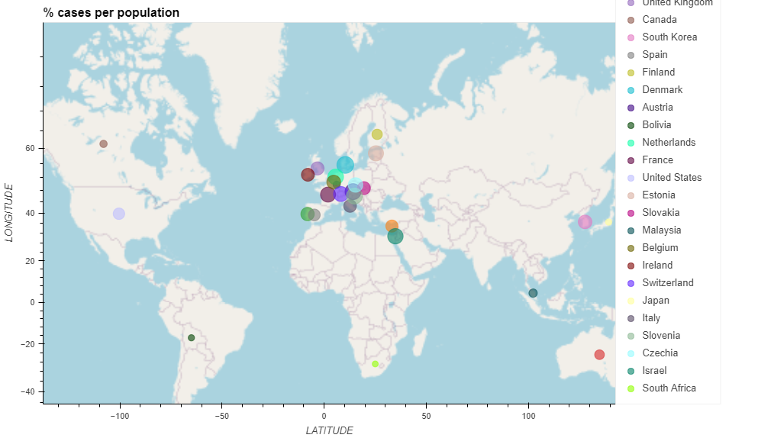

Slide 4
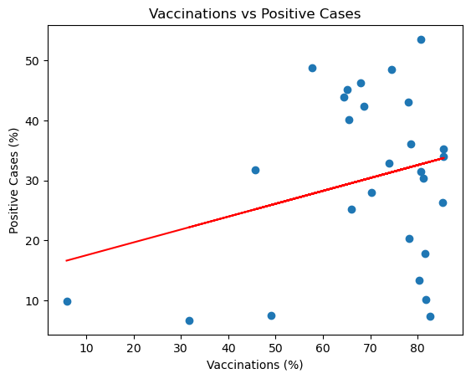
Vaccinations Vs Positive Cases
The r-squared is: 0.07459382788591065
.The r-squared value is 0.07, showing that there is no correlation between vaccinations and positive cases.
.looking at the graph, as the amount of people vaccinated in a country increase, the amount of positive cases in that country also increases.

Slide 5
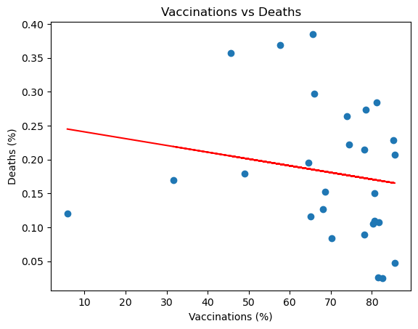
Vaccinations Vs Deaths
The r-squared is: 0.03257792304763469
.The r-squared value is 0.03, showing that there is no correlation between vaccinations and deaths.
.looking at the graph, as the amount of people vaccinated in a country increase, the amount of covid-19 deaths in that country slightly decreases.

Slide 6
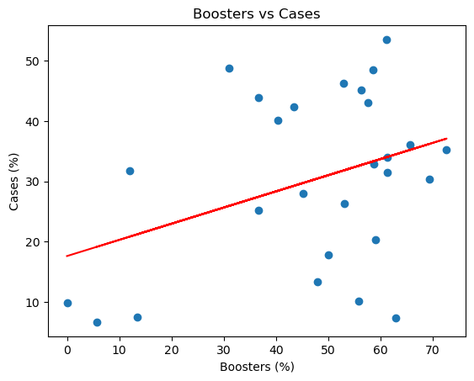
Boosters Vs Cases
The r-squared is: 0.13329843189491056
.The r-squared value is 0.13, showing that there is very little positive correlation between the amount of booster shots taken in a country and positive cases.
.looking at the graph, as the total amount of booster shots taken in a country increases, the amount of positive cases in that country also increases.

Slide 7
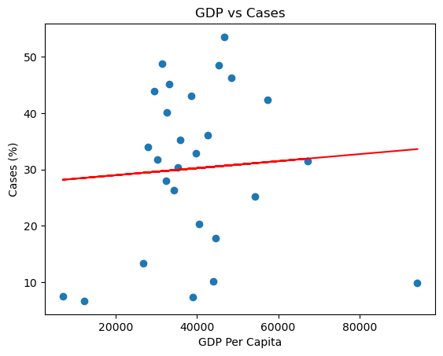
GPD Vs Cases
The r-squared is: 0.005118975966555018
.The r-squared value is 0.005, showing that there is no correlation between a country's GDP and its amount of positive cases.
.looking at the graph, the slope almost looks like a parabola, where the data is at its lowest in the extremities and highest in the center.
.something of note, the countries with lower GDP may have poor recording of data.

Slide 8
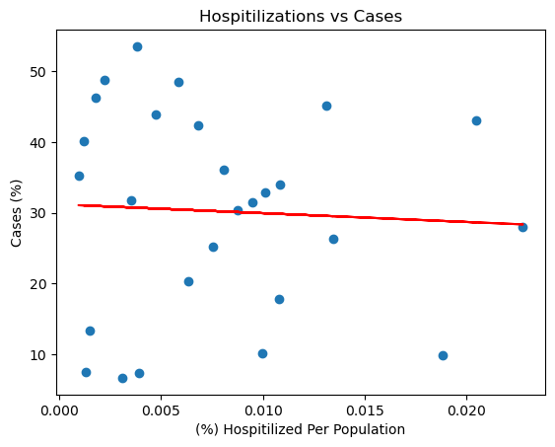
Hospitalizations Vs Cases
The r-squared is: 0.002663234187759335
.The r-squared value is 0.002, showing that there is no correlation between the amount of covid-19 hospitalizations in a country and its positive cases.
.looking at the graph, it is clear that there is no apparent trend or line of best fit. This means that there is possibly something else that correlates with hospitalizations, so what about GDP?

Slide 9
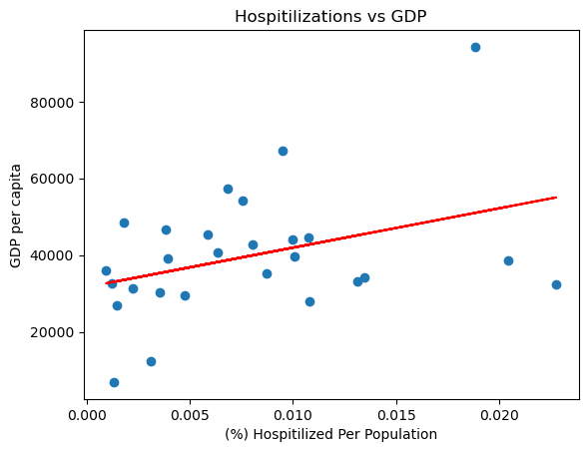
Hospitalizations Vs GPD
The r-squared is: 0.13751709510884047
.The r-squared value is 0.14, showing that there is very little positive correlation between the GDP in a country and the amount of hospitalizations in that country.
.looking at the graph, as the GDP in a country increases, the amount of hospitilizations in that country also increases.

Slide 10
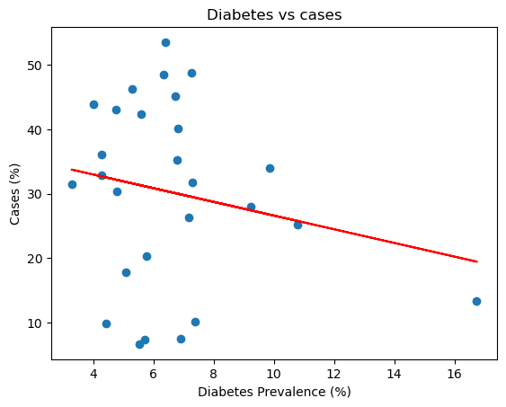
Diabetes Vs Cases
The r-squared is: 0.039442408139996964
.The r-squared value is 0.04, showing that there is no correlation between the prevalence of diabetes in a country and the amount of positive cases.
.looking at the graph, as diabetes prevalence increases, the amount of positive cases actually decreases.

Slide 11
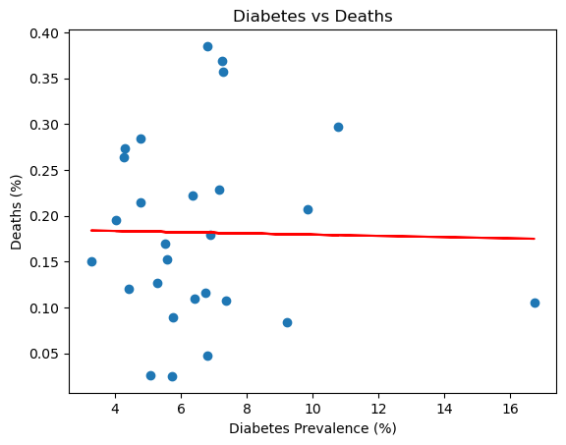
Diabetes Vs Deaths
The r-squared is: 0.00031670623648438805
.The r-squared value is 0.0003, showing that there is no correlation between the prevalence of diabetes in a country and covid-19 deaths.
.looking at the graph, there is no apparent trend or line of best fit, showing that there is no relationship between diabetes prevalence and covid-19 deaths.

Slide 12
Conclusion
The vaccine seemed to have no positive or negative effect on COVID-19
Positive rate of deaths
Booster shots seemed to have no positive effect in protecting from COVID-19.
In fact, the countries that took more booster shots had more positive cases and deaths.
The country that had the most positive cases for their population is
Denmark with %53.5 percent of its population contracting COVID-19.
The country that had the most COVID-19 deaths for their population is
Czechia with %0.39 percent of their population dying from COVID-19.
The country that had the least positive cases for their population is
South Africa with %6.66 percent of its population contracting COVID-19.
The country that had the least COVID-19 deaths for their population is
Japan with %0.025 percent of their population dying from COVID-19.
The median age for covid-19 victims is 40.36 while the global median age is 30 years old.
The GDP of countries is not linearly correlated with positive cases.
There is no correlation between the prevalence of diabetes and the number of positive cases in a country.

