Slide 1

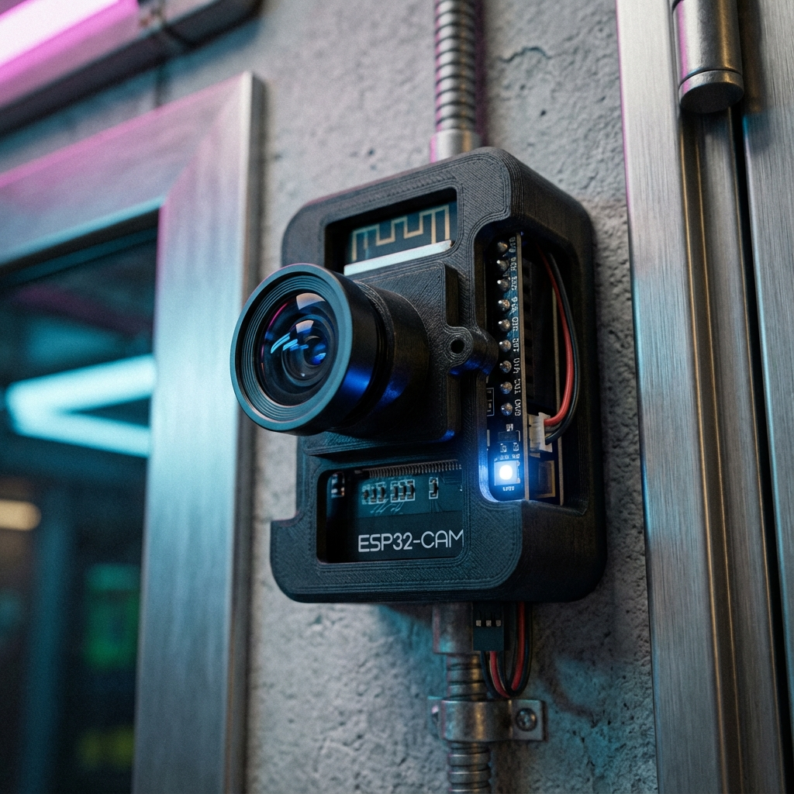
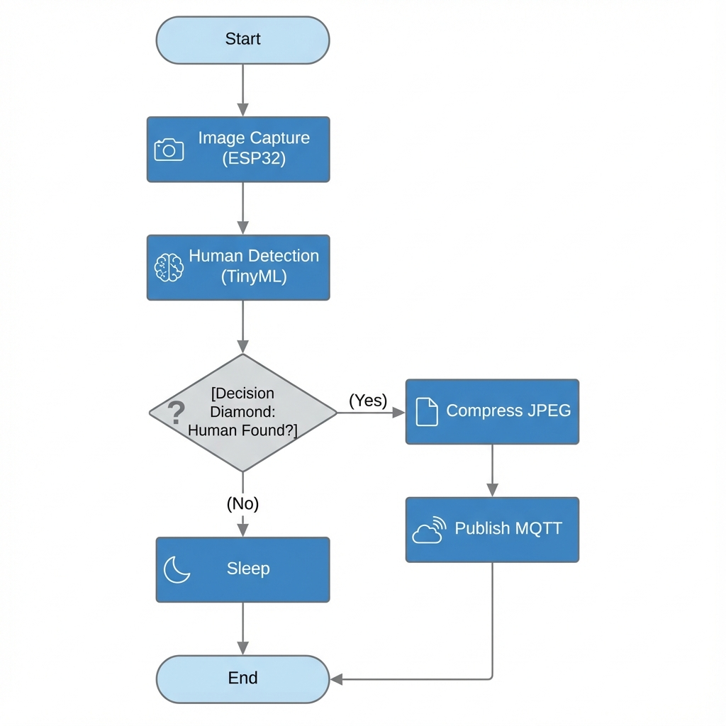

EagleEye
Intelligent Edge AI Surveillance System
On-device AI · Cloud-connected · Watch your space from anywhere
SparkUp / ORIC
logo
assets/sparkup_logo.png
Murtaza Khalid (BSCE22004) · Huzaifa Khan (BSCE22025) · Haseeb Ahmed (BSCE22048)
Supervisor: Dr. Rehan Hafiz · Co-Supervisor: Dr. Rehan Ahmed · Dept. of Computer & Software Engineering, Information Technology University (ITU), Lahore
① THE PROBLEM
④ SYSTEM ARCHITECTURE
Security cameras force a bad trade-off:
Cloud cams stream your footage to a company's servers — privacy risk + monthly fees.
LAN / DIY cams work only on the same Wi-Fi — typed IP, a PC left on, risky port-forwarding.
Most record everything — real events buried in hours of empty video.
SITE A
CLOUD
ANYWHERE
ESP32-CAM
On-device AI
Servo pan
Captures JPEG
HiveMQ — MQTT broker
Phone app
React Native
Alerts
Live view
Pan control
TLS
Cloudinary · Firebase
wss
Goal: see real intrusions — anywhere, privately, no subscription.
Deno relay (live video)
② OUR SOLUTION
The camera reaches OUT to the cloud; the phone reaches the same cloud — they meet in the middle.
Works on any network · no static IP · no port-forwarding · no on-site PC · end-to-end TLS
EagleEye runs a neural network on the camera itself. A low-cost ESP32-CAM decides on-device whether a human is present — images are analysed locally, never streamed to the cloud.
On an intruder it pushes a photo alert to your phone; you can open live video and pan the camera — from any network (Wi-Fi or 4G/LTE).
The camera reaches OUT to the cloud — no static IP, no port-forwarding, no on-site PC. Encrypted end-to-end; runs on free tiers.
⑤ HOW IT WORKS
Capture frame
AI: human?
Snap JPEG
Upload + Alert
Phone push
On request → live video via cloud relay | No human → keep watching (only confirmed humans trigger an alert).
⑥ RESULTS & TECH STACK
90.8%
detection accuracy (test; 87.5% human recall)
<1 s
on-device inference (~872 ms, ESP32-CAM)
<3 s
detection → phone alert (end-to-end)
18
model versions (v1.0 → v7.17)
~$10
device vs $200+ · $0/month cloud
100%
private — frames stay on device
EagleEye node — ESP32-CAM in a 3D-printed mount · swap for a real photo (assets/prototype_photo.jpg)
Tech stack: ESP32-CAM · Edge Impulse (TinyML) · MQTT / HiveMQ · Cloudinary · Firebase · Deno relay · React Native + Expo · TLS / WebSocket
Why it's novel: Edge AI on a microcontroller (privacy + zero inference cost) + an outbound-only architecture that works on any network — the pattern commercial IoT (AWS IoT, Ring/Nest) uses, rebuilt at $0/month.
③ KEY FEATURES
App screenshot
dashboard / live view
assets/app_screenshot.png
Real detection
one clean capture
assets/detection_sample.jpg
✓ On-device human detection — TinyML; images never leave the device
✓ Instant intruder alerts — captured photo pushed to your phone
✓ On-demand remote live video — stream only when you ask
✓ App-controlled camera pan — servo aim from the app
✓ Arm / disarm + true online status — real online/offline, not guesswork
✓ Encrypted & private — TLS everywhere, per-device credentials
✓ ~$10 hardware · $0/month cloud — entire stack on free tiers
IMPACT & SUSTAINABILITY
Affordable AI security — ~$10 vs $200+ systems democratizes safety for low-income homes (SDG 9 · 11).
Privacy by design — only confirmed threats ever leave the device (SDG 16).
Detection pipeline (on-device)
Team: Murtaza Khalid (BSCE22004) · Huzaifa Khan (BSCE22025) · Haseeb Ahmed (BSCE22048)
Supervisor: Dr. Rehan Hafiz Co-Supervisor: Dr. Rehan Ahmed
Dept. of Computer & Software Engineering, ITU Lahore · SparkUp Innovation Summit 2026 (19 June 2026) · UN SDG 9 · 11 · 16
Demo QR
add URL
GitHub repo
Demo video

