Slide 1
EagleEye: A TinyML Voice-Based Smart Intrusion Detection System
A Privacy-Preserving, Hybrid Edge-Cloud Security Solution
Team Members: Murtaza khalid, Muhammed Haseeb, Huzaifa Khan
Advisors: Rehan Hafiz,
co-Advisor: Rehan Ahmed
Faculty of Engineering, Information Technology University

Slide 2



Home Security Today Faces a Critical Gap in Both Interaction and Evidence
Homeowners require an affordable way to not just detect potential intruders, but to actively verify and speak to them in real-time to deter crime. Passive alerts are not enough.
Passive Alerts
Purely offline cameras are critically vulnerable. If an intruder steals or destroys the device, all recorded footage—and the only evidence of the crime—is permanently lost.
Evidence Lost
G NotebookLM

Slide 3
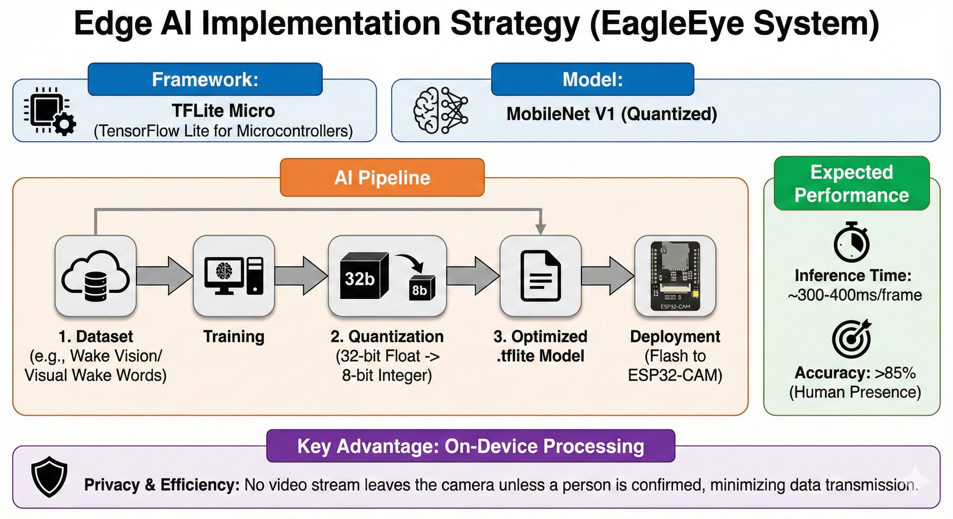

Slide 4

The Technical Barrier: Affordable Edge Devices Cannot Handle AI and Live Streaming Simultaneously
ESP32
Task 1: Al Inference - Running a person detection model.
Task 2: Real-time Streaming - Handling a two-way video and audio feed.
The primary challenge lies in the hardware limitations of low-cost microcontrollers like the ESP32.
These devices lack the memory and processing power to perform two resource-intensive tasks at once.
Attempting both simultaneously results in system crashes or unacceptable performance, creating a
fundamental roadblock to building a low-cost, full-featured device.
G NotebookLM

Slide 5
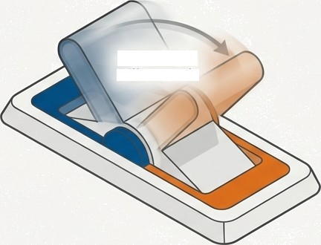


Our Breakthrough Is a State Machine That Intelligently Switches Device Functionality
Switching in Milliseconds
AI Mode
Sentry & Detect
System resources are dedicated to running the TinyML model.
Intercom Mode
Verify & Talk
System resources are
re allocated to video and
audio streaming.
Instead of trying to do everything at once, our firmware enables the device to operate in two distinct, mutually exclusive modes.
The system intelligently swaps its function based on the immediate need, managing
the limited hardware resources effectively.

Slide 6


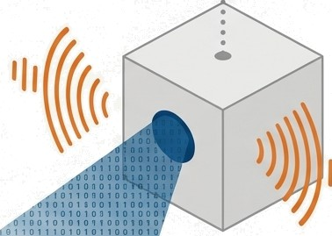





This Logic Enables “EagIeEye^.
Affordable, Full-Featured Security Node
*”Primary Objective“*
To develop a battery-powered security node that combines Edge AI Person detection, secure Cloud Evidence Storage, and Two-WayAudio Intercom.
Key Deliverables:
Hardware: A self-contained unit using an ESP32-CAM with a high-quality l2S microphone and Speaker interface.
Edge AI: A quantized TinyML model (MobileNet) optimised for on-device person detection.
Cloud Backend: Secure, event-based image storage to prevent evidence loss.
Mobile App: A custom interface for receiving instant alerts and initiating’Push-to-Talk’ intercom calls.
›o:vo1ooooo1ooooo1ooo!
' ' 1 1 0 0 1 1 0 0 1 0 9 T 0 9 T 0 0 T
G
NotebookLM

Slide 7







System Architecture: A Step-by-Step Flow from Detection to Deterrence
1. Deep Sleep
Device is in sleep utilizing low power
2. PIR Trigger
Motion is detected, waking the ESP32.
3. Edge AI Check
The on-board MobileNet model runs to verify if the motion is a 'Person'.
4. Secure Alert
If a person is confirmed, an image is immediately uploaded to Cloud Storage and a notification is sent to the mobile app.
5. User Response
The user taps 'Talk' on the app notification.
6. The State Switch
STOPS Al processes and STARTS STREAMING live video (MJPEG) and audio (UDP).
7. Return to Sentry
When the user hangs up, the device returns to Deep Sleep, awaiting the next event.

Slide 8
Carving Our Niche: How EagleEye Differs from Existing Solutions
Commercial Systems (e.g., Ring, Nest) | Standard CCTV | EagleEye (Our Contribution)
Pros: Excellent features, polished user experience. Cons: Expensive hardware ($100+), Energy ineffecient | Pros: Simple local recording. Cons: Passive monitoring only, no | The Research Gap We Fill: We address the lack of resource-constrained systems that can intelligently switch between Inference (for detection) and Throughput (for streaming).
mandatory cloud subscriptions. | real-time interaction, vulnerable
 | to evidence theft. | Our Unique Value: Our logic-driven firmware enables high-end features on low-cost, low-power hardware, without mandatory fees.
G
NotebookLM

Slide 9
The Hardware Stack Is Optimised for Low Power and High-Quality Audio
Clear Audio Output: MAX9835TA I2S Amplifier & 3W Speaker
Processing & Vision: ESP32-CAM Module
Wake-up Trigger:
PIR Sensor
Power & Programming:
Power Supply & FTDI Module
Key Insight
The use of the I2c protocol for audio ensures a dedicated, high-quality digital connection for the intercom function, separate from other processes.
High-FidelityAudio Input:
INNP441 I2S Microphone

Slide 10


Broader Impact: Contributing to Safer, More Sustainable
Communities
UN SDG 9 (Industry, Innovation, and Infrastructure)
We are democratising advanced security features (Al + Intercom) by building them upon highly affordable and accessible components.
UN SDG 11 (Sustainable Cities and Communities)
Our system provides a low-cost tool for reliable neighbourhood monitoring, enhancing community safety.
Environmental Impact
Our’Sensor Fusion’ and State Machine design is inherently energy-efficient. The high-power camera and streaming functions are only active during verified human interactions, drastically reducing overall energy consumption compared to always-on systems.
G NotebookLM

Slide 11



Our Team Possesses a Balanced Skillset Covering All Project Domains
Haseeb Ahmed:
Embedded Systems Lead
Murtaza khalid and Huzaifa: Cloud
& AI Lead
Murtaza khalid and Huzaifa: Application Development Lead
Custom mobile app
development (Flutter/React
Native)
Implementing 'Push-to-
Talk' logic
Video rendering
State machine firmware
Audio hardware integration (l2S)
Camera driver optimisation
Training and quantizing edge models
Setting up cloud storage buckets
Database management

Slide 12
The Total Project Cost Is Well Within the Approved Budget
Component | Cost (PKR)
ESP32-CAT Module | 1,500
125 Microphone (INMP441) | 400
l2S Amplifier (MAX98357A) | 350
Speaker (3W 4Ohm) | 150
Serial to USB (FTDI) | 300
PIR Sensor | 180
Power Supply | 300
Miscellaneous (PCB/Casing) | 400
TOTAL ESTIMATED COST | 3,580

Slide 13




In Summary: We Are Delivering an Intelligent System Built on a Novel Approach to Resource Management
The Problem: A gap exists for a Portable security that can both detect and deter. Also cost effective ,low power consuming hybrid cloud solution
The Barrier: Low-cost hardware cannot simultaneously perform AI and live streaming.
CRA
Our Innovation: A logic-driven State Machine that intelligently allocates system resources and solve traditional resource heavy security systems.
The Result: The EagleEye system, delivering features previously reserved for expensive hardware, providing an effective and accessible security solution.
G NotebookLM

Slide 14
References
Y. Chang et al.,’Design and Implementation of ESP32-Based Edge
Computing for Object Detection,’Sensors, 2025.
P. Warden, TinyML: Machine Learning with TensorFlow Lite, O'Reilly,
2019.
Espressif Systems, ‘ESP32-CAM Audio/Video Streaming Protocols,’
Technical Reference, 2023.
Banbury et at.,”Wake Vision: A Tailored Dataset for TinyML,’ arXiv,
2024.
G NotebookLM

Slide 15
Feedback
Overall project was good, but Advisor advised to also include the audio threat recognition part in your intrusion detection system he advised not to go onto doorbell system but to stick onto intrusion system he said the audio threat recognition system would work on machine learning threat recognition on edge device furthermore the co advisor advised us on to efficiently utilize the resources of our esp32 and try out different Edge AI models on microcontroller

