Slide 1
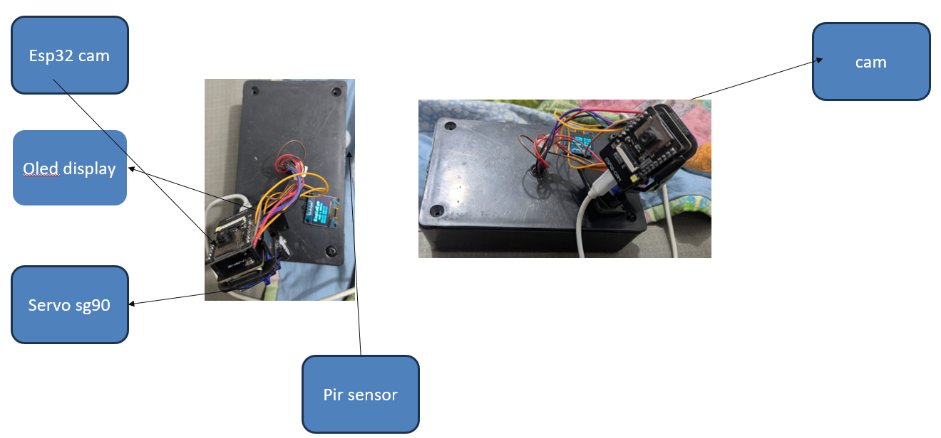
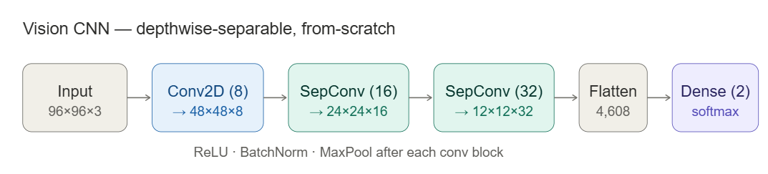
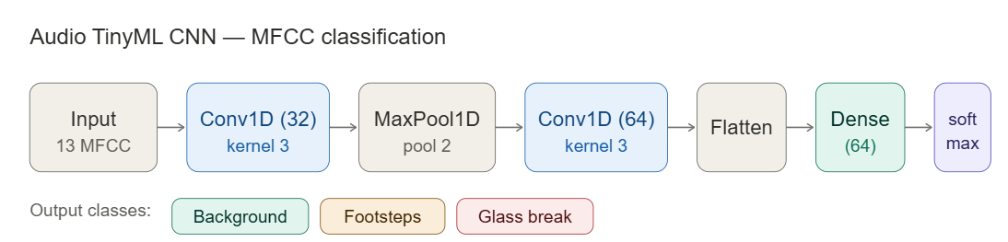

EagleEye
Intelligent Edge AI Surveillance System
EagleEye is a privacy-first, low-cost smart surveillance system. It runs a custom from-scratch TinyML CNN on an ESP32-CAM (~$10) for real-time human detection, paired with an audio intrusion classifier all on-device, zero cloud dependency. A React Native app provides alerts and live streaming from anywhere.
The Problem
Our Solution
Traditional surveillance streams 24/7 video to the cloud — expensive, bandwidth-heavy, and privacy-invasive.
Few affordable edge cameras run AI inference entirely on-device.
PIR-only motion detection causes 85–95% false alarms.
EagleEye: A decentralized, multi-sensor security system combining a custom depthwise-separable CNN for vision and an MFCC-based audio classifier — both running on a ~$10 ESP32-CAM with a cloud-connected React Native app.
System Architecture`
Hardware
Methodology — The Three Pillars
1
Vision AI
2
Audio AI
3
Cloud & App
Custom CNN on ESP32-CAM.
TinyML intrusion classifier.
Outbound-only, works anywhere.
Custom CNN built from scratch (96×96 RGB).
Model shrunk 75% via INT8 quantization.
Hardware-accelerated — 3× faster inference.
17 models tested across 4 architectures.
2,296 images collected over 17 days.
Digital microphone sampling at 16kHz.
MFCC audio features for classification.
Detects footsteps, glass break & ambient.
Under 50KB — runs continuously on-device.
Real-time: 87ms per prediction.
Secure MQTT messaging (HiveMQ Cloud).
Image evidence stored on Cloudinary.
Push notifications via Firebase.
On-demand video relay (Deno Deploy).
React Native app with camera controls.
Models
Key Results & Validation
90.83%
872 ms
93%
87 ms
~$10
Vision accuracy
(custom DS-CNN)
On-device inference
latency
Audio classifier
accuracy
Audio inference
speed
Total MCU
hardware cost
Murtaza Khalid, Huzaifa Khan & Muhammad Haseeb
Dr. Rehan Hafiz & Dr. Rehan Ahmed
Department of Computer & Software Engineering
Faculty of Engineering

