Slide 1
Contents
Problem Statement
Exploratory Data Analysis
Data Preparation
Modelling
Outcome

Slide 2
Problem Statement
1. About the stakeholder: Mr. Ali owns a perfume manufacturing business which supplies major distributors and retailers in the region. The perfumes
are manufactured at two different locations (plants), and both have different processes and recipes.
2. Stakeholders challenge: Mr. Ali has got wide array of perfumes. In the last one year, samples of perfumes from both factories were sent to customers for feedback, and general
impressions (“positive” / “like” or “negative” / “dislike”) were recorded.
Some perfumes are rated good, but majority are not, Ali wants to understand, if from data where the challenges are, from data driven approach can we identify which type of perfume would be liked much by customers.
3. Solution Proposed: During thorough EDA to understand , Developed a explanatory model to understand the drivers of good rating of perfume. i.e.
Which ingredient is working Better.
Which base[oil/oh] is working better.
Which plant is giving good rated product.
Which Fragrance type are liked by people.

Slide 3
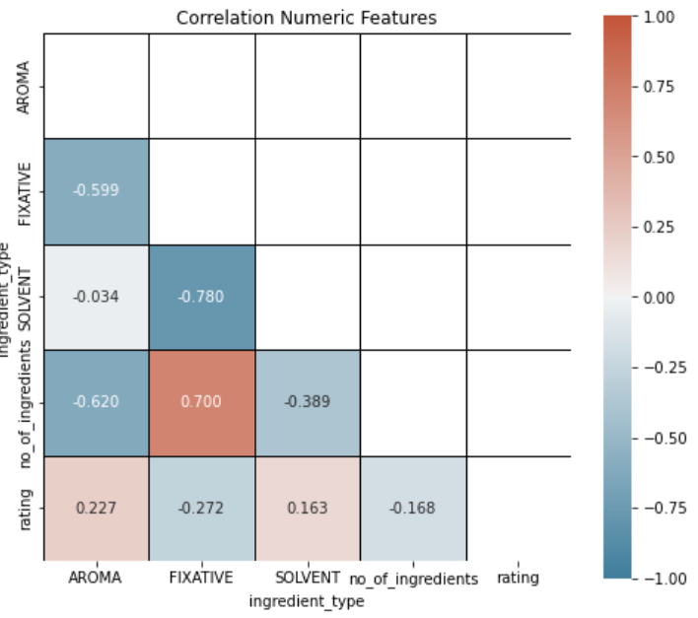
Exploratory Data Analysis
Features Aroma and Solvent Which are ingredient type, are highly correlated with the target variable[rating].

Slide 4
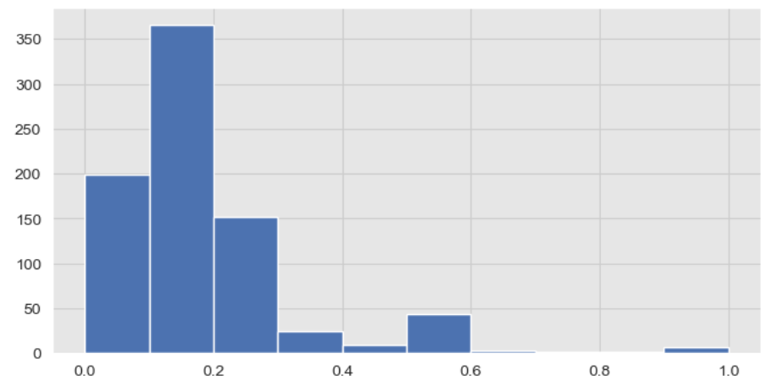
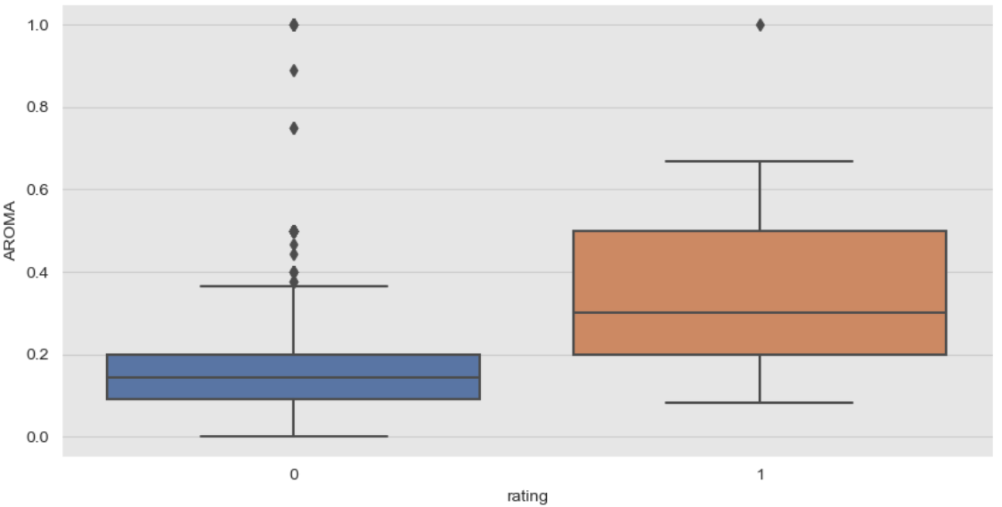
Variable - Aroma
Almost 75 % of perfume with good rating had more than 20 % ingredients of type Aroma, Though approx 75 % of perfume with bad rating had less than 20 % ingredients of type Aroma
Distribution

Slide 5
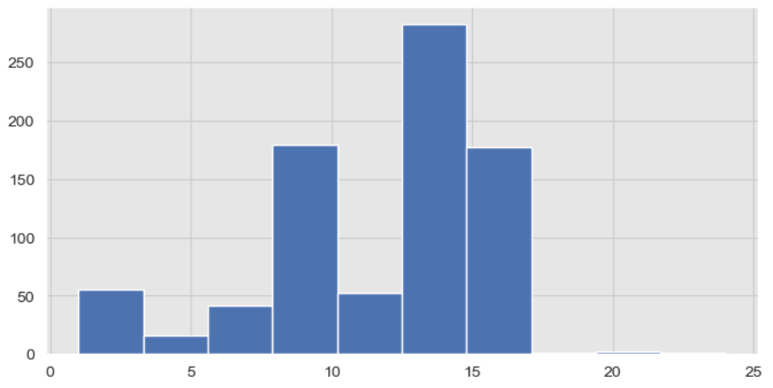
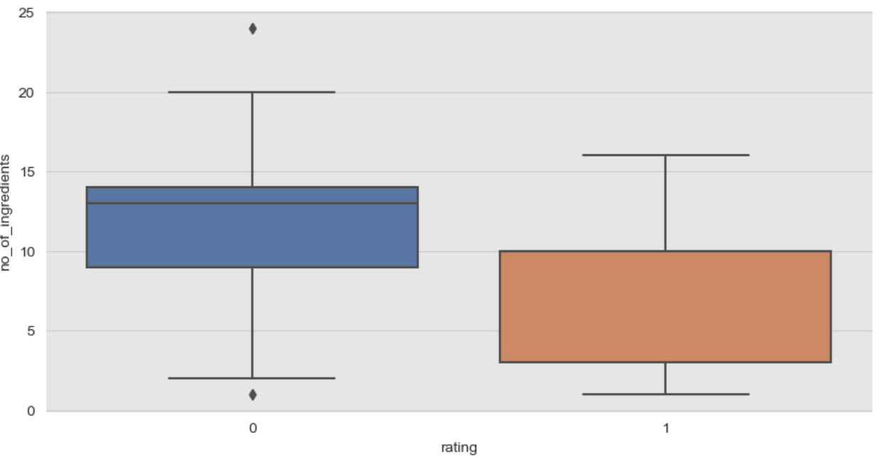
Variable – No Of Ingredients
No of Ingredients is derived variable and it’s the total number of different variety of ingredients used in manufacturing the perfume. Perfumes manufactured by using smaller number of ingredients are liked more by customers.
Distribution

Slide 6
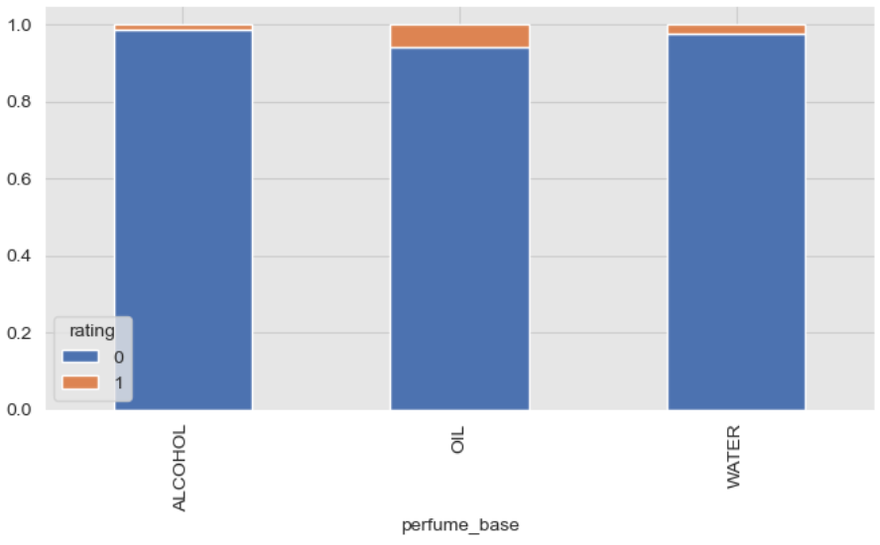
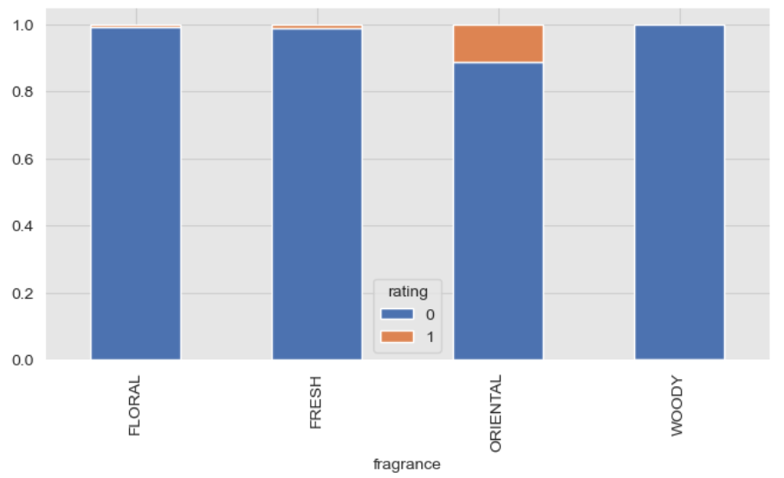
Variable – Perfume Base & Fragrance
Customers are preferring more to OIL based perfume compared to water and alcohol. While in case of fragrance ORIENTAL flavored fragrance is rated good compared to other flavored perfume.

Slide 7
Data Preparation
There are total of 9274 Records available though unique samples are only 808. Hence idea was to aggregate the data at Sample Id Level.
Dropped the ingredient feature based on the data analysis results.
Based on total occurrences of type of occurrences for each sample created 3 new numerical features with names AROMA, FIXATIVE and SOLVENT.
Which helped us to derive the new feature no_of_ingredients - sum(AROMA, FIXATIVE, SOLVENT
Processed categorical features using One Hot Encoding.
Train and Test Split
numeric features=['AROMA','FIXATIVE', 'SOLVENT', 'no_of_ingredients']
categorical features=['perfume_base', 'fragrance’, 'manufacture_plant’]
Target= ‘rating’
X_train, X_test, y_train, y_test = train_test_split(df[numeric_features+categorical_features], df[[target]], test_size=0.30, random_state=34,stratify=df[target])

Slide 8
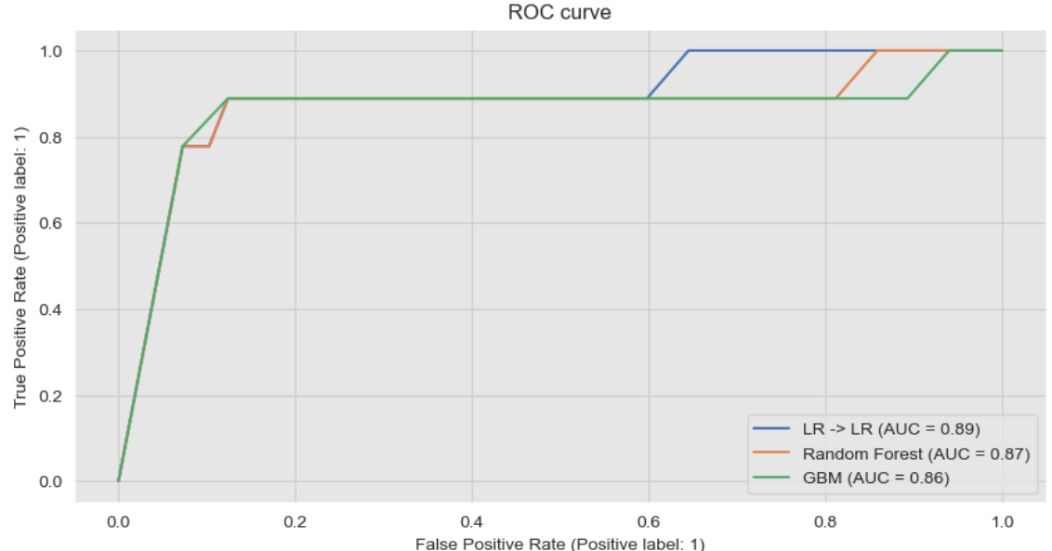
Modelling
Developed a set of Models, to predict given the features as perfume, If it would be rated Good or Bad
Models:
1. Logistic Regression
2. Random Forest
3. GBM
Owing to the smaller number of records, We don’t see a lot variations in modelling results. Almost all these models are showing the same results.
Modelling started with baseline logistic regression and then trained complex models like Random Forest and GBM but do not observe any new learning in complex models, Reason could be a smaller number of data available to us.
We would go Logistic Regression Model with F1 Score for the model selection , Owing to the unbalanced set of data with f1 score of 98%.

Slide 9
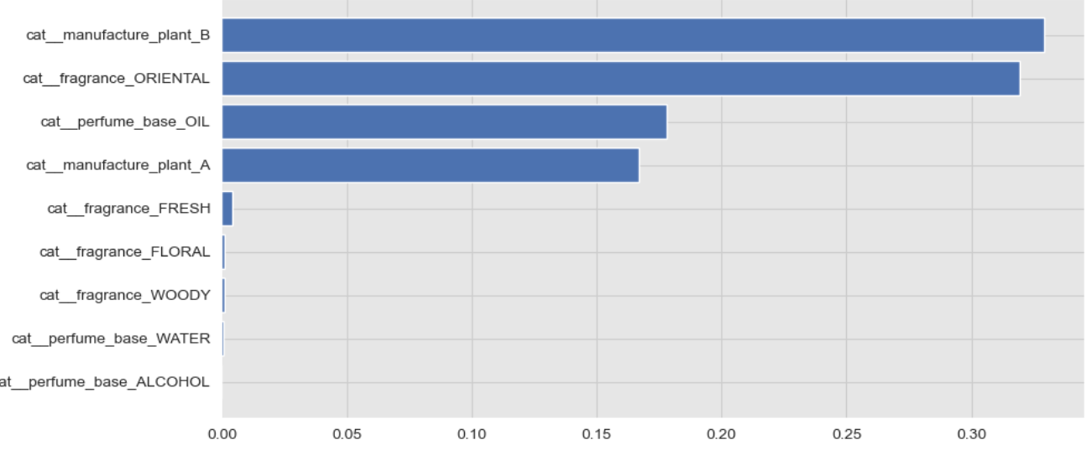
Outcome
Based on Data Exploration and Exploratory Data Analysis.
There are very few products which are rated good with the ingredient type as FIXATIVE, Hence use of this ingredient type can be minimized.
Simple perfumes with less no of (<10) ingredients are preferred by customers. Our aim should be to develop perfumes containing a smaller number of ingredients or no_of_ingredients <10.
Higher Percentage of Oil based perfumes are preferred the most by people followed by Water and then Alcohol based. We should focus on developing more quantity of oil-based perfume.
Based on Modelling Results:
We need to source more data, to develop a good model.
Model can be used to understand the drivers of a good rated perfume.
Model is able to learn well, Ali can use this model to simulate different combination of features based on feature importance to develop a good perfume.

