Slide 1



A Multimodal Context-Aware Music Recommendation System Using CNN and CLIP
Domain : Computer vision
Batch no: 213
Supervisor :
Dr. BALAMURUGAN A, PROFESSOR
Computer Science & Engineering
TEAM MEMBERS :
22AM038 - MURUGAN B
22AM067 - VIDHYA S
2025-2026 ( EVEN SEM )

Slide 2
OBJECTIVES
Overcome irrelevant music suggestions on streaming platforms.
Recognize the user’s mood through facial emotion detection.
Understand the user’s environment using scene and weather analysis.
Recommend songs that match the user’s mood and surroundings.
Enhance the user’s music experience through personalization.
2025-2026 ( EVEN SEM )

Slide 3
EXISTING REASERCH
[1] M. M. Joseph, D. Treessa Varghese, L. Sadath, and V. P. Mishra, “Emotion Based Music Recommendation System,” in Proc. 2023 Int. Conf. Computational Intelligence and Knowledge Economy (ICCIKE), Dubai, UAE, 2023, pp. 505–510, doi: 10.1109/ICCIKE58312.2023.10131874.
Observations :
Uses facial emotion recognition to detect user mood
Maps emotions (happy, sad, etc.) to music playlists
Enhances personalization compared to traditional systems
Key Limitation:
Depends only on facial expressions
Performance drops in poor lighting conditions
2025-2026 ( EVEN SEM )

Slide 4
EXISTING REASERCH
[2] O. Chandraumakantham, N. Gowtham, M. Zakariah, and A. Almazyad, “Multimodal Emotion Recognition Using Feature Fusion: An LLMBased Approach,” IEEE Access, vol. 12, pp. 108052–108071, 2024, doi: 10.1109/ACCESS.2024.3425953.
Observations :
Uses multimodal inputs (text, image, audio)
Applies LLM-based feature fusion for emotion detection
Improves accuracy in understanding complex emotions
Key Limitation:
High computational complexity
Not suitable for real-time applications
2025-2026 ( EVEN SEM )

Slide 5
EXISTING REASERCH
[3] X. Wang, “Research on Music Intelligent Recommendation System Based on Spark Framework and Hybrid Algorithm,” in Proc. 2022 6th Asian Conf. Artificial Intelligence Technology (ACAIT), Changzhou, China, 2022, pp. 1–4, doi: 10.1109/ACAIT56212.2022.10138008.
Observations :
Uses hybrid recommendation (collaborative + content-based)
Implemented using Apache Spark
Efficient for large-scale data processing
Key Limitation:
Does not consider real-time emotion
Lacks contextual awareness
2025-2026 ( EVEN SEM )

Slide 6
EXISTING REASERCH
[4] M. S. Guthula and M. Bordoloi, “Music Recommendation System Using Facial Detection Based Emotion Analysis,” in Proc. 2024 Int. Conf. Emerging Techniques in Computational Intelligence (ICETCI), Hyderabad, India, 2024, pp. 296–301, doi: 10.1109/ICETCI62771.2024.10704201.)
Observations :
Uses facial detection for emotion recognition
Recommends music based on detected mood
Applies computer vision techniques
Key Limitation:
Limited to facial input only
Less effective in real-world conditions
2025-2026 ( EVEN SEM )

Slide 7
EXISTING REASERCH
[5] D. Zeng, “Design of a Music Recommendation System Based on Lookalike and K-means Algorithms,” in Proc. 2023 Int. Conf. Evolutionary Algorithms and Soft Computing Techniques (EASCT), Bengaluru, India, 2023, pp. 1–5, doi: 10.1109/EASCT59475.2023.10392352.
Observations :
Uses K-means clustering to group users
Applies lookalike algorithm for recommendations
Identifies similar user preferences
Key Limitation:
No real-time adaptation
Ignores emotional state
2025-2026 ( EVEN SEM )

Slide 8
EXISTING REASERCH
[6] N. V. Durga Malleswari, K. Gayatri, K. Y. Sai Kumar, N. Likhita, P. K, and D. Bhattacharyya, “Music Recommendation System using Hybrid Approach,” in Proc. 2023 Second Int. Conf. Electronics and Renewable Systems (ICEARS), Tuticorin, India, 2023, pp. 1560–1564, doi: 10.1109/ICEARS56392.2023.10085059.
Observations :
Combines multiple recommendation techniques
Uses user history and preferences
Improves recommendation accuracy
Key Limitation:
Static recommendation approach
No emotion or environmental context
2025-2026 ( EVEN SEM )

Slide 9
EXISTING REASERCH
[7] J. G. B. Vitorio and C. N. Silla, “Music Recommendation System for ´ Shared Environments,” in Proc. 2023 30th Int. Conf. Systems, Signals and Image Processing (IWSSIP), Ohrid, North Macedonia, 2023, pp. 1–5, doi: 10.1109/IWSSIP58668.2023.10180270.
Observations :
Designed for group music recommendation
Considers multiple users’ preferences
Suitable for shared spaces
Key Limitation:
Ignores individual emotions
Limited personalization
2025-2026 ( EVEN SEM )

Slide 10
EXISTING REASERCH
[8] S. Sasaki, T. Hirai, H. Ohya, and S. Morishima, “Affective Music Recommendation System Reflecting the Mood of Input Image,” in Proc. 2013 Int. Conf. Culture and Computing, Kyoto, Japan, 2013, pp. 153– 154, doi: 10.1109/CultureComputing.2013.42.
Observations :
Uses input images to detect user mood
Maps visual emotions to music
Introduces affective computing approach
Key Limitation:
Outdated method
No real-time contextual integration
2025-2026 ( EVEN SEM )

Slide 11
EXISTING REASERCH
[9] S. P. Deore, “Enriching Song Recommendation Through Facial Expression Using Deep Learning,” Ingenierie des Syst ´ emes d’Information ` , vol. 28, no. 1, pp. 225–229, 2023, doi: 10.18280/isi.280126.
Observations :
Uses deep learning for facial emotion detection
Maps expressions to music recommendations
Automates mood-based music selection
Key Limitation:
Depends only on facial expressions
No environmental awareness
2025-2026 ( EVEN SEM )

Slide 12
EXISTING REASERCH
[10] H. S. Angkasa and N. U. Maulidevi, “Emotion Classification of User Face Image in Music Recommendation System,” in Proc. 2022 9th Int. Conf. Advanced Informatics: Concepts, Theory and Applications (ICAICTA), Tokoname, Japan, 2022, pp. 1–6, doi: 10.1109/ICAICTA56449.2022.9933010.
Observations :
Focuses on facial emotion classification
Uses image processing techniques
Supports recommendation systems
Key Limitation:
Only handles emotion detection
Does not include full recommendation system
2025-2026 ( EVEN SEM )

Slide 13
OBSERVATIONS OF EXISTING SOLUTIONS
Limited to facial input; performance drops under poor lighting or low-quality cameras.
Computationally intensive; requires sequential emotion data which may not always be available.
Fixed input structure; lacks flexibility for diverse real-world scenarios.
Resource-heavy; some inputs are impractical for everyday users.
Ignores other real-time contextual factors such as weather, location, or dynamic changes.
High complexity; prone to overfitting and difficult to deploy for real-time applications.
No hybrid approach combining emotion, contextual information, and user language preference for better personalization.
2025-2026 (EVEN SEM )

Slide 14
PROBLEM STATEMENT
Most existing music recommendation systems rely on static user data and cannot understand the listener’s real-time emotions or environment, leading to generic and unsuitable suggestions. Despite advancements in emotion and context recognition, there is still no unified framework that integrates facial emotion analysis, scene understanding, and contextual factors like weather or location. Muzly aims to address this gap by developing an intelligent, context-aware system that provides adaptive and emotionally aligned music recommendations.
2025-2026 (EVEN SEM )

Slide 15
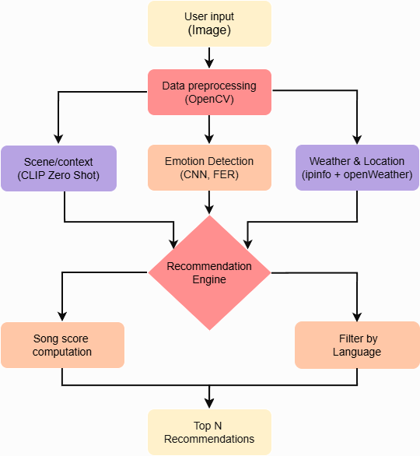
Process flow
2025-2026 (EVEN SEM )

Slide 16
DATA COLLECTION
Facial Emotion Dataset (FER2013)
The FER2013 dataset, available on Kaggle, is widely used for training emotion detection models.
It contains 35,887 grayscale facial images of size 48×48 pixels, each labeled with one of seven basic emotions: happy, sad, angry, disgust, fear, surprise, and neutral.
The dataset is split into training, validation, and test sets, with 28,709 images for training, 3,589 for validation, and 3,589 for testing.
2025-2026 (EVEN SEM )

Slide 17
DATA COLLECTION
Custom Song Dataset
A custom CSV file is created to map songs with specific emotional and contextual attributes.
Each record includes:
Song Title and Artist
Emotion Label (happy, sad, calm, energetic, etc.)
Context/Scene (party, romantic, travel, relaxation, etc.)
Climate/Weather (rainy, sunny, cloudy, etc.)
Location Type (urban, beach, mountain, indoor, etc.)
Language (English, Hindi, Tamil, etc.)
2025-2026 (EVEN SEM )

Slide 18
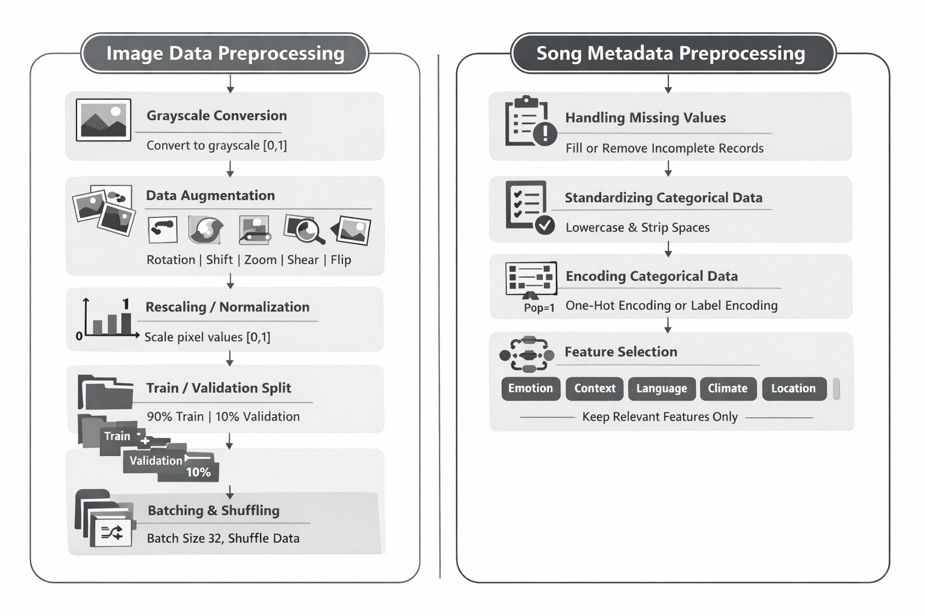
DATA PREPROCESSING
2025-2026 (EVEN SEM )

Slide 19
Facial Emotion Recognition (FER) Model
Input Processing: The system uses 48×48 grayscale facial images as input for emotion detection.
Feature Extraction: Convolutional layers extract facial features using ReLU, batch normalization, and MaxPooling.
Regularization & Flattening: Dropout prevents overfitting, and a Flatten layer prepares features for classification.
Classification with Dense + Softmax: Dense layers process the extracted features, and Softmax outputs emotion probabilities.
Training & Output: The model is trained with categorical cross-entropy and Adam, and predicts the emotion with the highest probability.
2025-2026 (EVEN SEM )

Slide 20
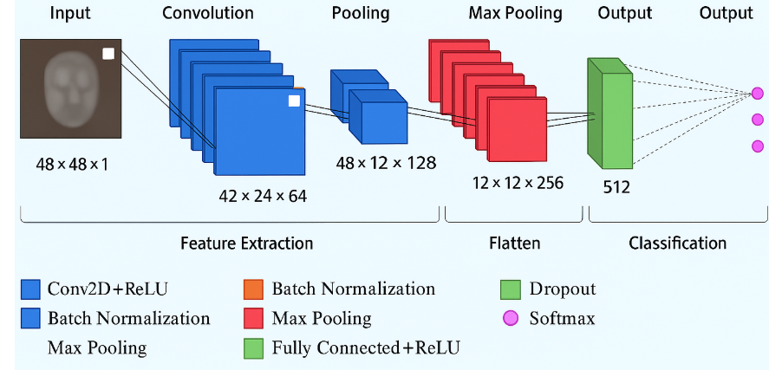
Facial Emotion Model Architecture
2025-2026 (EVEN SEM )

Slide 21
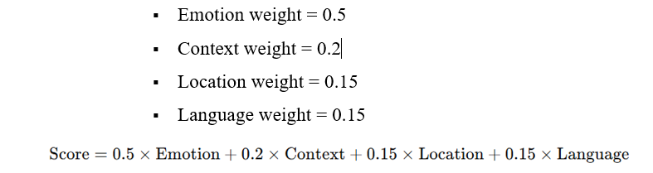
MUSIC RECOMMENDATION ENGINE
Emotion detected using the FER model from facial expressions.
Context/Scene analyzed with CLIP(Contrastive Language–Image Pretraining) , and weather fetched from OpenWeather.
Location obtained via IPinfo to determine preferred language, then songs are recommended.
Context-Aware Scoring : Multiply each feature by a weight factor to reflect its
Ranking Layer: Songs are ranked based on final similarity scores.
Top N Recommendations displayed as song cards with name, artist, language, and mood.
2025-2026 (EVEN SEM )

Slide 22




MODEL EVALUATION
Accuracy: Measures the percentage of correctly predicted emotions from test images.
Precision: Measures the proportion of correct predictions among all predictions for each emotion.
Recall: Measures how many actual emotion instances were correctly identified.
F1-Score: Harmonic mean of precision and recall, balancing false positives and false negatives.
Confusion Matrix: Shows the distribution of predicted vs. actual emotions to identify misclassifications.
2025-2026 (EVEN SEM )

Slide 23
RESULTS
The training and validation performance curves were monitored throughout the learning process to ensure proper convergence and prevent overfitting.
A confusion matrix was used to visualize the model’s predictions and identify which emotions were most frequently misclassified.
The evaluation demonstrated that the model could reliably detect the majority of emotions, providing accurate input for the music recommendation engine.
Additionally, the system was integrated into a Streamlit UI, allowing real-time emotion detection and music recommendations with an interactive and user-friendly interface.
2025-2026 (EVEN SEM )

Slide 24
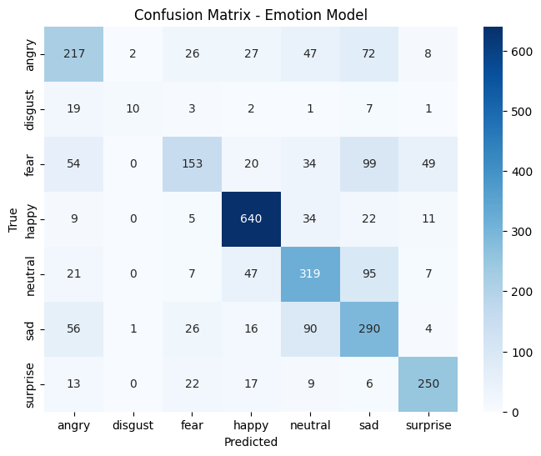
CONFUSION MATRIX
2025-2026 (EVEN SEM )

Slide 25
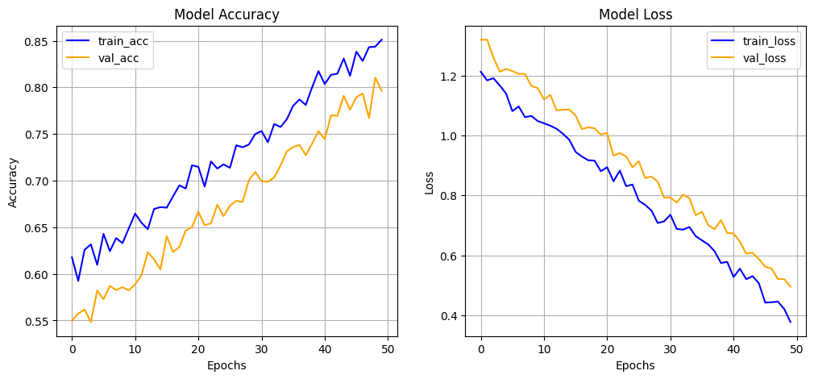
PERFORMANCE ANALYSIS
2025-2026 (EVEN SEM )

Slide 26
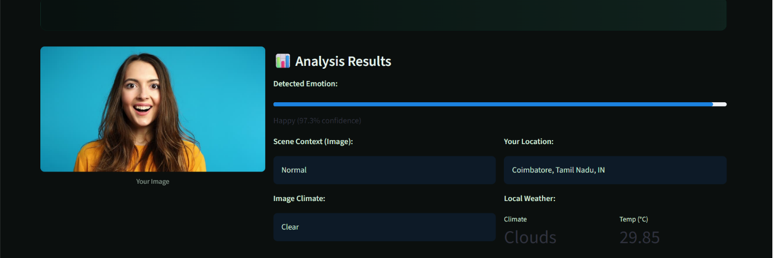
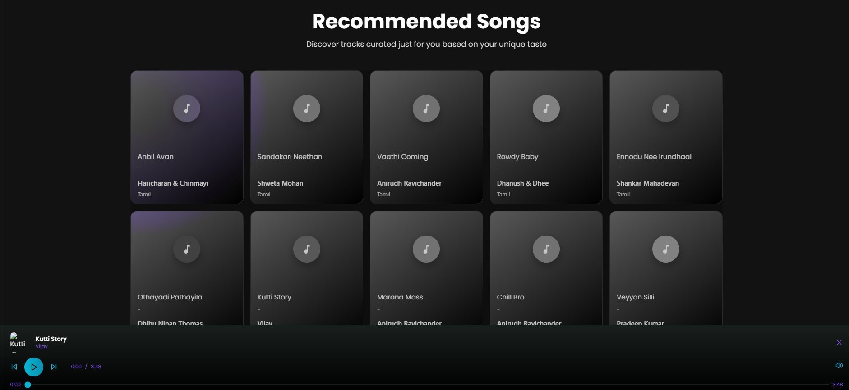
UI RESULTS
2025-2026 (EVEN SEM )

Slide 27
CONCLUSION
Muzly presents a powerful AI-driven solution for delivering highly personalized music recommendations by seamlessly integrating facial emotion recognition, scene analysis, and contextual data. By leveraging a CNN-based emotion detection model along with environmental cues and user preferences, the system provides accurate, real-time music suggestions tailored to the listener’s current mood and surroundings. Through its interactive interface and adaptive recommendation process, Muzly enhances user engagement and delivers a more dynamic, immersive, and meaningful music-listening experience.
2025-2026 (EVEN SEM )

Slide 28
FUTURE WORK
Support live camera feeds for real-time emotion detection and continuous recommendations.
Optimize the system for faster performance and mobile deployment.
Incorporate collaborative filtering to leverage user listening history.
Integrate additional modalities like voice or text-based sentiment analysis.
Implement adaptive learning to refine recommendations based on feedback and preferences.
2025-2026 (EVEN SEM )

Slide 29
Thank
you
2025-2026 (EVEN SEM )

