Slide 1



Image-based Emotion-based Music recommendation system
Domain : Computer vision
TEAM MEMBERS :
22AM038 - MURUGAN B
22AM067 - VIDHYA S
Batch no: 213
Dr. BALAMURUGAN A
Computer Science & Engineering
2025-2026 ( ODD SEM )

Slide 2
OBJECTIVES
Overcome irrelevant music suggestions on streaming platforms.
Recognize the user’s mood through facial emotion detection.
Understand the user’s environment using scene and weather analysis.
Recommend songs that match the user’s mood and surroundings.
Enhance the user’s music experience through personalization.
2025-2026 ( ODD SEM )

Slide 3
EXISTING SOLUTIONS
M. M. Joseph, D. Treessa Varghese, L. Sadath and V. P. Mishra, "Emotion Based Music Recommendation System," 2023 International Conference on Computational Intelligence and Knowledge Economy (ICCIKE), Dubai, United Arab Emirates, 2023, pp. 505-510, doi: 10.1109/ICCIKE58312.2023.10131874.
Developed an emotion-based music recommendation system using CNN for facial expression recognition and deep learning.
Trained a CNN model using Keras to classify emotions (happy, sad, angry, neutral, surprise, etc.) from the captured facial expressions.
Deployed the trained model (model.h5) in a Streamlit web app integrated with WebRTC for live emotion detection and user input (language, singer).
Recommended songs by generating YouTube URLs dynamically based on detected emotion, preferred language, and singer, redirecting the user to the appropriate playlist.
Front-end interface displayed personalized music suggestions automatically, enhancing user experience and reducing effort in choosing songs.
2025-2026 ( ODD SEM )

Slide 4
EXISTING SOLUTIONS
O. Chandraumakantham, N. Gowtham, M. Zakariah and A. Almazyad, "Multimodal Emotion Recognition Using Feature Fusion: An LLM-Based Approach," in IEEE Access, vol. 12, pp. 108052-108071, 2024, doi: 10.1109/ACCESS.2024.3425953.
keywords:
Proposed a multimodal emotion recognition system using early-fusion of audio, visual, and text features, leveraging rule-based systems to convert non-verbal cues into text.
Extracted audio features (loudness, spectral flux, MFCCs, pitch stability/emphasis) using Librosa and OpenSMILE, and visual features (facial action units) using PyFEAT.
Fine-tuned the pre-trained DistilRoBERTa LLM on the textual representation of audio-visual features for 7-class emotion classification.
Evaluated on RAVDESS and BAUM-1 datasets, achieving high accuracy (93.18% and 93.69% respectively), comparable to or surpassing state-of-the-art methods.
System allows scalability for additional modalities and demonstrates robust multimodal emotion recognition with early-fusion LLMs, offering potential for comprehensive human emotion analysis.
2025-2026 ( ODD SEM )

Slide 5
EXISTING SOLUTIONS
X. Wang, "Research on Music Intelligent Recommendation System Based on Spark Framework and Hybrid Algorithm," 2022 6th Asian Conference on Artificial Intelligence Technology (ACAIT), Changzhou, China, 2022, pp. 1-4, doi: 10.1109/ACAIT56212.2022.10138008.
Proposed a hybrid music recommendation algorithm combining Collaborative Filtering (CF) and Tag-based methods for improved accuracy in music education systems.
Introduced a dynamic Jaccard coefficient and time-weight factor to adjust similarity and capture users’ changing music preferences.
Implemented on a Spark framework integrated with Hadoop for distributed data processing and real-time recommendation generation.
Used a subset of the Million Song Dataset (500 users, 5000 songs) containing listening and purchase behavior records.
Designed a front-end interface displaying personalized song recommendations (title, artist, album, duration) stored in MySQL for interactive music education.
2025-2026 ( ODD SEM )

Slide 6
EXISTING SOLUTIONS
M. S. Guthula and M. Bordoloi, "Music Recommendation System Using Facial Detection Based Emotion Analysis," 2024 International Conference on Emerging Techniques in Computational Intelligence (ICETCI), Hyderabad, India, 2024, pp. 296-301, doi: 10.1109/ICETCI62771.2024.10704201.
Utilized the FER2013 dataset (35,000 facial images) to train the model for seven emotions – happy, sad, angry, disgust, fear, surprise, and neutral.
Implemented Haar Cascade for face detection and CNN for emotion classification, followed by emotion-music mapping based on pitch, tempo, and volume.
Created a web-based interface for real-time video capture, live emotion recognition, and instant music recommendation.
Achieved 97% accuracy in emotion recognition, outperforming existing CNN-based systems in precision and reliability.
2025-2026 ( ODD SEM )

Slide 7
EXISTING SOLUTIONS
D. Zeng, "Design of a Music Recommendation System Based on Look-alike and K-means Algorithms," 2023 International Conference on Evolutionary Algorithms and Soft Computing Techniques (EASCT), Bengaluru, India, 2023, pp. 1-5, doi: 10.1109/EASCT59475.2023.10392352.
Proposed a hybrid music recommendation system combining Look-alike and K-means clustering to improve personalization accuracy.
The Look-alike algorithm identifies user groups with similar listening behaviors, while K-means clusters them by musical preferences.
Implemented a three-module system – protocol scheduling, recommendation algorithm, and data storage – for efficient processing.
Conducted experiments on 2000 users, comparing recommended music types with actual playlists for validation.
Achieved a 0.18% difference between recommended and actual playlist proportions, confirming high accuracy and personalization.
2025-2026 ( ODD SEM )

Slide 8
EXISTING SOLUTIONS
N. V. Durga Malleswari, K. Gayatri, K. Y. Sai Kumar, N. Likhita, P. K and D. Bhattacharyya, "Music Recommendation System using Hybrid Approach," 2023 Second International Conference on Electronics and Renewable Systems (ICEARS), Tuticorin, India, 2023, pp. 1560-1564, doi: 10.1109/ICEARS56392.2023.10085059.
Proposed a hybrid music recommendation system combining Collaborative Filtering (CF) and music gene–based algorithms for personalized song suggestions.
Utilized audio features, lyrics, and user log data to analyze preferences and recommend songs in real time.
Used Pandora Radio dataset containing 40,000 songs and 101,000 users to evaluate the model’s performance.
Achieved minimum RMSE and MAE values, confirming the hybrid model’s higher accuracy over traditional CF and content-based systems.
Implemented a Firebase-based interface for storing recommendations and enabling interactive, user-driven music playback and suggestions.
2025-2026 ( ODD SEM )

Slide 9
EXISTING SOLUTIONS
J. G. B. Vitório and C. N. Silla, "Music Recommendation System for Shared Environments," 2023 30th International Conference on Systems, Signals and Image Processing (IWSSIP), Ohrid, North Macedonia, 2023, pp. 1-5, doi: 10.1109/IWSSIP58668.2023.10180270.
Proposed a real-time group music recommendation system that considers shared environmental contexts such as time, location, and activity.
Used Spotify API to collect each user’s top 50 most-listened songs, modeling relationships between songs, artists, and genres using a graph database (Neo4j).
Implemented a graph-based aggregation strategy to create a pseudo-user profile combining multiple listeners’ preferences.
Incorporated contextual features like danceability and energy to tailor recommendations for specific situations (e.g., gym, party, work, travel).
Developed a prototype system (SRMAC) that dynamically updates playlists as new group members join and visualizes genre influence weights.
2025-2026 ( ODD SEM )

Slide 10
EXISTING SOLUTIONS
S. Sasaki, T. Hirai, H. Ohya and S. Morishima, "Affective Music Recommendation System Reflecting the Mood of Input Image," 2013 International Conference on Culture and Computing, Kyoto, Japan, 2013, pp. 153-154, doi: 10.1109/CultureComputing.2013.42.
Proposed an affective music recommendation system that recommends songs based on the mood derived from an input image, without requiring textual input.
Used the Valence–Arousal (V-A) emotional model to map both image and music features into a shared emotional space.
Computed valence–arousal values for music using acoustic features analyzed via Principal Component Analysis (PCA) on the RWC Music Database.
Recommended music by calculating Euclidean distance between image and music positions on the V-A plane; interactive interface allows users to refine mood-based search.
2025-2026 ( ODD SEM )

Slide 11
EXISTING SOLUTIONS
Deore, S.P. (2023). Enriching song recommendation through facial expression using deep learning. Ingénierie des Systèmes d’Information, Vol. 28, No. 1, pp. 225-229.
Proposed a CNN-based emotion recognition model to detect users’ moods from facial expressions and recommend suitable music automatically.
Trained a Convolutional Neural Network with multiple Conv2D, ReLU, MaxPooling, and Dropout layers; used Adam optimizer and Softmax for seven emotion classes.
Integrated a Fuzzy Classification layer to refine detected emotions and map them to corresponding music categories for personalized recommendations.
Achieved training accuracy of 97.64% and real-time testing accuracy of 62.88%, with MSE = 8.5 and RMSE = 2.9, showing optimized emotion recognition.
Developed the system using Python (TensorFlow, Keras, OpenCV) and Java interface, demonstrating an effective, low-cost emotion-driven music recommendation model.
2025-2026 ( ODD SEM )

Slide 12
EXISTING SOLUTIONS
H. S. Angkasa and N. U. Maulidevi, "Emotion Classification of User Face Image in Music Recommendation System," 2022 9th International Conference on Advanced Informatics: Concepts, Theory and Applications (ICAICTA), Tokoname, Japan, 2022, pp. 1-6, doi: 10.1109/ICAICTA56449.2022.9933010.
Implemented two convolution layers for feature extraction followed by XGBoost for classification, mapping detected emotions to mood attributes in the Emotify music dataset.
Proposed a ConvXGB-based emotion recognition system to detect users’ moods from facial expressions and enhance music recommendations, addressing the incomplete cold start problem.
Achieved 78.64% accuracy on 4 emotions and 80.99% on 7 emotions, outperforming prior CNN models on oversampled datasets.
Evaluated system for cold start scenarios, showing that mood information allows effective recommendations even with as little as 10% of user rating data.
2025-2026 ( ODD SEM )

Slide 13
OBSERVATIONS OF EXISTING SOLUTIONS
Limited to facial input; performance drops under poor lighting or low-quality cameras.
Computationally intensive; requires sequential emotion data which may not always be available.
Fixed input structure; lacks flexibility for diverse real-world scenarios.
Resource-heavy; some inputs are impractical for everyday users.
Ignores other real-time contextual factors such as weather, location, or dynamic changes.
High complexity; prone to overfitting and difficult to deploy for real-time applications.
No hybrid approach combining emotion, contextual information, and user language preference for better personalization.
2025-2026 ( ODD SEM )

Slide 14
PROBLEM STATEMENT
Most existing music recommendation systems rely on static user data and cannot understand the listener’s real-time emotions or environment, leading to generic and unsuitable suggestions. Despite advancements in emotion and context recognition, there is still no unified framework that integrates facial emotion analysis, scene understanding, and contextual factors like weather or location. Muzly aims to address this gap by developing an intelligent, context-aware system that provides adaptive and emotionally aligned music recommendations.
2025-2026 ( ODD SEM )

Slide 15
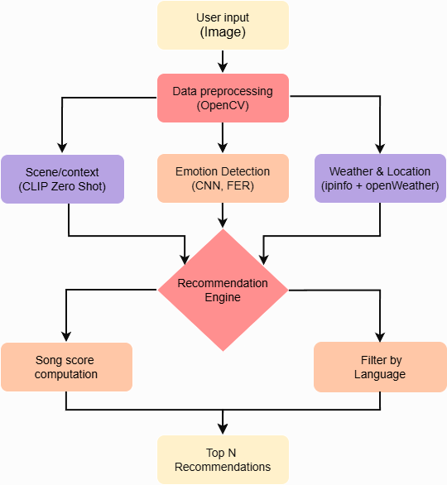
Process flow
2025-2026 ( ODD SEM )

Slide 16
DATA COLLECTION
Facial Emotion Dataset (FER2013)
The FER2013 dataset, available on Kaggle, is widely used for training emotion detection models.
It contains 35,887 grayscale facial images of size 48×48 pixels, each labeled with one of seven basic emotions: happy, sad, angry, disgust, fear, surprise, and neutral.
The dataset is split into training, validation, and test sets, with 28,709 images for training, 3,589 for validation, and 3,589 for testing.
Custom Song Dataset A custom CSV file is created to map songs with specific emotional and contextual attributes.
Each record includes:
Song Title and Artist
Emotion Label (happy, sad, calm, energetic, etc.)
Context/Scene (party, romantic, travel, relaxation, etc.)
Climate/Weather (rainy, sunny, cloudy, etc.)
Location Type (urban, beach, mountain, indoor, etc.)
Language (English, Hindi, Tamil, etc.)
2025-2026 ( ODD SEM )

Slide 17
DATA PREPROCESSING
Image Data Preprocessing
Grayscale Conversion: Reduce complexity, retain intensity
Rescaling/Normalization: Pixel values scaled [0,1] for faster training
Data Augmentation: Rotation ±15°, width/height shift 10%, zoom ±10%, shear, horizontal flip
Train/Validation Split: 90% train, 10% validation
Batching & Shuffling: Batch size = 32, shuffle=True
Song Metadata Preprocessing
Handling Missing Values: Fill or remove incomplete records
Standardizing Categorical Columns: Lowercase & strip spaces
Encoding Categorical Data: One-hot or label encoding
Feature Selection: Keep emotion, context, language, climate, location; remove unnecessary columns
2025-2026 ( ODD SEM )

Slide 18
Facial Emotion Recognition (FER) Model
Input Processing: The system uses 48×48 grayscale facial images as input for emotion detection.
Feature Extraction: Convolutional layers extract facial features using ReLU, batch normalization, and MaxPooling.
Regularization & Flattening: Dropout prevents overfitting, and a Flatten layer prepares features for classification.
Classification with Dense + Softmax: Dense layers process the extracted features, and Softmax outputs emotion probabilities.
Training & Output: The model is trained with categorical cross-entropy and Adam, and predicts the emotion with the highest probability.
2025-2026 ( ODD SEM )

Slide 19
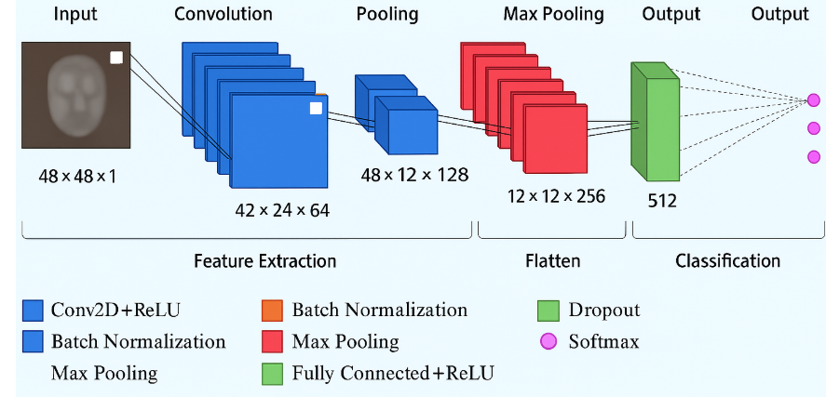
Facial Emotion Model Architecture
2025-2026 ( ODD SEM )

Slide 20
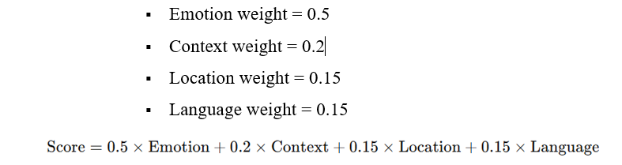
MUSIC RECOMMENDATION ENGINE
Emotion detected using the FER model from facial expressions.
Context/Scene analyzed with CLIP(Contrastive Language–Image Pretraining) , and weather fetched from OpenWeather.
Location obtained via IPinfo to determine preferred language, then songs are recommended.
Context-Aware Scoring : Multiply each feature by a weight factor to reflect its
Ranking Layer: Songs are ranked based on final similarity scores.
Top N Recommendations displayed as song cards with name, artist, language, and mood.
2025-2026 ( ODD SEM )

Slide 21




MODEL EVALUATION
Accuracy: Measures the percentage of correctly predicted emotions from test images.
Precision: Measures the proportion of correct predictions among all predictions for each emotion.
Recall: Measures how many actual emotion instances were correctly identified.
F1-Score: Harmonic mean of precision and recall, balancing false positives and false negatives.
Confusion Matrix: Shows the distribution of predicted vs. actual emotions to identify misclassifications.
2025-2026 ( ODD SEM )

Slide 22
RESULTS
The training and validation performance curves were monitored throughout the learning process to ensure proper convergence and prevent overfitting.
A confusion matrix was used to visualize the model’s predictions and identify which emotions were most frequently misclassified.
The evaluation demonstrated that the model could reliably detect the majority of emotions, providing accurate input for the music recommendation engine.
Additionally, the system was integrated into a Streamlit UI, allowing real-time emotion detection and music recommendations with an interactive and user-friendly interface.
2025-2026 ( ODD SEM )

Slide 23
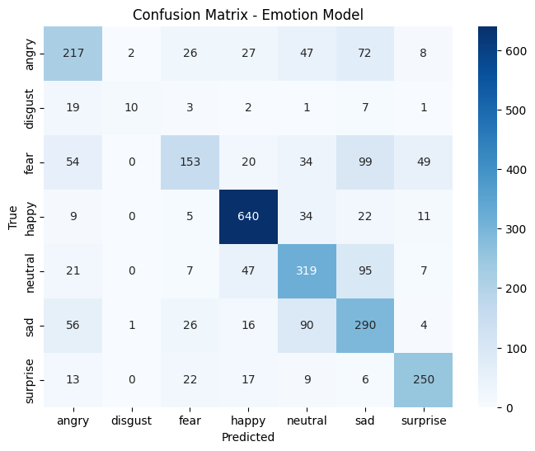
CONFUSION MATRIX
2025-2026 ( ODD SEM )

Slide 24
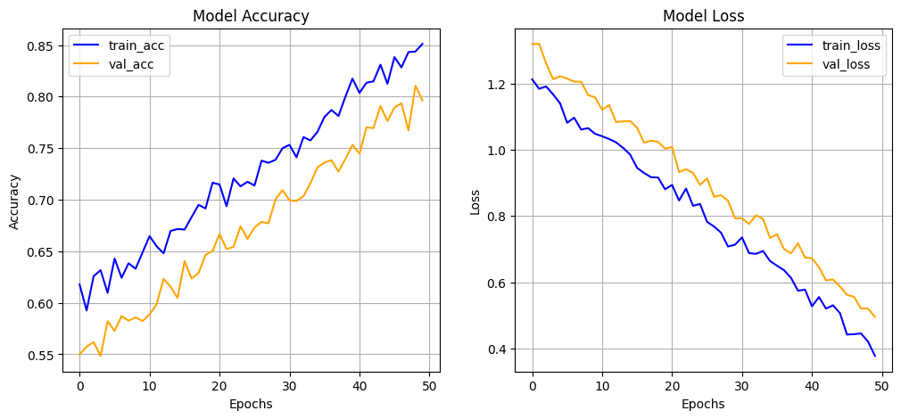
PERFORMANCE ANALYSIS
2025-2026 ( ODD SEM )

Slide 25
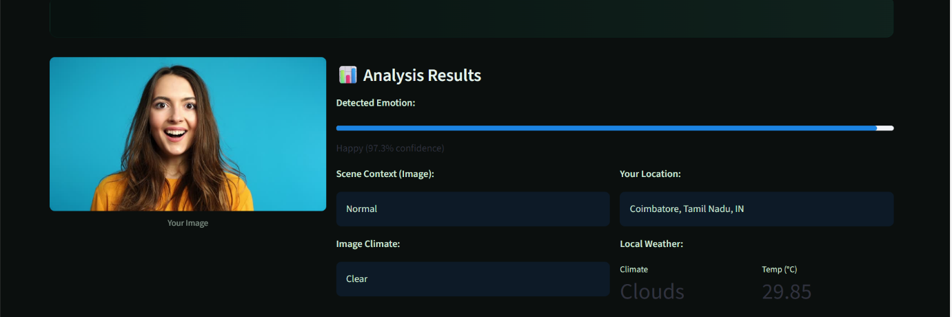
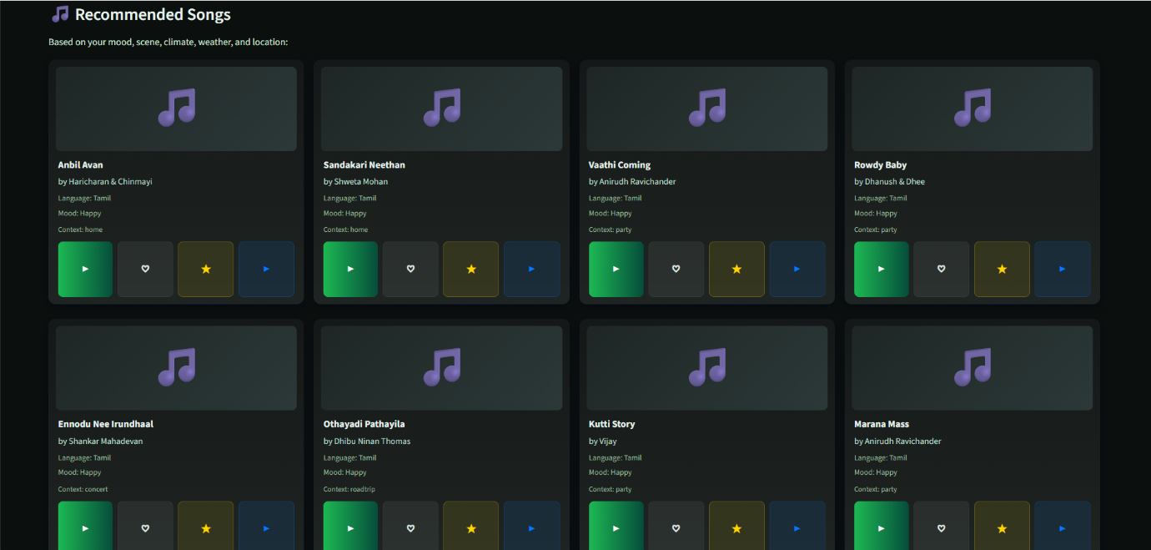
UI RESULTS
2025-2026 ( ODD SEM )

Slide 26
CONCLUSION
Muzly presents a powerful AI-driven solution for delivering highly personalized music recommendations by seamlessly integrating facial emotion recognition, scene analysis, and contextual data. By leveraging a CNN-based emotion detection model along with environmental cues and user preferences, the system provides accurate, real-time music suggestions tailored to the listener’s current mood and surroundings. Through its interactive interface and adaptive recommendation process, Muzly enhances user engagement and delivers a more dynamic, immersive, and meaningful music-listening experience.
2025-2026 ( ODD SEM )

Slide 27
FUTURE WORK
Support live camera feeds for real-time emotion detection and continuous recommendations.
Optimize the system for faster performance and mobile deployment.
Expand the song database with more multilingual tracks.
Incorporate collaborative filtering to leverage user listening history.
Integrate additional modalities like voice or text-based sentiment analysis.
Implement adaptive learning to refine recommendations based on feedback and preferences.
2025-2026 ( ODD SEM )

Slide 28
Thank
you
2025-2026 ( ODD SEM )

