Slide 1


Efficient Intrusion Detection System in MANET
Proposed by,
Murugan vengkadaeswara L(810015104726)
Amuthasurabi V(810015104727)
Guided By,
Mr.Sivanesh S Asst.Professor
Dept of CSE
UCE-BIT campus, Trichy

Slide 2
Abstract
MANET is a field of Wireless Networking with autonomous mobile devices which communicate with each other.
Due to the lack of centralized control AODV is vulnerable to various attacks.
BLACK HOLE is an attack in which the malicious nodes operates based on the False RREP(Route Reply) and Packet Dropping.
AODV has no security considerations to identify these malicious nodes and remove them from the Network.
Success rate is the new field introduced in the routing table.
To detect the Blackhole nodes and to reduce the packet drop, Success rate is compared to the threshold value and the malicious route is identified and so the malicious node. To calculate the Success rate(SR) before the transmission of actual packets “TEST PACKETS” are used.

Slide 3
Objective
The major aim of this proposal is
This project aims to increase the Detection efficiency and Power efficiency by modifying the existing AODV routing protocol.
The enhanced AODV protocol can detect and ignore the Black Hole nodes more efficiently in comparison with existing AODV protocol
To decrease the Packet drop and to increase the Packet delivery ratio

Slide 4
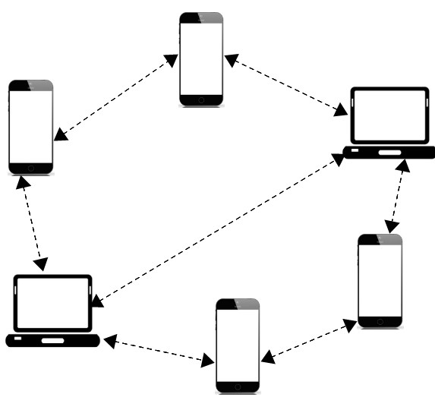
Introduction to MANET
MANET is a type of Ad-hoc network in which the nodes can change locations and configure itself on the fly.
They have many free or autonomous nodes composed of mobile devices. Therefore any node can participate in the network. This opens a vulnerability for intruders and increasing the risk of security in the network.
An intruder may be defined as any rogue mobile device aiming to destroy the integrity in the network by unusual activities. These activities may be called as ATTACKS.

Slide 5
Introduction to MANET
MANETs are a self-configuring and self managing network, so that it can be ease to deploy and having variety of applications in natural disasters, military conflicts, emergency situations and personal area network etc.
The primary challenge in building a MANET is equipping each device to continuously maintain the information required for proper route traffic.
Its dynamic and decentralized nature consequently invites various intruders to attack and deteriorate the network performance.
The intrusive attack is carried out in almost all the layers of the MANET architecture especially on the Network layer by disrupting the entire packet forwarding operation.
This will lead decrease of the AODV performance this will leads to decrease packet delivery ratio.

Slide 6
BLACKHOLE ATTACK
During route discovery, the blackhole node pretends to be the legitimate node and portrays that it has the best route to the destination.
The blackhole node responds with the false route reply(RREP) having the highest destination sequence number. Highest destination sequence number indicates freshness of the route.
Source node will consider it as a legitimate node due to freshness of the route and thus the blackhole node will become one of the intermediate nodes in the routing process.
The black hole node drops the packets instead of forwarding it to the destination.
It affects the overall performance of MANET.

Slide 7
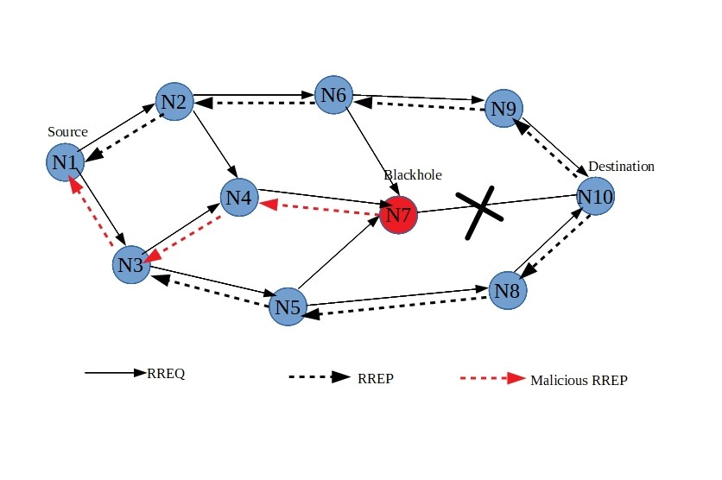
BLACKHOLE ATTACK

Slide 8
Literature Survey
S.NO | TITLE | AUTHORS | TECHNIQUE USED | YEAR
1. | A Detection and Prevention system against collabrative attacks in mobile adhoc networks | Muhammad Imran,Farrukh Aslam Khan | DPS nodes are deployed and continuously monitor the behaviour of other nodes | 2016
2. | A Survey of MANET intrusion detection and prevention approaches for network layer attacks | Adnan Nadeem,Michael P.Howarth | Single type of attacks,intrusion detection system(IDS) | 2013
3. | Ad hoc on-demand distance vector(AODV) routing | CharlesbE.Perkins,Samir R.Das | Routing algorithm | 2003
4. | Mitigating routing misbehaviour in mobile adhoc networks | Sergio Marti, T.J. Giuli, Kevin Lai, and Mary Baker | Watchdog identifies misbehaving nodes,pathrater avoid these nodes. | 2010

Slide 9
Existing System
Cont...
During the route discovery procedure in MANET, the source broadcasts the Route Request messages(RREQ) to its immediate neighbors in search of the destination node.
The intruding malicious nodes in the network accepts the RREQ and responds to it by sending a fake Route Reply(RREP) that has a highest destination sequence number denoting the freshness of route.
Source node will consider it as legitimate node due to freshness of the route thus the malicious node will become one of the intermediate nodes in the routing process.
Once it becomes a part of the packet forwarding operation successfully, the malicious nodes intentionally drops the packet instead of forwarding it. This lead to the Blackhole attack.

Slide 10
Existing System
Cont...
AODV uses the following fields with each route table entry:
1)Destination IP Address
2)Destination Sequence Number
3) Valid Destination Sequence Number flag
4)Other state and routing flags (e.g., valid, invalid, repairable, being repaired)
5)Network Interface
6)Hop Count (number of hops needed to reach destination)
7)Next Hop
8)List of Precursors (described in Section 6.2)
9)Lifetime (expiration or deletion time of the route)

Slide 11
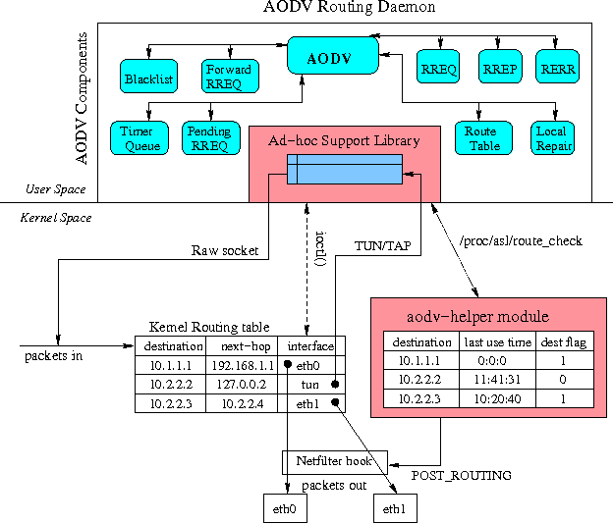
Existing System

Slide 12
Proposed System
Cont...
In order to resolve the excess amount of packet drop and lack in AODV security, we propose a mechanism that enhances the existing AODV routing protocol on Mobile Ad-hoc Network.
In our project, we propose two mechanisms that modify the existing AODV protocol.
  (i) “Test packets” are used to check the initial transmission status and
  (ii) An additional field called “Success Rate” is added to the AODV routing protocol which is calculated from the test packets

Slide 13
Proposed System
Cont...
Cont...
ROUTE TEST
In proposed strategy existing basic AODV mechanism remains unchanged with the addition of Test packets. The source node has sent test packets after the reception of RREP packets unicast by other nodes
Test packets are used to test whether the route is safe or faked. The malicious node forges the route by sending a fake RREP to the originator.
Source node receives more than one RREP packets in response to the RREQ message and checks the Destination sequence number in the RREP packets.
Test packets are transmitted like actual packets to the Destination node via the node which sent RREP with higher Destination sequence. So that the malicious node receives those Test packets and drops it. This rule is not only applied for the malicious nodes, rather than it is applied to every routes received on the source node.

Slide 14
Proposed System
Cont...
Cont...
SUCCESS RATE
An additional field called Success Rate is added to the AODV routing table which uses test packets to determine whether the route is malicious or not.
After the transmission of test packets to the destination, two parameters are evaluated. They are,
1.Number of Packets sent through the route(Packt_sent) and
2.Number of Packets Received through the same route(Packt_rcvd)
Success Rate(SR) = Number of Packets sent
Number of Packets Received
Success Rate is set to the threshold value of T_{h}, if the Success Rate below the threshold value then the correspondent node considered as a malicious node.

Slide 15
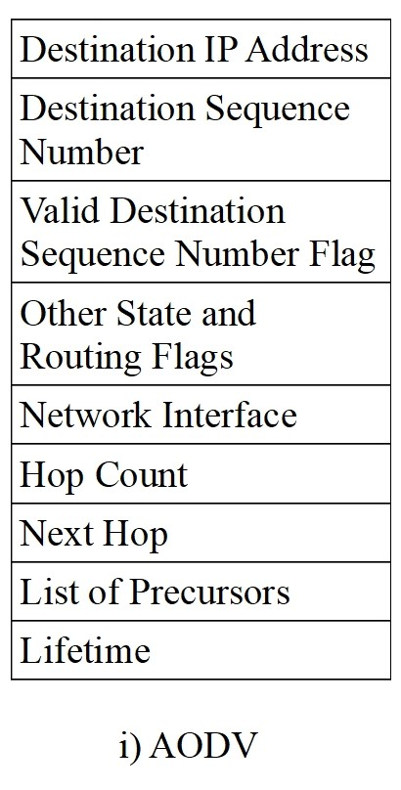
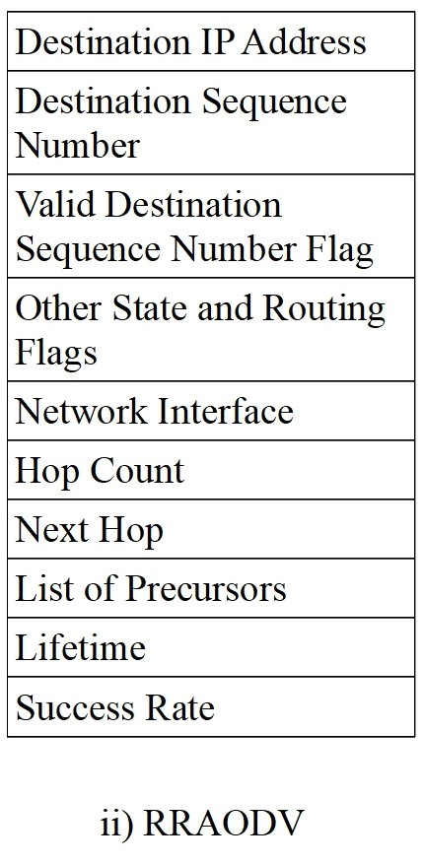
Proposed System
Cont...
Comparison between AODV and RRAODV

Slide 16
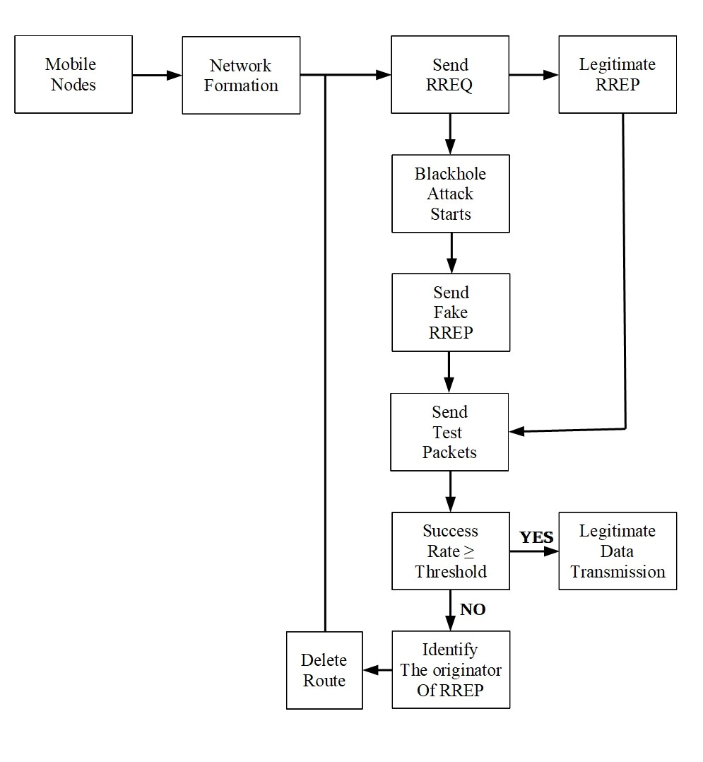
Proposed System Architecture

Slide 17
Psuedo code
Cont...
//Adding Field Success Rate to the Routing Table
{
Initialize Uint SuccessRate;
Add SuccessRate-> m_Routing Table;
}
//Creating Test Packets
{
Ptr<Packet> testpacket=createpacket<Packet>(1024);
}

Slide 18
Psuedo code
//Detection of Malicious nodes
if(Success Rate<Threshold)
{
Get ->HopCount;
Print <<Malicious route with hop count;
//Deletion of malicious Route
Delete->Route();
Send RouteRequest->Destination();
}
else
{ Send RouteReply();
}

Slide 19
Results
Cont...

Slide 20
Results
Cont...

Slide 21
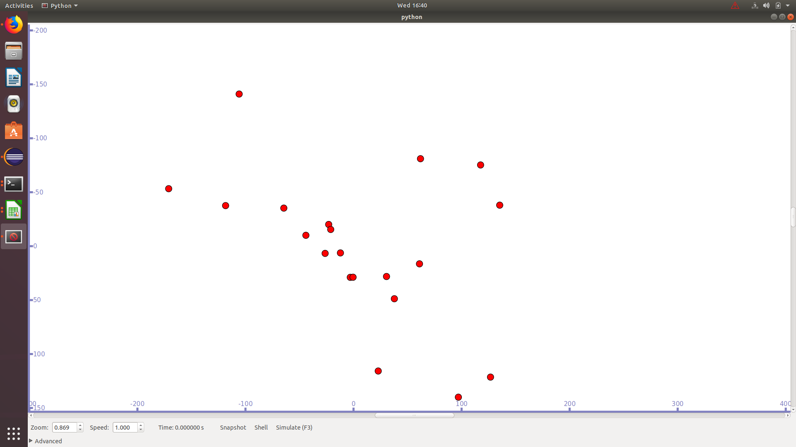
Simulation Outcomes

Slide 22
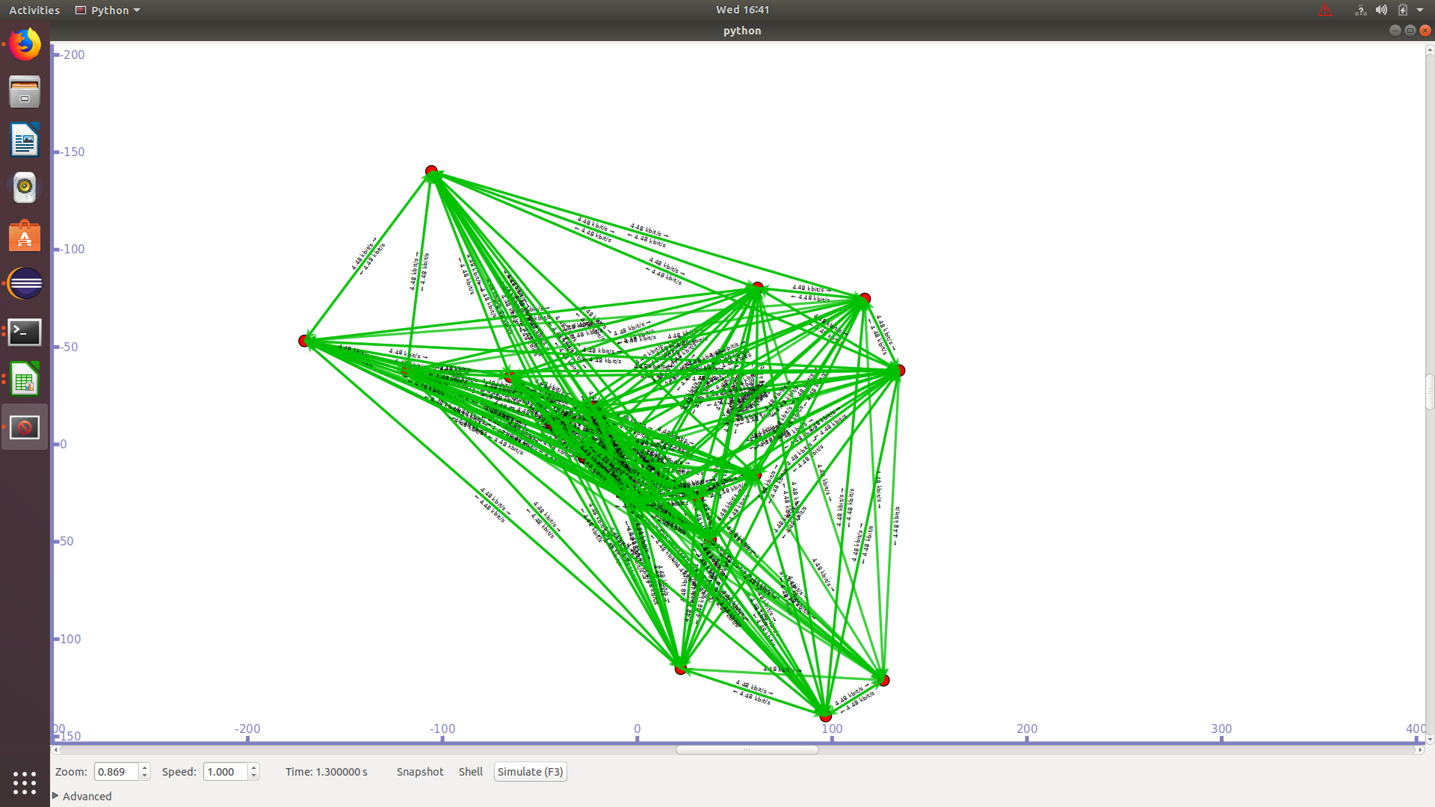
Simulation Outcomes

Slide 23
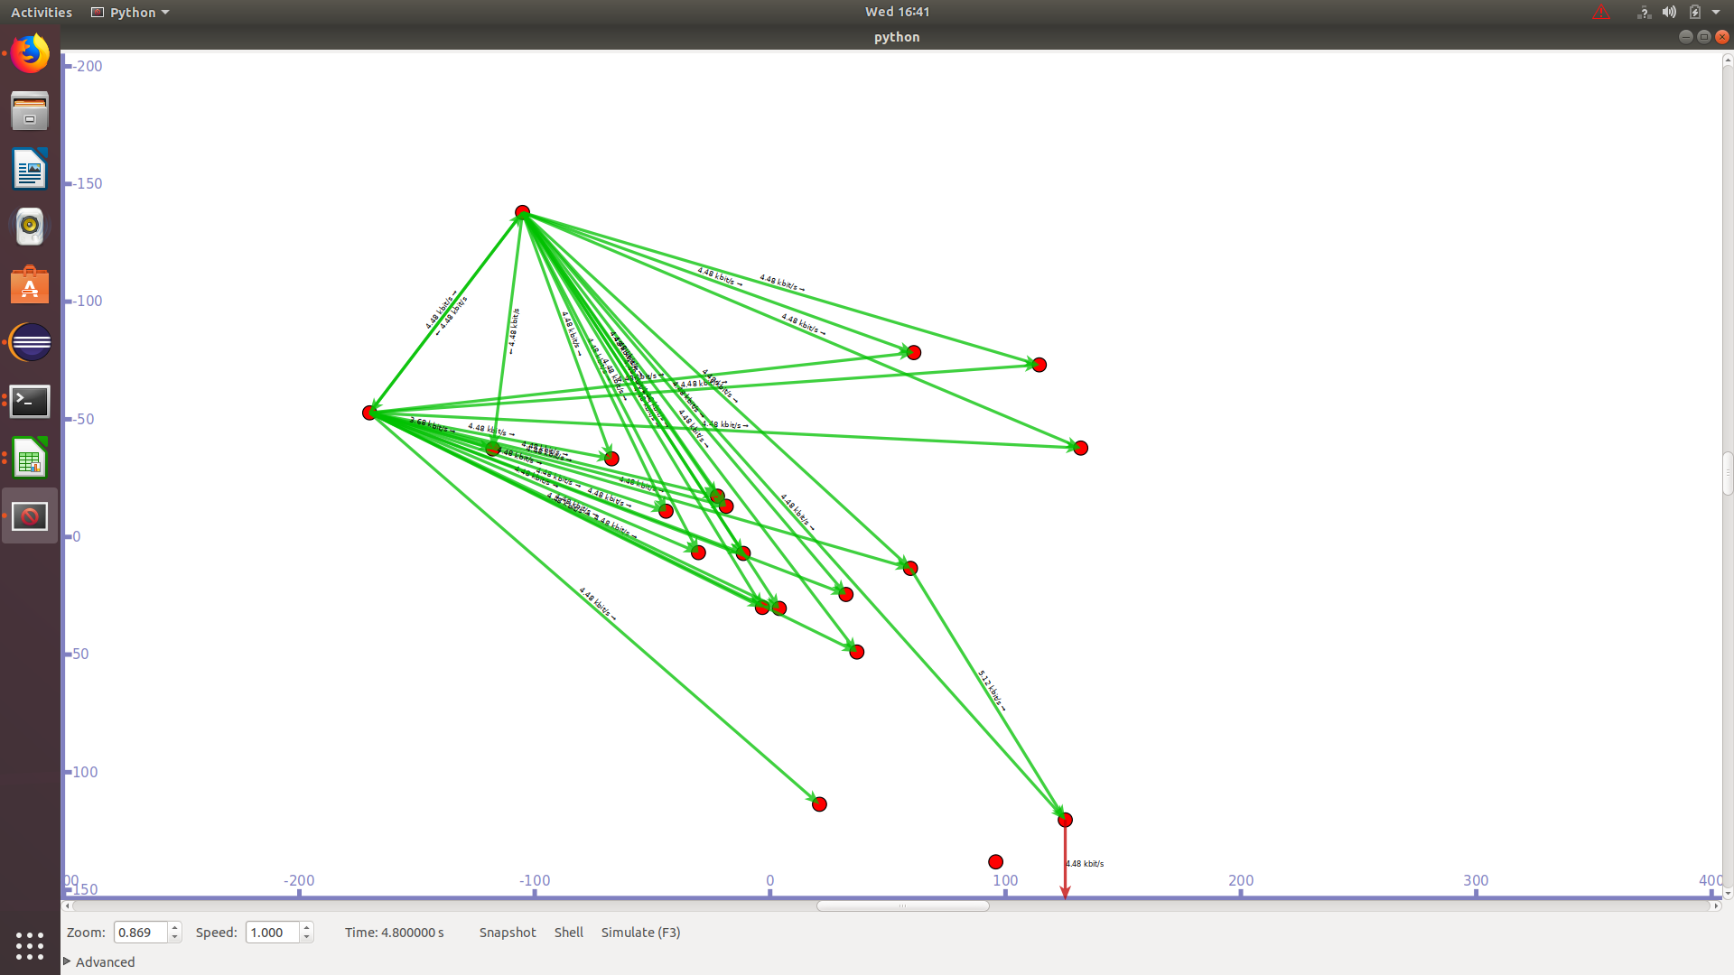
Simulation Outcomes

Slide 24
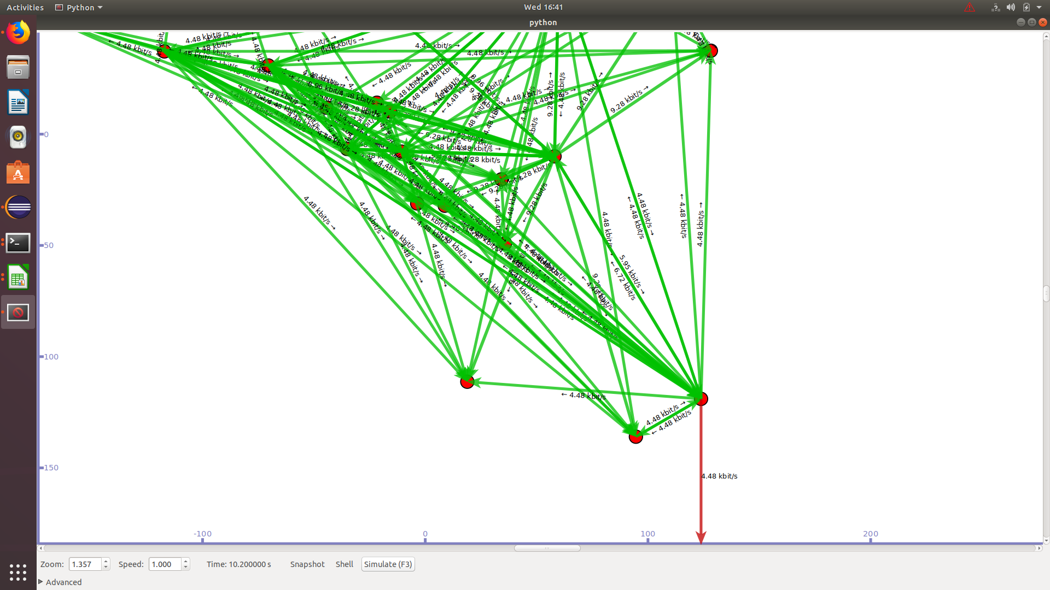
Simulation Outcomes

Slide 25
Simulation Outcomes

Slide 26
Conclusion & FutureWork
Cont...
From the results obtained it is evident that RRAODV accurately detects the Blackhole nodes in MANET.
By using Route Ranking Method, the detection of Blackhole nodes and avoidance of the malicious routes are done.
By the use of Test Packets and the parameters Packet_sent and Packet_received Success Rate of the individual routes are calculated and Success Rate below the threshold are totally discarded.
The analogous results obtained from NS3 simulations proved that the reduction of Packet drop ratio in our proposed system “RRAODV”.
In the future, we would like to improve and modify the proposed RRAODV. So that the system can also be used to detect the other similar attack like Blackhole and we can prevent the MANET from Intruders.

Slide 27
References
[1]IETF Mobile Ad-Hoc Networks Working Group (MANET), IETF website www.ietf.org/dyn/wg/charter/manet-charter.html.
[2]C.Perkin, E. Belding-Royer and S.Das, “Ad hoc On-Demand Ditance Vector(AODV) Routing”, Network Working Group, 2003.
[3]The Network Simulator NS-3 version 3.29, http://www.nsnam.org/
[4]Shashi Gurung1 and Siddhartha Chauhan, “A Review of Black-Hole Attack Mitigation Techniques and its Drawbacks in Mobile Ad-hoc Network”, IEEE WiSPNET conference 2017.
[5]Shaveta, Pawan Luthra, Gagandeep, “Implementation of Blackhole Attack under Aodv Routing Protocol”, International Conference on Energy, Communication, Data Analytics and Soft Computing (ICECDS-2017)

Slide 28
References
[6]C.Pano, C. Ntantogian, S.Malliiaros, C. Xenakis, “Analyzing, quantifying and detecting the blackhole attack in infrastructure-less networks”, Computer Networks, Volume 113, 2017.
[7]Guoquan Li, Zheng Yan, Yulong Fu, “A Study and Simulation Research of Blackhole Attack on Mobile AdHoc Network”, 1st International Workshop on System Security and Vulnerability (SSV)-IEEE CNS 2018
[8]Taranpreet Kaur, Rajeev Kumar, “Mitigation of Blackhole Attacks and Wormhole Attacks in Wireless Sensor Networks Using AODV Protocol”, 6th IEEE International Conference on Smart Energy Grid Engineering-2018.
[9]Oussama Sbai, Mohamed Elboukhari, “Simulation of MANETs single and multiple Blackhole attack with NS-3”, IEEE 2018.
[10]Blackhole source code, “mohittahiliani.blogspot.com/2014/12/ns3-blackhole-attack-simulation-in-ns3.html”.

Slide 29
Thank You!

