Slide 1
Football Player Selection Based on Positions and Skills Using Ensemble Machine Learning and Similarity Measure Techniques
Murugappan Murugappan
x19239831

Slide 2
Problem Addressed and Need For This Research
Problem Discussed:
In all the previous researches, football players has been selected based on predicting only the 4 major positions like forward, midfielder, defender and goalkeeper and not by considering the minor positions also and here this research novel part is to consider all the major and minor positions in predicting the player position and, also includes another approach of selecting similar players using similarity measures.
Need for this research:
To help the football team selection committee to select the players more precisely by considering all the 27 major and minor positions using ensemble ML approach, which helps in improving the model performance and this research mainly helps to avoid selecting the Players only based on their current ratings, market value and second approach is to select similar player considering various factors using similarity measures.
The main business idea of this research to help the football team selection committee and management team to invest precisely in selecting the suitable player exactly required for a particular position including all the major and the minor positions in football and to make their teams more successful in terms of both business and winning records. This helps team management not to waste their time, energy, money investing in any wrong player selection and giving them training.
As a Novel approach to this research, Football players has been selected based on two approaches.
First approach is predicting the player position to select that player to play for a particular position. This is done in two novel ways
One is traditionally predicting the player positions out of 4 major position using the novel ensemble machine learning models.
Second is novel approach of predicting the player positions out of 27 different major and minor positions using the novel ensemble machine learning models like svc lrc, rfc and dtc.
Second approach is selecting the most similar player for replacing a particular player using novel similarity measures like cosine similarity and Euclidean distance and compared these similarity measures techniques.

Slide 3
Background, Motivation, Objective & Scope
Background:
In Previous Research, player selection based on current performance ratings, market value, positions with only 4 major positions.
Motivation:
This motivates to do a novel research in selecting a unique player to a team by considering 27 different positions using ensemble approach and various similarity measures as explained in detail in the previous slide.
Objective:
The main objective is to find the player’s position to select that player for a particular position with respect to 27 different positions using novel ensemble approach and selecting similar players using cosine similarity and by calculating Euclidean distance.
Scope:
This research scope is On 18k+ records of football players details and mainly with 27 different major and minor positions.

Slide 4
Research Question & Literature Review
The aim of the research focuses on creating different Ensemble machine learning models to predict the player position with respect to 4 major positions and another approach with 27 different positions and other approach to find the similar player to be selected in place of other players based on various players attributes using similarity measures techniques.
The research question are as follows
“Can the prediction of the player’s position in advance will helps in selecting a player to play in a particular position in the team?”
The above question is answered in two different approaches uniquely one with predicting only 4 major positions forward, midfielder, defender and goalkeeper and in another method is predicting 27 different positions using ensemble machine learning models.
“Can we predict a Similar players based on the skills and other attributes of another player and can be selected in the team with the help of various similarity measures techniques?”
Various research papers has been used in literature review to study the previous work done in this research idea and added the novel part to it.

Slide 5
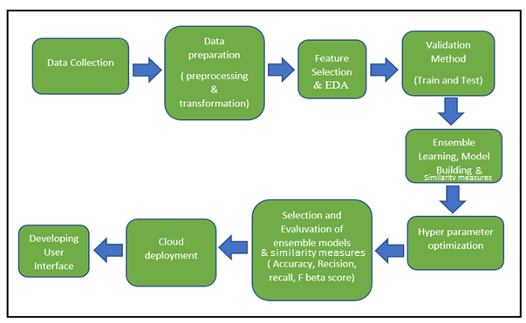
Research Methodology

Slide 6
Design Specification
Two Tier Architecture:
Since data is not stored in Database. There is no data tier.
Application Tier:
Where the logics are incorporated using ensemble machine learning models.
Presentation Tier:
Where the visualizations like evaluation of the models, web app are incorporated using python libraries.

Slide 7
Implementation Specification
Let’s see how this approach is implemented in this research with various types of prediction approach with the help of code explanation.

Slide 8
Model Evaluation
With respect to 1st approach 1st part in predicting the only 4 major positions, Random Forest Classifier performs better with above Both Base and Tuned models evaluation metrics when compared to all other 3 models.
With respect to 1st approach 2nd part in predicting the 27 different positions of the player, Tuned Support Vector Classifier performs better when compared to Base Random Forest Classifier evaluation metrics.
With respect to 2nd approach in selecting the similar players using similarity measures, Cosine similarity performs better when compared to the Euclidean distance approach and helps to find the more similar player in replacing a particular player.

Slide 9
Discussion, Conclusion & Future Work
Discussion and Conclusion
Football player prediction can be helpful to the sports management where player can be easily selected and replaced based on the skills and positions and it can be beneficial as algorithmic prediction can be far better accurate compared to the human prediction. This is, why machine learning and other approaches had been significantly studied and discussed in sports domain now a days in order to increase the efficiency of selecting different team members based on their skills and other attributes by predicting their positions and by similarity measures. In our research, we performed different ensemble machine learning algorithms to predict the position of the players(done in 2 different approaches) helps to select the player to play in a particular position in the team and, also performs similarity measures to find the similar players based on the skills and other player attributes using various techniques. We have found out that random forest classifier model gave the best accuracy of around 87% in predicting the positions with only 4 major positions and tuned support vector classifier gave the best accuracy of around 60% in predicting the positions with 27 different major and minor positions compared to all other algorithms and cosine similarity measure is found to be a better technique to find out the similar players based on skills and other attributes to select the player to the team.
Future Work
In this research, only ensemble machine learning algorithms are studied to predict the positions in two approaches and the accuracy is little low even after doing hyperparameter optimization to the ensemble models in predicting the 27 different positions to select the player for a particular position in a team and there are various other deep learning approaches which have the tendency to give better results more 90% classification accuracy in this type of categorical and numerical data which is left unstudied in this research. So, the future work includes implementation of different deep learning algorithms to predict the 27 different major and minor positions and, also adding more relevant features that might be beneficial to predict the 27 different position of the players in a much better way. The various other similarity measures techniques can also be implemented as part of future work and comparison can be done to chose the best techniques in finding the similar players . This can be deployed in real life applications so that domain experts and sports analysts can easily predict the player position and select that player to play in a particular position and finding the similar players for replacement based on skills and other attributes in a much easier way.

Slide 10
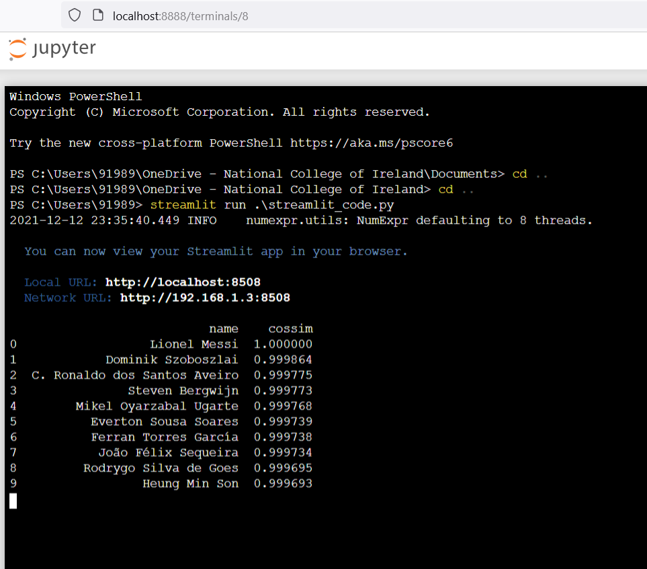
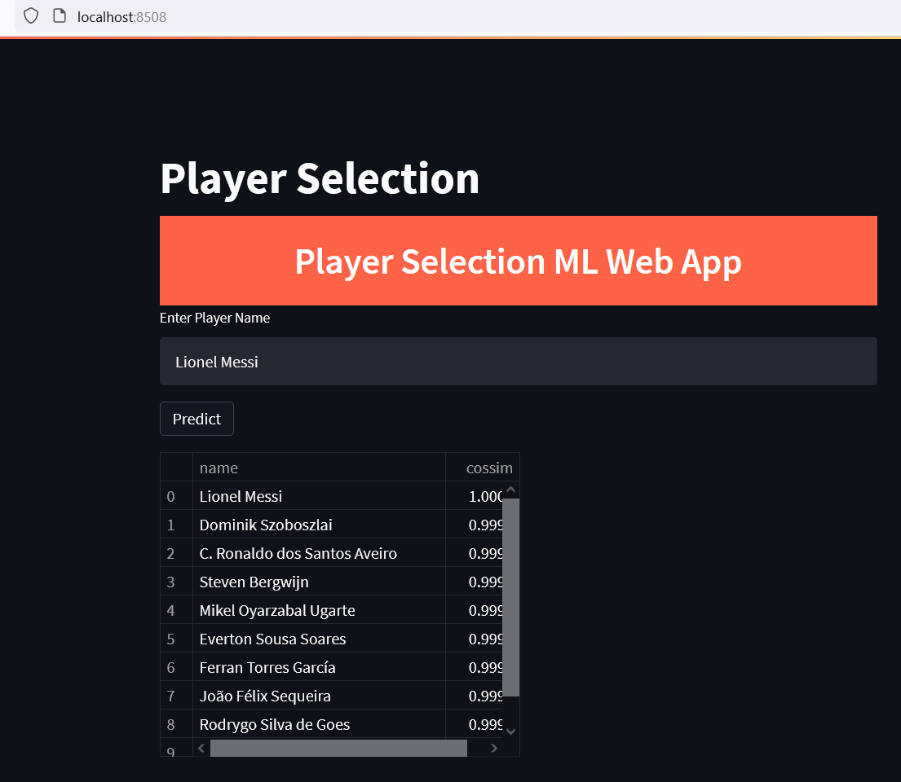
Web App Developed for finding similar player’s using Cosine Similarity Measures Techniques

Slide 11
Acknowledgments & References
Acknowledgments:
Thanking Aaloka Anant for supervising my research and other people’s who supported me to complete this research.
References:
Haugen, K.K. (2017). Equilibrium team selection in football under win or profit maximisation. Mathematics for Application, 6(2), pp.161–170.
Chen, H. (2019). Neural Network Algorithm in Predicting Football Match Outcome Based on Player Ability Index. Advances in Physical Education, 09(04), pp.215–222
Bolturk, E. and Kahraman, C. (2018). A novel interval-valued neutrosophic AHP with cosine similarity measure. Soft Computing, 22(15), pp.4941–4958.
Qingwen, T. (2020). Football Player Performance Prediction Based on Combined Kernel Function Correlation Vector Machine. Dynamic Systems and Applications, 29(5).

Slide 12

Thank You

