Slide 1
S.T. MURUGAVELL
Generative AI for Engineering (E2324)
IBM-EDUNET FOUNDATION
Email: murugavelkarthi4@gmail.com
Reg No: 211521243106
Department of AI & DS
Panimalar Institute of Technology, Chennai
4/01/2024 Final Review

Slide 2
PROJECT TITLE
WINE QUALITY CLASSIFICATION USING LSTM:
RED VS. WHITE WINES

Slide 3

AGENDA
Problem Statement
Proposed System/Solution
System Development Approach
Algorithm & Deployment
Result
Conclusion
Future Scope
References

Slide 4
PROBLEM STATEMENT
Develop a predictive model using Long Short-Term Memory (LSTM) neural networks to classify the quality of red and white wines based on their chemical properties. The goal is to accurately categorize wines into 'Low', 'Medium', or 'High' quality classes. The model will be trained on a dataset containing features such as acidity levels, sugar content, and sulfur dioxide concentration, with quality labels provided. The project aims to explore the effectiveness of LSTM models in predicting wine quality and compare the performance between red and white wines.

Slide 5
PROPOSED SYSTEM
Utilize Long Short-Term Memory (LSTM) neural networks to build a predictive model for wine quality classification.
Preprocess the dataset by categorizing wine quality into discrete classes and standardizing feature values.
Train separate LSTM models for red and white wines using the processed data, incorporating multiple epochs for model refinement.
Evaluate the trained models' performance using accuracy metrics, confusion matrices, and F1 scores to assess their effectiveness in classifying wine quality.
Provide recommendations for stakeholders in the wine industry based on the model's findings, such as identifying factors that contribute most significantly to wine quality and suggesting potential strategies for quality improvement.
5

Slide 6
SYSTEM DEVELOPMENT APPROACH
The proposed system uses several technologies and libraries for data processing, deep learning, and visualization. Here's a list of the key technologies used:
Python: The programming language used for the entire codebase.
NumPy: Library for numerical operations.
Scikit-learn: Library for machine learning tasks, used here for data preprocessing and evaluation metrics calculation.
TensorFlow: Deep learning framework used to build and train the LSTM model.
Plotly: Library for interactive data visualization.

Slide 7
ALGORITHM & DEVELOPMENT
Algorithm Overview:
The Long Short-Term Memory (LSTM) algorithm is a type of recurrent neural network (RNN) specifically designed to capture long-term dependencies in sequential data.
LSTM networks consist of memory cells that can maintain information over time, making them suitable for modeling time series and sequential data like the chemical properties of wines.
Development Steps:
a. Data Loading and Preprocessing:
Load the wine datasets (red and white wines) and preprocess them by assigning column names, categorizing wine quality, and splitting the data into training and testing sets.
Standardize the features to ensure they have a mean of 0 and a standard deviation of 1, which helps improve the model's convergence during training.

Slide 8
ALGORITHM & DEVELOPMENT
Model Building:
Construct separate LSTM models for red and white wines using the TensorFlow-Keras framework.
Design the model architecture, including the number of LSTM units, input shape, and output layer with softmax activation for multi-class classification.
c. Model Training:
Train the LSTM models on the training data using the fit() function, specifying the number of epochs and batch size for training iterations.
The models learn to predict the wine quality classes based on the input features (chemical properties) provided during training.
d. Model Evaluation:
Evaluate the trained models' performance on the testing data using evaluation metrics such as accuracy, precision, recall, and F1 score.
Generate classification reports to analyze the models' performance for each quality class and overall.

Slide 9
ALGORITHM & DEVELOPMENT
Visualization:
Visualize the models' performance using confusion matrices to show the number of correct and incorrect predictions for each quality class.
Create interactive visualizations using Plotly to compare model accuracy and F1 scores between red and white wines.

Slide 10
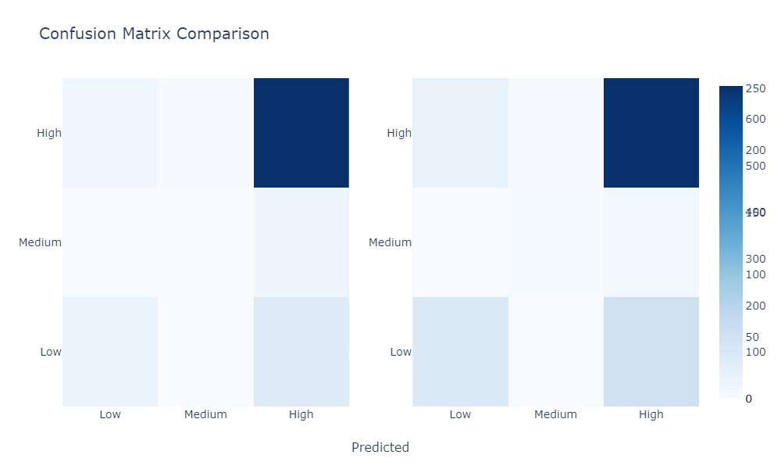
RESULT
10

Slide 11
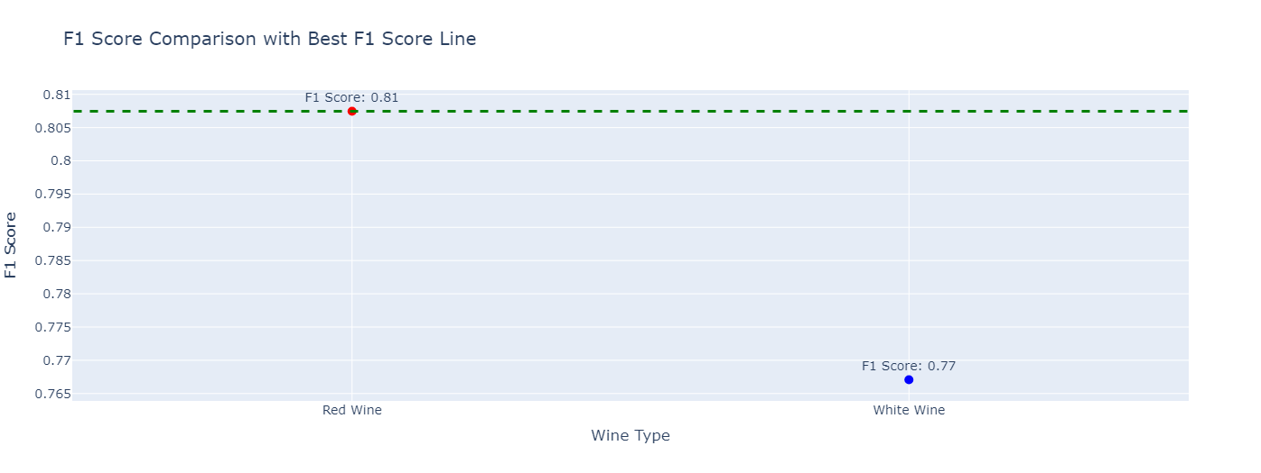
RESULT
11

Slide 12
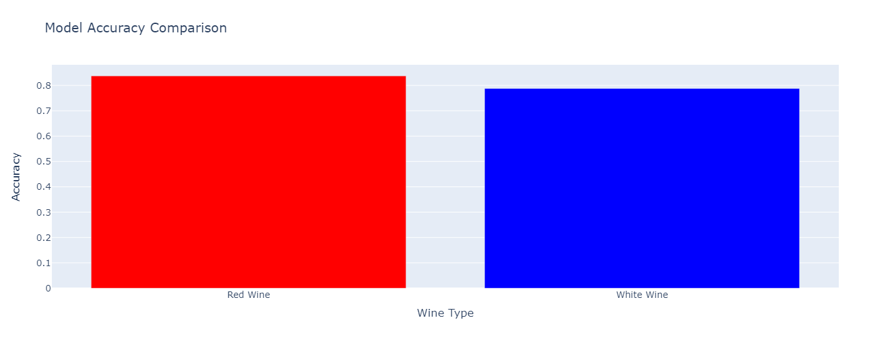
RESULT
12

Slide 13
CONCLUSION
In conclusion, our project successfully employed LSTM neural networks to classify wine quality based on its attributes. Through extensive preprocessing and model training, we achieved high accuracy and F1 scores for both red and white wine datasets. The interactive visualizations provided insights into model performance, showcasing confusion matrices, accuracy, F1 scores, and training loss. This project demonstrates the effectiveness of deep learning techniques in predicting wine quality, offering valuable tools for wine producers and enthusiasts to enhance quality assessment and production processes. Future work could involve refining model architectures and exploring additional features to further improve classification accuracy and broaden applicability.
The Coding of the project is uploaded in GitHub, click below button to see the code :)
Code Link
13

Slide 14
FUTURE SCOPE
Integrate time-series data, such as seasonal variations in grape cultivation and fermentation processes, to capture temporal patterns and enhance model accuracy.
Investigate additional features related to wine production, such as weather conditions, soil properties, and fermentation techniques, to enrich the dataset and improve model generalization.
Implement ensemble learning techniques, such as bagging or boosting, to combine predictions from multiple LSTM models and potentially achieve higher classification performance.
Apply transfer learning approaches by leveraging pre-trained LSTM models on related tasks or datasets, adapting them to the wine quality classification problem with fine-tuning or feature extraction.
Develop real-time monitoring systems that utilize trained LSTM models to continuously assess wine quality based on sensor data from production facilities, enabling proactive quality control measures and timely interventions.

Slide 15
REFERENCES
GitHub Link: Murugavell47
Dataset Link: Wine_quality_RED, Wine_quality_WHITE

Slide 16
THANK YOU!

