Slide 1
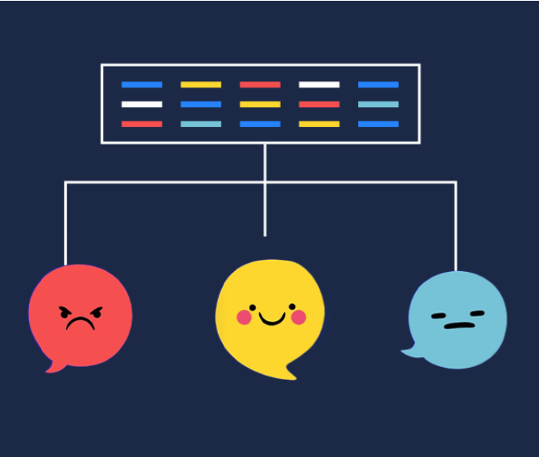
FROM HASHTAGS TO INSIGHTS : Predicting Sentiment, Shaping Strategy

Slide 2
BUSINESS UNDERSTANDING
In the current digital landscape, social media platforms such as X (Formerly Twitter) have become powerful spaces where consumers express their opinions, experiences, and perceptions about brands and products. These online conversations offer organizations a valuable opportunity to measure customer sentiment, evaluate brand perception, and shape strategies that drive competitive advantage.

Slide 3
BUSINESS GOALS
Turn social media text into actionable insights
Compare brand perception for Apple and Google
Classify tweet sentiment: Positive, Neutral, Negative
Support marketing, customer service, and strategy decisions
Recommend actions to improve customer experience

Slide 4
TARGET AUDIENCE
Marketing Teams at Apple and Google
Customer Engagement & Experience Managers.
Product Managers (Apple & Google divisions such as iPhone, Pixel, Android, iOS)
Competitive Strategy Analysts.
Business Executives & Senior Leadership

Slide 5
DATA UNDERSTANDING
Data cleaning: remove noise (URLs, mentions), lowercase, tokenize
Feature extraction: bag-of-words / TF–IDF
Build a predictive model that classifies sentiments of a tweet.
Modeling: baseline classifiers and evaluation (accuracy, F1)
DATA SOURCE: data.world

Slide 6
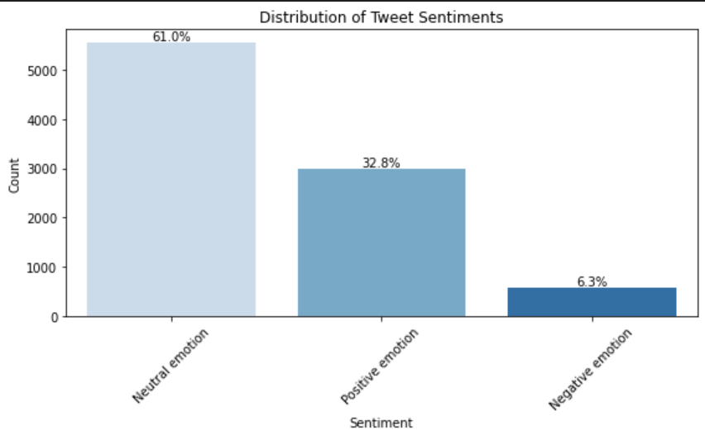
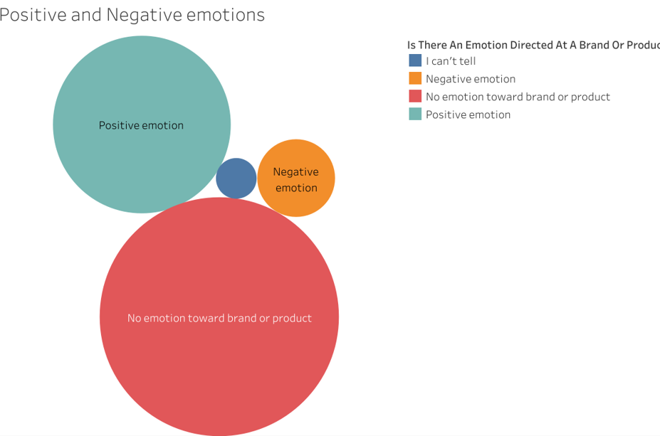
Plotting Tweets Sentiment Distribution

Slide 7
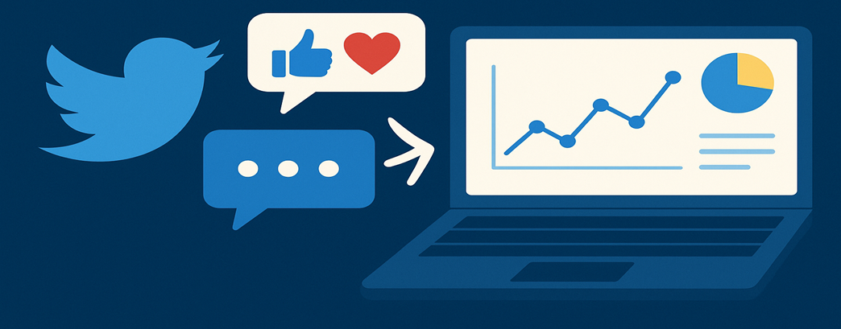
The sentiment distribution indicates that the majority of conversations are neutral, with 5,544 tweets, representing approximately 60.6% of the dataset. This suggests that while consumers are actively discussing brands and products, a large portion of the discourse remains informational or unbiased, lacking strong emotional tones.

Slide 8
Positive sentiment follows with 2,978 tweets (32.6%), highlighting a considerable base of satisfied or supportive consumers who express favorable opinions. Meanwhile, negative sentiment is minimal, at only 570 tweets (6.2%), indicating relatively low levels of dissatisfaction or criticism compared to the overall conversation volume.

Slide 9
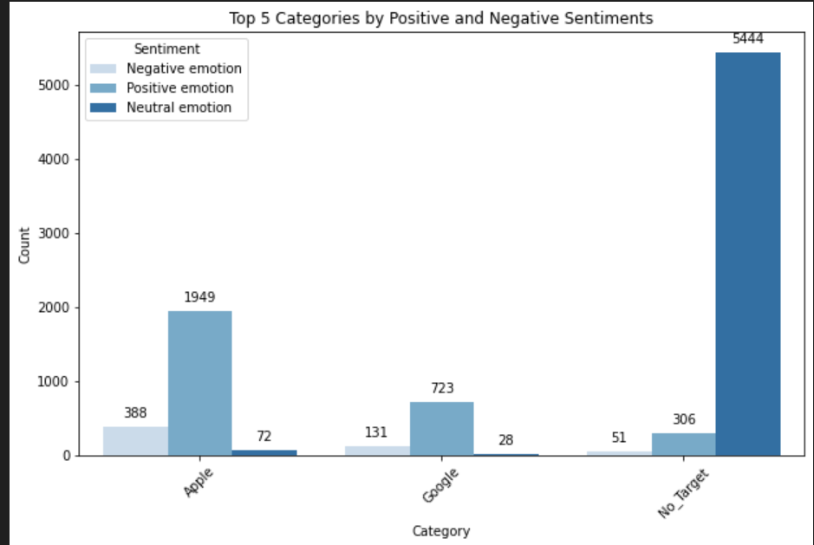
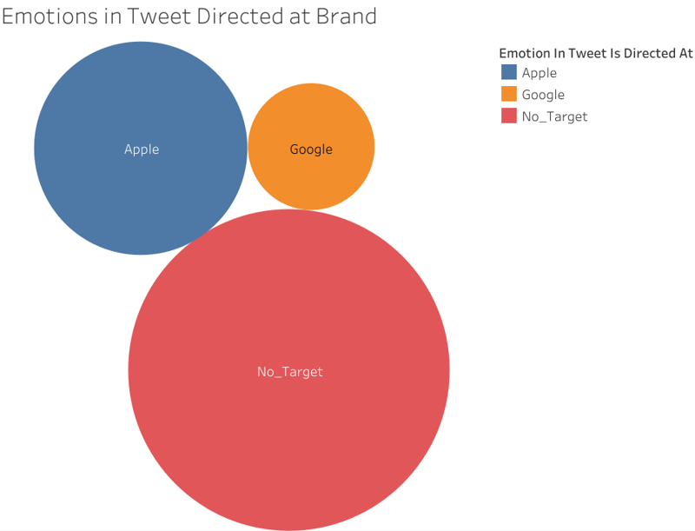
BRAND SENTIMENTS ANALYSIS

Slide 10
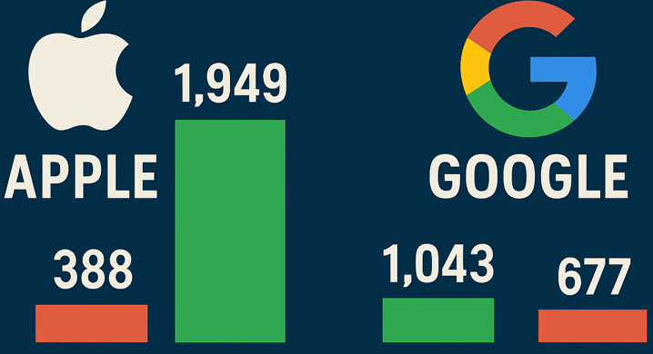
Apple holds a stronger brand perception compared to Google within the dataset from the analysis. Apple products and the brand generate the highest level of engagement, with 1,949 positive mentions against 388 negative mentions, indicating strong consumer affinity despite some criticism.

Slide 11
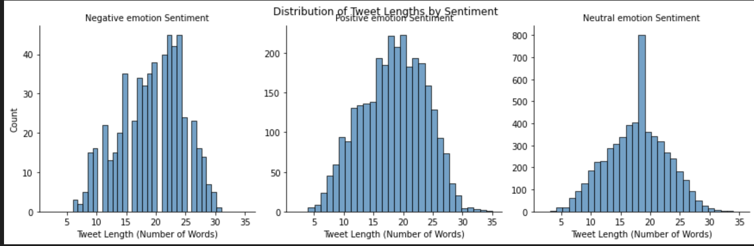
TWEET LENGTH DISTRIBUTION BY SENTIMENT

Slide 12
Negative tweets has a clear peak around 22–24 words. Very short tweets (<10 words) and very long tweets (>30 words) are rare. The distribution is right-skewed, suggesting that while most negative tweets are moderately long, a few extend further in length.
Positive tweets curve peaks around 18–20 words, ranging between 10 and 26 words. The distribution is also right-skewed, indicating that users tend to use slightly more words when expressing positive sentiment.
Neutral tweets follow a normal distribution with a strong central peak at 18 words, showing a consistent word count pattern , suggesting that neutral tweets are more standardized, possibly because they are more factual or informational.

Slide 13
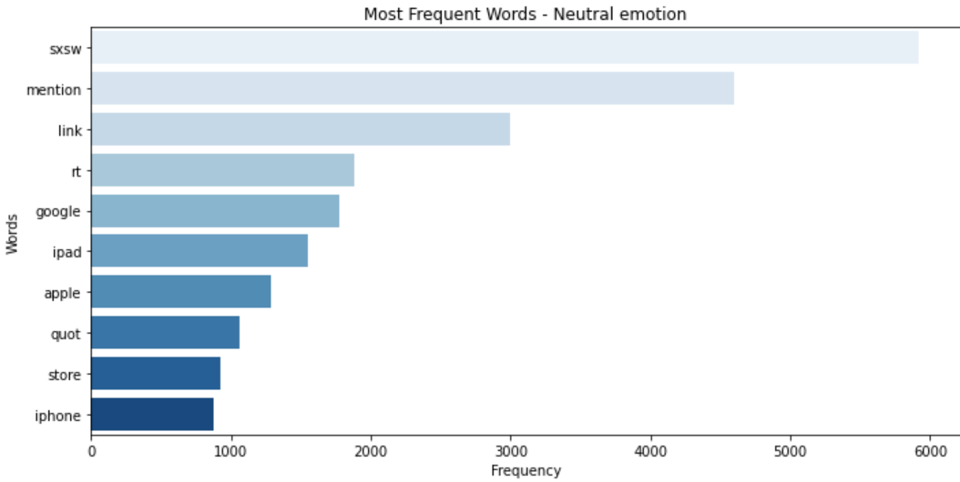
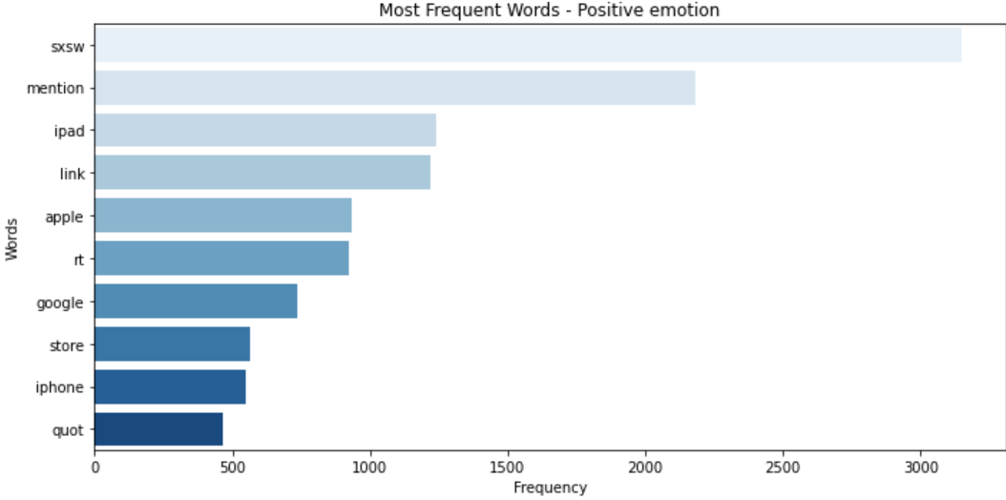
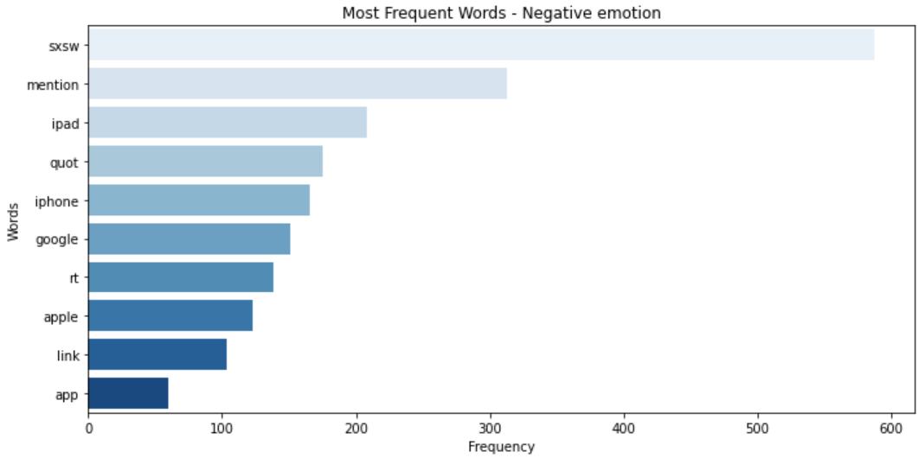

Slide 14
Discussions on Twitter were largely event-driven, with “sxsw” dominating across negative, positive, and neutral tweets.
Negative tweets focused on dissatisfaction with the event or frustrations with tech products like the iPad, iPhone, Apple, and Google.
Positive tweets reflected enthusiasm and praise for the same event and products, underscoring how shared experiences can generate both excitement and criticism.
Neutral tweets were largely informational, consisting of news, updates, and links about SXSW and tech launches, without strong emotional tones.

Slide 15
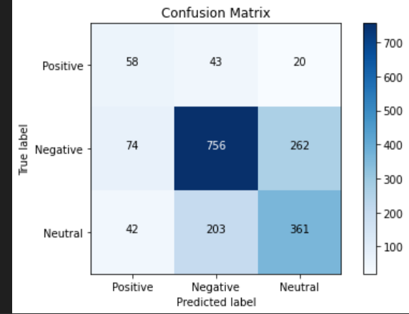
MODELLING
Logistic Regression was used due to its superior precision in classifying tweet sentiments. This makes it especially effective for identifying positive sentiment with minimal false positives, aligning well with our goal of extracting reliable brand perception insights.
EDA revealed a significant imbalance in sentiment classes, with neutral tweets dominating the dataset and negative sentiment underrepresented. SMOTE was used to address during model training using Logistic Regression.
The model automatically adjusts the importance of each class based on its frequency, penalizing misclassification of minority classes more heavily. This approach helps improve recall and F1-score for underrepresented sentiments without altering the original data distribution.

Slide 16
MODEL PERFROMANCE
Accuracy: 0.647

Slide 17
RECOMMENDATIONS
The dominance of neutral sentiment suggests that many consumers are either undecided or simply sharing factual content without emotional attachment. This is an opportunity for brands to convert neutral mentions into positive advocacy through targeted engagement and value-driven messaging. It is also essential to monitor and address negative feedback to protect brand reputation and maintain consumer trust.
Apple’s strong but more polarized presence highlights both its competitive strength and the need to address customer pain points to sustain loyalty. Google, meanwhile, maintains a stable and less contentious perception, but may need to invest in strategies that enhance consumer engagement and brand excitement to match Apple’s market visibility.

Slide 18
WAY FORWARD
Monitor trending issues weekly; respond within hours
Amplify high-sentiment topics; address recurring negatives
A/B test messaging where sentiment is borderline neutral

Slide 19

Q&A

Slide 20

THANK YOU
PROJECT COLLABORATORS
AGNES CHOMBA
OLGAH OMOLLO
DERRICK MALING’A
ERIC OKACHA
JUDAH ODIDAH
NICK MWAI
LUCAS OMINDE

