Slide 1
From Tweets to Insights
General Sentiment Analysis (Non-Technical)

Slide 2
Objective
Turn social media text into actionable insights
Compare brand perception for Apple and Google
Classify tweet sentiment: Positive, Neutral, Negative
Support marketing, customer service, and strategy decisions
Recommend actions to improve customer experience

Slide 3
Approach
Data cleaning: remove noise (URLs, mentions), lowercase, tokenize
Feature extraction: bag-of-words / TF–IDF
Modeling: baseline classifiers and evaluation (accuracy, F1)

Slide 4
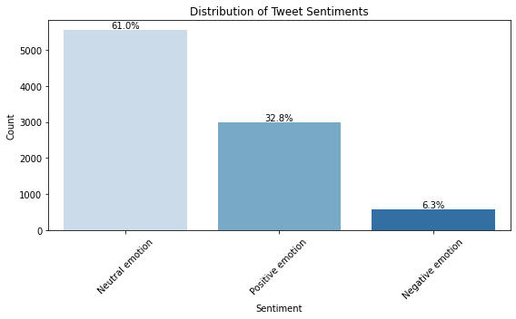
Notebook Visualization

Slide 5
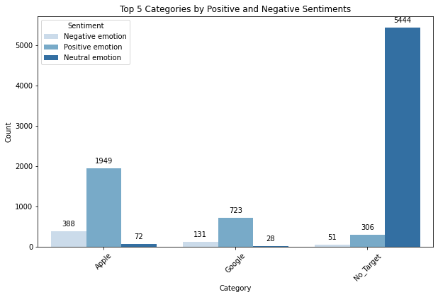
Notebook Visualization

Slide 6
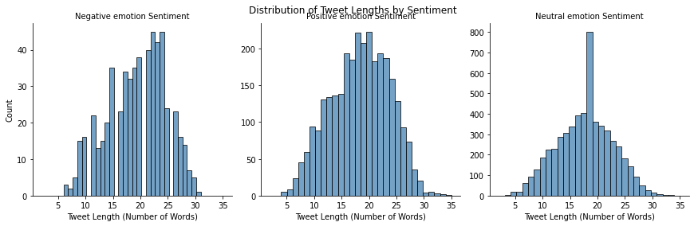
Notebook Visualization

Slide 7
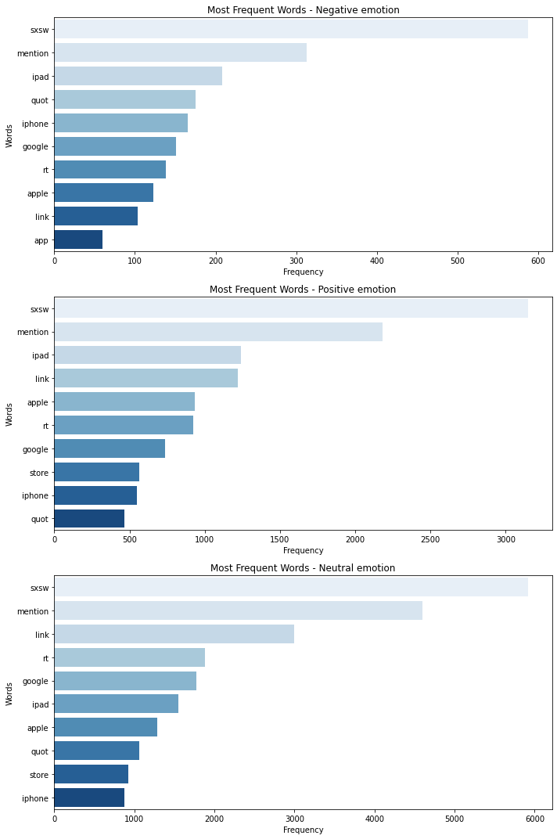
Notebook Visualization

Slide 8
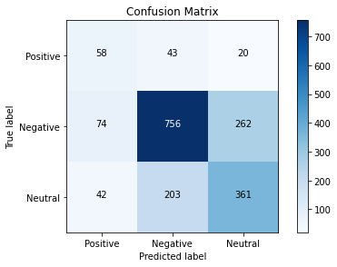
Notebook Visualization

Slide 9

Notebook Visualization

Slide 10
Model Performance
Accuracy: 0.647

Slide 11
Insights
Overall sentiment skew indicates areas to celebrate and address
Longer tweets often correlate with detailed complaints or praise
Targeted responses can reduce negative spikes

Slide 12
Business Value
Identify customer pain points and promoters in real time
Prioritize issues that drive negative sentiment
Track campaign impact via sentiment shifts

Slide 13
Recommendations
Monitor trending issues weekly; respond within hours
Amplify high-sentiment topics; address recurring negatives
A/B test messaging where sentiment is borderline neutral

