Slide 1

Aircraft Risk Analysis for Investment Decisions

Slide 2

Business Problem
The organization is planning to diversify its portfolio by entering the aviation industry through the purchase of aircraft for commercial and private use.
While this offers new growth opportunities, it also introduces substantial risks. Hence, a thorough risk assessment is required to ensure the investment is viable and sustainable.
Project Goal
To identify the aircraft with the lowest risk for company to venture in.

Slide 3




DATA SOURCE & DATA ANALYSIS PROCESS
Data Analysis process
Steps
1. Cleaning data to handle the missing values and ensure consistency
.
2. Exploratory Data Analysis Analysing trends and patterns in accidents by Phase, Weather, Flight purpose, number of engines and aircraft make.
. .
3. Visualization : Interactive charts and dashboards created in Tableau and also with seaborn &matplotlib in jupyter notebook for different stakeholders' utilization
Source: Kaggle, National Transportation Safety Board that includes aviation accident data from 1962 to 2023 about civil aviation.

Slide 4
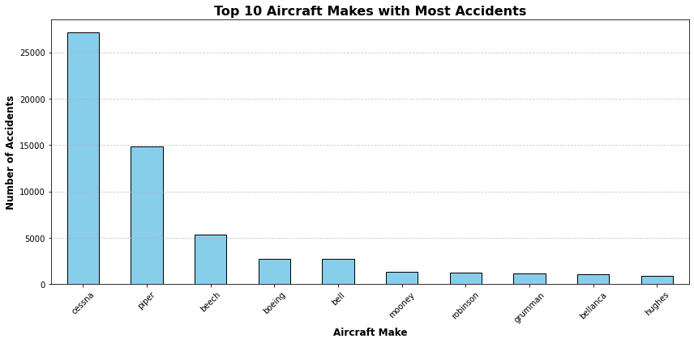
Key Findings
Top 10 Aircrafts Make Involved in Accidents
Cessna and Piper aircraft have by far the highest number of accidents, significantly more than any other manufacturers.
Beech and Bell follow, but with far fewer cases. Boeing appears in both accident and incident records, with numbers that are close but still relatively low compared to Cessna and Piper.
Other makes like Mooney, Robinson, Grumman, and Bellanca show smaller but still notable accident counts.

Slide 5
Key Findings Cont.
Checking the relationship between Total Injuries in Aircraft accidents and number of Engines
A correlation coefficient of 0.349 indicates a weak to moderate positive relationship, suggesting that as the number of engines increases, total injuries tend to increase as well. However, the correlation is not strong enough to conclude that the number of engines is a dominant factor in predicting injuries, and other factors may play a more significant role in influencing injury rates.
Correlation Coefficient | Value
 | 0.3494

Slide 6
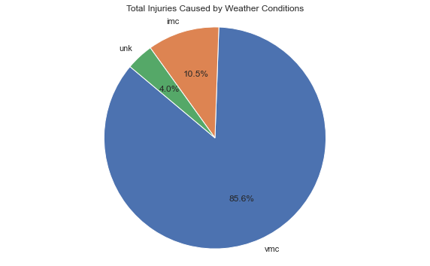
Key Findings cont.
The count of injuries incurred due to different Weather conditions
VMC accounts for the highest number of injuries at 85.6 %. This means that most accidents and resulting injuries happen when the weather is generally clear, and visibility is good.
IMC accidents under poor visibility conditions account for 53,648 injuries. This is significantly lower than in VMC, but still notable.
There were also 20,393 injuries reported under unknown weather conditions.

Slide 7
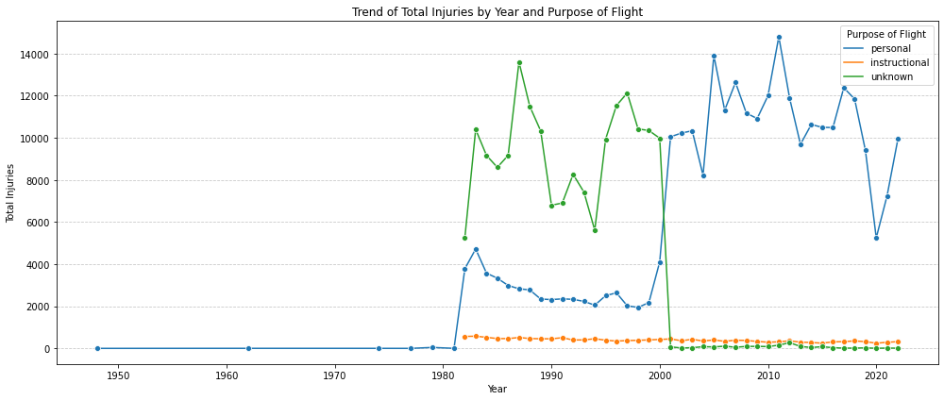
Key Findings cont.
Accidents Incurred During Different Flight Purposes
From the line graph, it is evident that most injuries occur during personal flights over the years, followed by flights with an undefined or unknown purpose. Instructional flights rank third in terms of injury frequency.

Slide 8
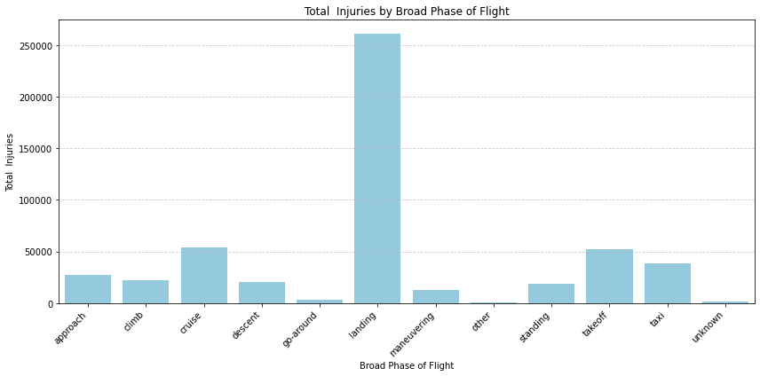
Key Findings cont.
Count of Occurrences per phase of Flight
The bar plot indicates that the highest number of injuries occur during the landing phase of flights, followed by injuries during cruise, takeoff, taxi, and approach phases, in that order.
This pattern highlights that the landing phase presents a higher risk of accidents compared to other phases of flight.

Slide 9
Recommendations
Prioritize investment in aircraft models with lower accident rates; Cessna and Piper models pose higher operational and insurance risks.
Good weather does not eliminate accident risk; maintain caution and enhance pilot training even in clear conditions. In Instrument Meteorological Conditions (IMC), invest in aircraft with advanced avionics and navigation systems.
It is also recommended that investments should Focus investments on the instructional aviation sector, which has a lower injury and liability risk.
Invest in advanced pilot training, particularly in landing techniques, emergency landings, and adverse weather handling. In addition, invest in Equipping aircrafts with technologies like Enhanced Vision Systems (EVS), Autoland systems, and Ground Proximity Warning Systems (GPWS) to minimize accidents during Landing Phase.

Slide 10

Next Steps
Collaborate with other stakeholders in Aviation Industry to implement the strategies and Recommendations above.
First step
Evaluate Insurance implication to the company based on the risk assessment conducted
Second Step
Lastly, Continuously monitor the Investment strategy.
Third Step

Slide 11

Thank You
For further inquiries or collaboration opportunities, feel free to reach out.
LinkedIn: www.linkedin.com/in/agnes-murugi-1a26612a1/
Name : Agnes Chomba

