Slide 1
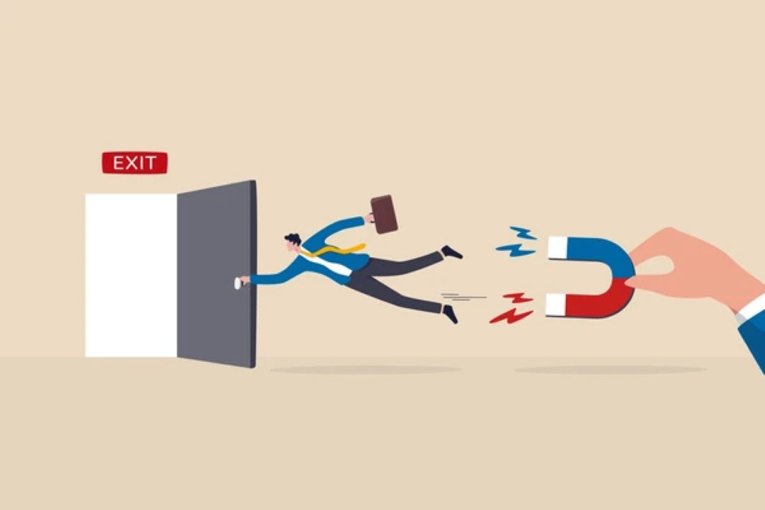
Customer Churn Prediction for SyriaTel

Slide 2
Business Understanding
SyriaTel, like many telecom providers, operates in a highly competitive industry where retaining existing customers is often more cost-effective than acquiring new ones. Customer churn — when subscribers stop using the service — directly impacts revenue and long-term profitability.
The challenge is that churn doesn't usually happen randomly. It can result from dissatisfaction with service quality, pricing, customer support, or competitors' offers.
2. Business Goal
i) Build a Predictive Model for Churn
ii) Gain Insight into Churn Drivers
iii) Provide Strategic Recommendations

