Slide 1
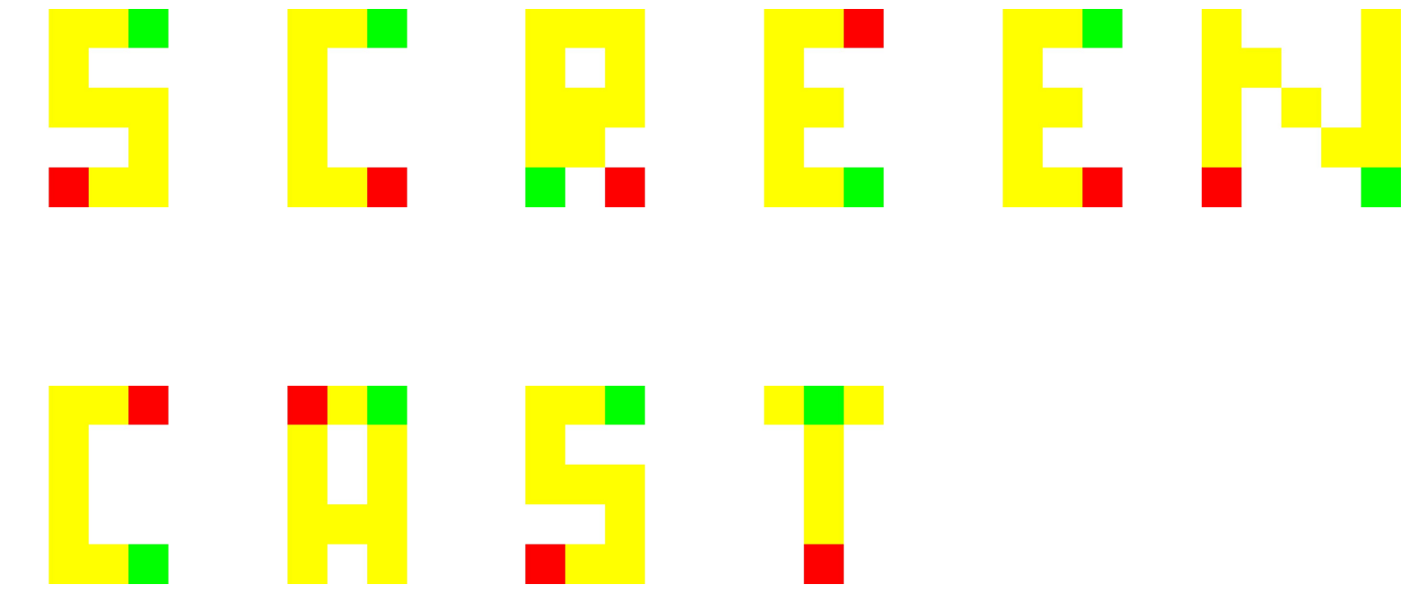
Generalised Planning for Complex Path Finding Games
Authored by: Murtaza Daudali
Supervised by: Ramon Fraga Pereira

Slide 2

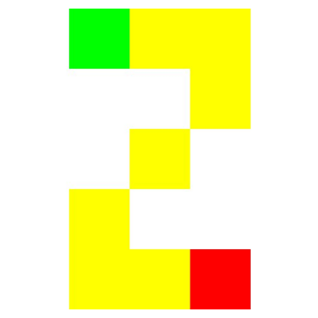

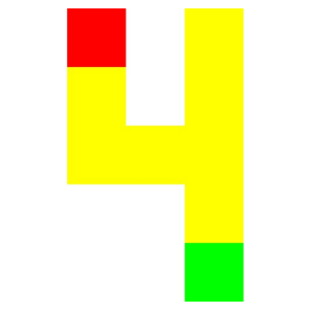
Outline
Introduction to PDDL and Automated Planning
Interest and Importance of Generalised Planning
Explored Domains
Demonstration

Slide 3

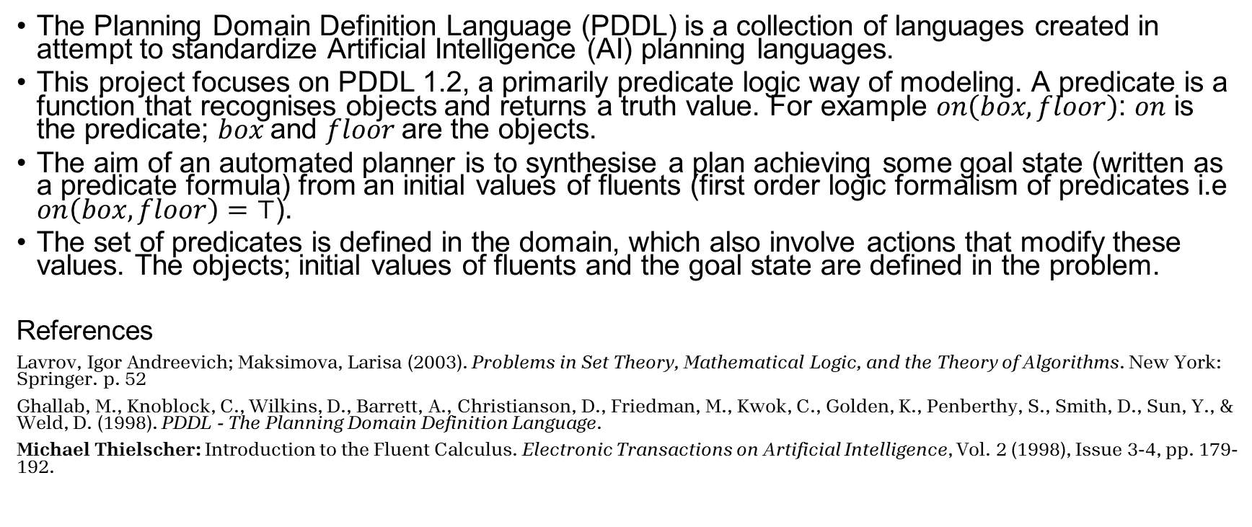
Introduction to PDDL and Planning
The Planning Domain Definition Language (PDDL) is a collection of languages created in attempt to standardize Artificial Intelligence (AI) planning languages.
This project focuses on PDDL 1.2, a primarily predicate logic way of modeling. A predicate is a function that recognises objects and returns a truth value. For example $on\left(box,floor\right)$: $on$ is the predicate; $box$and $floor$are the objects.
The aim of an automated planner is to synthesise a plan achieving some goal state (written as a predicate formula) from an initial values of fluents (first order logic formalism of predicates i.e $on\left(box,floor\right)=⊤$).
The set of predicates is defined in the domain, which also involve actions that modify these values. The objects; initial values of fluents and the goal state are defined in the problem.
References
Lavrov, Igor Andreevich; Maksimova, Larisa (2003). Problems in Set Theory, Mathematical Logic, and the Theory of Algorithms. New York: Springer. p. 52
Ghallab, M., Knoblock, C., Wilkins, D., Barrett, A., Christianson, D., Friedman, M., Kwok, C., Golden, K., Penberthy, S., Smith, D., Sun, Y., & Weld, D. (1998). PDDL - The Planning Domain Definition Language.
Michael Thielscher: Introduction to the Fluent Calculus. Electronic Transactions on Artificial Intelligence, Vol. 2 (1998), Issue 3-4, pp. 179-192.

Slide 4
Interest and Importance of Generalised Planning
Generalised planning aims at solving multiple problems simultaneously to produce a single algorithm-like plan, computing this algorithm gives the individual plans.
These problems share the same observations and actions and the planner extracts and reuses general knowledge from the same domain.
Generalised planning is a relatively new field in AI, traditionally focusing on solvable instances in the synthesis of programs (2003) to uses in robotics seen since the previous decade.
Due to its novelty, this project aims to expand the horizons by utilising these planners in gaming notably simple path finding games, evaluating its performance and its limitations.
References
Javier Segovia-Aguas, Sergio Jiménez, Anders Jonsson, Computing programs for generalized planning using a classical planner, Artificial Intelligence, Volume 272, 2019, Pages 52-85,ISSN 0004 -3702,
Segovia-Aguas, J., Jiménez, S., & Jonsson, A. (2020). Generalized Planning with Positive and Negative Examples. Proceedings of the AAAI Conference on Artificial Intelligence, 34(06), 9949-9956.

Slide 5
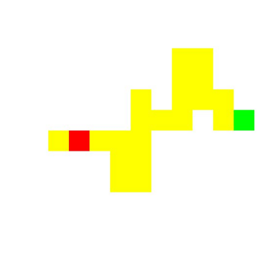
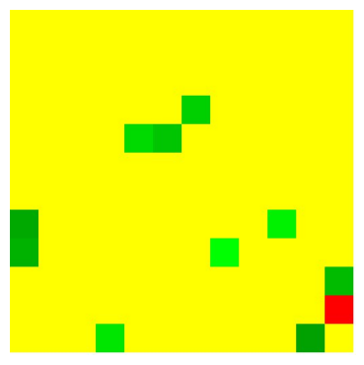
Explored Domains
This project focuses on two games: Maze and Snake, involving complex path planning.
The Maze game involves the agent navigating the shortest path from the start tile to the goal tile. A tile represents a position on a grid where (0, 0) of the top-left-most position. The agent can either: move or turn 90°
The Snake game involves the agent navigating the shortest path from each “apple” to the next, until all apples have been collected. When the agent “eats” an apple by moving on its location, the agent increases in size, blocking tiles on the grid.
Due to the complexity of these games and generalised planning, I performed a grid-based problem reduction to get the planner to compile within a reasonable time frame (i.e 60s for problems in a 5x5 grid).
Red: Start.
Green: Goal(s) - Must be achieved in order from lightest to darkest.
Maze
Snake

Slide 6
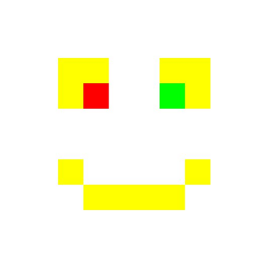
Demonstration

