Slide 1
Data Analysis on Stroke Predictions
Mustafa Johar Udegadhwala
ITE 5201 Humber College

Slide 2
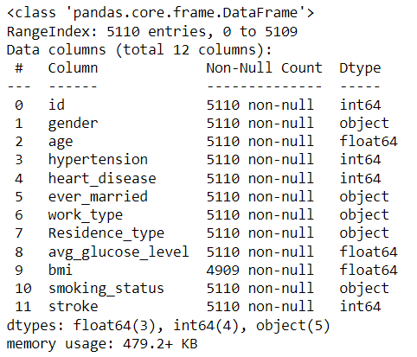
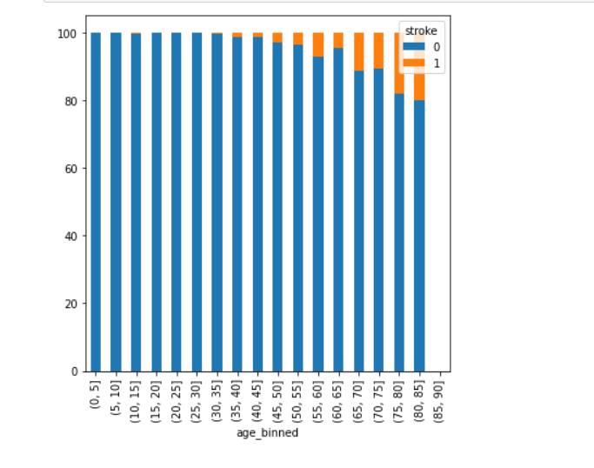
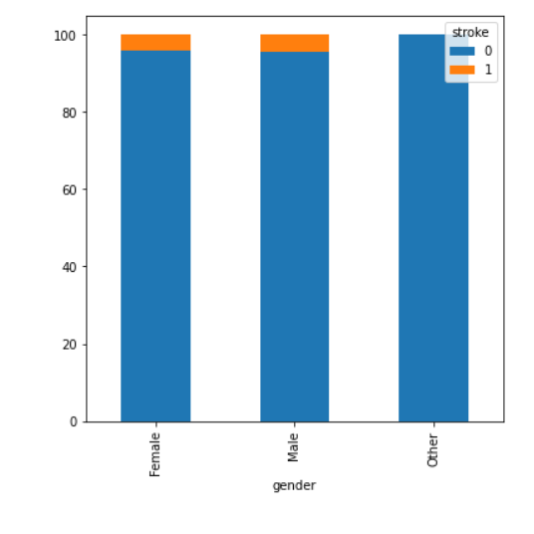
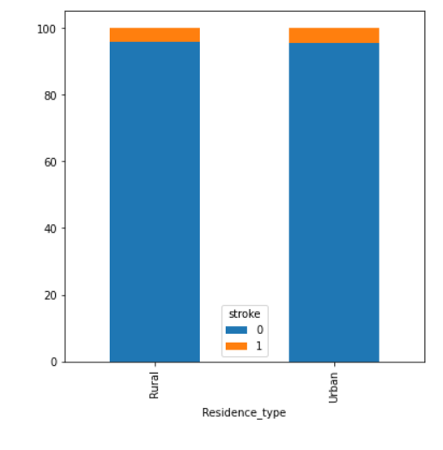
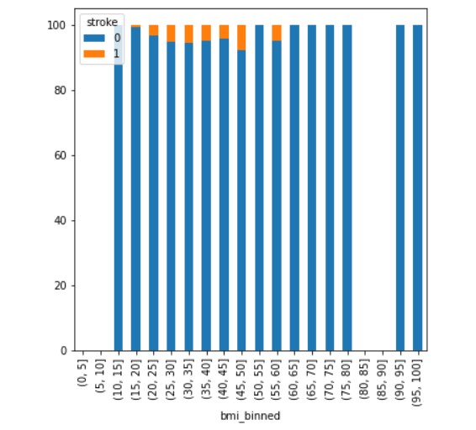
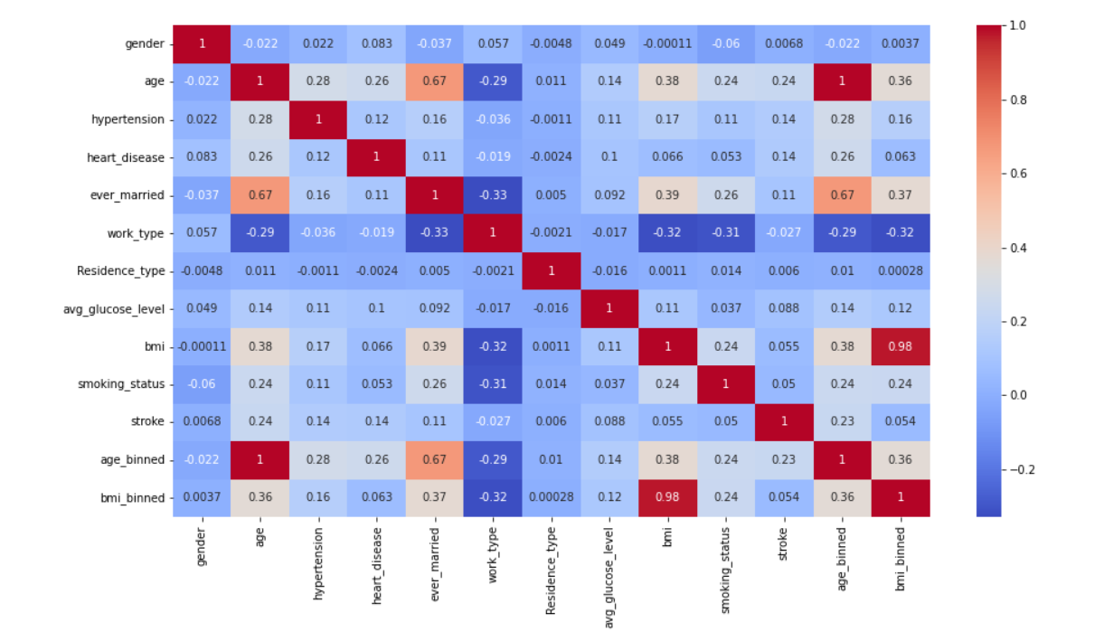
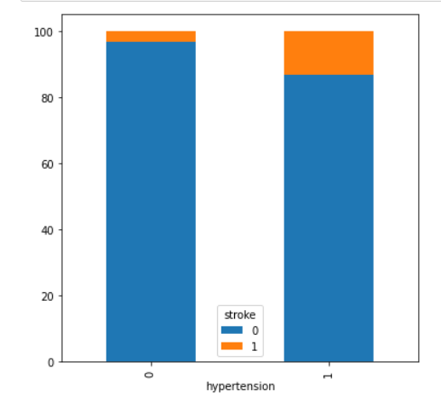
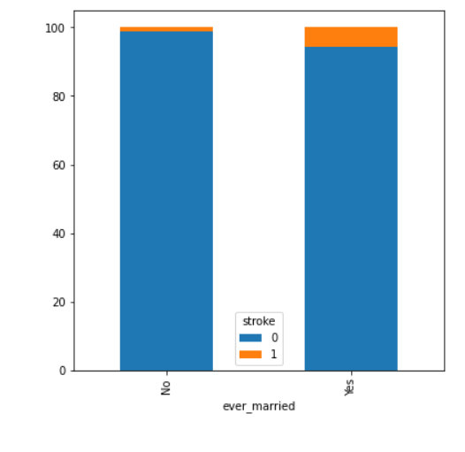
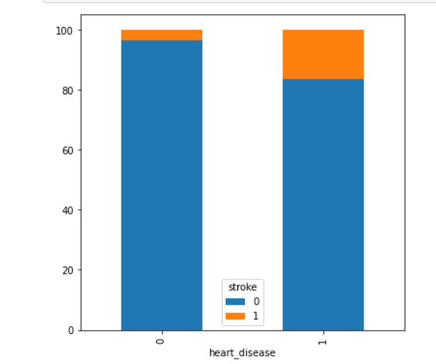
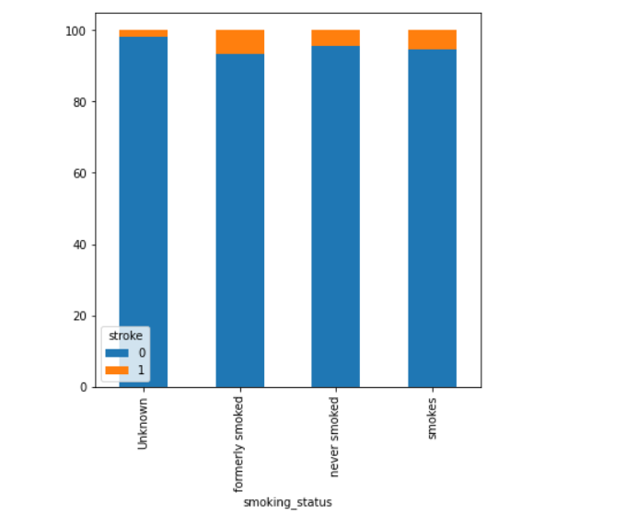
Problem Statement and Dataset Discussion
Problem Statement:This dataset is used to predict whether a person can suffer from a stroke based on the input parameters like gender, age, marital status, work type, residence type , different health Issues, and smoking status.
Dataset Description: The dataset consisted of 5110 records with 12 variables which includes people’s demographic data (gender, age, marital status, type of work and residence type) and health records (hypertension, heart disease, average glucose, Body Mass Index (BMI), smoking status and experience of stroke).
Statistical plots:

Slide 3
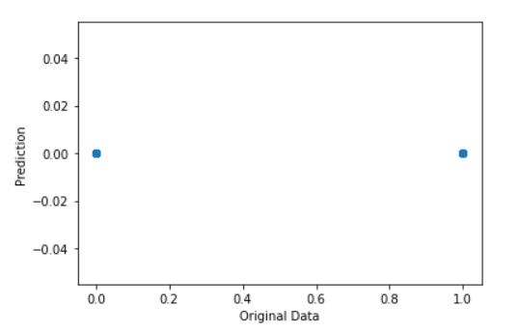
Proposed Analytical/Predictive Model
First of all I removed the Id column as it was not necessary for prediction and then I preprocessed the data and converted the categorical data to numbers. Then I did the Bivariate analysis. In the dataset, The Variables are ordinal, numeric, and categorical and are related nonlinearly and is also non-normally distributed so to find the co-relation i used Spearman’s Rank Correlation. and after that i did the Prediction.
As a Prediction Model I have Used Logistic Regression Classification Model because in the selected data set most values are binary so Classification model is the best one to be used as Classification algorithms are used to predict/Classify the discrete values. And then there were only two classes so I have used Logistic regression Classification Model.
As The Data set mainly contains Binary value we
cant see all the prediction value and all original
value as all the values are either 0 or 1 and so all
the data points are overlapping each other.

Slide 4
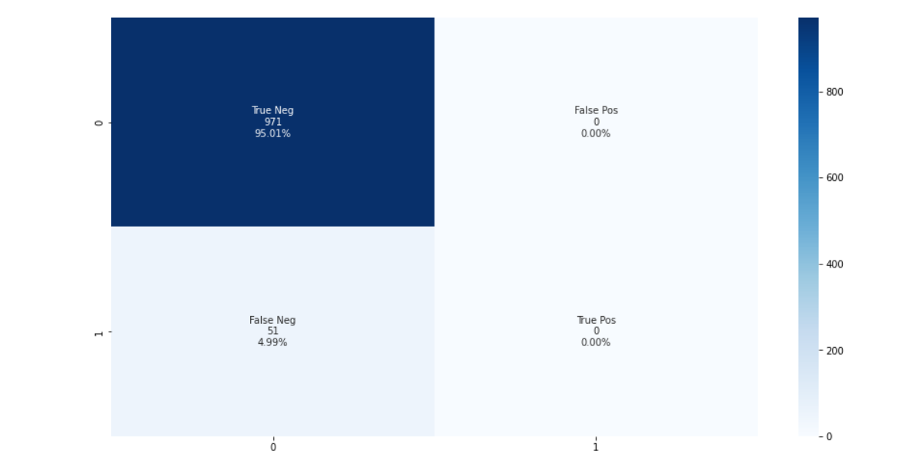
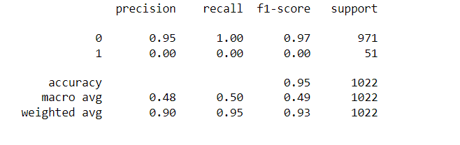
Results and Discussion
Observations:
  Old people are more likely to suffer from a stroke compared to young people.
  Gender Does not show much variation, Both Male and Female have equal chances of having stroke.
  People with HyperTension has higher chances of stroke
  From the analysis it can be said married people suffer from stroke more, but again that is a fact that married people are older in age compared to unmarried so we cannot infer much from it.
  People from Rural areas as well as urban areas both suffer from strokes equally.
  People with BMI 45-50 suffer more from stroke.
  Even the Non Smokers can get a stroke so Smoking does not make any difference in chances of getting a stroke.
  We could only see correlation between variables age and ever_married.
The Model has achieved 95% accuracy and 0.97 f1-score.
Heat Map of Confusion Matrix Classification Report

