Slide 1
A Prototype for Preservation and Harvesting of International ETDs using LOCKSS and OAI-PMH
9th ETD Conference
Venue: Quebec City, Canada
Date: Jun 9th, 2006
Presented By:
Kamini Santhanagopalan
Virginia Tech

Slide 2
Authors:
  Kamini Santhanagopalan, Graduate Student, Department of CS, Virginia Tech
  Dr. Edward A. Fox, Professor, Department of CS, Virginia Tech
  Prof. Gail McMillan, Director, DLA, Virginia Tech

Slide 3
Agenda
Introduction to Digital Data Preservation
What is LOCKSS
Participating Universities
International ETDs Preservation
Analysis and Results
Conclusion

Slide 4
Digital Data Preservation
Goal
  Digital information should be
    Readable
    Usable, in the future
Preservation – NOT just backup
Existing preservation techniques
  Floppy, CD and Hard Disk Drives
  Central and distributed database servers

Slide 5
LOCKSS
Lots of Copies Keep Stuff Safe (LOCKSS)
  Peer-to-peer digital preservation system
  Open Source Software
  Turns a low cost PC into a digital preservation appliance
  Easy, inexpensive way to
    Collect
    Store
    Preserve, and
    Provide Access to the contents

Slide 6
Functions of LOCKSS (1)
Collecting
  Via a web crawler
    Appropriate crawl rules are specified
Preserving and Auditing
  Every institution preserves
    Its own contents, and
    Contents of other universities

Slide 7
Functions of LOCKSS (2)
Providing Access
  By running web proxies
  Can provide open or restricted access
Administering
  Via a web user interface
    Controlling access to appliance and other functions

Slide 8
LOCKSS Preservation
Contents of each university (M1 through M5) preserved at every other node
  Multiple copies
Not a backup, which is unreliable
* Universities are represented by nodes
M2
M1
M3
M5
M4

Slide 9
Preservation using LOCKSS
Pre-requisites
  Minimum hardware configuration requirement
  LOCKSS software needs to be installed in the respective systems
  The university (whose digital data needs to be preserved) has to give permissions for the LOCKSS system to collect and preserve journals/ETDs
    Permissions page is called “publisher manifest page”

Slide 10
Participating Universities
International universities
  Pontifícia Universidade Católica do Rio de Janeiro, Brazil
  Humboldt-Universität, Germany
  University of Cape Town, South Africa
US universities
  Florida State University
  Georgia Tech
  Virginia Tech

Slide 11
International ETDs Preservation (1)
For International universities
  Plug-ins were written for collecting contents of ETD collections of the 3 universities
For US universities
  The created OAI plug-ins for the 3 universities in US were verified and reused

Slide 12
International ETDs Preservation (2)
Example ETD collection
  University of Cape Town ETD collection
  Manifest page: http://pubs.cs.uct.ac.za/lockss/manifest.html
  The screen shots of the UCTPlugin and the crawl results of contents are shown below

Slide 13
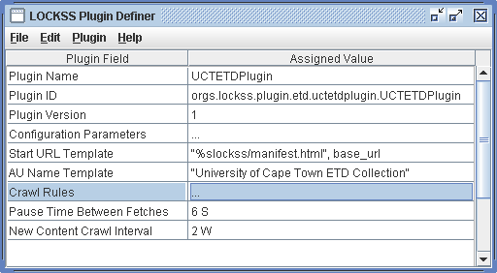
University of Cape Town Plug-in (1)

Slide 14
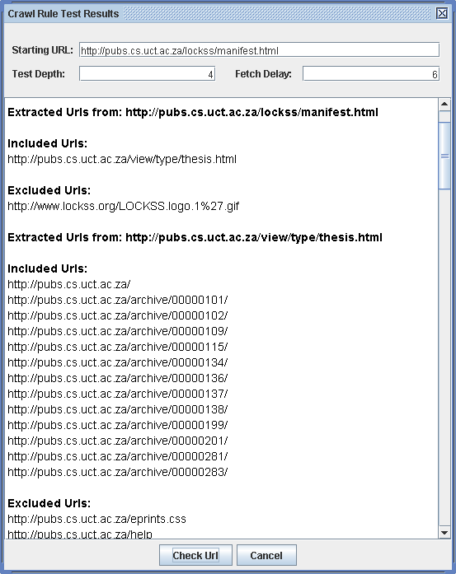
UCTPlugin:
Crawl Results with
Level (depth) =4
Fetch delay = 6 seconds, is shown here

Slide 15
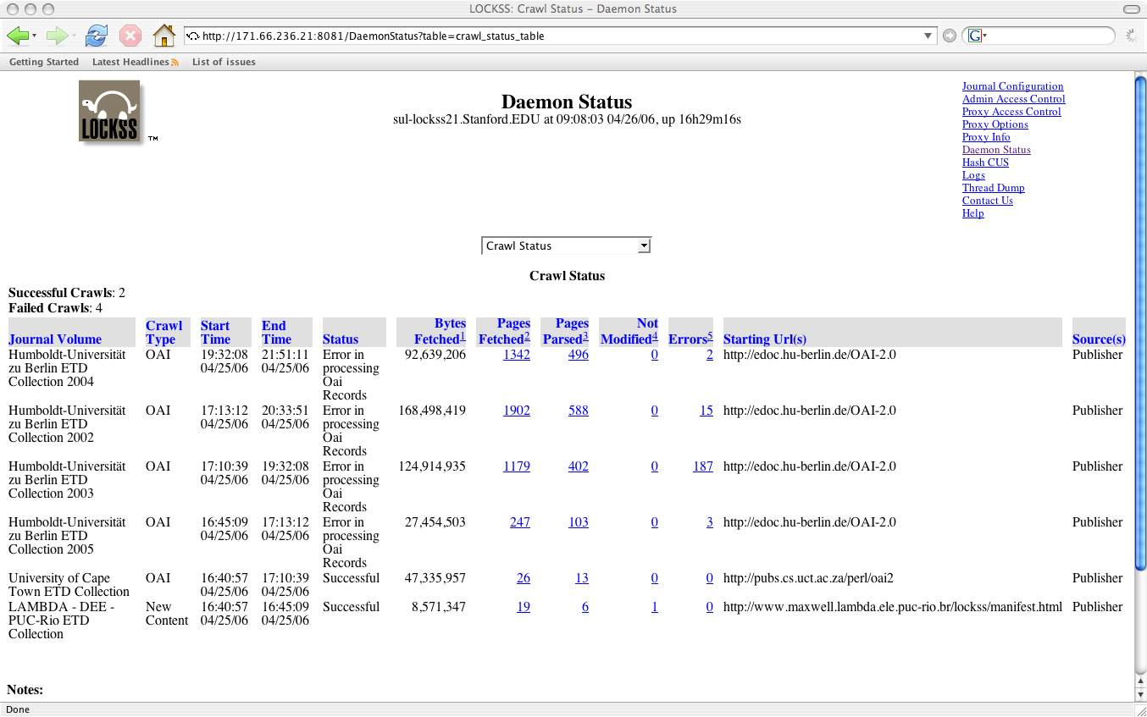
Harvesting of International ETD Collections

Slide 16
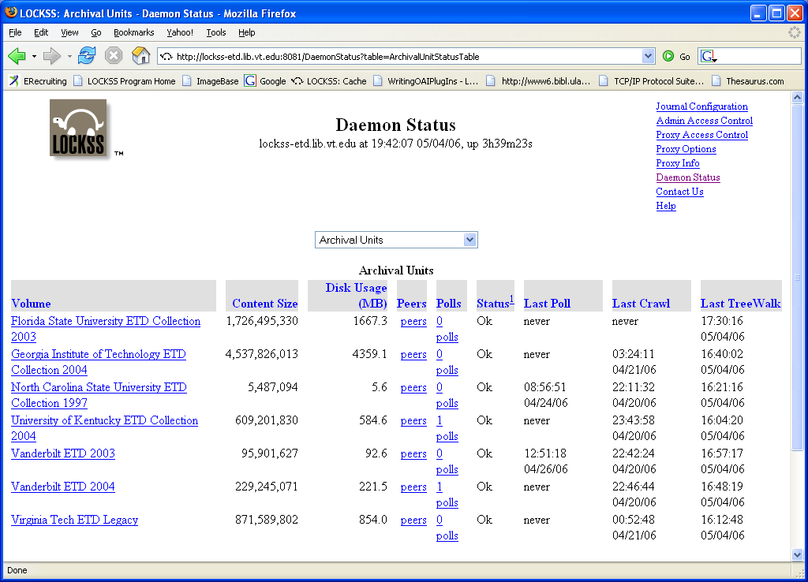
Harvesting of US universities’ ETD Collection [source: http://lockss-etd.lib.vt.edu:8081/DaemonStatus ]

Slide 17
Tutorial for writing plug-ins
A mini tutorial on writing plug-ins using LOCKSS tool is available at http://scholar.lib.vt.edu/lockss/introduction.htm
It is a 10 screen tutorial explaining how to write plug-ins
  Example journal considered: Virginia Libraries
This tutorial can be
  Generalized for ETD plug-ins
  Extended to write OAI plug-ins

Slide 18
Conclusion & Future work
International ETDs can be harvested and preserved using LOCKSS and OAI-PMH
It requires collaboration and help from participating universities
Future Work
  An online portal open for the public to view certain details could be incorporated later

Slide 19
Acknowledgements
Sincere thanks to Dr. Edward Fox and Prof. Gail McMillan, Virginia Tech
Special thanks to Mr. Thomas Robertson and Mr. Seth Morabito, Stanford Universities
Thanks to all participating universities

Slide 20
Any Questions?
Send in your Questions/Comments to ksanthan@vt.edu

Slide 21
Thank You!

