Slide 1

Digital Library Curriculum Development:
Enhancing Education and
Comprehension of NDLTD
Edward A. Fox, Seungwon Yang,
Barbara M. Wildemuth, Jeffrey Pomerantz
ETD 2006, Quebec Canada

Slide 2
NDLTD Goals
For Students:
  Gain knowledge and skills for the Information Age, especially about Digital Libraries
  Richer communication (digital information, multimedia, …)
For Universities:
  Easy way to enter the digital library field and benefit thereby
For the World:
  Global digital library – large, useful, many services

Slide 3
Curriculum Development Project
Collaborative Research launched by:
- Department of Computer Science, Virginia Tech
- School of Information and Library Science (SILS), University of North Carolina, Chapel Hill
Three year (2006 - 2008) NSF-funded project
Partly will help achieving NDLTD goals

Slide 4
Project Teams / NSF Grant
Project Team at VT (IIS-0535057):
  PI: Dr. Edward A. Fox (fox@vt.edu)
  GRA: Seungwon Yang (seungwon@vt.edu)
Project Team at UNC-CH (IIS-0535060):
  Co-PI: Dr. Barbara Wildemuth (wildem@ils.unc.edu)
  Co-PI: Dr. Jeffrey Pomerantz (pomerantz@unc.edu)
  GRA: Sanghee Oh (shoh@email.unc.edu)

Slide 5
Project Links
Homepage
http://curric.dlib.vt.edu/DLcurric.html
- overview, other links, progress diary, news &
interviews
Project progress diary
http://tuppence.dlib.vt.edu/blogs/index.php?blog=2
- discussion summaries, meeting pictures, events,
announcements

Slide 6
News and Interviews
WVTF Public Radio: Morning Edition,
"Interview with Dr. Fox" [January 30, 2006]
VT Collegiate Times article [January 26, 2006]
UNC Gazette article [January 25, 2006]
Virginia Tech Computer Science Department News article [January 23, 2006]
Virginia Tech News article [January 20, 2006]

Slide 7
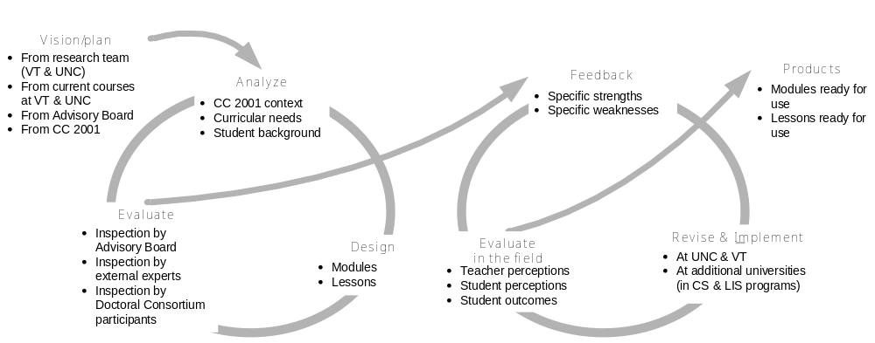
Development / Evaluation Process
January 2006 – December 2008

Slide 8
Project Timeline
Activities |  | 2006 |  |  | 2007 |  |  | 2008
 | Sp | Su | Fa | Sp | Su | Fa | Sp | Su | Fa
Creation of an advisory board
Engagement of experts to assist with module development
Development of modules
Development of lessons within modules
Development of 1- and 2-semester courses
Preliminary evaluation of modules and lessons by experts
Revision of modules and lessons
Implementation of modules and lessons in existing courses
Evaluation of modules and lessons in the field
Offering of new courses at UNC & VT
ETD, JCDL and Doctoral Consortium
ECDL & SIGIR conferences
ASIS&T conference
ICADL conference

Slide 9
What We Do:
Identify, develop and test educational DL modules, guided by
- Experts and international collaborators
- Computing Curriculum 2001 [6, 7]
- 5S framework [1,2,3,4]
(Ex) Module revision in 3/27/06
- Analysis of DL course syllabi
(Ex) UNC-CH is collecting DL syllabi
VT collected syllabi from DELOS member institutions in Europe
- Development of module template

Slide 10
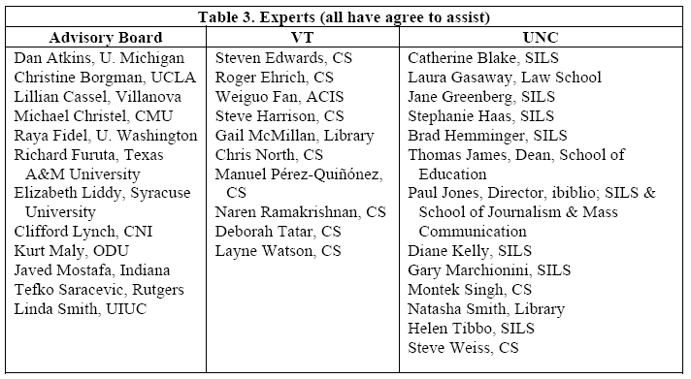
Experts / Advisory Board Members

Slide 11
Selected International Collaborators
India
Dr. Arun Kumar Chakraborty
– Bose Institute, Kolkata, India
Brazil
Dr. Ricardo da Silva Torres
– State University of Campinas (UNICAMP), SP, Brazil

Slide 12
What We Do:
Identify, develop and test educational DL modules, guided by
- Experts and international collaborators
- Computing Curriculum 2001 [6,7]
- 5S framework [1,2,3,4]
(Ex) Module revision in 3/27/06
- Analysis of DL course syllabi
(Ex) UNC-CH is collecting DL syllabi
VT collected syllabi from DELOS member institutions in Europe
- Development of module template

Slide 13
CC2001 Information Management Areas
IM1. Information models and systems* | IM8. Distributed DBs
IM2. Database systems* | IM9. Physical DB design
IM3. Data modeling* | IM10. Data mining
IM4. Relational DBs | IM11. Information storage and retrieval
IM5. Database query languages | IM12. Hypertext and hypermedia
IM6. Relational DB design | IM13. Multimedia information & systems
IM7. Transaction processing | IM14. Digital libraries

Slide 14
What We Do:
Identify, develop and test educational DL modules, guided by
- Experts and international collaborators
- Computing Curriculum 2001 [6,7]
- 5S framework [1,2,3,4]
(Ex) Module revision in 3/27/06
- Analysis of DL course syllabi
(Ex) UNC-CH is collecting DL syllabi
VT collected syllabi from DELOS member institutions in Europe
- Development of module template

Slide 15
5S Framework
Developed by Digital Library Research Laboratory (DLRL) at Virginia Tech
Strong foundation for DL module development
Captures entities and medium involved in DLs.
The five S’s
- streams, structures, spaces, scenarios, societies

Slide 16
5S Framework (2)
“Streams”
- All types of contents
(as well as communications and flows over networks, or into sensors, or sense perceptions)
“Structures”
- Organizational schemes
(including data structures, databases, and knowledge representations)

Slide 17
5S Framework (3)
“Spaces”
- 2D and 3D interfaces, GIS data,
representations of documents and queries.
“Scenarios”
- System states and events, but also can represent
situations of use by human users (or machine
processes, yielding services or transformations of data).
“Societies”
- Both software “service managers” and fairly generic
“actors” who could be (collaborating) human (users).

Slide 18
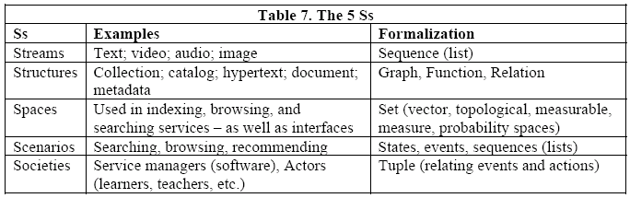
5S Examples

Slide 19
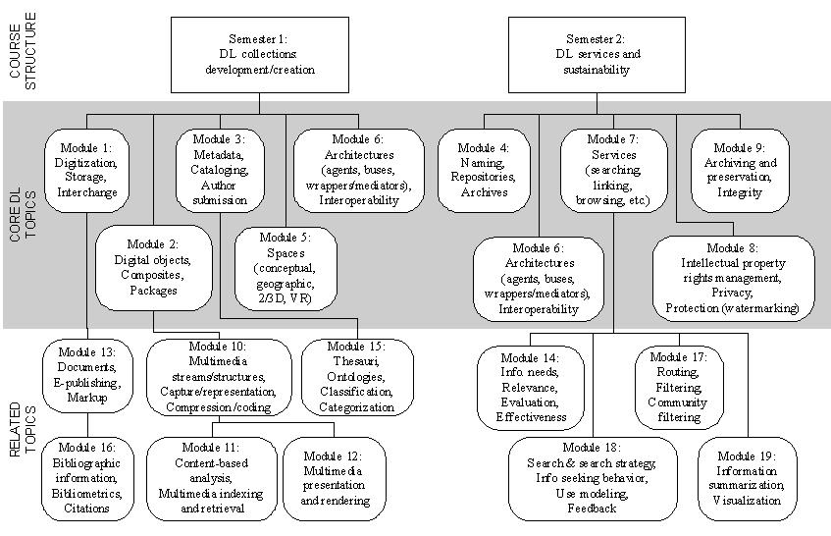
DL Topics in 19 Modules (original)

Slide 20
Module Revision in 3/27/06
Organized using 5S framework
STREAM
Collection Development
  Digitization
  Document and E-publishing Markup
  Harvesting
Digital objects/Composites/Packages
  Text Resources
  Multimedia streams/structures, Captures/representation, Compression/coding
    Content-based analysis, Multimedia indexing
    Multimedia presentation rendering
STRUCTURE
Metadata, Cataloging, Author submission
  Thesauri, Ontologies, Classification, Categorization
  Bibliographic information, Bibliometrics, Citations
Architecture (agents, buses, wrappers/mediators), Interoperability

Slide 21
Module Revision 06/01/06
SPACE
Spaces (conceptual, geographic, 2/3D, VR)
  Storage
  Repositories, Archives
SENARIOS
Services (searching, linking, browsing, etc.)
  Info needs, Relevance, Evaluation, Effectiveness
  Search & search strategy, Info seeking behavior, User modeling, Feedback
  Routing, Filtering, Community filtering
  Sharing, Networking, Interchange
  Info summarization, Visualization
Archiving and preservation integrity (ILS)
SOCIETIES
Intellectual property rights management, Privacy, Protection (watermarking) (ILS)
Social issues / Future DLs

Slide 22
What We Will Do:
Each module will include
- Topics
- Lesson plan
- Concept maps
- Recommended reading list
- Demos / online resources
- Exercises and quizzes
The first will be developed during this summer…

Slide 23
What We Will Do:
Course Development (summer 2006)
- 1-semester and 2-semester courses
will be based on the developed modules
Courses and modules will be…
- Evaluated by experts
- Pilot-tested in CS and LIS courses by
the U.S. institutions and our international
collaborators in India (Dr. Arun Kumar Chakraborty)
and Brazil (Dr. Ricardo da Silva Torres).

Slide 24
Dissemination Efforts
Conference | Type | Status
JCDL 06 | Curriculum Development for Digital Libraries (paper) | Accepted
ETD Symposium 06 | Digital Library Curriculum Development: Enhancing Education and Comprehension of NDLTD (paper) | Accepted
ICADL 06 | Collaborative Research: Community-Oriented Curriculum Development for Digital Library Education (paper) | Planned

Slide 25
Ascertaining Priority Topics
We’ve manually classified and analyzed publications using 9-Modules (revised):
 | Source | Count
Proceedings | JCDL ’01 – ’05 | 354
Proceedings | ACM DL ’96 – ’00 | 189
Magazine articles | D-Lib ’95 – ‘06 | 521
Session titles | JCDL, ACM DL, ECDL | 264

Slide 26
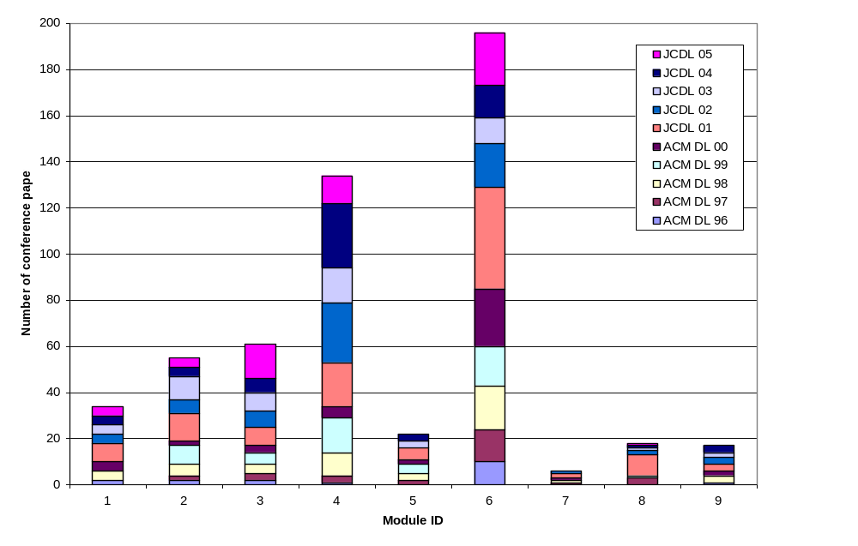
Distribution of Conference Papers across Module Topics

Slide 27
Analysis Results:
Total of 543 proceedings:
Most popular topics were
architecture (module 4) and services (module 6)

Slide 28
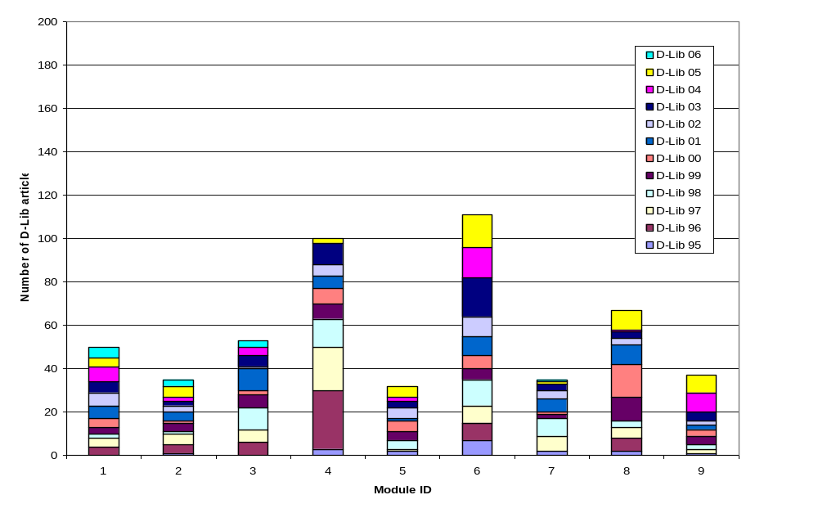
Distribution of D-Lib Magazine Articles across Module Topics

Slide 29
Analysis Results:
Total of 521 articles:
Most popular topics were
architecture (module 4), services (module 6)
and social issues (module 9)

Slide 30
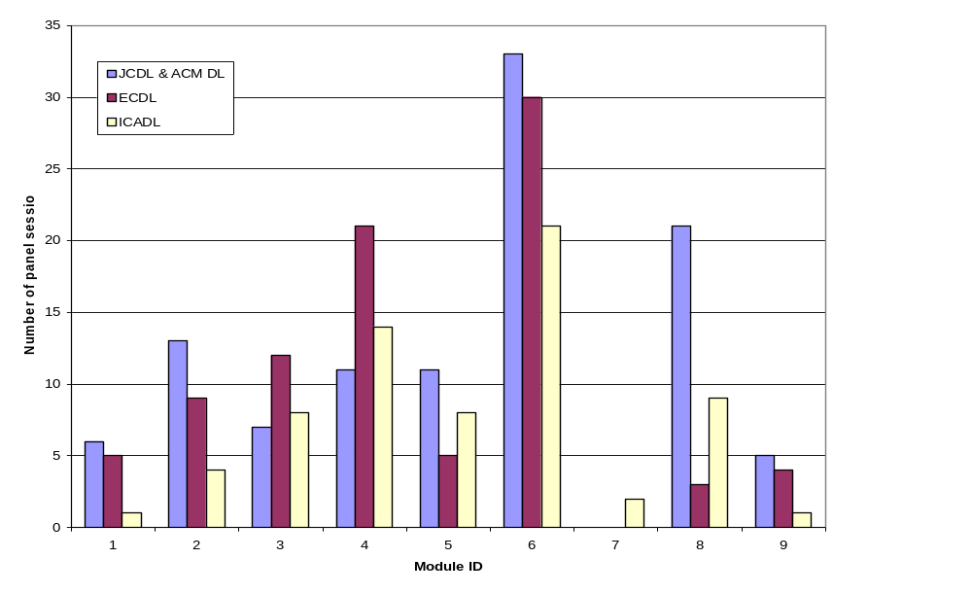
Distribution of Session Titles across Module Topics

Slide 31
Analysis Results:
Total of 264 session titles (JCDL, ECDL, ICADL):
Most popular topic was services (module 6)
followed by architecture (module 4)

Slide 32
What We Do:
Identify, develop and test educational DL modules, guided by
- Experts and international collaborators
- Computing Curriculum 2001
- 5S framework
(Ex) Module revision in 3/27/06
- Analysis of DL course syllabi
(Ex) UNC-CH is collecting DL syllabi
VT collected syllabi from DELOS member institutions in Europe
- Development of module template

Slide 33
Resource Analysis
- European DL course syllabi -
DL-related course syllabi were collected from
- DELOS member institutions in Austria,
Czech Republic, United Kingdom, Switzerland,
Norway, and Germany
English resources (reference papers, textbooks, online demo) were retrieved from the syllabi and organized into tables.
We will expand this effort to include courses in the U.S., Asia, and Oceania.

Slide 34
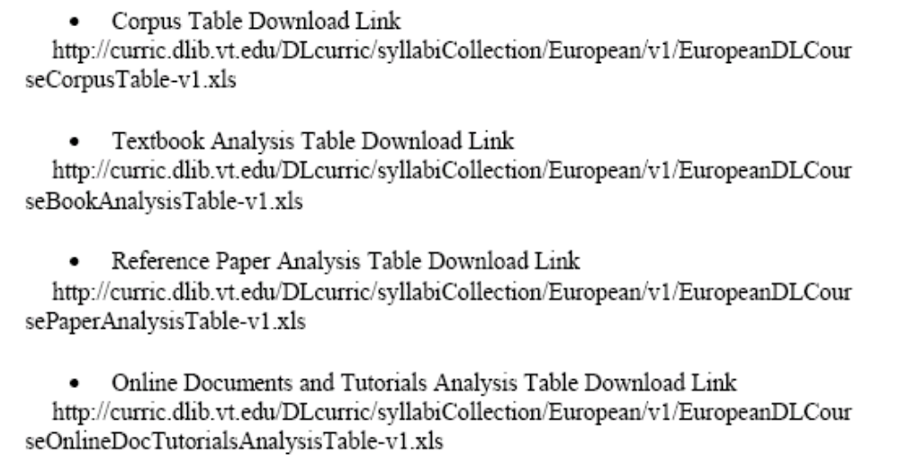
Links to Resources
Excel files can be downloaded from the links below.

Slide 35
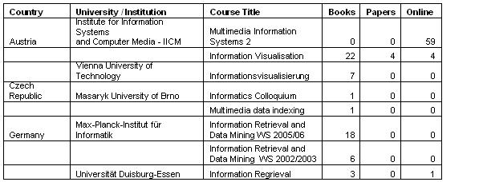
Selected Corpus Table

Slide 36
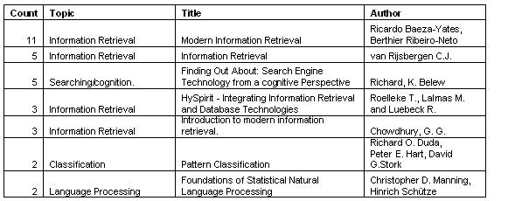
Selected Textbooks

Slide 37
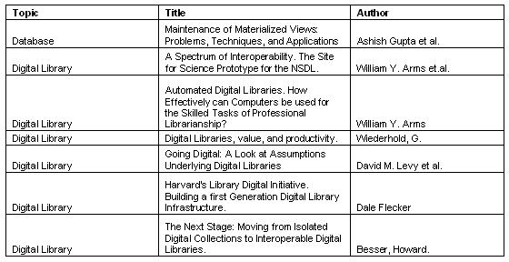
Selected Reference Papers

Slide 38
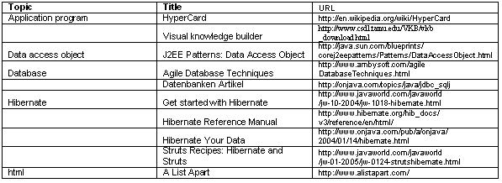
Online Software, Demos, Tutorials

Slide 39
Taxonomy Development:
- By examining the syllabi and current DL courses, we developed a Taxonomy of DL Educational Resources

Slide 40
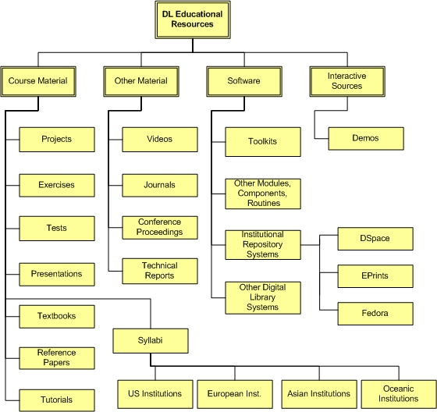
Taxonomy of DL Educational Resources

Slide 41
Textbook on DLs
PI Fox, along with co-author Gonçalves, is preparing a textbook on DLs based on 5S
This work will rely on the 5S framework to ensure that it provides integrated coverage of the many concepts related to DLs
Fox and Gonçalves are focused on a book for teaching as well as reference

Slide 42
Textbook Outline
Ch. 1. Introduction (Motivation, Synopsis)
Part 1 – The “Ss”
  Ch. 2: Streams
  Ch. 3: Structures
  Ch. 4: Spaces
  Ch. 5: Scenarios
  Ch. 6: Societies

Slide 43
Textbook Outline
Part 2 – Higher DL Constructs
  Ch. 7: Collections
  Ch. 8: Catalogs
  Ch. 9: Repositories and Archives
  Ch. 10: Services
  Ch. 11: Systems
  Ch. 12: Case Studies

Slide 44
Textbook Outline
Part 3 – Advanced Topics
  Ch. 13: Quality
  Ch. 14: Integration
  Ch. 15: How to build a digital library
  Ch. 16: Research Challenges, Future Perspectives
Appendix
  A: Mathematical preliminaries
  B: Formal Definitions: Ss
  C: Formal Definitions: DL terms, Minimal DL
  D: Formal Definitions: Archeological DL
  E: Glossary of terms, mappings

Slide 45
What We Do:
Identify, develop and test educational DL modules, guided by
- Experts and international collaborators
- Computing Curriculum 2001 [6,7]
- 5S framework [1,2,3,4]
(Ex) Module revision in 3/27/06
- Analysis of DL course syllabi
(Ex) UNC-CH is collecting DL syllabi
VT collected syllabi from DELOS member institutions in Europe
- Development of module template

Slide 46
Module Template
Module Design is based on the resources below and the UNC’s module template
1. Yue-Ling Wong, Jennifer Burg, and Leah McCoy, “Integrated
Digital Media Curriculum Development Project” Supported by the National Science Foundation under Grant No. DUE-0340969, from Jan 2004 - Dec 2006. The project homepage URL is http://digitalmedia.wfu.edu/project/digital-media-curriculum-development/textbased-index.html
2. Ze-Nian Li and Mark S. Drew, “Fundamentals of Multimedia” at http://www.cs.sfu.ca/mmbook/
3. Multimedia Systems course website, Department of computer science at University of Victoria, British Columbia, Canada. URL: http://www.csc.uvic.ca/courses/spring2004/csc/461-561.html

Slide 47
Module Template (2)
VT Template + UNC Template - June 2, 2006 (draft)
1. Module name
2. Learning objectives
3. Level of effort required (in-class and out-of-class
time required for students)
4. Prerequisite knowledge required (completion
optional)

Slide 48
Module Template (3)
5. Relationships with other modules
6. 5S characteristics of the module
7. Introductory remedial instruction
(completion optional: intended to address the prerequisite knowledge/skills required)
8. Resources (textbooks, required and optional readings for instructors and students)
→ plan A: all resources of the module are here

Slide 49
Module Template (4)
9. Body of knowledge (Theory + Practice)
Topics might be skipped or studied in different orders
  Topic 1
  Theories and background knowledge of the topic
  Learning activities
      - Chapters in the textbook / presentation slides
      - Interactive demo
  Resources → plan B: each topic has its resources
    - Reference papers (relevant parts might be marked with
    SI tool)
    - Advanced reading
    - Worksheets
  Topic 2
  ….
  Topic 3
  ….

Slide 50
Module Template (5)
10. Concept map (created by students)
11. Exercises / Learning activities
12. Evaluation of learning outcomes
13. Glossary
14. Useful links

Slide 51
Multimedia Module – Example
- Focus on the Body of Knowledge-
1. Module: 2.b.i Multimedia
2. Learning objective
- Gain knowledge of multimedia content
preservation, processing, and services in DL
3. Level of effort required
4. Prerequisite knowledge required (completion
optional)

Slide 52
Multimedia Module – Example (2)
5. Relationships with other modules
6. 5S characteristics of the module: Stream
7. Introductory remedial instruction
(completion optional: intended to address the prerequisite knowledge/skills required)
8. Resources will be in each topic
Digital Object
/Composite/Packages
Text Resources
Multimedia Resources

Slide 53
Multimedia Module – Example (3)
9. Body of Knowledge
Topics:
  1. Digital Data Representation and Communication
  2. Digital Image Representation
  3. Digital Image Processing
  4. Digital Audio Representation

Slide 54
Multimedia Module – Example (4)
- Topic Detail -
5. Digital Audio Processing
Digital Audio Processing (text)
File Size and Data Transfer Rate (worksheet)
Audio Dithering
  Interactive
  Mathematical Modeling (worksheet)
Noise Shaping
  Mathematical Modeling (worksheet)
Non-Linear Companding and mu-Law Encoding
  Interactive
  Mathematical Modeling (worksheet)
  Implementing mu-Law Encoding (programming worksheet) (worksheet)
Audio Processing: Adobe Audition (worksheet)

Slide 55
Multimedia Module – Example (5)
-Topic Continue -
Topics (continued...)
  6. Digital Video Representation
  7. Digital Video Processing
  8. Multimedia Programming

Slide 56
Summary
Identify, develop and test educational DL modules, guided by
- Experts and international collaborators
- Computing Curriculum 2001
- 5S framework
(Ex) Module revision in 3/27/06
- Analysis of DL course syllabi
(Ex) UNC-CH is collecting DL syllabi
VT collected syllabi from DELOS member institutions in Europe
- Development of module template

Slide 57
Conclusion
We hope that this project, DL curriculum development, would help achieving NDLTD goals benefitting students, universities and the world.
NDLTD Goals:
For Students:
  Gain knowledge and skills for the Information Age, especially about Digital Libraries
  Richer communication (digital information, multimedia, …)
For Universities:
  Easy way to enter the digital library field and benefit thereby
For the World:
  Global digital library – large, useful, many services

Slide 58
References
[1] M. Gonçalves, E. Fox, L. Watson, and N. Kipp, “Streams, Structures, Spaces, Scenarios, Societies (5S): A Formal Model for Digital Libraries,” ACM Transactions on Information Systems, vol. 22, pp. 270-312, 2004.
[2] M. A. Gonçalves, “Streams, Structures, Spaces, Scenarios, and Societies (5S): A Formal Digital Library Framework and Its Applications,” Computer Science Doctoral Dissertation. Blacksburg, VA: Virginia Tech, 2004, 161 pages. http://scholar.lib.vt.edu/theses/available/etd-12052004-135923/unrestricted/MarcosDissertation.pdf
[3] M. A. Gonçalves and E. A. Fox, “5SL - A Language for Declarative Specification and Generation of Digital Libraries,” in Proc. JCDL’2002, Second ACM / IEEE-CS Joint Conference on Digital Libraries, July 14-18, G. Marchionini, Ed. Portland, Oregon, USA: ACM, 2002, pp. 263-272.

Slide 59
References
[4] Q. Zhu, “5SGraph: A Modeling Tool for Digital Libraries,” Department of Computer Science MS thesis. Blacksburg: Virginia Tech, 2002. http://scholar.lib.vt.edu/theses/available/etd-11272002-21053
[5] NDLTD, Networked Digital Library of Theses and Dissertations. available at http://www.ndltd.org, 2006
[6] CC2001, “Computing Curricula 2001: Computer Science (IEEE Computer Society and Association for Computing Machinery Joint Task Force on Computing Curricula),” Journal on Educational Resources in Computing (JERIC), vol. 1, 2001. http://doi.acm.org/10.1145/384274.384275
[7] CC2001, “Computing Curricula 2001 (Web Site),” vol. 2004: ACM and IEEE-CS, 2001. http://www.computer.org/education/cc2001

Slide 60
Thank you!

