Slide 1
The Role of Penn State in Promoting Intellectual Property Rights Through eTDs Publishing
Naseem Saeed Sherwani
The Pennsylvania State University
Email: nss143@psu.edu

Slide 2

Purpose
To review the efforts made at Penn State
Current situation using
Graduate school data base
Interviews of key players

Slide 3
Definitions
IPRs: Information, ideas, and other intangible assets in expressed form.
Copyrights: Legal protection of intellectual property, denoted by ©.
eTDs: Digitally produced, archived, and accessed theses and dissertations (Soete,1998). http://etd.psu.edu

Slide 4


eTDs Creation & Development
Students
ProQuest
Keyword Form
Copyright Form
Publications
Graduate
School
Certifying thesis
Handling receipt
Paper work for publishing
ProQuest/
UMI
Universities
Libraries

Slide 5
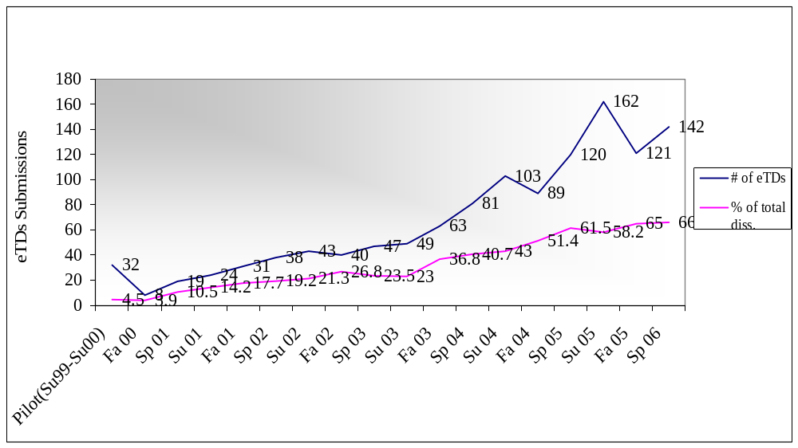
eTDs Submissions

Slide 6
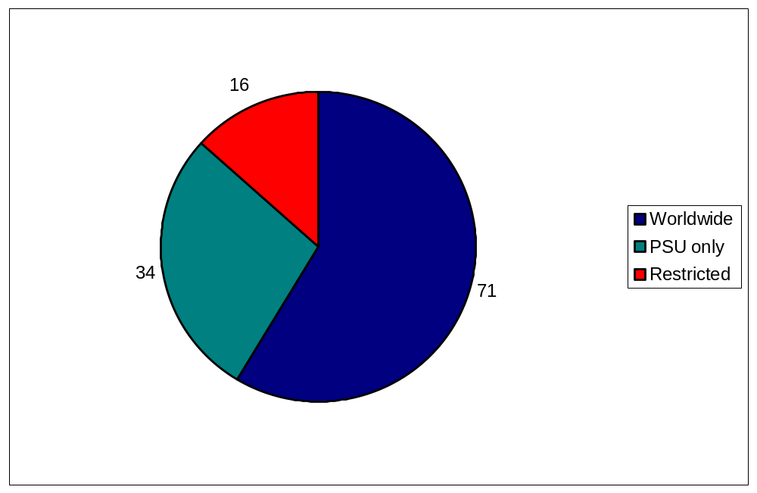
Availability options (Fall 2005)

Slide 7
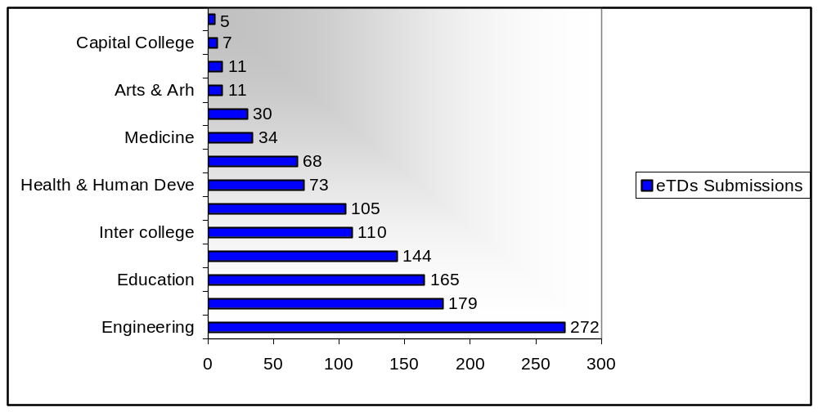
eTDs Submission by Colleges

Slide 8
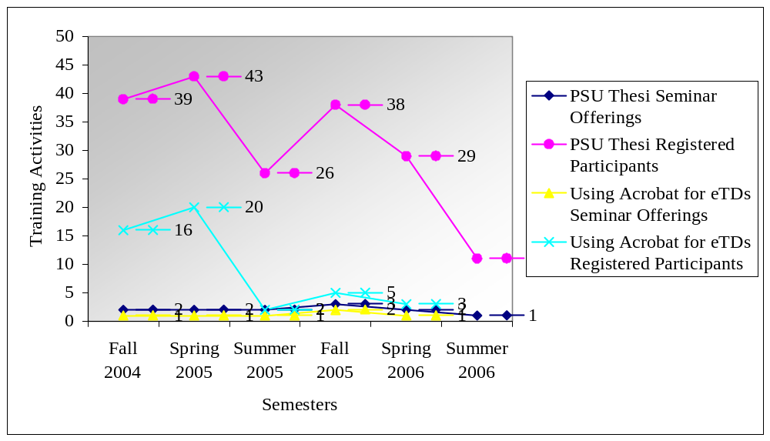
eTD Training of Graduate students

Slide 9
eTDs Formats
PDF or multimedia files
In addition to UMI, DLT provides the server and database for worldwide web
Regular data backed up by tape
Migration plan in progress
Disaster plan in progress

Slide 10
Milestones
Intellectual Property Right Office
Research budget > $638 million
Publication of research at Penn State
A signed ProQuest/UMI Doctoral Dissertation Agreement form by the doctoral student for granting permission to produce or distribute the work

Slide 11
Milestones
Pros
Accessibility
Wider dissemination
Reduced costs
Easy to fix last minute errors
Saves space
Enhance services
Cons
Republication
Books sales-No buy-ins
Lack of training
Lack of colors & graphics guidelines
Black & White distribution by UMI

Slide 12
Summary
More education about eTDs
Provision of Technical training
Simplified Procedures/Guidelines

Slide 13
Resources
Pennsylvania State University’s ETD web site: http://etd.psu.edu/
Pennsylvania State University’s ETD Cataloging Guidelines:
http://www.libraries.psu.edu/iasweb/catsweb/digital/edtd.htm
Pennsylvania State University’s Intellectual Property Office website:
http://www.research.psu.edu/ipo/index.html
Pennsylvania State University’s Thesis Guide (2006, January)
http://gradsch.psu.edu/current/thesis.html
Pennsylvania State University’s website for file formats:
http://cac.psu.edu/etd/howto/graphics
U.S. Copyright Office Website: http://lcweb.loc.gov/copyright/
Wikipedia Copyright issues the free encyclopedia
http://en.wikipedia.org/wiki/Copyright

Slide 14
Thank you for attention!

