Slide 1



DART-EUROPE
Digital Access to Research Theses
Christopher Pressler
Dean, Information and Learning
Dartington
Devon, UK
c.pressler@dartington.ac.uk

Slide 2
Content
Open Access in the UK and Europe
E-Theses in Europe
DART-Europe
Portal
Repository and Toolkit
Digital Preservation
Business Model and Value-Added Services

Slide 3
Activity in the UK
SHERPA repositories in 38 universities
  www.sherpa.ac.uk
  Of the top 20 UK universities, 16 have repositories
Research Assessment Exercise a major driver
  Copyright restrictions from publisher a major impediment
Ethos – Electronic Theses Online Service
– JISC funded project now in evaluation stage. Led by Consortium of University Research Libraries and The British Library
www.ethos.ac.uk

Slide 4
E-Theses in Europe
E-Theses
  not a universal driver in European Open Access debates
DiVA from Uppsala, Sweden
  Consortial Nordic E-Theses initiative
  www.diva-portal.org/
  10,138 research theses from 15 institutions
No pan-European approach to E-Theses development

Slide 5
DART-Europe
UCL, Dartington (founders)
ProQuest, (founders)
Trinity College Dublin
Oxford University
University College Dublin
Dublin City University
DiVa
Deutsche Bibliothek
Catalan Academic Libraries Consortium (CBUC)
Reported interest from France and Italy

Slide 6
Portal
Portal has been constructed "evaluatively."It will be the so-called "vanilla" model in this phase, founded on simple DC.
PQ were new to harvesting and have dealt with issues relating to consistency of practice at source repositories
The partners have been reviewing the Portal and influencing the usability of the interface.
content from UCL, TCD and DiVa, each representing a different type of contributor
Multi-lingual interfaces to be developed

Slide 7
Repository and toolkit
Hosted repository and toolkit are ready for use.
Trinity College Dublin has been working with ProQuest to customise it for the European market
Digital Preservation:
Digital preservation – develop a demonstrator service in the final 6 months of the project.

Slide 8
Business model
DART-Europe is testing new business models, moving to a model which allows customisation for each participating institution, consortium or country, with opt-in services for purchase on demand.
The following services were identified by the Board as potentially being of some interest to the community:

Slide 9
Added- Value Services
services at deposit
· hosted repositories
· plagiarism detection
· copyright checking
access services
· metadata enrichment, including subject keywording, abstract translation (not automated)
· full-text indexing
preservation services
· digital preservation, including format migration
· persistent identifiers
· microfilming of text-based theses
digital content creation
· retrodigitisation

Slide 10
Possible DART-Europe architectures
Institution/
Country/
Consortium
Germany
UCL
Dartington
Ireland
Spain
Nordic
countries
Holland
Oxford
Russia
Deposit
Deposit Software
Local /National
Platforms
& Access
IR
IR
IR
IRs
IR
IRs
IRs
IRs
OAI
Optional service Platform
OAI
OAI
Optional
DART-Europe
repository service
hosted by
ProQuest
International Platform
DART-Europe portal
DEEP
OAI
OAI
Optional Preservation Platform
ProQuest

Slide 11
Layers of service
DART-Europe will
  Create a ‘vanilla’ service, conforming to Open Access principles
    Where E-Theses can be deposited in Open Access repositories
    Metadata harvested
    European portal (DEEP) created
    View of European E-Theses available in one-stop search
  Other elements are optional and can be charged
    Deposit tool
    Additional functionalities
    Preservation platform

Slide 12
Main DART-Europe outputs
Customised deposit tool
DART-Europe repository service
DART-Europe portal (DEEP) .eu registered
Best-practice guidelines on E-Theses management
Preservation platform
Identification of multi-lingual issues
Identification of sustainable business models
Dissemination

Slide 13
Project timescales
Phase 1
  18 months – June 2005-December 2006
  Major technical development was completed in December 2005
  Deposit tool already being customised by partners
  Hosted repository service available
  DEEP portal created
  Initial partners identified
  Identify possible business models – where might this lead University / Publisher relationships?
  Seek endorsement from LIBER

Slide 14
Project timescales
Phase 2 (2007-)
  Enlarge partnership
    Special emphasis on EU Accession countries
  Multilingual aspects of project identified
    Projects identified to address these issues
  Technology watch to ensure systems and processes are best of breed
  Consider launch of DART-Europe as full service

Slide 15
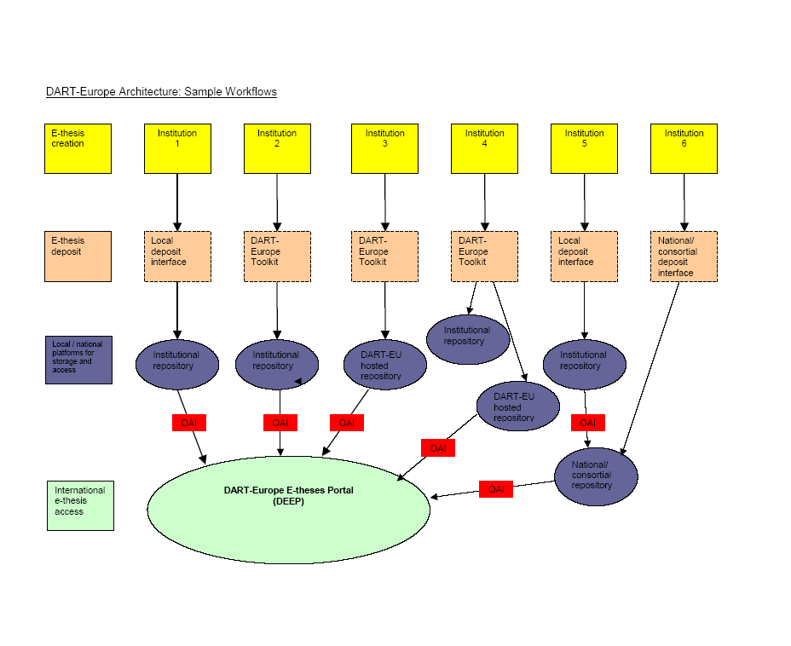


Slide 16
Objectives
To work together for the discovery, retrieval and use of research theses from European universities
  Working in an Open Access environment
  European in scope
  Aligned with national E-Theses developments in each member country
  To provide a ‘vanilla’ service, fully Open Access, which is free at point of use
  To develop a business model for Value-Added services

Slide 17

questions
www.dartington.ac.uk/dart/
www.dart-europe.org

