Slide 1
Open Access for ETDs
Unlocking Scholarly Access: ETDs, Institutional Repositories and Creators
9th International Symposium on ETDs
Quebec City, June 7-10, 2006
Peter Suber
Open Access Project Director, Public Knowledge
Research Professor of Philosophy, Earlham College
Senior Researcher, SPARC
peter.suber@earlham.edu

Slide 2

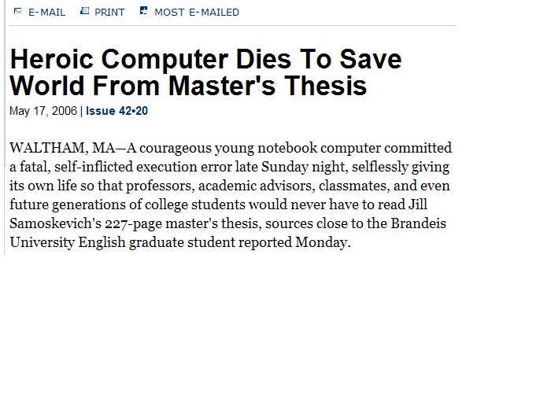
Notes:
Onion story,
http://www.theonion.com/content/node/48461

Slide 3
The dark ages
My dissertation
  Submitted, accepted in 1977
  Typed on an Olivetti typewriter
  Paid to have it retyped according to university’s formatting requirements
  Bound by university, placed in library, open stacks
  Sent a copy to UMI for on-demand, for-fee publishing (paper, microfilm)
  Stolen from library

Slide 4
Quality of TDs
Carefully vetted by expert faculty
Meet requirements for originality, contribution to knowledge, familiarity with the literature
Meet high standards of universities and faculty jealous of their reputations
Notes:
I don’t have to tell this audience about the quality of TDs, but here are a few points to consider
Journals are jealous of their reputations too; not saying univs have higher standard, merely that same dynamic is at work

Slide 5
Quality (2)
Compared to peer-reviewed journal articles,
  Longer, more detailed
  More responsive to past literature
  Scrutinized at least as rigorously
  Revised at least as often
  More time put into them
  Not (yet) salami-sliced

Slide 6
Quality (3)
Like preprints: not formally peer-reviewed
But faculty review is rigorous
  Sometimes more rigorous than formal peer review
  More focused, more time-consuming
Win-win
  Sufficiently rigorous to make TDs good, worth disseminating and using
  Sufficiently unconventional to avoid a publisher’s investment and barriers to OA

Slide 7
Invisibility of TDs
Copies seldom available from libraries
Copies available for a price
  But not well-indexed
  Hard to peruse before purchase
Many details from TD’s never make it into journal articles
Many TD topics too narrow to justify book publication

Slide 8
The pinch
TDs are high in quality, low in accessibility.
  The most invisible form of useful literature
  The most useful form of invisible literature
Because of their high quality, the access problem is worth solving.

Slide 9
Digression
Brief intro to OA
The low-hanging fruit and some higher-hanging varieties
(OA mandates by funding agencies and universities)

Slide 10
Open-access literature:
Digital
Online
Free of charge for everyone with an internet connection
Free of most copyright and licensing restrictions

Slide 11
Refining the definition
Digital and online
  …but compatible with print editions
Free of charge
  …but compatible with priced enhancements
Free of most permission barriers
  …but flexible about which to remove

Slide 12
Legal basis of open access
Public domain
  Copyright waived or expired
Copyright-holder consent
  The typical case for new research
  Consent to unrestricted reading, downloading, copying, sharing, storing, printing, searching, linking, crawling
  Consent with Creative Commons or similar license
  No need to abolish, reform, or violate copyright law

Slide 13
Three degrees of difficulty
When permission is unnecessary, already given, or easy to get
  Public domain lit
  Royalty-free lit (like journal articles)
  Funder-mandated OA
  Employer-mandated OA
When permission requires persuasion
  Royalty-producing lit (like books)
Copyright reform
  Shorten term of copyright, extend first-sale to digital content, restore fair-use rights, protect public domain

Slide 14
ETDs are Phase One
Permission easy to give
  ETDs are royalty-free
  Students will not lose revenue
Permission easy to get
  ETDs are subject to terms and conditions of university
  Even easier if reasonable exceptions allowed

Slide 15
Mandating OA to ETDs
OA not the hard step
Not original
Nine reasons
The university message
The paternalism objection
Sample policies
Snags and solutions
Advocacy and tactics

Slide 16
OA not the hard step
In principle, a university could encourage or require:
  Electronic submission without deposit
  Deposit without OA
But in practice, most that encourage or require electronic submission, also encourage or require OA.
The hard step is to encourage or require electronic submission.

Slide 17
Very different from journal lit
For TDs that are born digital, and submitted in digital form, OA is generally assumed
  Not at all the case for journal literature

Slide 18
Two lessons
Fostering ETDs fosters OA
  Arguments for ETDs include arguments for OA
My argument isn’t original
  You were all here before me

Slide 19
Other calls for OA for ETDs
Edward Fox and Gail McMillan (1997)
UNESCO ETD project called for “equal access” (1999)
Edinburgh’s Theses Alive (2004)
JISC’s Electronic Thesis Project (2005)
Richard Jones and Theo Andrew (2005)
Arthur Sale (2006)
DART (Digital Access to Research Theses)

Slide 20
The case for mandated OA to ETDs
Born-digital
Royalty-free
  Phase One (unlike the book it might become)
No publishers to resist, oppose, lobby
  No publisher fears of lost revenue
  No publisher permissions or negotiations
  Lowest of low-hanging fruit: royalty-free AND publisher-free (AND publicly-funded?)

Slide 21
OA for ETDs (4)
Mandates work, exhortations don’t
  Experience of funding agencies
    NIH v. Wellcome Trust
  Experience of universities
    Arthur Sales studies in Australia
    CERN

Slide 22
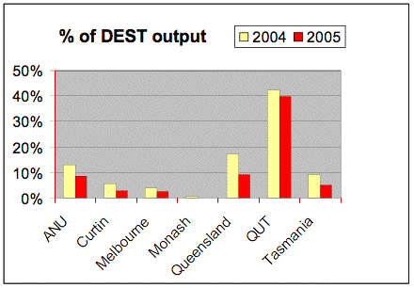
Compliance rates
Arthur Sale, First Monday, April 2006
Notes:
Arthur Sale, Comparison of content policies for institutional repositories in Australia, First Monday, April 2006.
http://www.firstmonday.org/issues/issue11_4/sale/
http://eprints.comp.utas.edu.au:81/archive/00000264

Slide 23
Compliance rates
“[V]oluntary ETD deposition results in repositories collecting less than 12% of the available theses, whereas mandatory policies are well accepted and cause deposit rates to rise towards 100%.”
  Arthur Sale, D-Lib, April 2006
Notes:
Arthur Sale, The Impact of Mandatory Policies on ETD Acquisition, D-LIB, April 2006
http://www.dlib.org/dlib/april06/sale/04sale.html

Slide 24
OA for ETDs (5)
Solve the invisibility problem
  Without OA, almost no access, visibility, or indexing for TDs
    Hard to retrieve even if discovered
    Hard to discover
  Mainstream search engines eager to crawl them; Google, Yahoo, Microsoft...
    NDLTD to be indexed by Scirus
  Improve citation impact 50-250%

Slide 25
OA for ETDs (6)
Universities are in a good position to mandate OA
  As a condition of submission and acceptance
  Easier to get authors’ attention, cooperation, than faculty
  Universities without IRs could
    Launch one
    Use existing ETD repositories, including NDLTD
    Use OARA

Slide 26
ProQuest-UMI options
Open Access ETDs in PQDT
  If authors or institutions decide on OA, then PQDT will make them OA
    Will also offer priced/printed version
    Expected in Fall 2005. Here yet?
PQDT Open
  OA dissertations will be available to all users, even non-subscribers
PQDT lets users view dissertations from their own institution without charge

Slide 27
OA for ETDs (7)
Educate the next generation of scholars about OA
  How easy it is
  How beneficial it is
  How routine and expected it ought to be
  Create life-long habits of self-archiving
  Remove the “unfamiliarity” obstacle

Slide 28
OA for ETDs (8)
Elicit better work
  Students do better work if they know their work will be seen by others
  OA provides a real audience beyond the thesis committee, and real incentives to do original, impressive work

Slide 29
OA for ETDs (9)
Take the work seriously
  University asks for a new and significant work of scholarship
  Public dissemination treats it as one
  Private dissemination and non-dissemination treat it:
    a hoop to jump through
    an admission ticket to the profession
    “student work”
    disposable
    fodder for future publications, perhaps, but only if future jobs provide the incentives

Slide 30
University message
Without an OA mandate, the university is saying it doesn’t care whether the TD is publicly disseminated.
But if it’s really a new and significant work of scholarship, then the university should care.

Slide 31
Message
Should be:
  If we approve a dissertation, then we think it’s good.
  If we think it’s good, then we want others to be able to find it, use it, build on it.

Slide 32
Paternalism objection
“An OA mandate coerces students for their own good.”
  I only support mandates that are conditions on voluntary contracts.
  I only support mandates with reasonable exceptions.
  An OA mandate helps the university and scholars elsewhere, not just the student.
  This requirement is as justified as other academic requirements.

Slide 33
Samples: Electronic submission
Permissible but not required; no apparent university preference
U of Kentucky | Many others
Encouraged
Brigham Young U Case Western U U of Cincinnati Florida State U George Washington U | Kent State U U of Manitoba Notre Dame U Vanderbilt U
Required
Georgia Institute of Tech U of Maryland North Carolina State U U of Pittsburgh SUNY Buffalo | U of Texas, Austin Texas Tech U Virginia Tech U of Waterloo

Slide 34
Samples: OA to ETDs
Student option, no apparent university preference
Brigham Young U | Georgia Institute of Technology
Encouraged
Florida State U | George Washington U
Default for e-submissions but...
Case Western U U of Cincinnati | U of North Carolina, Chapel Hill
Required (with exceptions)
U of Minho (Portugal) Nat. Institute of Technology (India) U of Bergen U of Oslo | U of Tennessee U of Texas, Austin U of Waterloo 14 Australian universities (out of 39)

Slide 35
Snags
Student fears disqualifying the work for later publication (“Ingelfinger rule”)
Solution
  Require deposit of text and metadata upon acceptance
  Require immediate OA to the metadata
  Require OA to full text after certain period
    Default, immediate OA to full text
    With Dean’s permission, delay in OA to full text or to relevant chapters
    In the meantime, either dark deposit or limited scope of access

Slide 36
More on the solution
  Limited-access and no-access options
    Always minimal
    Always temporary
  The ETD gathers citations, impact, and reputation while student works on article, book
  Some schools say OA ETD helps land book contract, helps increase sales
  Future publication probably not barred anyway

Slide 37
Most Ingelfinger fears groundless
“Therefore, if one looks at the results of the Dalton and Seaman surveys in combination with Virginia Tech’s surveys of graduate student alumni, the ready availability of ETDs on the Internet does not deter the vast majority of publishers from publishing articles derived from graduate research already available on the Internet.”
  Gail MacMillan, C&RL News, June 2001
Notes:
Macmillan, http://scholar.lib.vt.edu/staff/gailmac/publications/pubrsETD2001.html

Slide 38
Snags
Student is applying for a patent.
Solution
  Same as for Ingelfinger problem
  Delay before OA may have to be longer

Slide 39
Snags
Some chapters under copyright by others.
Solution
  Same as Ingelfinger solution except:
  Student must seek permission to include the problematic chapters
  OA exemption temporary if possible, permanent if necessary

Slide 40
Advocacy and tactics
Three key groups:
You: the experts on ETDs
The people I normally talk to: the experts on OA to journal literature
The university administrators, faculty, and grad students we’re both trying to reach

Slide 41
Coordination
We should talk to each other more often.
We could
  Talk more effectively to our common audience
  Make faster progress to our related goals

Slide 42
Coordination
We can share
  Ideas, arguments
  Strategies that work
  Allies
  Successes (not just news but impact)

Slide 43
Coordination
IR tools for ETD supervision can
  Help persuade universities to require electronic submission
  Help persuade universities to launch IRs
For example
  TAPIR plug-in for DSpace
  VALET plug-in for Fedora
  Tracking and submission system in Bepress
  Review features of Eprints

Slide 44
Coordination
Unifying repositories
  ETDs and journal eprints in the same place
Benefits (Arthur Sale, 2005)
  No doubling of software, training, back-ups, expense
  No second-class repository
  More content to attract users, links, crawlers
Notes:
http://eprints.comp.utas.edu.au:81/archive/00000202/
http://eprints.comp.utas.edu.au:81/archive/00000202/01/037Sale.pdf

Slide 45
Coordination
When talking to grad students
  Educate them about ETDs and OA eprints at the same time
    Common info about deposit process and benefits
    Common interest in OA visibility and impact
When talking to administrators
  Work for OA ETD policies and OA eprint policies at the same time
    Common infrastructure
    Common arguments about visibility and impact

Slide 46
Thank you
Home
http://www.earlham.edu/~peters
OA Overview
http://www.earlham.edu/~peters/fos/overview.htm
OA Blog
http://www.earlham.edu/~peters/fos/fosblog.html
OA Newsletter
http://www.earlham.edu/~peters/fos/newsletter/archive.htm
What you can do
http://www.earlham.edu/~peters/fos/do.htm
Peter Suber

