Slide 1
The Rejection of D-Space:
Selecting Theses Database Software at the University of Calgary Archives
Lisa Atkinson
Archival Program Manager  University of Calgary Archives
ETD 2006: The 9th International Symposium on Electronic Theses and Dissertations
Quebec City, Canada  June 8, 2006

Slide 2
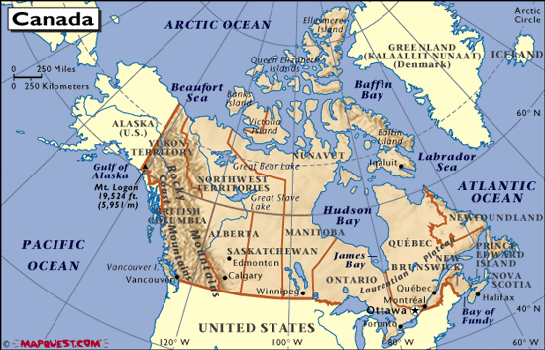
Where on Earth is Calgary?

Slide 3
The Context: The University of Calgary
Established as an autonomous institution in 1966, roots date to 1905
Professional programs: Engineering, Law, Medicine, Nursing, Social Work, Environmental Design, Veterinary Medicine
16 Faculties, 53 Departments, 30+ research institutes and centres
28,000 FTE students; 5300 graduate students
550-600 theses annually; 13,000 in collection

Slide 4
Why D-Space?
Online theses database ceased functioning
Pressure to make theses information available
  offsite researchers  international clients
Support for Institutional Repository amongst administrators  D-Space chosen as tool
Migrating theses data to D-Space seen as
  easy solution for replacing online theses database
  tool for promoting Institutional Repository
  way to encourage e-theses program on campus

Slide 5
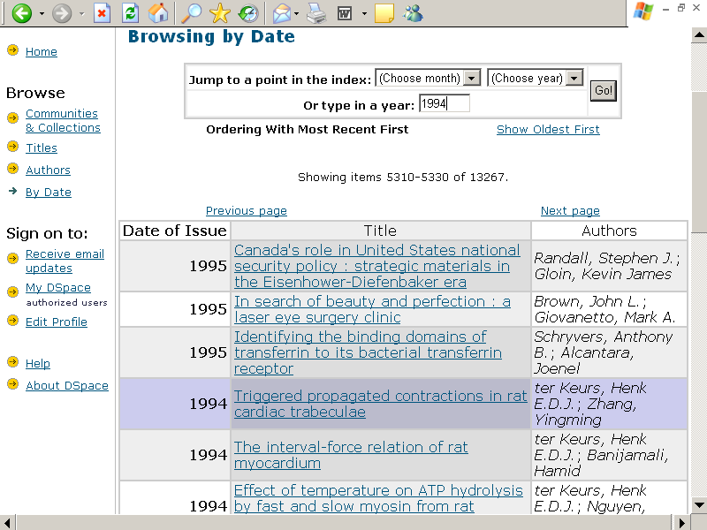

Problems: Searching Issues

Slide 6
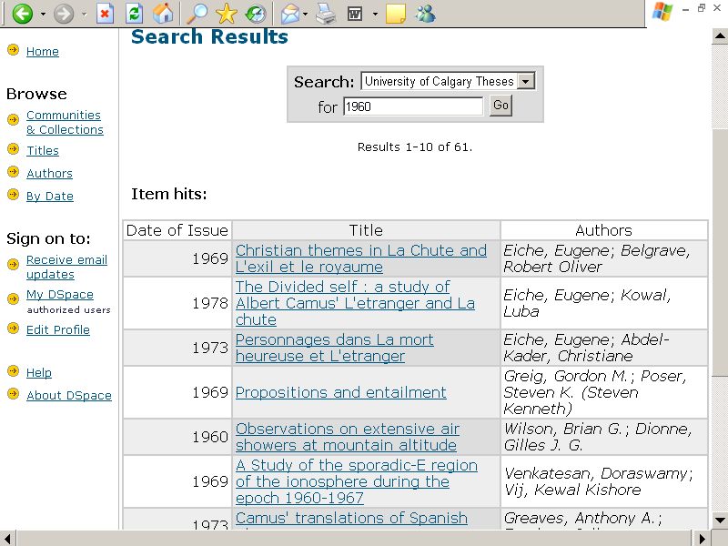
Problems: Searching Issues

Slide 7
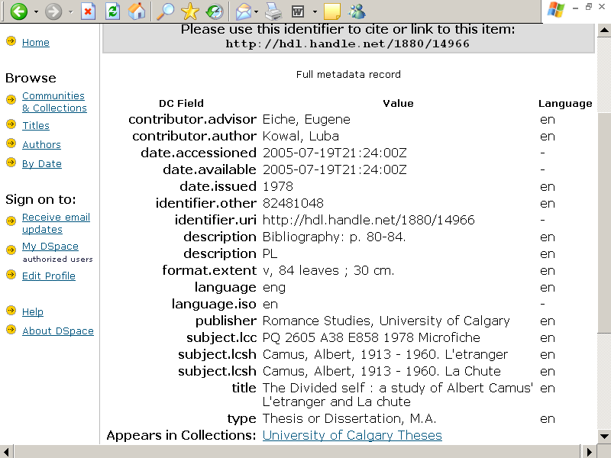
Problems: Searching Issues

Slide 8
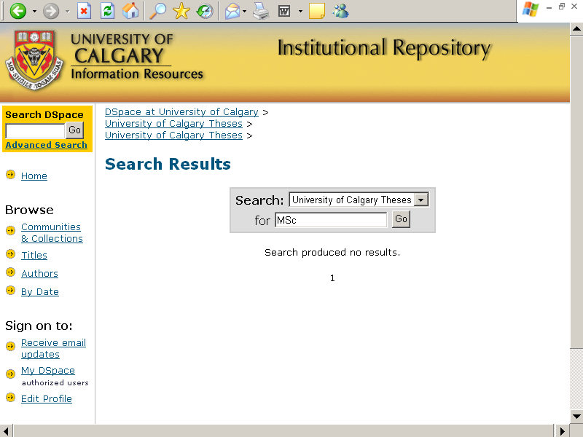
Problems: Searching Issues

Slide 9
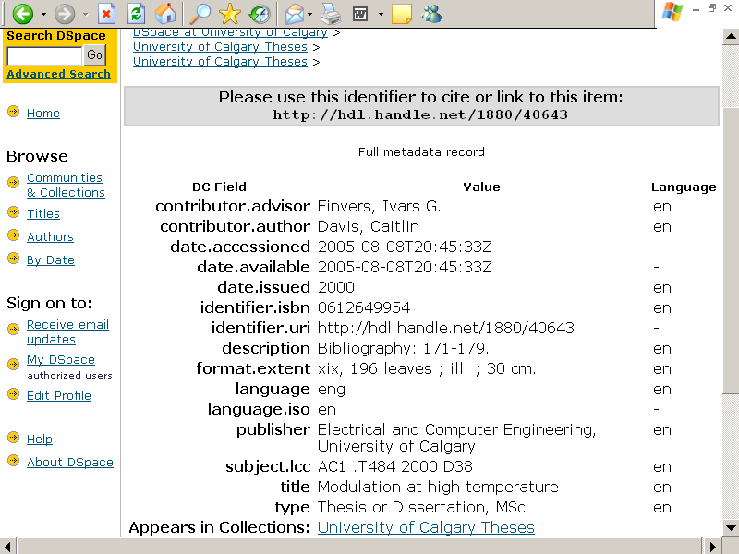
Problems: Searching Issues

Slide 10
Problems: Reporting Issues
Cannot print reports containing more than one hit
  Drill down to required version of report
  Print off one at a time
Cannot save multiple hits as electronic documents
  Must save individually
Cannot move between hits without retreating to search results screen
  May involve 5 screens per item if looking at full metadata report

Slide 11
Problems: Admin and Display Issues
D-Space does not allow administration and public views
  May not wish to make all item tracking data available for public view: physical location, barcodes, notes
  Choice between making “in-house” information publicly available, or maintaining separate tracking system
D-Space display is confusing, unattractive and counter-intuitive to researchers

Slide 12
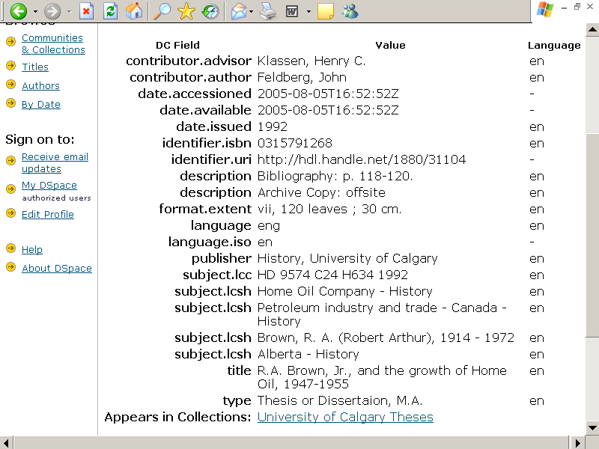
Problems: Display Issues

Slide 13
Selected Theses Database Software
Three modules required in University Archives
  Theses
  Archives
  Records Management
WebGencat Library module -- theses

Slide 14
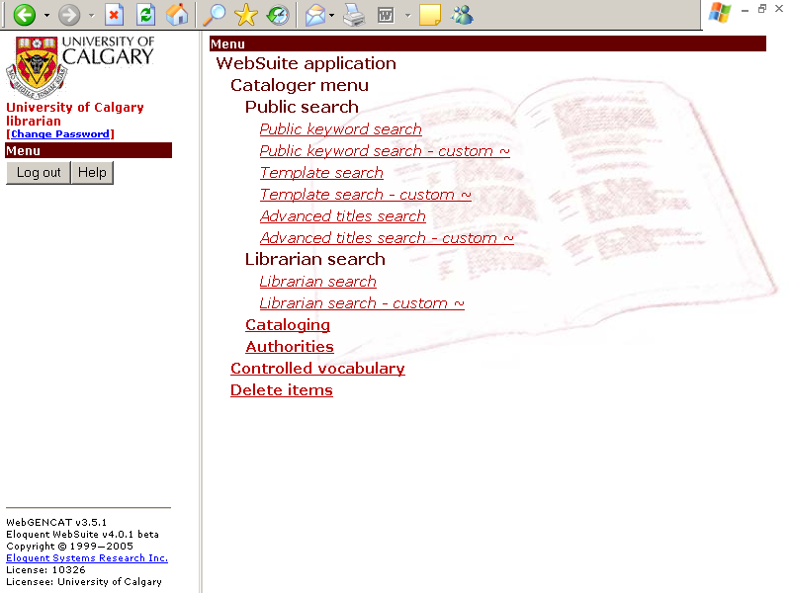

WebGencat: Display Options

Slide 15
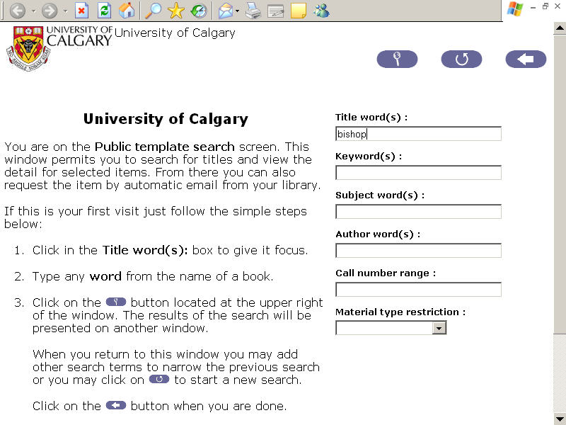
Public Template Search Screen

Slide 16
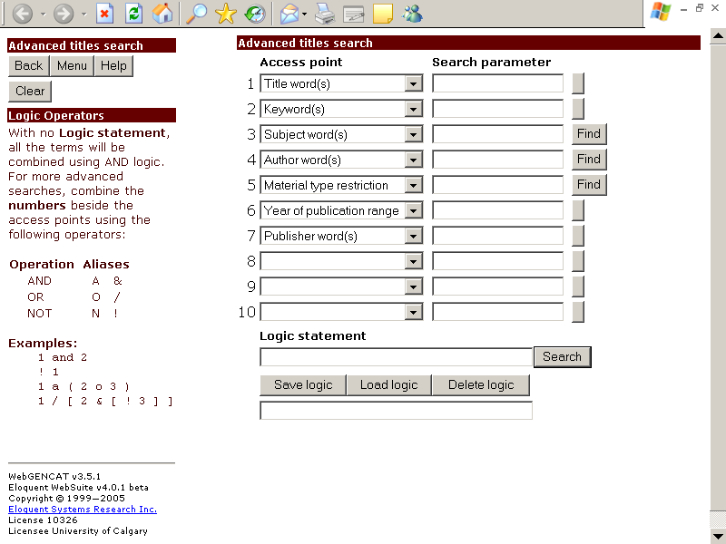
Public Advanced Search Screen

Slide 17
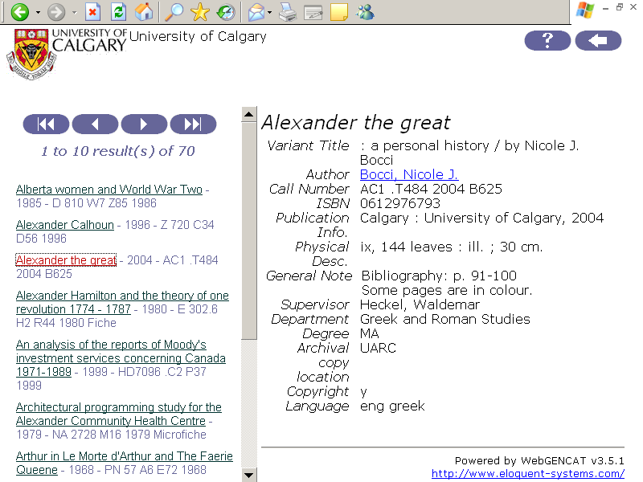
Search Results – Public Template Search

Slide 18
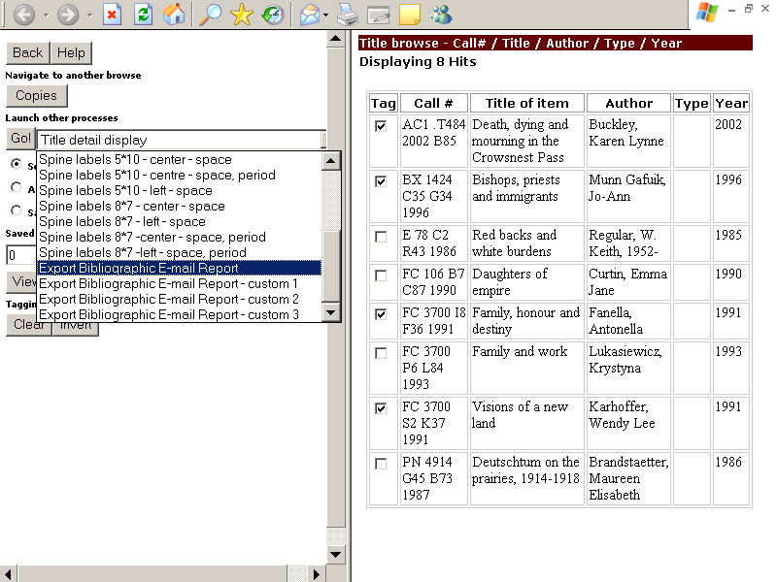
Reporting: Multiple Hits Selected

