Slide 1

Developing an E-theses Collection in the
CityU Institutional Repository
Philip Wong
Systems Librarian
City University of Hong Kong Library
ETD2006
9th International Symposium on Electronic Theses and Dissertations
Quebec City, Canada
June 7 -10, 2006

Slide 2
Outline
About CityU
Existing E-theses
CityU Institutional Repository
E-theses in IR

Slide 3
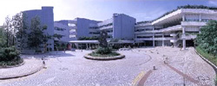
About CityU
City University of Hong Kong
  Found in 1984 as City Polytechnic of Hong Kong.
  Upgraded to self-accrediting University in 1994.
  3 faculties (17 departments), 4 schools and 1 community college.
  Programs cover Doctoral, Master, Bachelor and Associate degrees.
  Student enrollment as of 2005/06:
    full-time: 16,000
    part-time: 9,500
  Strong IT infrastructure in supporting e-learning & teaching.
  Deployment of e-portal on Bb6.

Slide 4
About CityU (cont.)
CityU Library
  Collections (2004/05)
    885,000 volumes of monographs: 70% Western, 30% Chinese
    180,000 volumes of bound periodicals
    3,850 print serials titles
  E-resource as of 2004/05
    E-databases: 466
    E-journals 32,595 titles
    E-books: 50,518 titles
  Linking software: SFX
  Automated library system: INNOPAC
  One of the busiest libraries in the region: opened until 1:00 am in regular semester.
  Number of entrance (2004/05): 1.85 millions

Slide 5
Existing E-theses
CityU’s theses and dissertation collection includes papers dated back to 1990.
  1200 research postgraduate theses (Ph.D., M.Phil.)
  1300 taught postgraduate dissertations (M.A., M.Sc., M.Eng, LLM)
Began digitization project in 2002.
In 2003, the School of Graduate Studies require submission of electronic copy of Ph.D. and M.Phil. theses along with the printed copy.

Slide 6
Existing E-theses (cont.)
Created MARC records in online catalog with tag 856 linking to abstract and full-text.
Search by author, title, subject.
Created Web pages to facilitate browsing by titles, degrees, and departments.
Limited access
  Abstracts and tables of contents – open to public
  Full-text – restricted to CityU for theses submitted before 2004, i.e. before the electronic submission requirement. The Library is working towards widening the access.

Slide 7
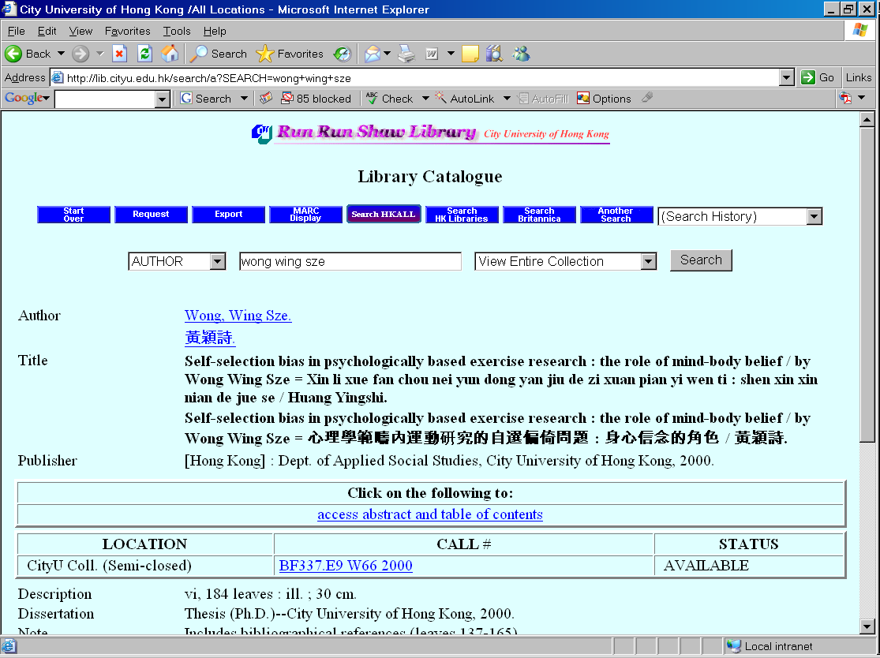
Existing E-theses (cont.)
Thesis record in Library Catalog

Slide 8
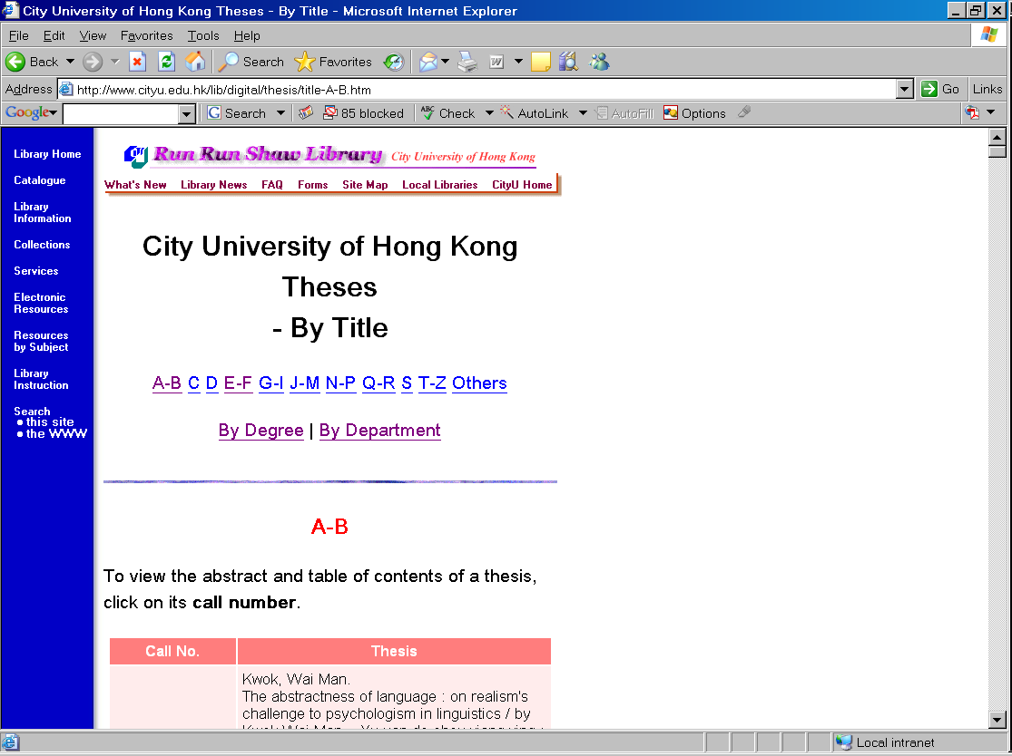
Existing E-theses (cont.)
Theses browsed by titles

Slide 9
Existing E-theses (cont.)
New demands
  To enhance searching and retrieval.
  To synchronize the development of the Institutional Repository.

Slide 10
CityU IR
CityU Institutional Repository
  September 2004: formed the IR Task Force
  2005: conducted systems evaluation and development
  February 2006: launched the IR
  Part of the CityU Library Digital Initiatives
    http://www.cityu.edu.hk/lib/digital/
  Developed in DSpace

Slide 11
CityU IR (cont.)
Why Created IR
  To support Knowledge Management, one key area in CityU’s Information Services Strategic Plan 2005-2010:
    “Provision of and access to scholarly information in electronic and print format in a timely manner.”
  To capture, disseminate, and preserve the scholarly outputs of CityU.
  To increase CityU’s “institutional visibility and prestige” and to exploit “new scholarly publishing paradigm”*.
  To support the Open Archives Initiative.
  * Raym Crow, “The Case for Institutional Repositories: A SPARC Position Paper”, 2002.

Slide 12
CityU IR (cont.)
Functional requirements
  Support Chinese
  OAI-compliant
  Provide administrative interface
  Allow customization
  Can be set up and supported by the Library

Slide 13
CityU IR (cont.)
Common open source software used for IR
  EPrints
  DSpace
  Fedora
  others
  Reference: Budapest Open Access Initiative: A Guide to Institutional Repository Software (http://www.soros.org/openaccess/software/)

Slide 14
CityU IR (cont.)
Selected DSpace
  It has good support to Unicode and therefore Chinese.
  It is OAI compliant off the shelf.
  It provides an administrative and submission interface.
  It is written in Java and JSP which allows high customization.
  Its hierarchy of communities and collections allows to build the repository along the administrative structure of the institution.

Slide 15
CityU IR (cont.)
IR configuration as of May 2006
  Home URL: http://dspace.cityu.edu.hk/
  DSpace version: 1.3.2
  Systems: Linux Enterprise 3; Tomcat 5
  Server: Intel Pentium 4 2.8 GHz; 1 GB RAM

Slide 16
CityU IR (cont.)
Current collections
  Emphasized on student works
  Outstanding Academic Papers by Students (OAPS)
  Student Works with External Awards
  Undergraduate Final Year Projects
  Theses and Dissertations (under development)

Slide 17
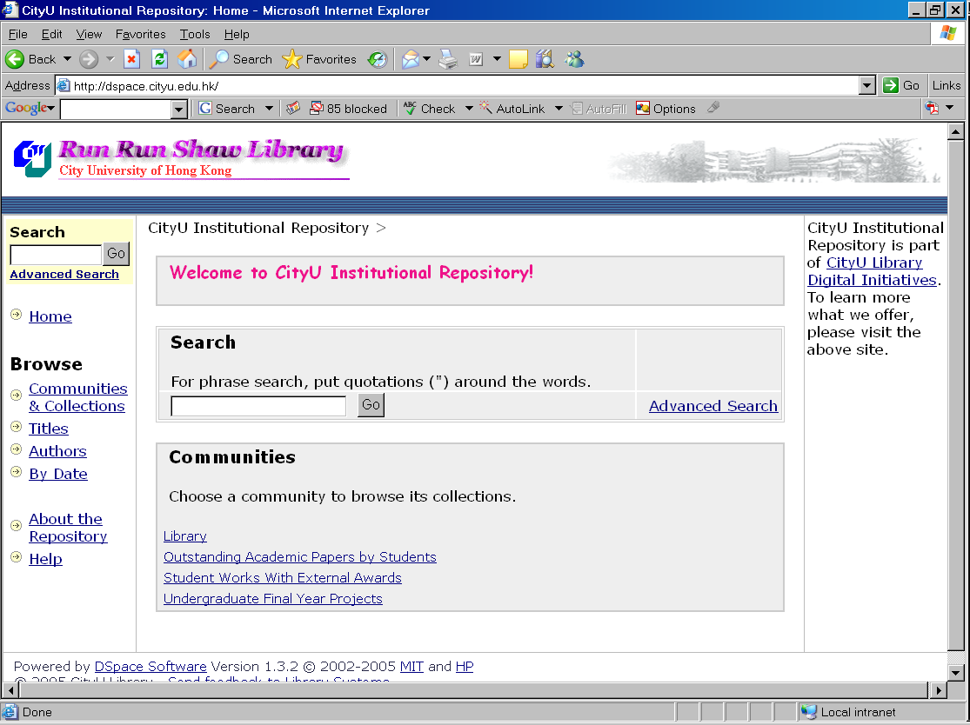
CityU IR (cont.)
CityU IR Home

Slide 18
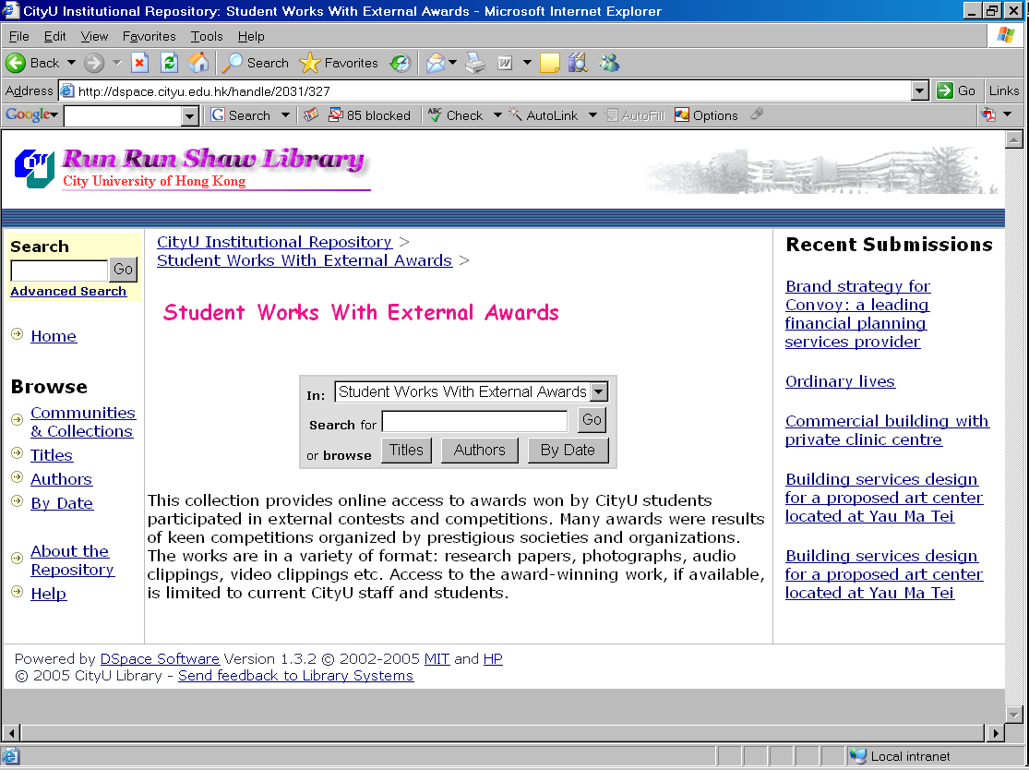
CityU IR (cont.)
Collection –
Student Works with External Awards

Slide 19
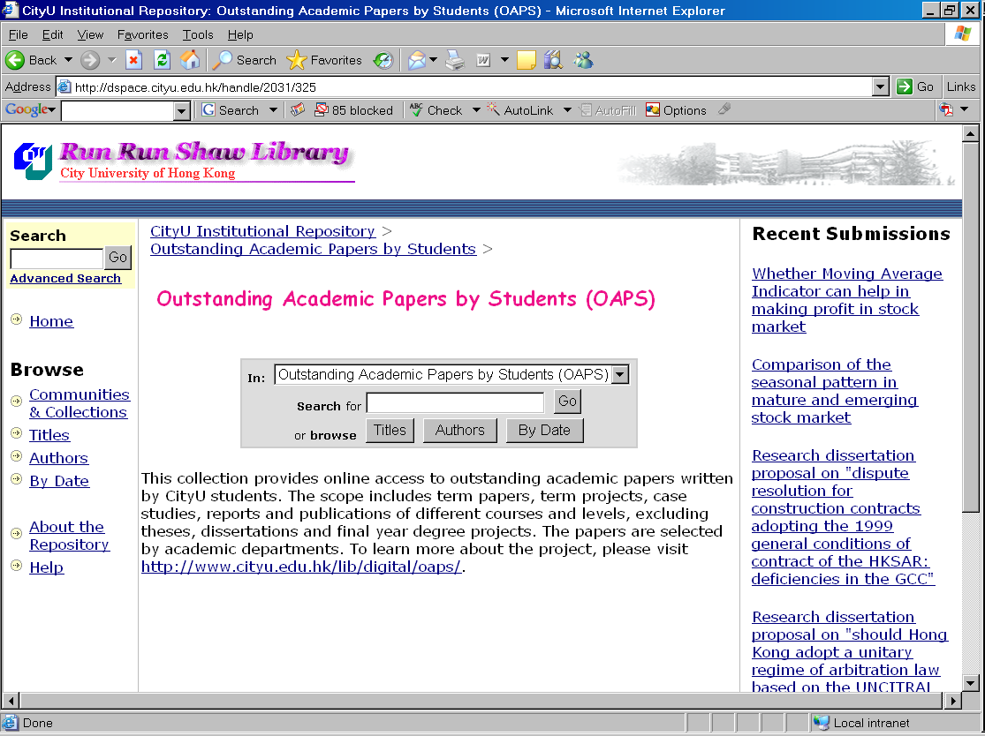
CityU IR (cont.)
Collection –Outstanding Academic Papers by Students

Slide 20
E-theses in IR
Benefits of migrating E-theses to IR
  IR is OAI-PMH complaint, ready to expose records immediately
  By publicizing theses through IR, more authors of old theses will be willing to grant access rights.
  Provides one-stop search for all student works.
  Provides excellent showcase of student academic achievements.
  Provides long-term reference by assigning persistent handle
  Provides fast start-up to the growth of IR.

Slide 21
E-theses in IR (cont.)
Issues migrating to DSpace
  Lack of theses-specific metadata set
  Lack of specific workplace for supervising the submission and acceptance of theses.
  Need to integrate E-theses into the existing hierarchy of communities and collections.
Not real issues
  For 1, Dublin Core is flexible to have qualified elements added.
  For 2, CityU E-theses emphasizes on post-submission workflow.
  For 3, DSpace allows cross collections mappings; collection-based metadata is also supported.

Slide 22
E-theses in IR (cont.)
Metadata in CityU E-theses
    title
    title.alternative
    contributor.author
    contributor.department [added by CityU]
    date.issued
    publisher
    subject
    description
    description.degree [added by CityU]
    description.abstract
    identifier.catalog [added by CityU]
    identifier.uri

Slide 23
E-theses in IR (cont.)
Thesis record in XML Dublin Core format
<dublin_core>
<dcvalue element="contributor" qualifier="author">Wong, Wing Sze</dcvalue>
<dcvalue element="contributor" qualifier="author">黃穎詩</dcvalue>
<dcvalue element="date" qualifier="issued">2000</dcvalue>
<dcvalue element="identifier" qualifier="uri">http://hdl.handle.net/2132/795</dcvalue>
<dcvalue element="description" qualifier="none">Thesis (Ph.D.)--City University of Hong Kong, 2000</dcvalue>
<dcvalue element="description" qualifier="none">Bibliography: leaves 68-70</dcvalue>
<dcvalue element="description" qualifier="none">vi, 184 leaves : ill. ; 30 cm.</dcvalue>
<dcvalue element="description" qualifier="abstract">This thesis examines the role of mind-body belief in understanding ....</dcvalue>
<dcvalue element="publisher" qualifier="none">Dept. of Applied Social Studies, City University of Hong Kong</dcvalue>
<dcvalue element="subject" qualifier="none">Exercise -- Psychological aspects</dcvalue>
<dcvalue element="subject" qualifier="none">Exercise -- Research -- Methodology</dcvalue>
<dcvalue element="subject" qualifier="none">Mind and body</dcvalue>
<dcvalue element="title" qualifier="none">Self-selection bias in psychologically based exercise research : the role of mind-body</dcvalue>
<dcvalue element="title" qualifier="alternative">Xin li xue fan chou nei yun dong yan jiu de zi xuan pian yi wen ti : shen xin xin nian de jue se.</dcvalue>
<dcvalue element="title" qualifier="alternative">心理學範疇內運動硏究的自選偏倚問題 : 身心信念的角色</dcvalue>
<dcvalue element="type" qualifier="none">Thesis</dcvalue>
<dcvalue element="contributor" qualifier="department">Dept. of Applied Social Studies</dcvalue>
<dcvalue element="identifier" qualifier="catalog">http://lib.cityu.edu.hk/record=b1578068</dcvalue>
<dcvalue element="description" qualifier="degree">Ph.D.</dcvalue>
</dublin_core>

Slide 24
E-theses in IR (cont.)
Migration process
  Output MARC records from Library Catalog.
  Converted MARC to Dublin Core in XML format.
  OCR over 2500 abstracts.
  Added metadata fields.
  Imported Dublin Core records to DSpace.

Slide 25
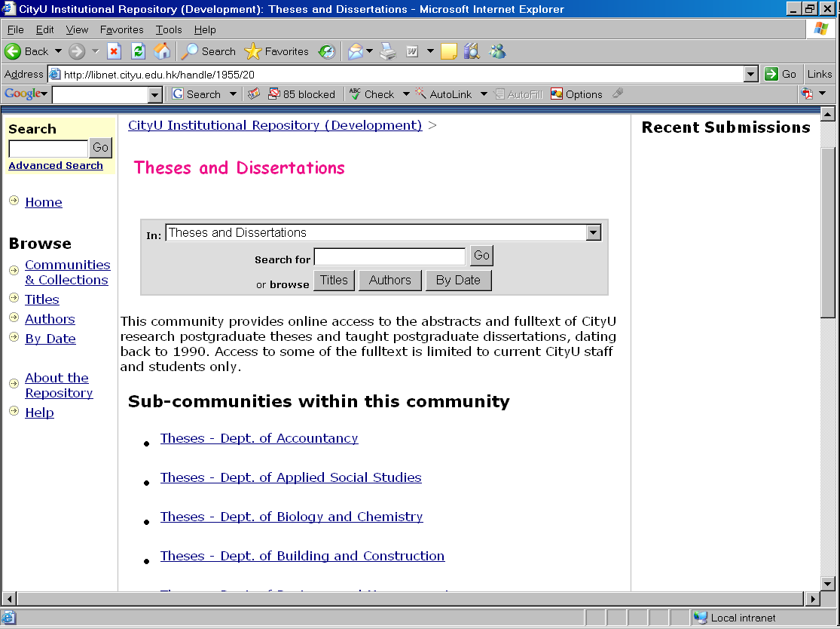
E-theses in IR (cont.)
Features – created subcommunities by departments

Slide 26
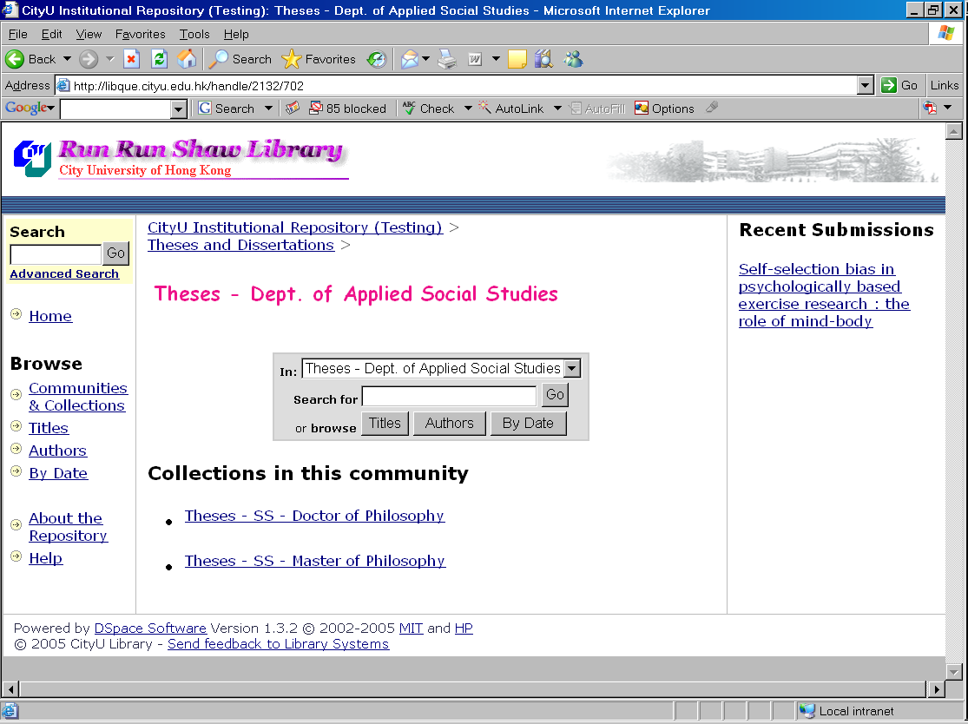
E-theses in IR (cont.)
Features –created collections by degrees

Slide 27
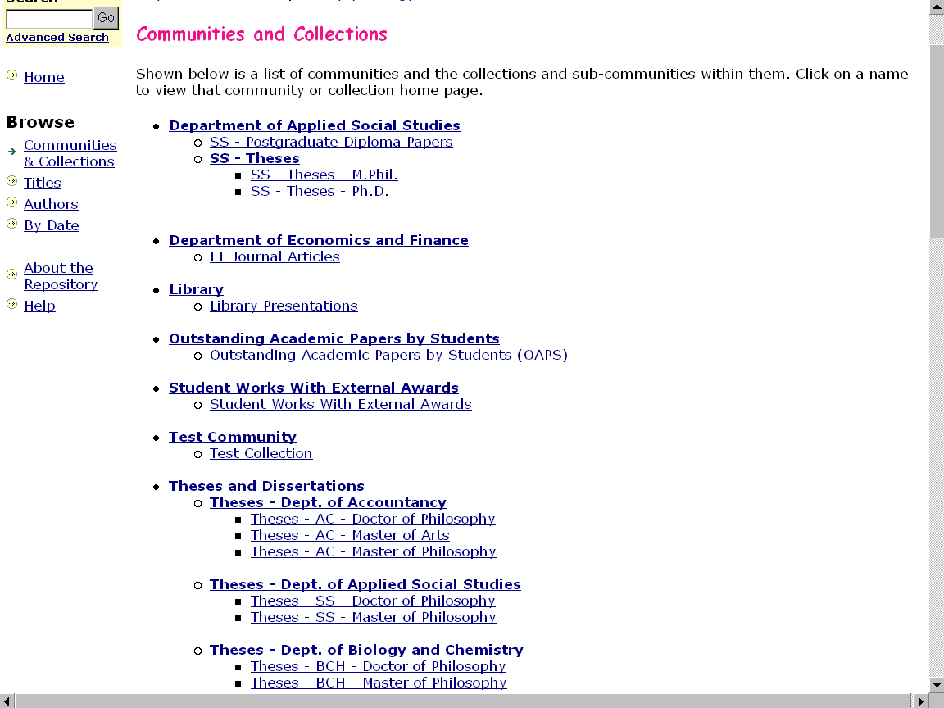
Features –
cross-linked between collections

Slide 28
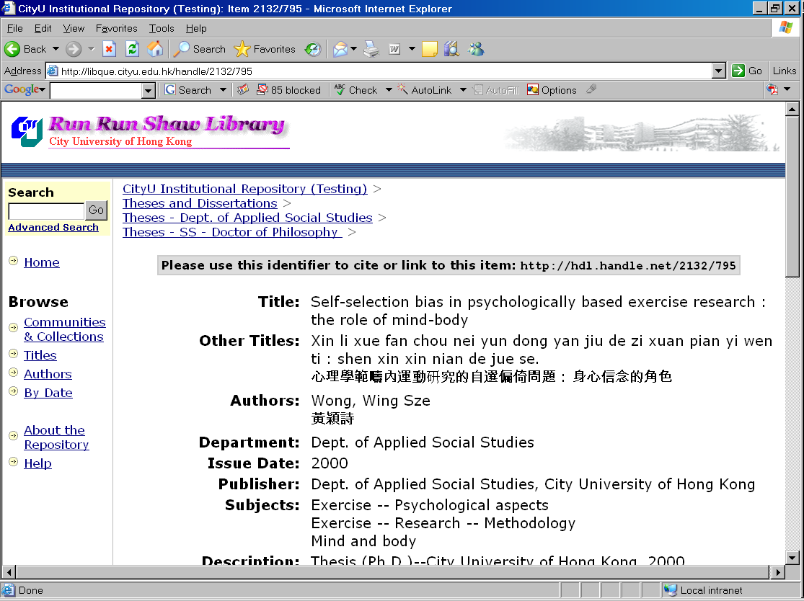
E-theses in IR (cont.)
Features –assigned CNRI persistent handle

Slide 29
E-theses in IR (cont.)
Features – enabled Chinese searching and display

Slide 30
E-theses in IR (cont.)
Limitations and future enhancements
  Access rights
    Old theses submitted before the electronic submission requirements (2004) can not be opened to public or for academic exchange.
    By providing a publishing platform in IR, it is hoped that more authors will be willing to grant access rights.
  Submission process
    Submission of e-copy is currently managed by School of Graduate Studies and departments, a rather manual process.
    Online submission is supported by DSpace, how far should it go?
      Online acceptance and approval - not necessary in CityU
      File upload and metadata input - easy to implement

Slide 31
Developing an E-theses Collection in the CityU IR
Thank You!
Philip Wong
lbphilip@cityu.edu.hk

