Slide 1
Promise of Science a ‘Dutch Treat’ to doctoral e-Theses
Gerard van Westrienen
SURF foundation, The Netherlands
ETD 2006 Quebec - June 10th, 2006

Slide 2
Outline
Doctoral theses in the Netherlands
DARE: digital academic repositories
Promise of Science: achievements
Lessons learned
Challenges ahead; next steps!?

Slide 3
Doctoral Theses in the Netherlands
Doctoral theses in the Netherlands:
Formally 4 years; average >5 years;
No ‘student’ work; normally temporary employment contract;
High quality and standard;
Showcase for researcher;
Showcase for university;
No legal depot; mainly theses-exchange projects and Interlibrary loan (ILL);
Average of 2500 per year (5% of formal scholarly output);
2/3 in STM and 1/3 in Humanities and Social Sciences

Slide 4
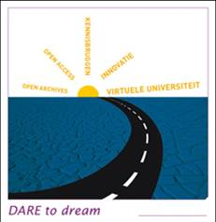
DARE: Digital Academic REpositories
Mission: Better access to results of publicly funded academic research
Period: 2003-2006
Budget: M€ 5.9, of which M€ 2 from national government
The Players:
ALL universities in the Netherlands,
KNAW, NWO, KB
Coordinated by SURF

Slide 5
DARE: Digital Academic REpositories
2003: infrastructure -> DAREnet (www.darenet.nl)
2004-2005: content -> 49,000 objects
May 2005: Cream of Science (www.creamofscience.org)
  Complete publication list of 207 top scientists/scholars
  42,000 records = 195 per author
  Almost 60% full text
Achievements:
  Exposure
  Positive attitude authors, management
  Copyright issue
  Repositories contain top-class material
But: top layer of ‘old established researchers’

Slide 6
Promise of Science
HunDAREd thousand
  Add 100,000 full-text documents to DARE (Oct 2005 – Dec 2006)
  Common focus: doctoral theses
Promise of Science - the young and promising scholars
  Aims:
    a national e-Theses Gateway with more than 10,000 e-theses (Dec. 2006)
    90% of all new theses digitally, full text and OA available (after Jan 2007)
  Work packages on:
    Organisational infrastructure
    Legal aspects
    Communication and awareness raising
    International cooperation

Slide 7
Promise of Science: achievements
WP1: Organisational issues
Studies and analyses
  Analysis of the workflow
  Identification of stakeholders
  Analysis of Promotion Charters
  Identification of Good Practices
National Gateway to doctoral e-Theses in the NL
  Beta-version April 2006
  Metadata; Open Access and embargos
Populating Promise of Science: www.darenet.nl/PromiseofScience
  October 2005: 6,400 e-theses
  June 2006: 9,800 e-theses
  Growth of 3,400 in 8 months (equivalent of 1.3 times the yearly output)

Slide 8
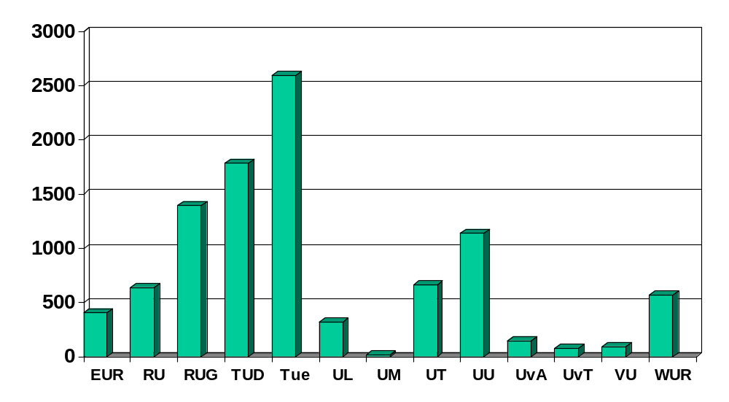
Number of e-Theses available in Promise of Science per university (June 2006)

Slide 9
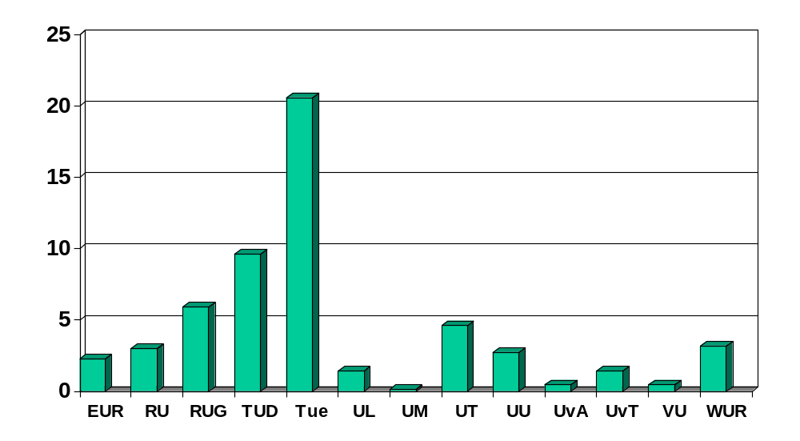
Part of universities’ yearly production of Theses, available in Promise of Science - June 2006
(average of 3,7 times the yearly output; 2003 as reference year)

Slide 10
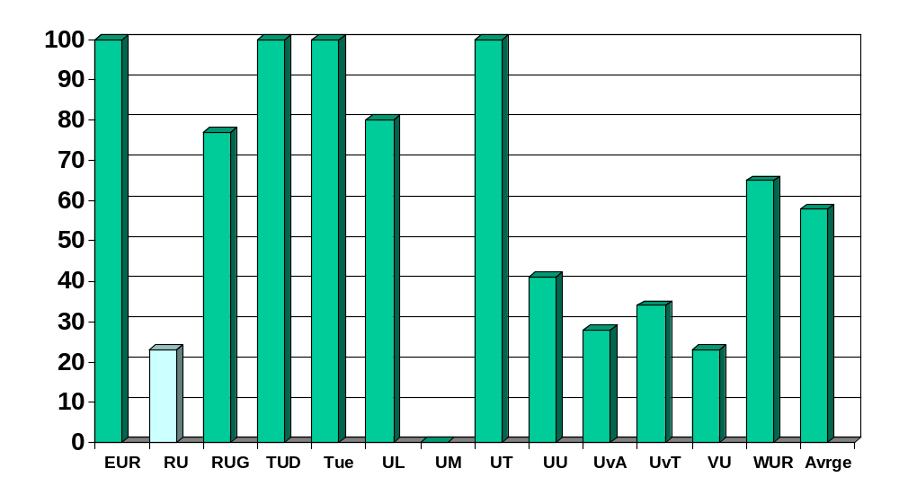
Theses Output per University in 2005, and the Compliance Rate in Promise of Science (preliminary data)

Slide 11
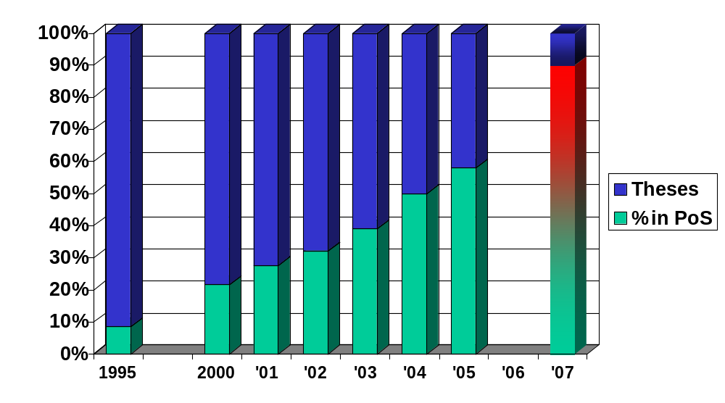
Compliance rate of doctoral theses in Promise of Science; 1995 - 2005

Slide 12
Promise of Science: achievements
WP2: Legal issues - achievements
Analysis of legally relevant moments
‘Work in Progress’:
Analysis of relation Author - publisher: www.surf.nl/copyrighttoolbox lnk
Analysis of relation Repository – Author: depot-licenses
Analysis of relation Repository – User: CC licenses
Legal toolkit
Study regarding enforcement options

Slide 13
Promise of Science: achievements
WP3: Communication and Awareness
Identified as the most important work package in the project
Change of work processes, regulations, charters and … CULTURE
Mainly important for the second goal: to harvest >90% of new e-theses
Achievements:
Communication Toolkit, filled with ‘semi-manufactured’ products - to be finalised and ‘branded’ locally
Various tools (letters, FAQ, flyer, course, check list etc.) and arguments for a diversity of stakeholders
‘Work in Progress’:
PR campaign for the national gateway ‘Promise of Science’

Slide 14
Promise of Science: achievements
WP4: International cooperation
Workshop on e-Theses by JISC and SURF in Amsterdam (Jan 2006)
Aims:
  Share current practice (lessons learned, Good Practices, legal constraints, cultural aspects)
  Identify areas of added value
  Identify potential for joint bid for European e-theses infrastructure
Presentation of state of the art from representatives of 11 European countries; conclusion: considerable variation (digitally collection; making available; preservation; interoperability; business models)
Report: http://www.ariadne.ac.uk/issue46/e-theses-rpt/

Slide 15
Promise of Science: achievements
Joint bid?
e-Theses NOT specific enough to warrant a specific EU-bid
No compelling reason to treat either e-Theses (as a research output) or Europe (as a geographical scope) as separate.
Follow-up: small task group to
develop a work plan for European networking and information exchange
Identify opportunities for more practical collaboration and quick wins
Four strands:
Legal issues
Organisational and cultural issues
Technical and metadata issues
External relations

Slide 16
Lessons Learned
The ‘Dutch Treat’ works! E-Theses as an integrated part of the decentralised Institutional Repositories infrastructure
Interoperability is not something that goes without saying…; clear and explicit appointments are needed
Attracting >90% of all new theses per 2007 too ambitious; change of culture, procedures, regulations takes more time
Beta-version Gateway ‘Promise of Science’ with overview per university, works as stimulator for those lagging behind
Without mandatory policy, relatively high result possible (compared to the 12% of Australia)
Mandatory policy in 6 out of 13 universities; doesn't directly mean a 100% coverage of e-theses

Slide 17
Lessons Learned (2)
Distinguish between archiving and publicly accessibility
An embargo period should be the exception, not the rule
E-Theses: good starting point for the creation of a university copyright policy
Sometimes a problem is defined as ‘legal’, while in fact it is ‘culture’;
Many (groundless) fears for the unknown; not always authors;
also librarians: timorous that authors are not willing to cooperate; just ‘DARE’!

Slide 18
Challenges ahead; next steps!?
Metadata (research project and publication; subject/discipline)
Enhanced publications (primary data; statistical information; multimedia files; simulations etc)
Value-added services (PoD; RSS feeds; citation and links; annotations)
Reliable data (links, citations, usage, contacts etc)

Slide 19
Thank you!
Promise of Science; a ‘Dutch Treat’ to doctoral e-Theses
Gerard van Westrienen
SURF foundation, The Netherlands
vanwestrienen@surf.nl
ETD 2006 Quebec - June 10th, 2006

