Slide 1

Supply and Demand Analysis in NDLTD Based on Patron Specialty and Contents Statistics
The 9th International Symposium on Electronic Theses and Dissertations
Quebec City, Quebec, Canada
June 7-10, 2005
Seonho Kim, Seungwon Yang, Edward A. Fox
Digital Library Research Laboratory Virginia Tech, Blacksburg, VA 26061 USA

Slide 2
Overview
Purpose of Study
NDLTD
Data Set (ETDs, patrons, queries)
Our Approach
Data Analysis
Conclusions and Future Work

Slide 3
Purpose of Study
Distribution analysis of NDLTD resources
Distribution analysis of patrons’
- Major field
- Years in the field
- Demand for resources
Comparison of supply-demand status in NDLTD

Slide 4
Overview
Purpose of Study
NDLTD
Data Set (ETDs, patrons, queries)
Our Approach
Data Analysis
Conclusions and Future Work

Slide 5
NDLTD
Networked Digital Library of Theses & Dissertations [1]
Members (2005/2006)
  36 full members, 195 associated members
  International (Canada, Turkey, Germany, Korea, South Africa, India, U.S.A., U.K., Jamaica, China, Taiwan, Sudan, Australia, and many more)
Total 242,688 electronic theses and dissertations
URL http://www.ndltd.org

Slide 6
Overview
Purpose of Study
NDLTD
Data Set (ETDs, patrons, queries)
Our Approach
Data Analysis
Conclusions and Future Work

Slide 7
Data Set - ETDs
Up-to-date Union archive harvested from
Online Computer Library Center (OCLC)
Using OAI/ODL Harvester [2] by Hussein Suleman
http://oai.dlib.vt.edu/odl/software/harvest/
Total 242,688 records

Slide 8
Example – ETD Data
<dc oai_dc="http://www.openarchives.org/OAI/2.0/oai_dc/" dc="http://purl.org/dc/elements/1.1/" xsi="http://www.w3.org/2001/XMLSchema-instance" schemaLocation="http://www.openarchives.org/OAI/2.0/oai_dc/ http://www.openarchives.org/OAI/2.0/oai_dc.xsd"><title>Composer-Centered Computer-Aided Soundtrack Composition</title><creator>Vane, Roland Edwin</creator><subject>Computer Science</subject><subject>human computer interaction</subject><subject>music composition</subject><subject>soundtracks</subject><subject>creativity</subject><description>For as long as computers have been around, people have looked for ways to involve them in music…. </description><publisher>University of Waterloo</publisher><date>2006</date><type>Electronic Thesis or Dissertation</type><format>application/pdf</format><identifier>http://etd.uwaterloo.ca/etd/revane2006.pdf</identifier><language>en</language><rights>Copyright: 2006

Slide 9
Patrons, Queries
User Profile Data (Oct. 2005 – May 2006)
Online User Survey [3] as part of User Modeling study
Total 1100 User Data that include
  User survey: majors, specialties, years of experience, and demographic information.
  Tracking Data: Queries and detailed research interests obtained by a Search User Interface embedded User Tracking System [4]

Slide 10
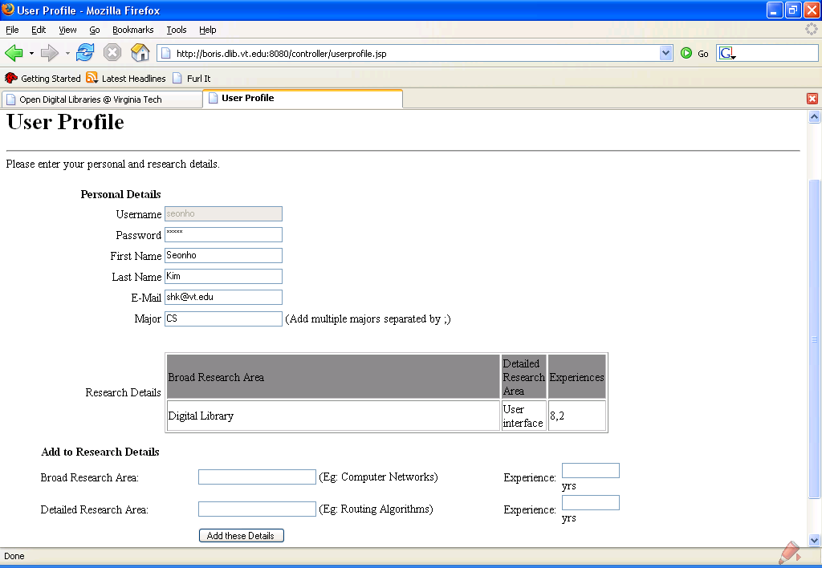
Registration Form

Slide 11
Example – User Data
<user> <userID>shk</userID> <email>shk@vt.edu</email> <name><first>Sh</first> <last>King</last> </name><major>CS</major><broadresearch>Digital Library <specific>User interface</specific> <experience>8,2</experience></broadresearch><group /> <query><item freq="79">digital library</item> <item freq="33">computer science</item> <item freq="25">virginia tech</item> <item freq="9">artificial intelligence</item> <item freq="5">digital library.</item> </query><selected><item freq="15">Digital Library</item> <item freq="6">Electronic Theses and Dissertations</item> </selected><proposed><item freq="80">Digital Library</item> <item freq="65">Data</item> </proposed></user>

Slide 12
User Data - Fields
<query> : entered by the user
<proposed> : ETD results clustered and displayed
<selected> : cluster labels clicked by the user

Slide 13
Overview
Purpose of Study
NDLTD
Data Set (ETDs, patrons, queries)
Our Approach
Data Analysis
Conclusions and Future Work

Slide 14
Categorization of Academic Subjects
Created our own classification categories ☺
Based on colleges/faculties in five universities in VA
- Virginia Tech, University of Virginia, George Mason University,
VCU and Virginia State University
Identified
- 7 categories and 77 subcategories
- Word patterns for each subcategories

Slide 15
Categorization of Academic Subjects
7 categories and selected 77 subcategories
 | 7 Categories | Selected 77 Sub-categories
1 | Architecture and Design | ArchitectureConstruction, LandscapeArchitecture,…
2 | Law | Law
3 | Medicine, Nursing and Veterinary Medicine | Dentistry, Medicine, Pharmacy, Nursing,…
4 | Arts and Science | Agriculture, AnimalPoultry,Biology,...
5 | Engineering and Applied Science | ComputerScience, Material, Electronics,…
6 | Business and Commerce | Buisiness, Economics, Management,…
7 | Education | Education
8 | Others (unclassifiable)

Slide 16
Categorization of Academic Subjects
Each subcategory has a set of word patterns
- Matching table developed
Process of word pattern table development
1. Run our subject-matching classifier program.
2. Group unclassifiable records & sort them.
3. If num. of records > 10, add the group’s label to matching table.
4. Repeat 1 – 3 until number of records in each group < 10.

Slide 17
Categorization of Academic Subjects
Matching Table
77 categories | Word Patterns
Education | /bildung/, /pedagog/, /fakul/, /educa/, /teaching/,…
Geology | /geolog/, /geoscience/,…
LibraryScience | /librari/, /library/, /informatik/,…
… | …

Slide 18
Categorization of Academic Subjects
Approx. 85 % of unclassifiable record’s subject
- Appears only once
Approx. 10 % of unclassifiable record’s subject
- Appears twice

Slide 19
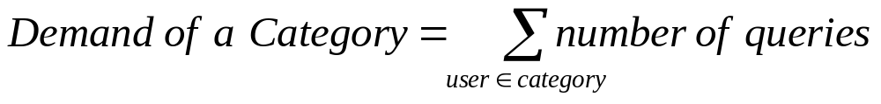
Measuring Supply – Demand
ETD Supply:
- Number of resources provided
- 242,688 ETDs classified into 7 categories and counted
Patron’s Demand:
- Number of queries entered
- 4519 queries (in 1100 user data) classified into 7 categories
- “Sum of all queries” in each category calculated as

Slide 20
ETD Classification
Based on the “first” subject field
<dc oai_dc="http://www.openarchives.org/OAI/2.0/oai_dc/" dc="http://purl.org/dc/elements/1.1/" xsi="http://www.w3.org/2001/XMLSchema-instance" schemaLocation="http://www.openarchives.org/OAI/2.0/oai_dc/ http://www.openarchives.org/OAI/2.0/oai_dc.xsd"><title>Composer-Centered Computer-Aided Soundtrack Composition</title><creator>Vane, Roland Edwin</creator><subject>Computer Science</subject><subject>human computer interaction</subject><subject>music composition</subject><subject>soundtracks</subject><subject>creativity</subject><description>For as long as computers have been around, people have looked for ways to involve them in music…. </description><publisher>University of Waterloo</publisher><date>2006</date><type>Electronic Thesis or Dissertation</type><format>application/pdf</format><identifier>http://etd.uwaterloo.ca/etd/revane2006.pdf</identifier><language>en</language><rights>Copyright: 2006

Slide 21
User Classification
Based on the “major”, ”broadresearch”, and “specific” fields in each user profile
<user> <userID>shk</userID> <email>shk@vt.edu</email> <name><first>Sh</first> <last>King</last> </name><major>CS</major><broadresearch>Digital Library <specific>User interface</specific> <experience>8,2</experience></broadresearch><group /> <query><item freq="79">digital library</item> <item freq="33">computer science</item> <item freq="25">virginia tech</item> <item freq="9">artificial intelligence</item> <item freq="5">digital library.</item> </query><selected><item freq="15">Digital Library</item> <item freq="6">Electronic Theses and Dissertations</item> </selected><proposed><item freq="80">Digital Library</item> <item freq="65">Data</item> </proposed></user>

Slide 22
Challenges
Varieties in describing research subjects
  → Solution: we built a subject mapping table
77 categories | Decision patterns
Education | /bildung/, /pedagog/, /fakul/, /educa/, /teaching/,…
Geology | /geolog/, /geoscience/,…
LibraryScience | /librari/, /library/, /informatik/,…
… | …

Slide 23
Challenges
Interdisciplinary Subjects
  e.g., “Music Education”
  Solution: adjust matching order
Unclassifiable Subjects
  Null Entry (29.7% of ETD records have no subject field data)
  Erroneous entries (e.g., “Ph.D”, “Georgia”,“gordd7@camu.edu”)
  Typo (e.g. “edcuation”, “poluition”)
  Too much detail (e.g., “pulsars”, “muon”, “cytochrome”)
  Abbreviations (e.g., “MOCVD”, “OFDM”)

Slide 24
Overview
Purpose of Study
NDLTD
Data Set (ETDs, patrons, queries)
Our Approach
Data Analysis
Conclusions and Future Work

Slide 25
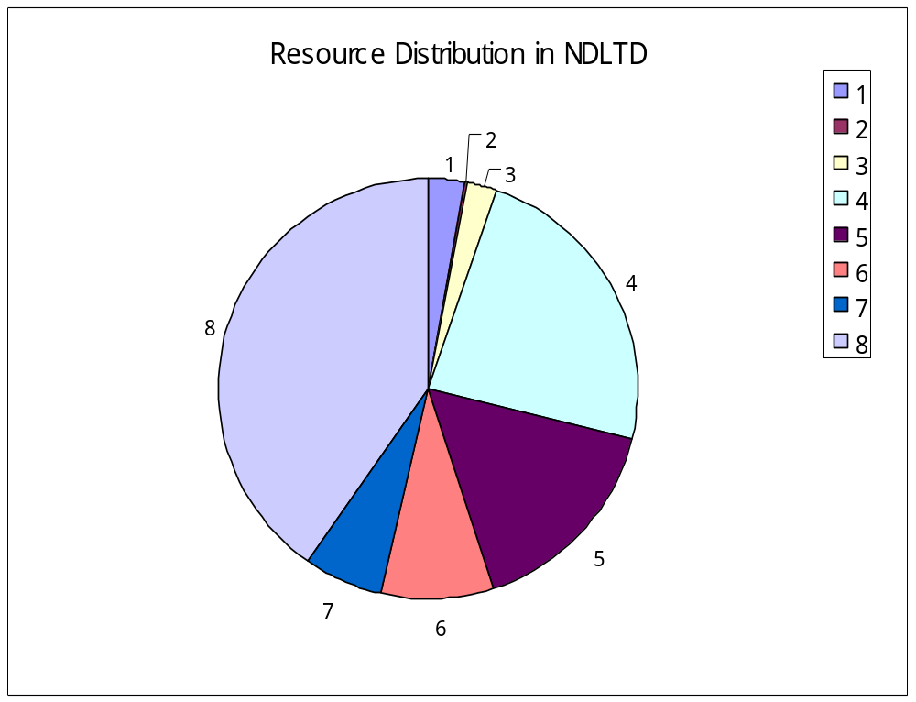
Resource Distribution
1 | Architecture and Design
2 | Law
3 | Medicine, Nursing and Veterinary Medicine
4 | Arts and Science
5 | Engineering and Applied Science
6 | Business and Commerce
7 | Education
8 | Others. (unclassifiable)

Slide 26
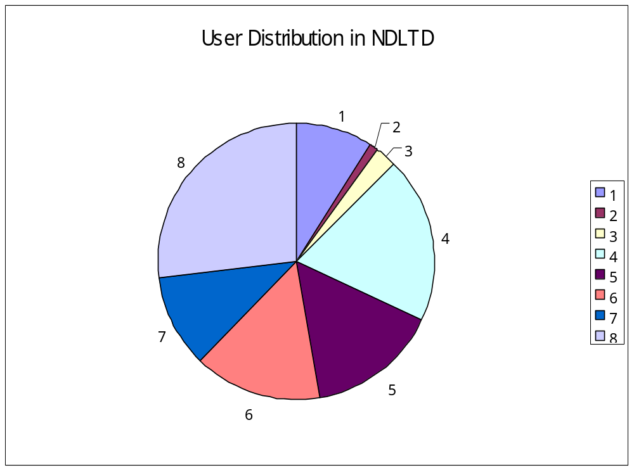
User Distribution
1 | Architecture and Design
2 | Law
3 | Medicine, Nursing and Veterinary Medicine
4 | Arts and Science
5 | Engineering and Applied Science
6 | Business and Commerce
7 | Education
8 | Others. (unclassifiable)

Slide 27
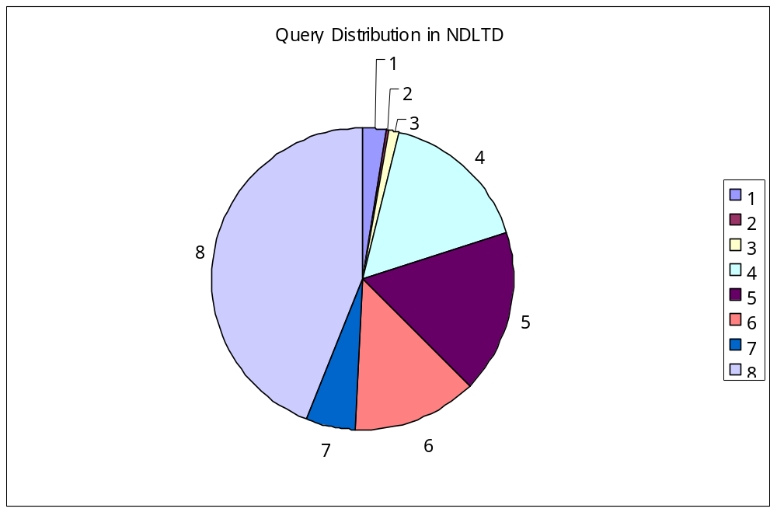
Query Distribution
1 | Architecture and Design
2 | Law
3 | Medicine, Nursing and Veterinary Medicine
4 | Arts and Science
5 | Engineering and Applied Science
6 | Business and Commerce
7 | Education
8 | Others. (unclassifiable)

Slide 28
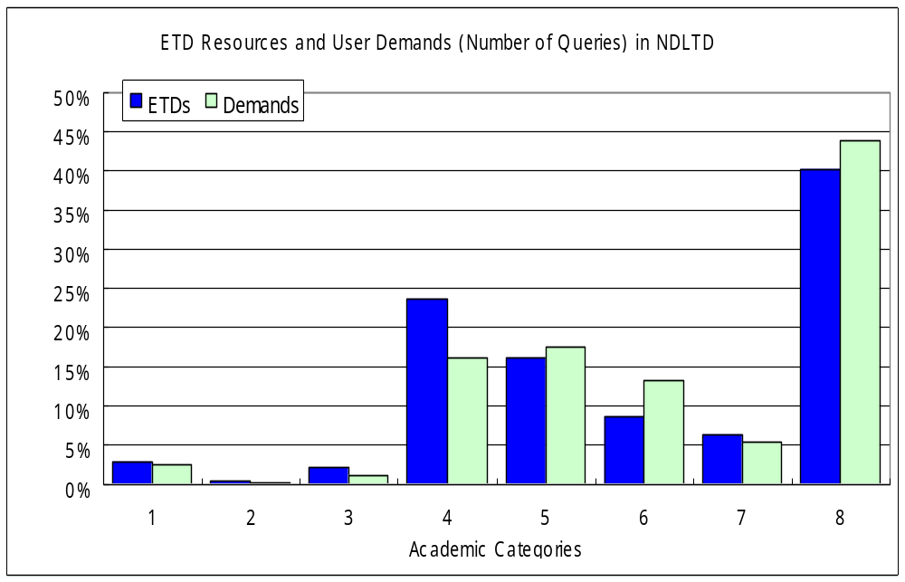
Supply-Demand Comparison
1 | Architecture and Design
2 | Law
3 | Medicine, Nursing and Veterinary Medicine
4 | Arts and Science
5 | Engineering and Applied Science
6 | Business and Commerce
7 | Education
8 | Others. (unclassifiable)

Slide 29
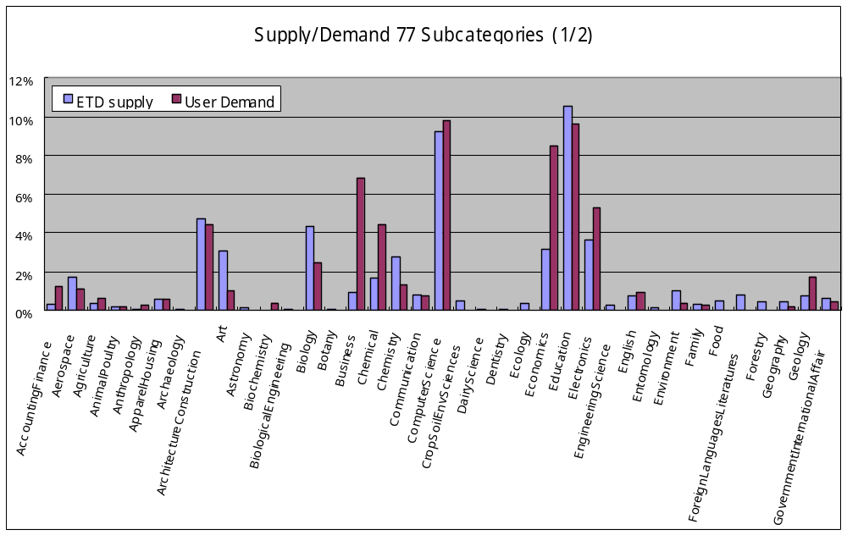
Supply-Demand of 77 Subcategories (1/2)

Slide 30
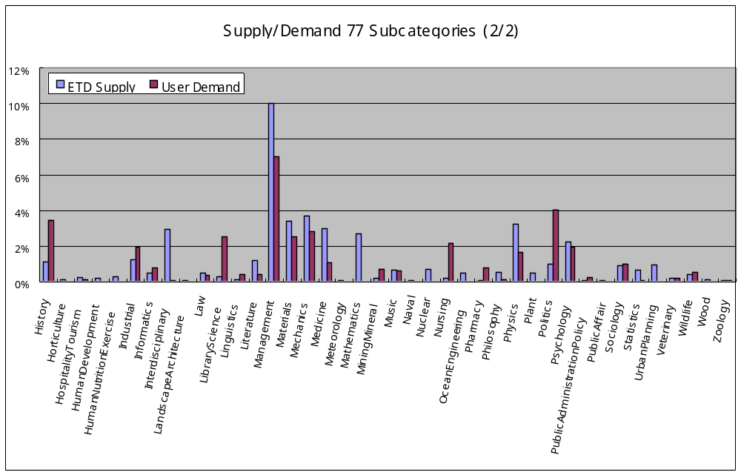
Supply-Demand of 77 Subcategories (2/2)

Slide 31
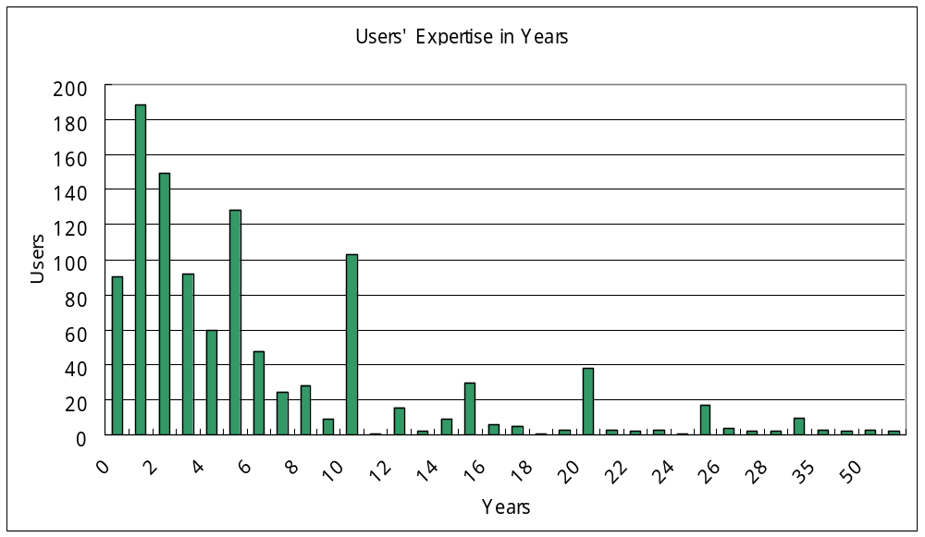
User Expertise Years

Slide 32
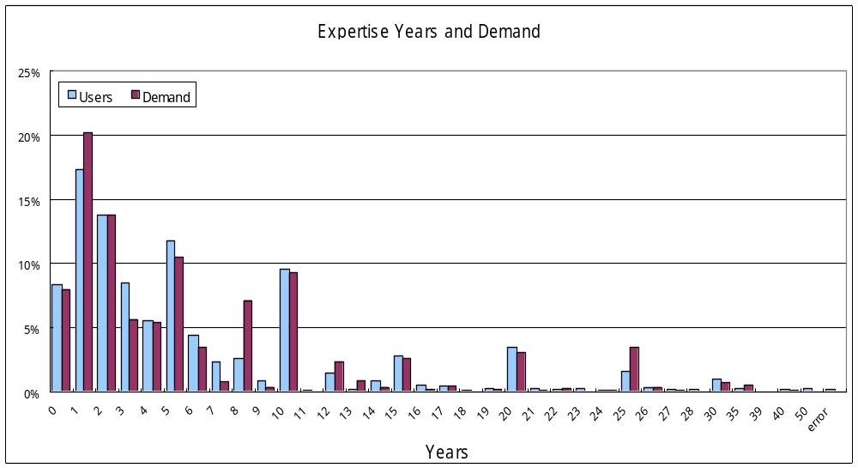
Expertise Years and Demand

Slide 33
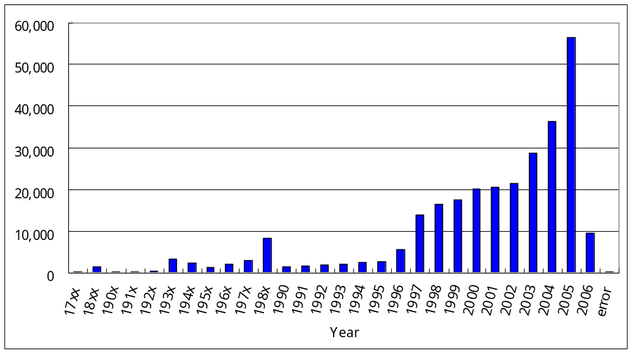
Date Stamp of ETD

Slide 34
Date Stamp of ETD
The number of ETDs begins increasing in 1997.
ETDs from seventeen hundreds ?
- some of scanned copies from European universities
- e.g., oldest ETDs are from British universities
- some of the older dates are typos - you'd have to
check each one to know for sure

Slide 35
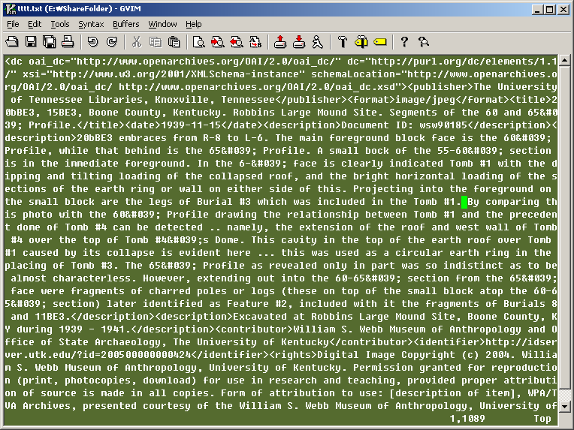
Date Error Sample

Slide 36
Overview
Purpose of Study
NDLTD
Data Set (ETDs, patrons, queries)
Our Approach
Data Analysis
Conclusions and Future Work

Slide 37
Conclusions
We analyzed the diversity and proportions of the ETDs, and compared them with the corresponding user demands.
We expect this result will provide a deeper understanding of NDLTD and its community.

Slide 38
Future Work
Use of widely-used classification system
- e.g., Dewey Decimal Classification 22 ($375)
More detailed classification of ETDs
- Include title, abstract and other subject field data
- Approx. 7000 etds in oai_etdms as well as oai_dc
➔ Utilize “discipline” in oai_etdms format records
Use of user activity data
- e.g., Clicking of query results in NDLTD
Visualization of NDLTD use and its community

Slide 39
References
[1] NDLTD, Networked Digital Library of Theses and Dissertations, available at http://www.ndltd.org, 2006
[2] Hussein Suleman, “OAI/ODL Harvester”, available at http://oai.dlib.vt.edu/odl/software/harvest/
[3] Seonho Kim, Uma Murthy, Kapil Ahuja, Sandi Vasile, Edward A. Fox, “Effectiveness of Implicit Rating Data on Characterizing Users in Complex Information Systems”, Springer-Verlag LNCS3652, 9th European Conference on Research and Advanced Technology for Digital Libraries (ECDL 2005), 2005, 186-194
[4] Search Interface Embedded User Tracking System, available at http://boris.dlib.vt.edu:8080/controller/index.jsp, 2006

Slide 40
Appendix
7 Categories and 77 Subcategories
 | 7 categories | 77 subcategories
1 | Architecture and Design | ArchitectureConstruction, LandscapeArchitecture
2 | Law | Law
3 | Medicine, Nursing and Veterinary Medicine | Dentistry, Medicine, Nursing, Pharmacy, Veterinary
4 | Arts and Science | Agriculture, AnimalPoultry, Anthropology, ApparelHousing, Archaeology, Art, Astronomy, Biochemistry, Biology, Botany, Chemistry, Communication, CropSoilEnvSciences, DairyScience, Ecology, EngineeringScience, English, Entomology, Family, Food, ForeignLanguageLiterature, Forestry, Geography, Geology, GovernmentInternationalAffair, History, Horticulture, HospitalityTourism, HumanDevelopment, HumanNutritionExercise, Informatics, Interdisciplinary, LibraryScience, Linguistics, Literature, Meteorology, Mathematics, Music Naval, Philosophy, Physics, Plant, Politics, Psychology, PublicAdministrationPolicy, PublicAffair, Sociology, Statistics, UrbanPlanning, Wildlife, Wood, Zoology
5 | Engineering and Applied Science | Aerospace, BiologicalEnginerring, Chemical, ComputerScience, Electronics, Environment, Industrial, Materials, Mechanics, MiningMineral, Nuclear, OceanEngineering
6 | Business and Commerce | AccountingFinance, Business, Economics, Management
7 | Education | Education
8 | Others. (unclassifiable) | (Unclassifiable)

Slide 41
Thank you!
Questions or Comments?

