Slide 1
EThOS
(Electronic Theses Online Service) – a national UK project
Martin Wolf
University of Warwick
10 June 2006

Slide 2
Introduction
Project background and approach
Proposals and achievements
Next steps

Slide 3
Background – current situation
User requests a known thesis
Thesis supplied in print or microfilm by British Library
Some interlending between institutions
Staff time and administration
End-user sometimes charged, 6 week wait

Slide 4
Background – the EThOS project
Builds on projects that examined:
  Best practice and implementation models
  Testing different software
EThOS brings the different strands together
Digitisation of current print theses in addition to born digital
A working, scaleable prototype national service

Slide 5
Approach – who?
Collaboration between varying institutions:
  Universities with experience of the prior projects
  Universities with no experience of e-Theses
  British Library, National Library of Wales
  National organisations for university administrators, postgraduate students
Work with other relevant projects

Slide 6
Approach – how?
Project board (advisory role, final sign-off)
Project Manager
8 separate workpackages covering 3 areas:
  Technical
  Business/legal
  Procedural

Slide 7
Proposals – service delivery
e-Theses stored on Central Hub and / or Institutional Repositories
Metadata harvester to hold information on all UK theses (eventually print and electronic)
Theses supplied either electronically or in a physical format

Slide 8
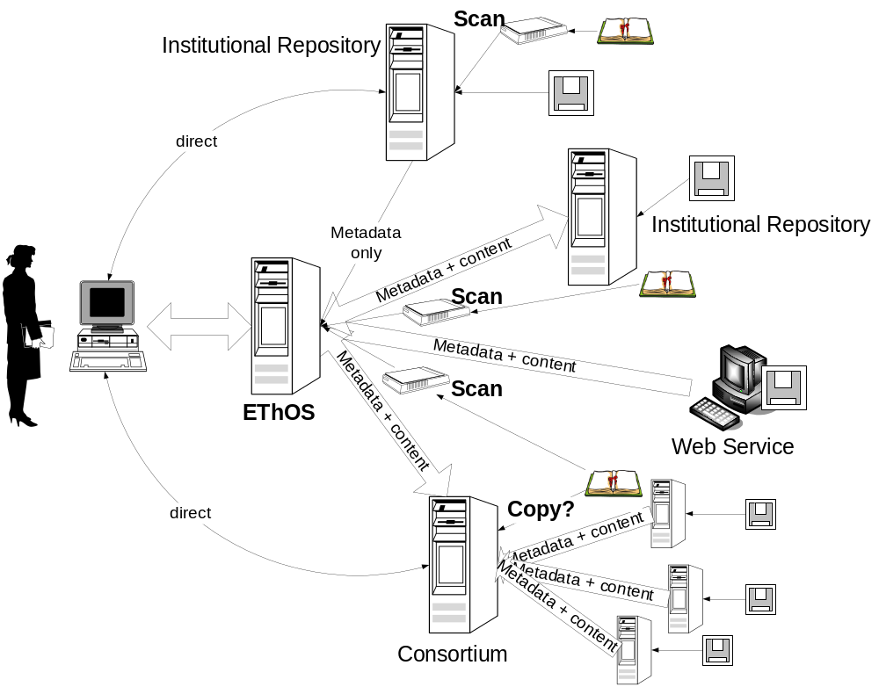
Proposals - Central Hub model

Slide 9
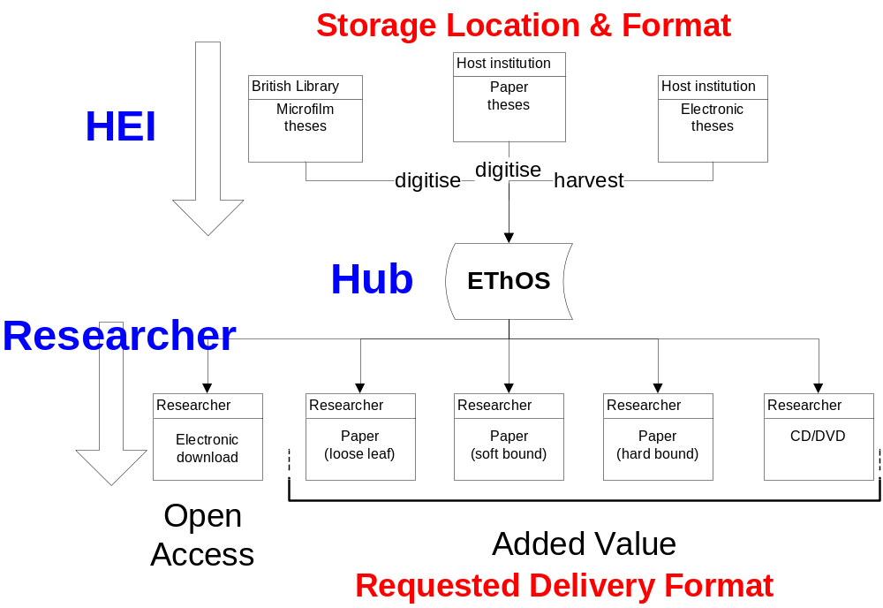
Proposals - Source to Delivery

Slide 10
Proposals – service sustainability
Universities to subscribe (Sponsor) or fund ad hoc (Associate)
Costs to cover digitisation of print material when requested by end-users
Universities to determine level of Open Access
Special digitisation projects available

Slide 11
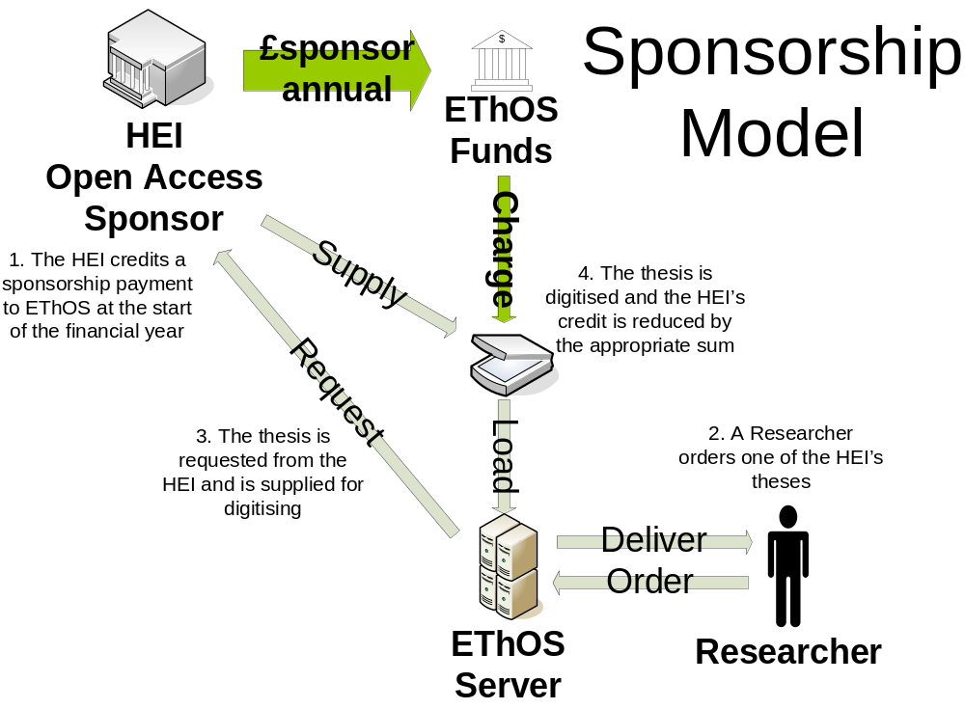
Proposals – Sponsor Model

Slide 12
Achievements 1
UK e-Theses metadata standards
IPR report and resultant risk management strategy
Standards and procedures for digitisation
Harvesting interface and mechanism tested and working

Slide 13
Achievements 2
Model end-user and deposit licences
Core system built and ingest mechanisms working
Advocacy within UK – articles, press releases, awareness events

Slide 14
Next steps
Project Evaluation underway
End-user interface to be finalised
Further advocacy events
Digitisation projects call
EThOS toolkit to be finalised

Slide 15
Thanks for your time
Any questions?

Slide 16

EThOS: Who’s involved?
The EThOS project is a partnership project between the following institutions:-

Slide 17

Others involved
Has also had input from:-

Slide 18

Funding
The EThOS project is funded by the partner institutions and :-

