Slide 1


ETD‘s as pilot materials for long-term preservation efforts in kopal
9th ETD Conference 2006, Quebec
Dr. Thomas Wollschläger,
German National Library (GNL)

Slide 2
Agenda
Challenges for long-term preservation
The ETD‘s at GNL and current tasks
The role and features of the kopal initiative
Planned data ingest
Future challenges

Slide 3
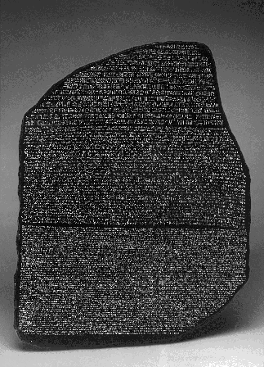
The problem of the digital age
1101110111001111001101001010101110101110010101011100011010101010100011010101010101010101000101010101010101010101010101010001010101010101
* 196 b.c. - † not yet *2000 - † 2005 (?)

Slide 4
Challenges of a digital long-term archive
Rapid technology changes hinder the access to older file formats
  Problem 1: Conservation of binary data (0 and 1)
    – No existing data carrier lasts forever
    – Solution: Regular bitstream-preservation
  Problem 2: Access to the content
    – Numerous formats; always new ones; old ones vanish
    – Dependencies from present soft- and hardware
    – Solutions: Migration (regular conversion),
    Emulation (re-enacting used systems)

Slide 5
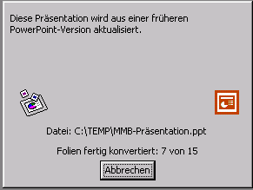
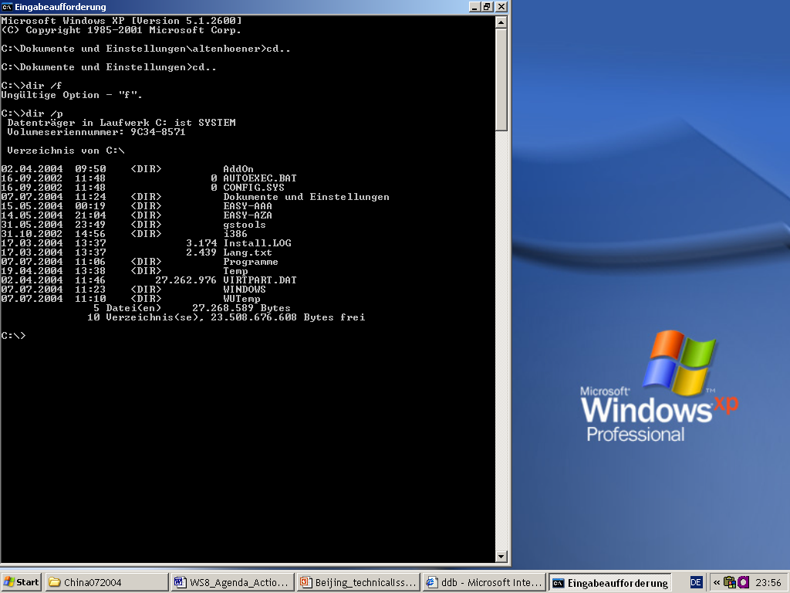
Approaches to ensure access
migration
emulation
condition: METADATA

Slide 6
ETD‘s for Ingest at German National Library
Online Theses and Dissertations at GNL
  Number: ~ 44.500 at present
  Growth: ~ 10.000 p.a.
  From: German universities (at present, 90 with 83 active)
  Collected since 1997
  Data amount: ~ 350 GB
  Accessible via the Online Catalogue of GNL
  All are accessible for free and in full-text (except a tiny amount for legal reasons)
  Most used & respected digital collection of GNL
  (> 350.000 access cases/month)

Slide 7
ETD preservation challenges
German ETD‘s are delivered in numerous file formats
Innovative file formats have been encouraged over the years
  3-D images & simulations
  Embedded audio and video
  Executables
First file types are no longer accessible
Unsatisfying document server architecture up to now
Advantage: Excellent metadata format throughout Germany, trusted workflows for ETD delivery from universities

Slide 8
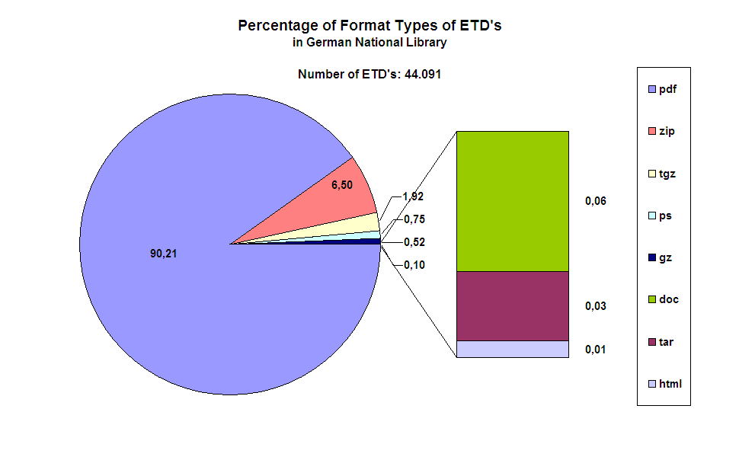
ETD File Formats in GNL

Slide 9
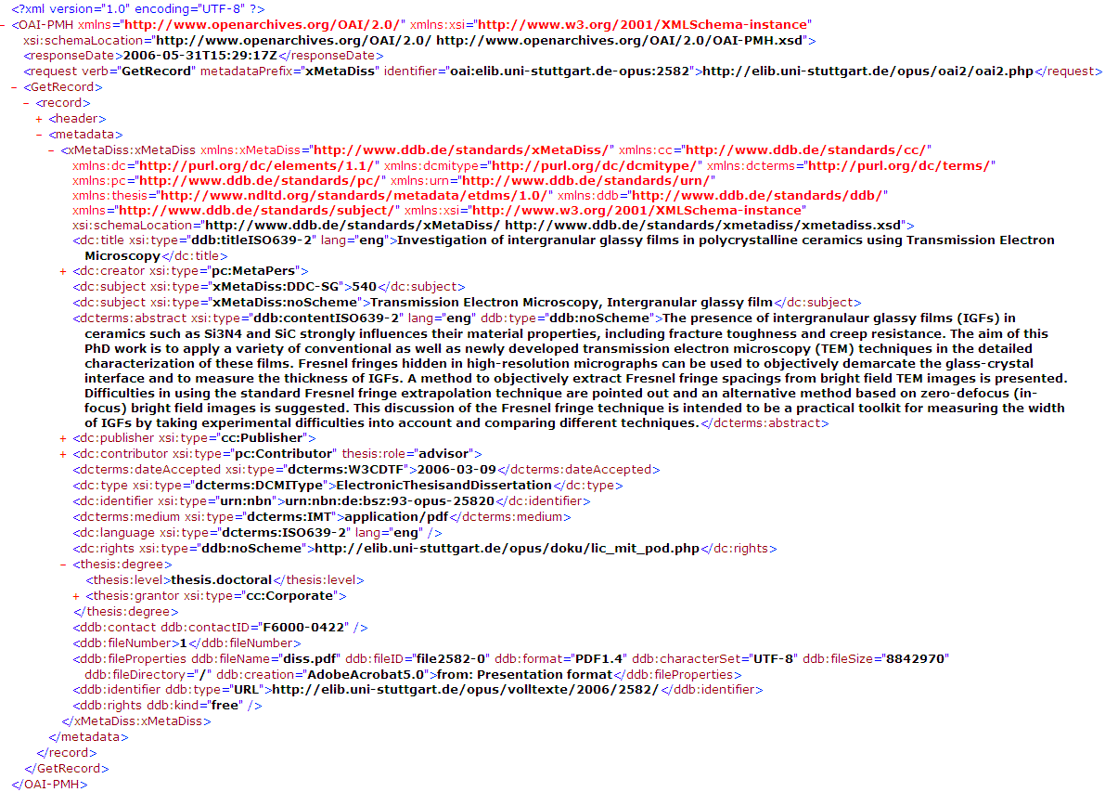
XMetaDiss Example for an ETD

Slide 10
German national initiative „kopal“
Co-operative development of a long-term
digital information archive
funded by the Federal Ministry for Education
and Research
Financial volume: 4,2 Mio € + self-financed activities of all partners, duration: 1.7.2004 – 30.6.2007 (+ X)
Task: Development of a standardized long-term preservation solution to facilitate long-term preservation for other libraries / industries
Solution as a facilitator for co-operation between libraries and other institutions / companies

Slide 11
kopal: Concept and background
Basis: DIAS (Digital Information and Archiving System) of the Royal Dutch Library, The Hague
  Developed by IBM → reliable standard components (CM, TSM, …)
  Implementation of the OAIS standard
  Further development of a suitable long-term preservation component (emulation, migration)
  Starting point for preservation planning
What we’ve missed:
  Enhancement for co-operative usage
  Hosting outside the library (remote access)
  Development of a universal object scheme
  A more generic approach
Conclusion:
  Extension of DIAS-Core and development of peripheral open-source based software tools to broaden its usability

Slide 12



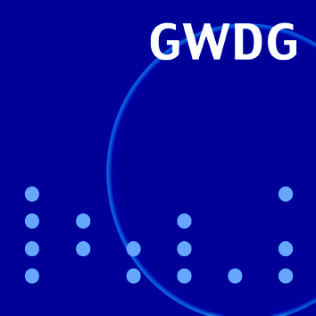
kopal: Partners
German National Library (GNL, leader)
State and University Library Göttingen
Industrial Business Machines (IBM) Germany
Society for Scientific Data Processing Göttingen (GWDG)
Working relationship:
Royal Dutch Library, The Netherlands

Slide 13
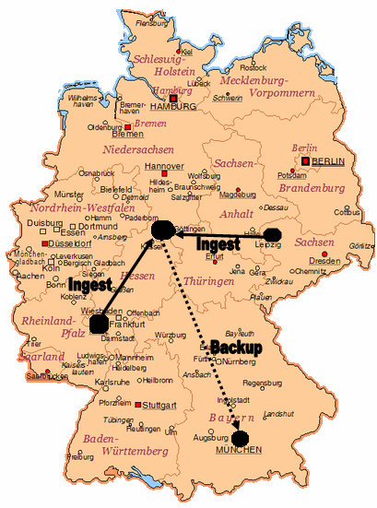
Kopal storage structure in Germany

Slide 14


kopal: Structure & concept
GNL
(Frankfurt)
GWDG
(Göttingen)
DIAS by IBM
Local
software
Account 1
SUB Göttingen
Account 2
Local
software
Partners nn

Slide 15

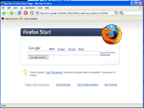

Selection
Presentation components
Collection
User
XML
+
Data
XML
+
Data
koLibRI
Ingest
Component
koLibRI
Retrieval
Component
(OAIS Compliant)
Preservation
Metadata
Extraktion
Ingest
Data
Manag.
Access
UOF (SIP)
UOF (DIP)
Metadata
Generation
(JHOVE)
Archival Storage
UOF Creation (SIP with
METS)
Admin
Cache
DIAS

Slide 16

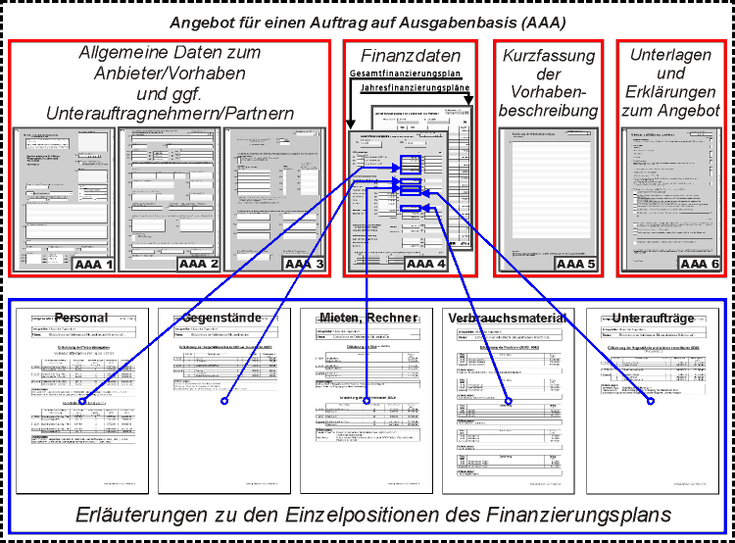
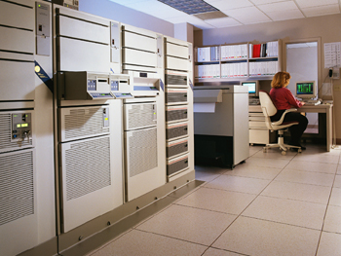
Packaging
UniversalObjectFormat
Submission Information Package
METS 1.4
Object
Header
dmdSec
amdSec
File Section
Structural Map
Mets.xml
LMER 1.2 – Long-term preservation Metadata for Electronic Ressources

Slide 17
XMetaDiss Example for an ETD

Slide 18
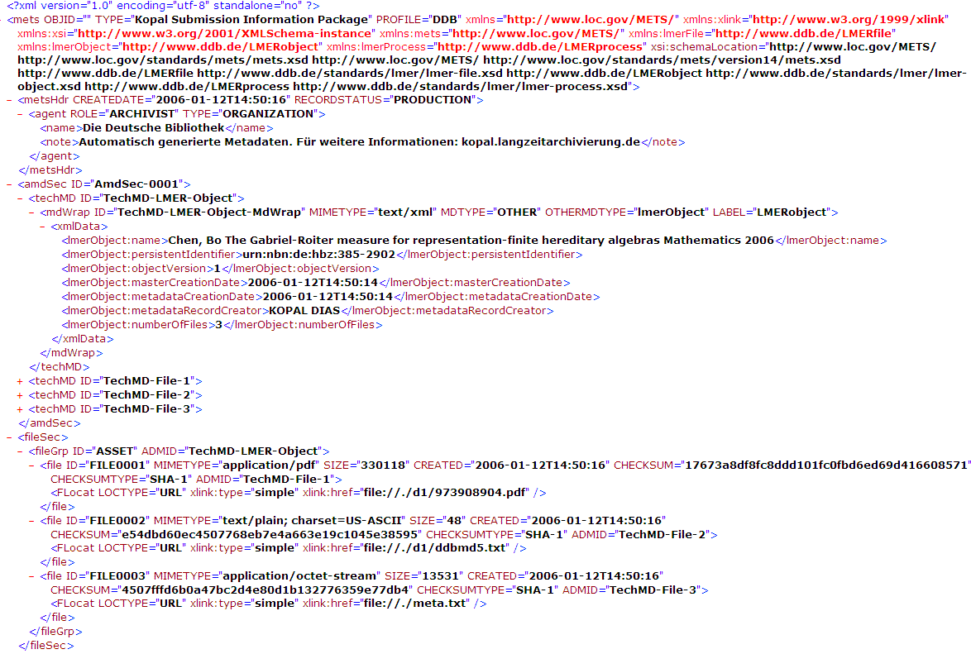
Example for mets.xml in kopal

Slide 19
Kopal preservation strategy
Migrate object with urn xxx into new format yyy
Migrate all objects
  of format xxx and/or
  that have been ingested before a certain date and/or
  that are larger than zzz MB
  into new format xyz (e.g. from TIFF to PNG)
Implementation of emulation view paths
No restriction as of file size or file format / type – all known and unknown file formats are being accepted (text, pictures, video, audio, executables, ... etc.)

Slide 20
Other data for Ingest
Electronic journals & serials
  Data amount: ~ 300 GB
CD-ROM images
  Number: ~ 50.000 to 100.000
  Data amount: ~ 28.000 to 56.000 GB
Digitised materials:
  Exil Press Digital (from GNL): ~ 150 GB
  External digital collections: ~ 1.500 GB
  Digitised books from the German Book & Scripture Museum (GNL): ~ 5.000 GB (for starters)
  Born-digital and digitised audio from the German Music Archive (GNL): ~ 544.000 GB

Slide 21
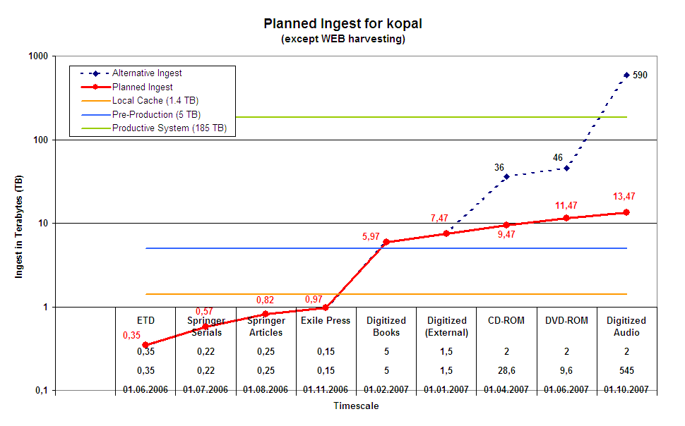
Data ingest for kopal with ETD‘s as start

Slide 22
Challenge: Preservation Planning + Access
In face of rising data amounts and large single objects (e.g. digitised DVD-ROM images with ~8 GB):
  Guarantee a sufficient performance of the system
  Implementation of suitable access systems
  Fast Internet connections, user support
Implementation of a functioning Preservation Planning mechanism
  Functioning international File Format Registry
  Performant migration of large data amounts
  Successful implementation of emulation mechanisms
Information, support & encoragement of ETD producers towards a format & preservation awareness

Slide 23
Informations on kopal
For further information on the kopal project, used standards and for downloads of documentation see
  http://kopal.langzeitarchivierung.de/index.php.en
Questions to the kopal team at German National Library:
  info@kopal.langzeitarchivierung.de
Questions on all ETD issues:
  Co-ordination Agency DissOnline,
  dissonline@dbf.ddb.de
Thanks for your patience and attention!

