Slide 1
Preserving ETDs With D.A.I.T.S.S.
FC
LA
FLORIDA CENTER FOR LIBRARY AUTOMATION
01010100101110111000010111110001
01010100101110111000010111110001
PAPER AUTHORS:
Priscilla Caplan
01010100101110111000010111110001
01010100101110111000010111110001
Chuck Thomas
01010100101110111000010111110001
01010100101110111000010111110001
01010100101110111000010111110001
01010100101110111000010111110001
ETD2006

Slide 2
<archiving_options>
FC
LA
?
FLORIDA CENTER FOR LIBRARY AUTOMATION
?
?
D.A.I.T.S.S.
?
?
?
?
?
ETD2006

Slide 3
reformat to “safe” archival media
<archiving_options>
FCLA
outsource archiving
FLORIDA CENTER FOR LIBRARY AUTOMATION
D.A.I.T.S.S.
enforce limits on permissible formats
do it yourself
ETD2006

Slide 4
<archiving_options>
FCLA
FLORIDA CENTER FOR LIBRARY AUTOMATION
D.A.I.T.S.S.
do it yourself
ETD2006

Slide 5
<archiving_options>
FCLA
STANDARDS
FLORIDA CENTER FOR LIBRARY AUTOMATION
METADATA
FILE FORMATS
OAIS FRAMEWORK
D.A.I.T.S.S.
COMMUNITIES
PRESERVATION
GRADUATE STUDIES
DIGITAL LIBRARIES
do it yourself
SYSTEMS
COMMERCIAL
OPEN SOURCE
MIXED SOLUTIONS
ETD2006

Slide 6
<archiving_options>
FCLA
MORE & MORE POSSIBLE TO PLAN & BUILD DIGITAL ARCHIVING SOLUTIONS
FLORIDA CENTER FOR LIBRARY AUTOMATION
D.A.I.T.S.S.
THIS DOES NOT MEAN THERE ARE ENOUGH OPTIONS
PLENTY OF MORE ROOM
ETD2006

Slide 7

<archiving_options>
FCLA
FLORIDA CENTER FOR LIBRARY AUTOMATION
D.A.I.T.S.S.
…another software option
Format Normalization Mass Format Migration Migration On Request
ETD2006

Slide 8
<daitss>
FCLA
Dark archive, use tape storage
Focus on data for cost analysis
Treatment based on Action Plans
Limit ingest to formats with Action Plan
Canonicalization & forward format migration
Make tools available as Open Source
11 Library Directors Wanted ETD Preservation Solution
FLORIDA CENTER FOR LIBRARY AUTOMATION
D.A.I.T.S.S.
FCLA Developed FL Digital Archives
(initial IMLS support for 3-year analysis of costs)
Original Plan
Revised Plan
ETD2006

Slide 9
<daitss>
FCLA
Dark archive, use tape storage
Focus on data for cost analysis
Treatment based on Action Plans & Background Reports
Limit ingest to formats with Action Plan
Canonicalization & forward format migration, & bit pres. of original
Make tools available as Open Source
11 Library Directors Wanted ETD Preservation Solution
FLORIDA CENTER FOR LIBRARY AUTOMATION
designing DAITSS
D.A.I.T.S.S.
FCLA Developed FL Digital Archives
(initial IMLS support for 3-year analysis of costs)
Unltd ingest, 2 pres. levels
Normalization,
Original Plan
DAITSS
Revised Plan
ETD2006

Slide 10
<daitss>
FCLA
Became Operational November 2005
FLORIDA CENTER FOR LIBRARY AUTOMATION
D.A.I.T.S.S.
Written In Java Runs on LINUX Uses MySQL Database
Data Model
DAITSS
Manages Relationships Between Components
Stores Tech., Admin., Structural, Pres., and Descriptive Metadata
Builds Provenance History of Submitted, Normalized and Migrated Versions of Entity and Components
Information Package
Intellectual
entity
Data File
Bitstream
ETD2006

Slide 11
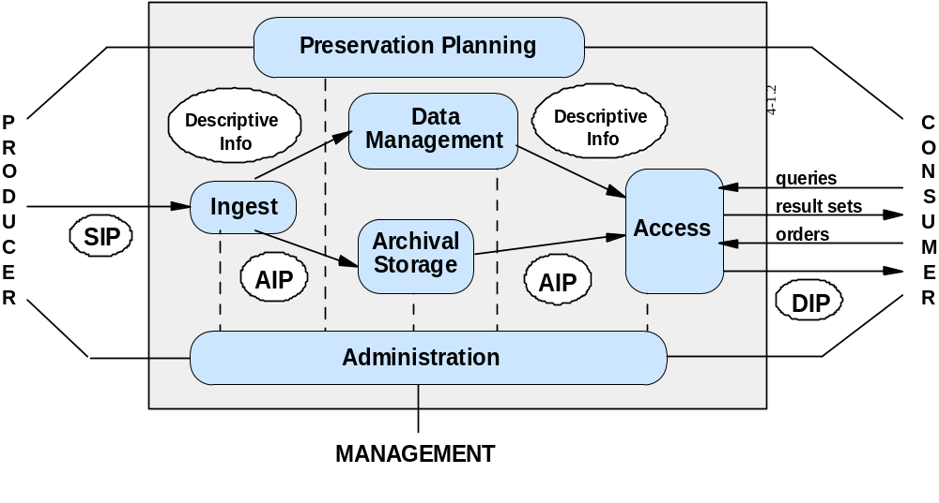
<daitss>
FCLA
Supports Major Functional Areas of OAIS Framework
FLORIDA CENTER FOR LIBRARY AUTOMATION
D.A.I.T.S.S.
NOTE
Uses Existing and Emerging Library Standards
PREMIS core preservation metadata elements
Z39.87 technical metadata for still images
Metadata Encoding Transmission Standard (METS)
ETD2006

Slide 12
<daitss>
FCLA
Action Plans & Background Reports
FLORIDA CENTER FOR LIBRARY AUTOMATION
Normalization format(s)
Preservation Plans
>> Original Format
>> Normalized Format
Timetable: Short-Term
Schedule for Revision
Format Description
Pointer to Specification
How to Recognize
History & Duration
Maintenance Body
Platform Support
Legal Issues
Perceived Popularity
Limitations
Related Specifications
All good for format registry!
D.A.I.T.S.S.
ETD2006

Slide 13
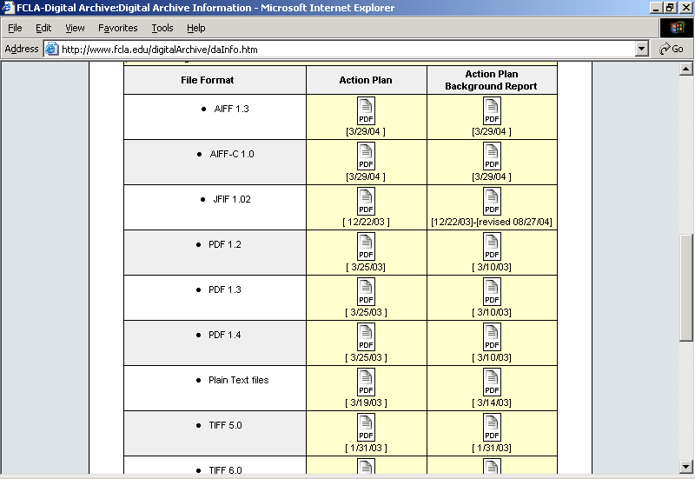
<daitss>
FCLA
Action Plans: Currently 18 Action Plans
FLORIDA CENTER FOR LIBRARY AUTOMATION
D.A.I.T.S.S.
Infinitely Expandable: More Implementors = More Action Plans
ETD2006

Slide 14
<daitss>
FCLA
Unique & Interesting Characteristics
DAITSS built for digital preservation only
3 main functions (normalization, mass migration, on request)
storage not built in, programmed function
real-time access/display not a function
truly a “dark” archive
FLORIDA CENTER FOR LIBRARY AUTOMATION
D.A.I.T.S.S.
Preservation of original bitstream(s)
Full preservation treatment as owner decides
ETD2006

Slide 15
<daitss>
FCLA
Unique & Interesting Characteristics
FLORIDA CENTER FOR LIBRARY AUTOMATION
Most activity pushed to ingest
Submission Information Packet processed all at once
SIP ingested as METS, supplemented as METS to form AIP
D.A.I.T.S.S.
INGEST
Validate ingested file formats
Derive normalized files according to Action Plan
Localize externally referenced schema, DTD’s etc.
Extract specified technical metadata
Record anomalies, quirks
Record relationships among components
Writes record of all actions, files, etc. to MySQL and XML (METS) to form AIP
ETD2006

Slide 16
<daitss>
FCLA
Unique & Interesting Characteristics
FLORIDA CENTER FOR LIBRARY AUTOMATION
Can be configured to work with any Storage Mgmt. System
FCLA uses Tivoli Storage Mgmt. System, 3 tape systems
DAITSS daemons continuously monitoring fixity, integrity of stored files
Allows implementors to use DAITSS as a modular preservation component of larger asset management strategy
Particularly good for ETDs; universities can relay on other systems or vendors for submission, searching, presentation as separate, upgradeable components
D.A.I.T.S.S.
Redundant Copies of Each Archival Information Packet
Multiple (3) independently written masters on different tape backup systems
Not considered “written” to archival storage until all 3 copies created
ETD2006

Slide 17
<daitss>
FCLA
Unique & Interesting Characteristics
No changes permitted on AIP stored within DAITSS
Originally a matter of convenience
Quickly became clear it was easier to code, simpler to manage
Dissemination required to for any change
FLORIDA CENTER FOR LIBRARY AUTOMATION
D.A.I.T.S.S.
dissemination request
1
INGEST
DISSEMINATION
ARCHIVAL STORAGE
5
2
AIP
3
DIP
4
changes
ETD2006

Slide 18
<daitss>
FCLA
Unique & Interesting Characteristics
DAITSS permits withdrawals
Not part of the OAIS framework
Necessary part of the archive needed for ETDs & other content
FLORIDA CENTER FOR LIBRARY AUTOMATION
D.A.I.T.S.S.
Every Dissemination Information Packet Contains:
Original Ingested files and metadata
Separated component bitstreams
Additional technical, admin., preservation and provenance history
Normalized versions or latest/best migrations from originals
Other versions by negotiation, prior agreement
ETD2006

Slide 19
<services>
FCLA
Florida Digital Archive Offers
FLORIDA CENTER FOR LIBRARY AUTOMATION
Deposit of packets
Secure storage and file management
Preservation services
Accounting & reporting
Dissemination & withdrawal
Under consideration: regeneration of use copies (typically only masters are archived)
Under consideration: exploration of databases/datasets & executable environments that require emulation
D.A.I.T.S.S.
ETD2006

Slide 20
<status>
FCLA
FDA Using DAITTS:
FLORIDA CENTER FOR LIBRARY AUTOMATION
Currently Holds: 11,786 information packages (digital books, photographs and ETDs) comprising 118,918 files requiring 2.7 TB of storage
D.A.I.T.S.S.
Routinely Performs Format Normalizations:
>> PDF to TIFF page images
>> AVI and other Multimedia Formats to PCM for audio bitstream and motion JPEG for video bitstream
Fine-tuning software with more automated functions for requesting disseminations, adding in graphical administration interface
Seeking Development Partners: Contact Priscilla Caplan at pcaplan@ufl.edu or 352-392-9020 x324
ETD2006

Slide 21
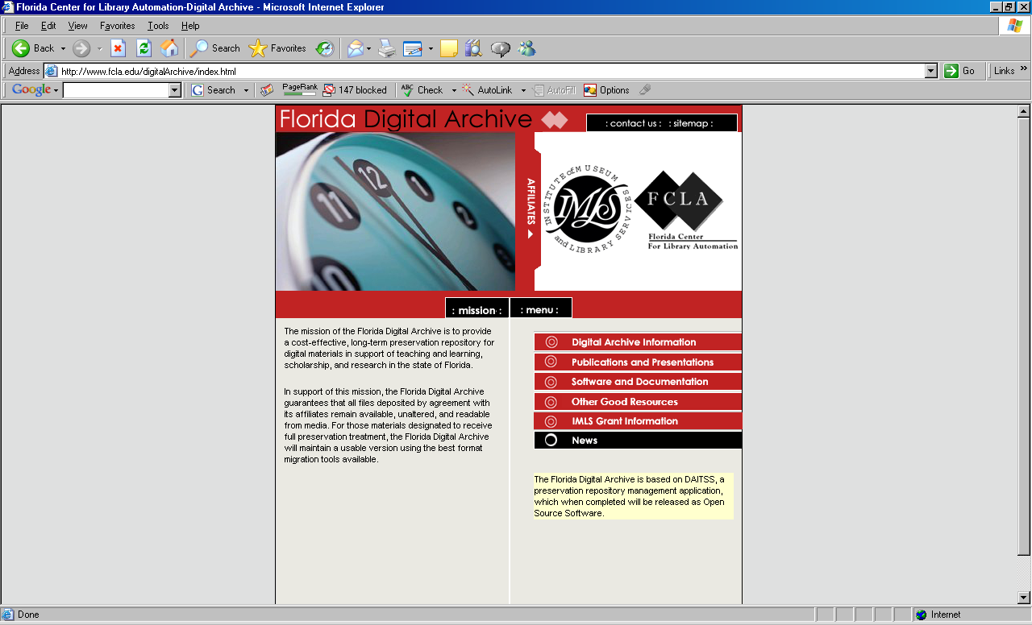
www.fcla.edu/digitalArchive

