Slide 1


The Institutional Repository at West Virginia University
Resources for Effective Promotion

Slide 2
West Virginia University
eIDR Program Model
University Libraries
Electronic Institutional Document Repository
Theses & Dissertations (eTD Program)
Graduate Research
Honors Theses
(eHT Program)
Undergraduate Research
Electronic Scholarly Resources Archive (eSRA)
Faculty Research,
Administrative Reports,
Student Programs

Slide 3

Electronic Theses and Dissertations (eTD)
Required electronic submission since 1998
Over 6 million ETDs served
Over 100 countries access WVU research
ETDs are accessed 145,000% more than print documents
3,000 documents in the collection
80% of the collection is available without restriction
Most popular ETD accessed over 15,000 times
Excellent promotional tool for students and departments

Slide 4
Electronic Honor’s Theses
(eHT)
Undergraduate senior projects, technical reports, capstone experiences
Over 900 students in WVU Honors College
Thesis submission required as of Fall 2005
eHT program will use online submission process to create digital collection
Excellent promotional tool for students and departments

Slide 5

Electronic Scholarly Resources Archive (eSRA)
Faculty technical reports / white papers, pre-prints, post-prints
Conference / Symposium proceedings
Departmental Showcase Venue
E-Portfolios
Administrative Reports
Excellent promotional tool for faculty and departments
Electronic Scholarly Resources Archive

Slide 6
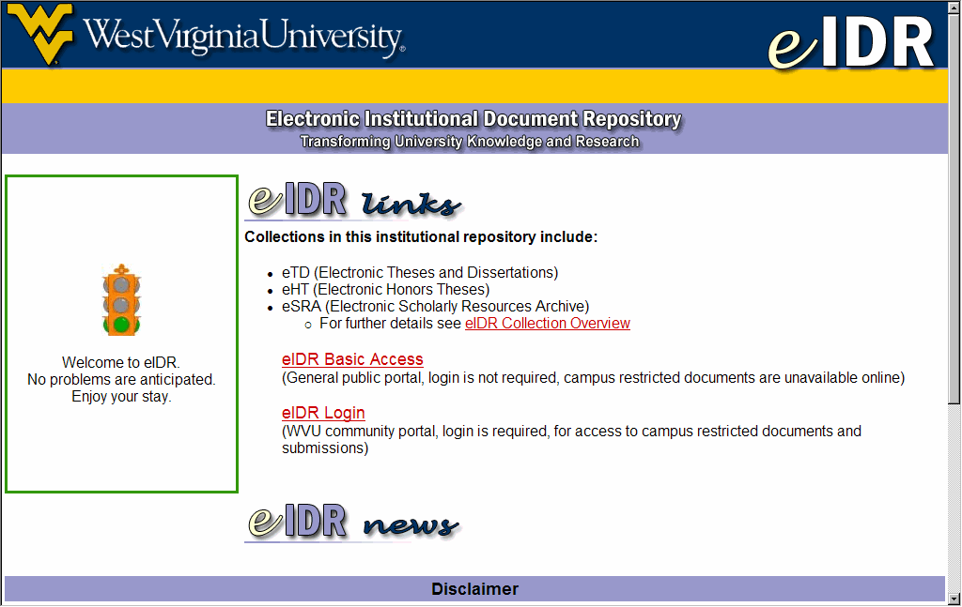
WVU eIDR Web Interface

Slide 7
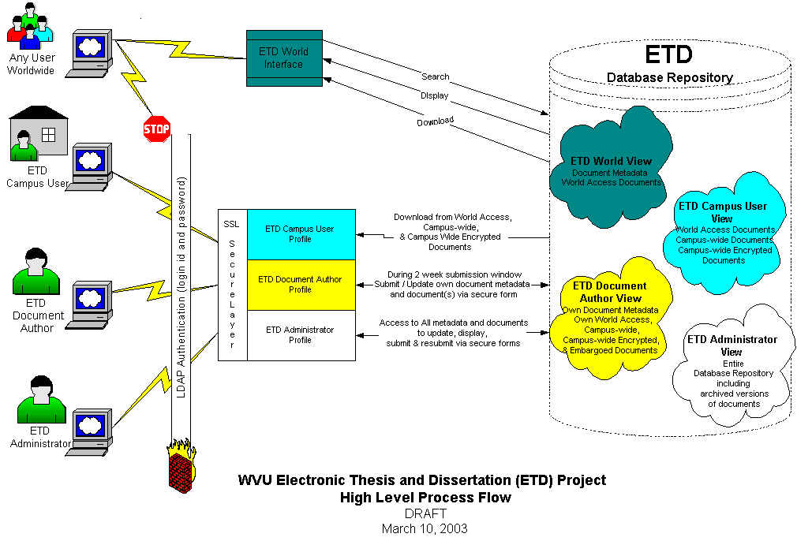

Slide 8




WVU Open Archives Initiative
Protocol for Metadata Harvesting
WVU EIDR Database
System Indices Required:
Record ID Number & Date/Time Stamp of last record update (date of approval)
↓
Provides Metadata to OAI Harvesters & Automated Cataloging Records for MountainLynx
Metadata Compiled via OAICat Software
↑
↓
MARC21-XML
Records Derived

Slide 9

The Future
RFP to solicit commercial IR vendors
  Need to maintain latest standards
  Avoid over-dependency on in-house operation and key personnel

Slide 10

Open Access
Self-Acknowledged Archiving of Research =
2-5 Times Increased Scholarly Citations

Slide 11
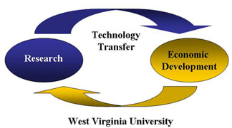
Research & Economic Impact
Generate & disseminate new knowledge, techniques, scholarly & creative works
Promote economic development through technology transfer

Slide 12

Consortium Support

Slide 13
WVU Collaboration
University Libraries
Office of Academic Affairs and Research / Provost
Office of Information Technology
Office for Institutional Advancement
Office of Technology Transfer
Honors College
ETD Task Force
NDLTD Consortium
WVU Faculty, Students and Staff

Slide 14


WVU Electronic Institutional Document Repository Program
http://eidr.wvu.edu/
Presented by John H. Hagen,
University Libraries
ETD 2006 Symposium
Laval University, Quebec, Canada
8 June 2006
John.Hagen@mail.wvu.edu

