Slide 1

Enhancing Digital Repository of Scholarly Publications at Indian Institute of Technology Bombay
7-10 June
University of Laval, Quebec Canada
by
Mr. Mahendra N. Jadhav
Assistant Librarian
Central Library
IIT Bombay, India
Notes:
Good Morning,
It’s a real honour to have an opportunity to speak to such a distinguished audience.
First and foremost, I’d like to thank you for taking your very precious time off to come here, but I guarantee you because of your presence here today, you and your colleagues will in the long run be saving a lot of time because we are going to introduce to you a new technology, a novel concept and an excellent tool which will revolutionalise and improve the very way to work. I know I’ve met some of you but for the benefit of those I have not, my name is Perdeep Kumar (you can call me Kumar for short) and I am the Account Manager (India) for ScienceDirect.
Today, I hope to introduce you to our company Science Direct and to keep you informed of ScienceDirect’s offerings to the academic community. Before going any further into this presentation, I would like to give you a generic definition of what Science Direct is.
I’ve divided my presentation into 7 section. [Use words like ……To start off, followed by, ….. the next topic is….]

Slide 2

Contents
Introduction
Objectives
Scholarly Publications At IITB
  Electronic Theses & Dissertations -Submission Process @ IITB
Selection of Software
Pilot Study
Future Plans
Conclusions
Notes:
Good Morning,
It’s a real honour to have an opportunity to speak to such a distinguished audience.
First and foremost, I’d like to thank you for taking your very precious time off to come here, but I guarantee you because of your presence here today, you and your colleagues will in the long run be saving a lot of time because we are going to introduce to you a new technology, a novel concept and an excellent tool which will revolutionalise and improve the very way to work. I know I’ve met some of you but for the benefit of those I have not, my name is Perdeep Kumar (you can call me Kumar for short) and I am the Account Manager (India) for ScienceDirect.
Today, I hope to introduce you to our company Science Direct and to keep you informed of ScienceDirect’s offerings to the academic community. Before going any further into this presentation, I would like to give you a generic definition of what Science Direct is.
I’ve divided my presentation into 7 section. [Use words like ……To start off, followed by, ….. the next topic is….]

Slide 3
Introduction
IITB is an academic and research institution set up in 1958, and it is a prime educational institution in India and awarding degrees in engineering, technology and science.
Objectives of the Institute: training, leadership, organize educational programmes, interact with industrial national/international professional bodies.
Central library plays vital role in acquisition, preservation, dissemination, advancement of knowledge etc. to fulfill the institute’s objectives.
Notes:
Good Morning,
It’s a real honour to have an opportunity to speak to such a distinguished audience.
First and foremost, I’d like to thank you for taking your very precious time off to come here, but I guarantee you because of your presence here today, you and your colleagues will in the long run be saving a lot of time because we are going to introduce to you a new technology, a novel concept and an excellent tool which will revolutionalise and improve the very way to work. I know I’ve met some of you but for the benefit of those I have not, my name is Perdeep Kumar (you can call me Kumar for short) and I am the Account Manager (India) for ScienceDirect.
Today, I hope to introduce you to our company Science Direct and to keep you informed of ScienceDirect’s offerings to the academic community. Before going any further into this presentation, I would like to give you a generic definition of what Science Direct is.
I’ve divided my presentation into 7 section. [Use words like ……To start off, followed by, ….. the next topic is….]

Slide 4
Objectives
Unlocking the scholarly publication of IITB to the research community.
Make this database available to INDEST consortium members as a data provider.
OAI-PMH compliant of IITB Digital repository
Notes:
Good Morning,
It’s a real honour to have an opportunity to speak to such a distinguished audience.
First and foremost, I’d like to thank you for taking your very precious time off to come here, but I guarantee you because of your presence here today, you and your colleagues will in the long run be saving a lot of time because we are going to introduce to you a new technology, a novel concept and an excellent tool which will revolutionalise and improve the very way to work. I know I’ve met some of you but for the benefit of those I have not, my name is Perdeep Kumar (you can call me Kumar for short) and I am the Account Manager (India) for ScienceDirect.
Today, I hope to introduce you to our company Science Direct and to keep you informed of ScienceDirect’s offerings to the academic community. Before going any further into this presentation, I would like to give you a generic definition of what Science Direct is.
I’ve divided my presentation into 7 section. [Use words like ……To start off, followed by, ….. the next topic is….]

Slide 5
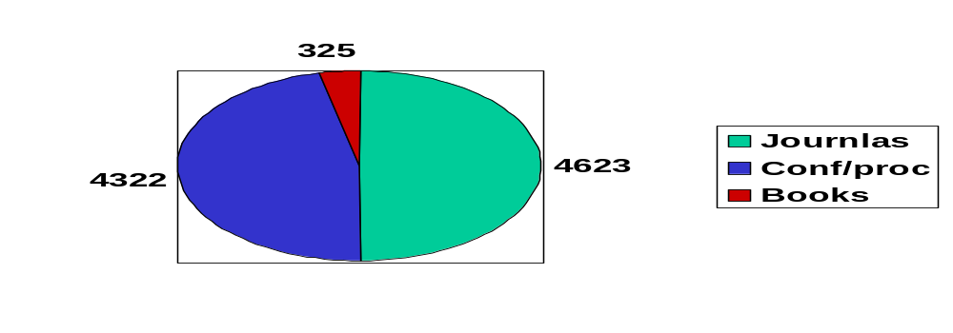
Scholarly Publications at IITB
Generation of literature : IITB have 27 departments, 450 Faculty + Scientific project staff, 1269 registered Research Scholars and 1290 Post Graduate students are actively involved in research in engineering, Technology, humanities and social sciences, management areas.
Publications produced during last ten years 1995-2005 by IITB
Notes:
Good Morning,
It’s a real honour to have an opportunity to speak to such a distinguished audience.
First and foremost, I’d like to thank you for taking your very precious time off to come here, but I guarantee you because of your presence here today, you and your colleagues will in the long run be saving a lot of time because we are going to introduce to you a new technology, a novel concept and an excellent tool which will revolutionalise and improve the very way to work. I know I’ve met some of you but for the benefit of those I have not, my name is Perdeep Kumar (you can call me Kumar for short) and I am the Account Manager (India) for ScienceDirect.
Today, I hope to introduce you to our company Science Direct and to keep you informed of ScienceDirect’s offerings to the academic community. Before going any further into this presentation, I would like to give you a generic definition of what Science Direct is.
I’ve divided my presentation into 7 section. [Use words like ……To start off, followed by, ….. the next topic is….]

Slide 6
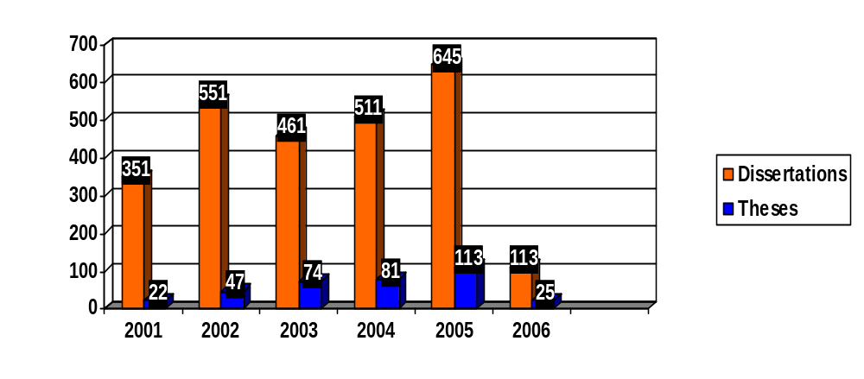
Scholarly Publications at IITB
IITB offers B.Tech., M.Tech., M.Des., Ph.D., MS., MSc., M.Phil. and M. Management degrees in 27 subjects and large number of research out put is generated in the form of Theses and dissertations.
Statistics of ETD submitted by IITB students
Notes:
Good Morning,
It’s a real honour to have an opportunity to speak to such a distinguished audience.
First and foremost, I’d like to thank you for taking your very precious time off to come here, but I guarantee you because of your presence here today, you and your colleagues will in the long run be saving a lot of time because we are going to introduce to you a new technology, a novel concept and an excellent tool which will revolutionalise and improve the very way to work. I know I’ve met some of you but for the benefit of those I have not, my name is Perdeep Kumar (you can call me Kumar for short) and I am the Account Manager (India) for ScienceDirect.
Today, I hope to introduce you to our company Science Direct and to keep you informed of ScienceDirect’s offerings to the academic community. Before going any further into this presentation, I would like to give you a generic definition of what Science Direct is.
I’ve divided my presentation into 7 section. [Use words like ……To start off, followed by, ….. the next topic is….]

Slide 7
Submission Process- ETD
IITB has implemented e-submission of theses and dissertations in 1999-2000, to its parallel printed submission and it was first kind of its in India
Request
Valid
Registration through LDAP login
Check
LDAP
Student defense
Supervisor
approved
Submit ETD
Registration complete
No
GSDL
Internet
Yes
Submission
OK
Resubmit
ETD Archive
Intranet
Reviewer
Library staff
ETD Workflow@IITB
Notes:
Good Morning,
It’s a real honour to have an opportunity to speak to such a distinguished audience.
First and foremost, I’d like to thank you for taking your very precious time off to come here, but I guarantee you because of your presence here today, you and your colleagues will in the long run be saving a lot of time because we are going to introduce to you a new technology, a novel concept and an excellent tool which will revolutionalise and improve the very way to work. I know I’ve met some of you but for the benefit of those I have not, my name is Perdeep Kumar (you can call me Kumar for short) and I am the Account Manager (India) for ScienceDirect.
Today, I hope to introduce you to our company Science Direct and to keep you informed of ScienceDirect’s offerings to the academic community. Before going any further into this presentation, I would like to give you a generic definition of what Science Direct is.
I’ve divided my presentation into 7 section. [Use words like ……To start off, followed by, ….. the next topic is….]

Slide 8
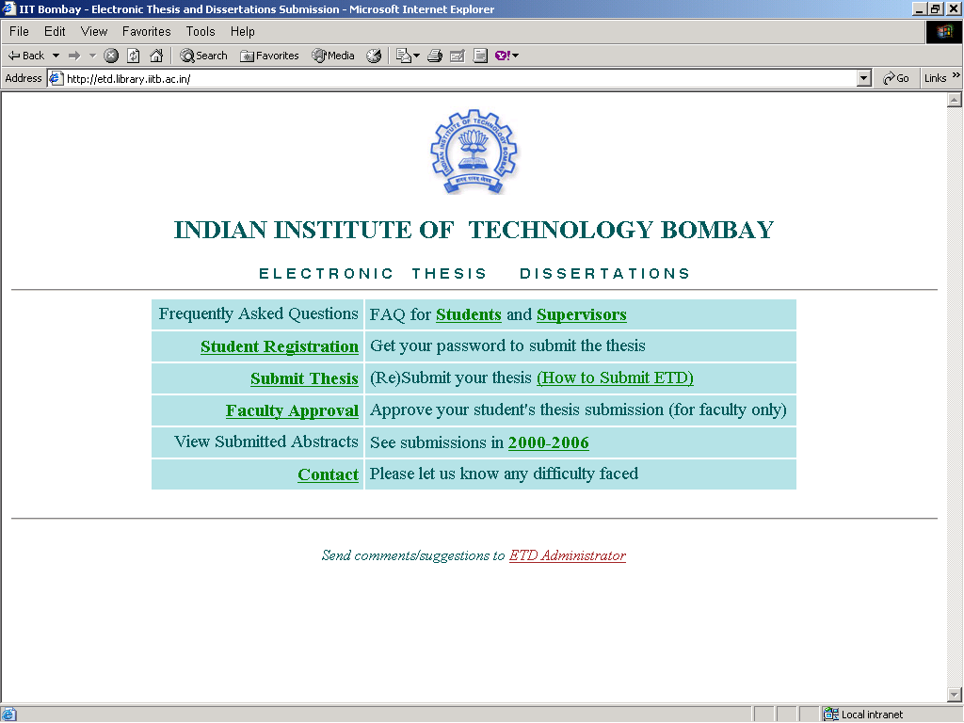
Notes:
Good Morning,
It’s a real honour to have an opportunity to speak to such a distinguished audience.
First and foremost, I’d like to thank you for taking your very precious time off to come here, but I guarantee you because of your presence here today, you and your colleagues will in the long run be saving a lot of time because we are going to introduce to you a new technology, a novel concept and an excellent tool which will revolutionalise and improve the very way to work. I know I’ve met some of you but for the benefit of those I have not, my name is Perdeep Kumar (you can call me Kumar for short) and I am the Account Manager (India) for ScienceDirect.
Today, I hope to introduce you to our company Science Direct and to keep you informed of ScienceDirect’s offerings to the academic community. Before going any further into this presentation, I would like to give you a generic definition of what Science Direct is.
I’ve divided my presentation into 7 section. [Use words like ……To start off, followed by, ….. the next topic is….]

Slide 9
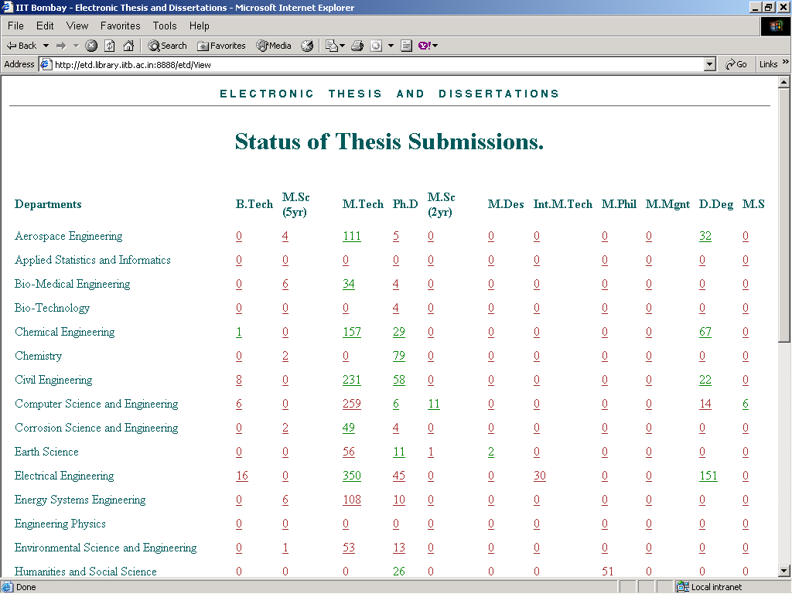
Notes:
Good Morning,
It’s a real honour to have an opportunity to speak to such a distinguished audience.
First and foremost, I’d like to thank you for taking your very precious time off to come here, but I guarantee you because of your presence here today, you and your colleagues will in the long run be saving a lot of time because we are going to introduce to you a new technology, a novel concept and an excellent tool which will revolutionalise and improve the very way to work. I know I’ve met some of you but for the benefit of those I have not, my name is Perdeep Kumar (you can call me Kumar for short) and I am the Account Manager (India) for ScienceDirect.
Today, I hope to introduce you to our company Science Direct and to keep you informed of ScienceDirect’s offerings to the academic community. Before going any further into this presentation, I would like to give you a generic definition of what Science Direct is.
I’ve divided my presentation into 7 section. [Use words like ……To start off, followed by, ….. the next topic is….]

Slide 10
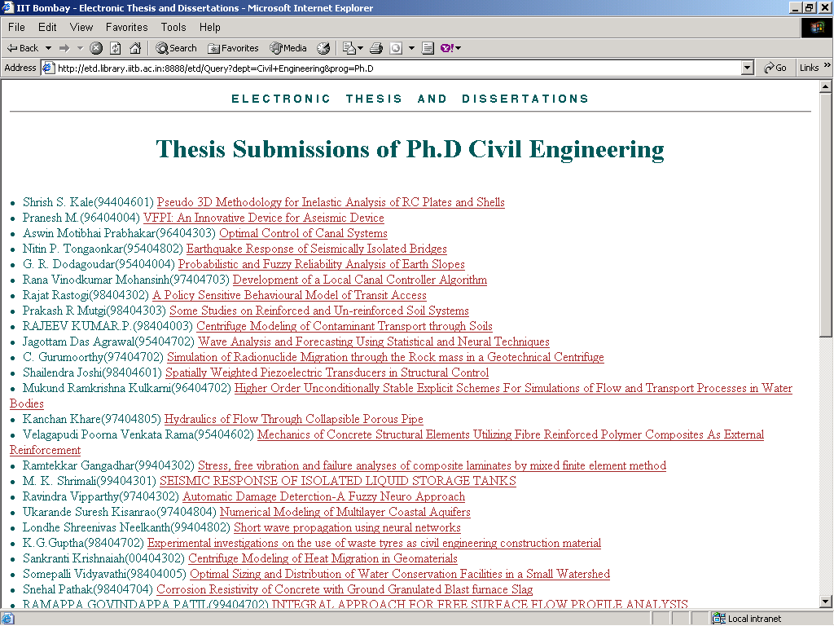
Notes:
Good Morning,
It’s a real honour to have an opportunity to speak to such a distinguished audience.
First and foremost, I’d like to thank you for taking your very precious time off to come here, but I guarantee you because of your presence here today, you and your colleagues will in the long run be saving a lot of time because we are going to introduce to you a new technology, a novel concept and an excellent tool which will revolutionalise and improve the very way to work. I know I’ve met some of you but for the benefit of those I have not, my name is Perdeep Kumar (you can call me Kumar for short) and I am the Account Manager (India) for ScienceDirect.
Today, I hope to introduce you to our company Science Direct and to keep you informed of ScienceDirect’s offerings to the academic community. Before going any further into this presentation, I would like to give you a generic definition of what Science Direct is.
I’ve divided my presentation into 7 section. [Use words like ……To start off, followed by, ….. the next topic is….]

Slide 11
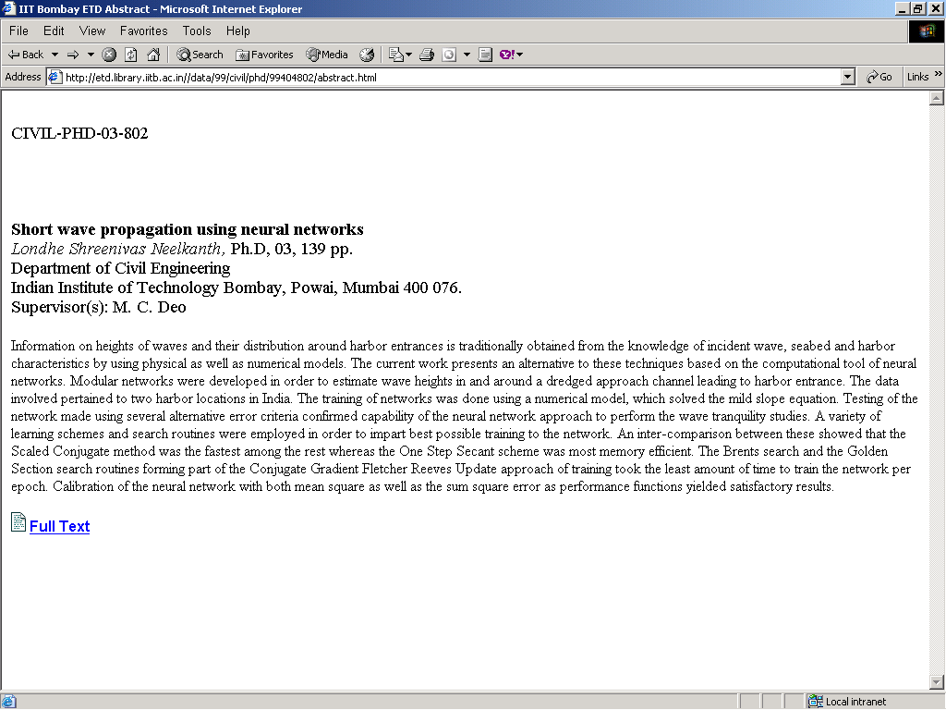
Notes:
Good Morning,
It’s a real honour to have an opportunity to speak to such a distinguished audience.
First and foremost, I’d like to thank you for taking your very precious time off to come here, but I guarantee you because of your presence here today, you and your colleagues will in the long run be saving a lot of time because we are going to introduce to you a new technology, a novel concept and an excellent tool which will revolutionalise and improve the very way to work. I know I’ve met some of you but for the benefit of those I have not, my name is Perdeep Kumar (you can call me Kumar for short) and I am the Account Manager (India) for ScienceDirect.
Today, I hope to introduce you to our company Science Direct and to keep you informed of ScienceDirect’s offerings to the academic community. Before going any further into this presentation, I would like to give you a generic definition of what Science Direct is.
I’ve divided my presentation into 7 section. [Use words like ……To start off, followed by, ….. the next topic is….]

Slide 12
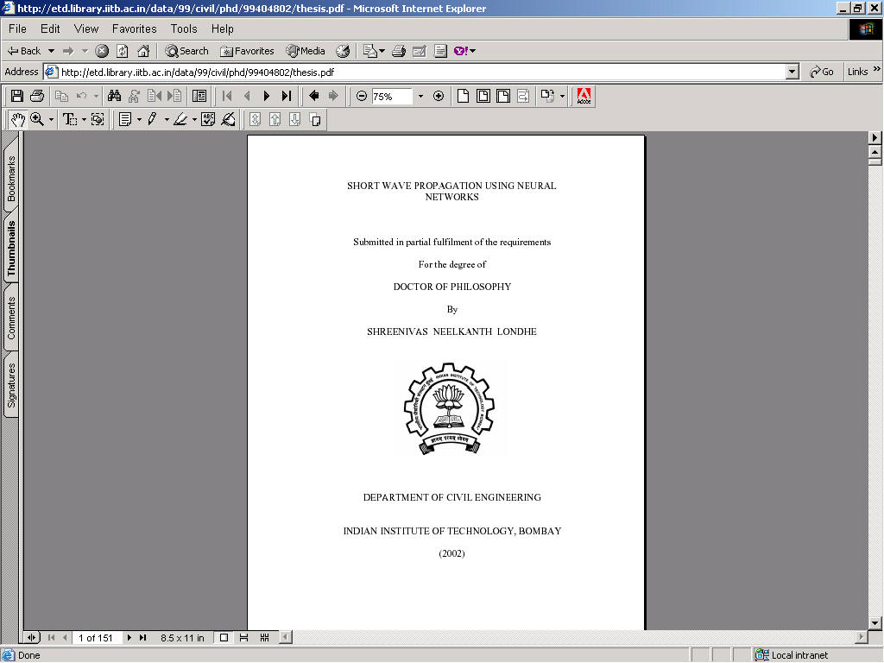
Notes:
Good Morning,
It’s a real honour to have an opportunity to speak to such a distinguished audience.
First and foremost, I’d like to thank you for taking your very precious time off to come here, but I guarantee you because of your presence here today, you and your colleagues will in the long run be saving a lot of time because we are going to introduce to you a new technology, a novel concept and an excellent tool which will revolutionalise and improve the very way to work. I know I’ve met some of you but for the benefit of those I have not, my name is Perdeep Kumar (you can call me Kumar for short) and I am the Account Manager (India) for ScienceDirect.
Today, I hope to introduce you to our company Science Direct and to keep you informed of ScienceDirect’s offerings to the academic community. Before going any further into this presentation, I would like to give you a generic definition of what Science Direct is.
I’ve divided my presentation into 7 section. [Use words like ……To start off, followed by, ….. the next topic is….]

Slide 13
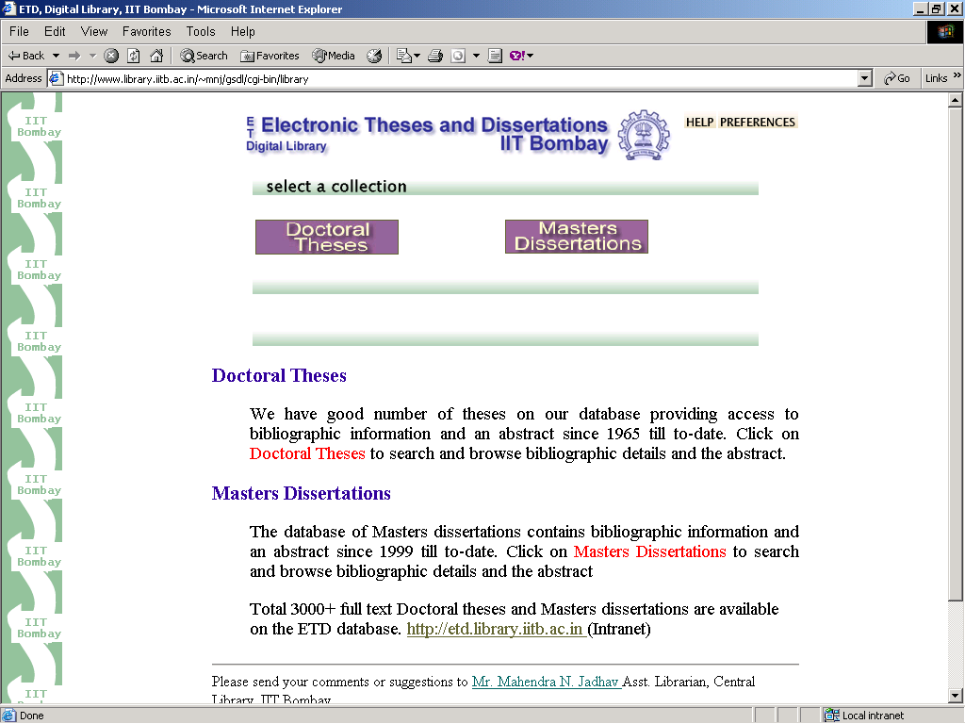
Notes:
Good Morning,
It’s a real honour to have an opportunity to speak to such a distinguished audience.
First and foremost, I’d like to thank you for taking your very precious time off to come here, but I guarantee you because of your presence here today, you and your colleagues will in the long run be saving a lot of time because we are going to introduce to you a new technology, a novel concept and an excellent tool which will revolutionalise and improve the very way to work. I know I’ve met some of you but for the benefit of those I have not, my name is Perdeep Kumar (you can call me Kumar for short) and I am the Account Manager (India) for ScienceDirect.
Today, I hope to introduce you to our company Science Direct and to keep you informed of ScienceDirect’s offerings to the academic community. Before going any further into this presentation, I would like to give you a generic definition of what Science Direct is.
I’ve divided my presentation into 7 section. [Use words like ……To start off, followed by, ….. the next topic is….]

Slide 14
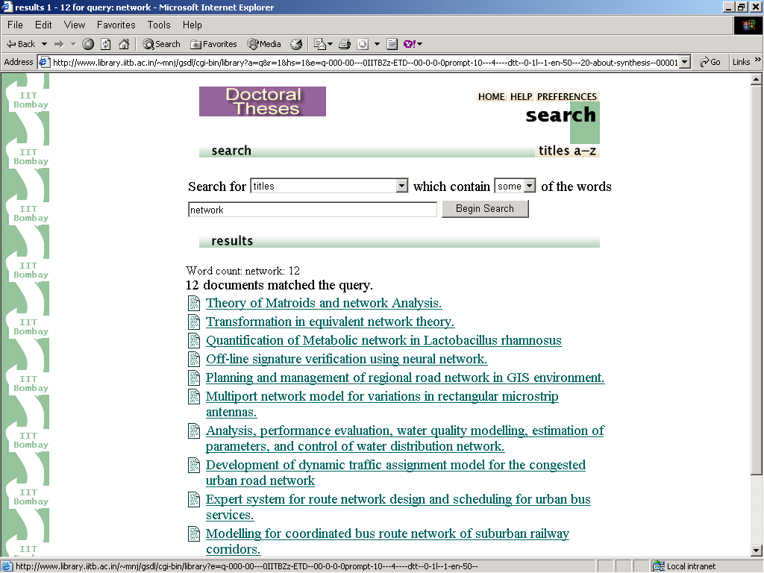
Notes:
Good Morning,
It’s a real honour to have an opportunity to speak to such a distinguished audience.
First and foremost, I’d like to thank you for taking your very precious time off to come here, but I guarantee you because of your presence here today, you and your colleagues will in the long run be saving a lot of time because we are going to introduce to you a new technology, a novel concept and an excellent tool which will revolutionalise and improve the very way to work. I know I’ve met some of you but for the benefit of those I have not, my name is Perdeep Kumar (you can call me Kumar for short) and I am the Account Manager (India) for ScienceDirect.
Today, I hope to introduce you to our company Science Direct and to keep you informed of ScienceDirect’s offerings to the academic community. Before going any further into this presentation, I would like to give you a generic definition of what Science Direct is.
I’ve divided my presentation into 7 section. [Use words like ……To start off, followed by, ….. the next topic is….]

Slide 15
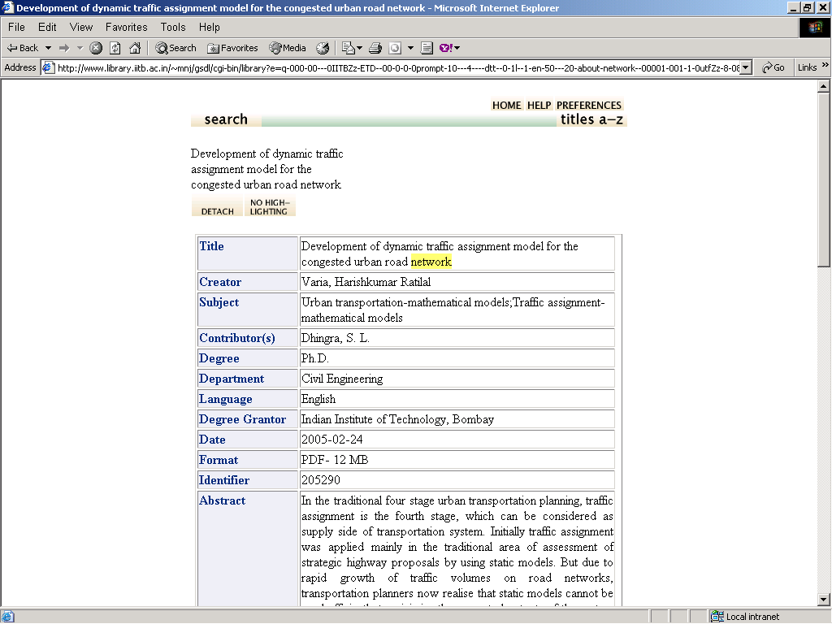
Notes:
Good Morning,
It’s a real honour to have an opportunity to speak to such a distinguished audience.
First and foremost, I’d like to thank you for taking your very precious time off to come here, but I guarantee you because of your presence here today, you and your colleagues will in the long run be saving a lot of time because we are going to introduce to you a new technology, a novel concept and an excellent tool which will revolutionalise and improve the very way to work. I know I’ve met some of you but for the benefit of those I have not, my name is Perdeep Kumar (you can call me Kumar for short) and I am the Account Manager (India) for ScienceDirect.
Today, I hope to introduce you to our company Science Direct and to keep you informed of ScienceDirect’s offerings to the academic community. Before going any further into this presentation, I would like to give you a generic definition of what Science Direct is.
I’ve divided my presentation into 7 section. [Use words like ……To start off, followed by, ….. the next topic is….]

Slide 16
Selection of software
Our in-house developed ETD software does not support the advanced search; standards and protocol like OAI-PMH.
After going through survey of open source software, we tested GSDL, E-prints, and DSpace
Our technical committee found DSpace is suitable to setup our institute digital repository to archive ETD, journal articles, conference proceeding papers etc.
Some of the INDEST members have also implemented DSpace e.g. IITD, IISC and other NITs.
Notes:
Good Morning,
It’s a real honour to have an opportunity to speak to such a distinguished audience.
First and foremost, I’d like to thank you for taking your very precious time off to come here, but I guarantee you because of your presence here today, you and your colleagues will in the long run be saving a lot of time because we are going to introduce to you a new technology, a novel concept and an excellent tool which will revolutionalise and improve the very way to work. I know I’ve met some of you but for the benefit of those I have not, my name is Perdeep Kumar (you can call me Kumar for short) and I am the Account Manager (India) for ScienceDirect.
Today, I hope to introduce you to our company Science Direct and to keep you informed of ScienceDirect’s offerings to the academic community. Before going any further into this presentation, I would like to give you a generic definition of what Science Direct is.
I’ve divided my presentation into 7 section. [Use words like ……To start off, followed by, ….. the next topic is….]

Slide 17
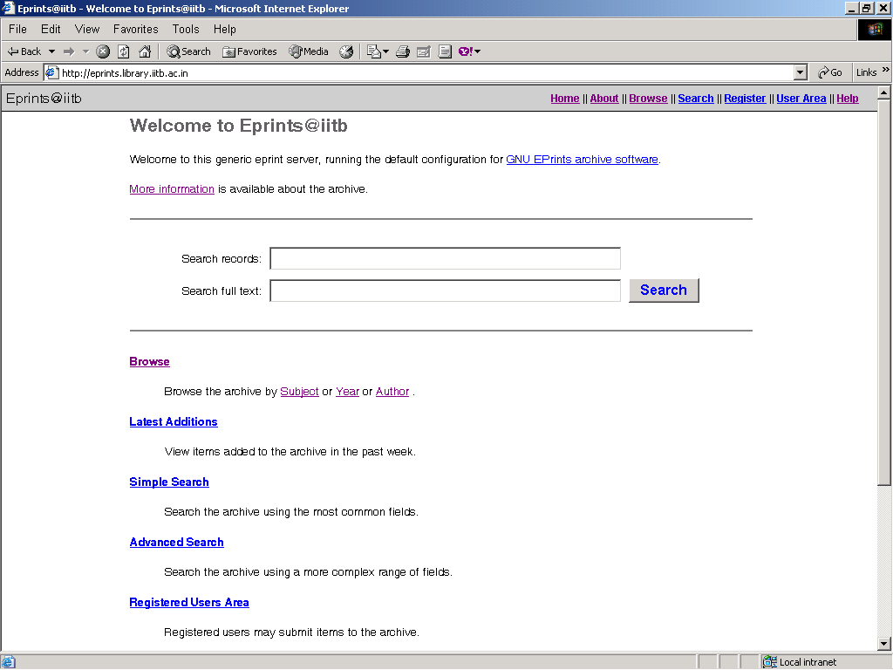
Notes:
Good Morning,
It’s a real honour to have an opportunity to speak to such a distinguished audience.
First and foremost, I’d like to thank you for taking your very precious time off to come here, but I guarantee you because of your presence here today, you and your colleagues will in the long run be saving a lot of time because we are going to introduce to you a new technology, a novel concept and an excellent tool which will revolutionalise and improve the very way to work. I know I’ve met some of you but for the benefit of those I have not, my name is Perdeep Kumar (you can call me Kumar for short) and I am the Account Manager (India) for ScienceDirect.
Today, I hope to introduce you to our company Science Direct and to keep you informed of ScienceDirect’s offerings to the academic community. Before going any further into this presentation, I would like to give you a generic definition of what Science Direct is.
I’ve divided my presentation into 7 section. [Use words like ……To start off, followed by, ….. the next topic is….]

Slide 18
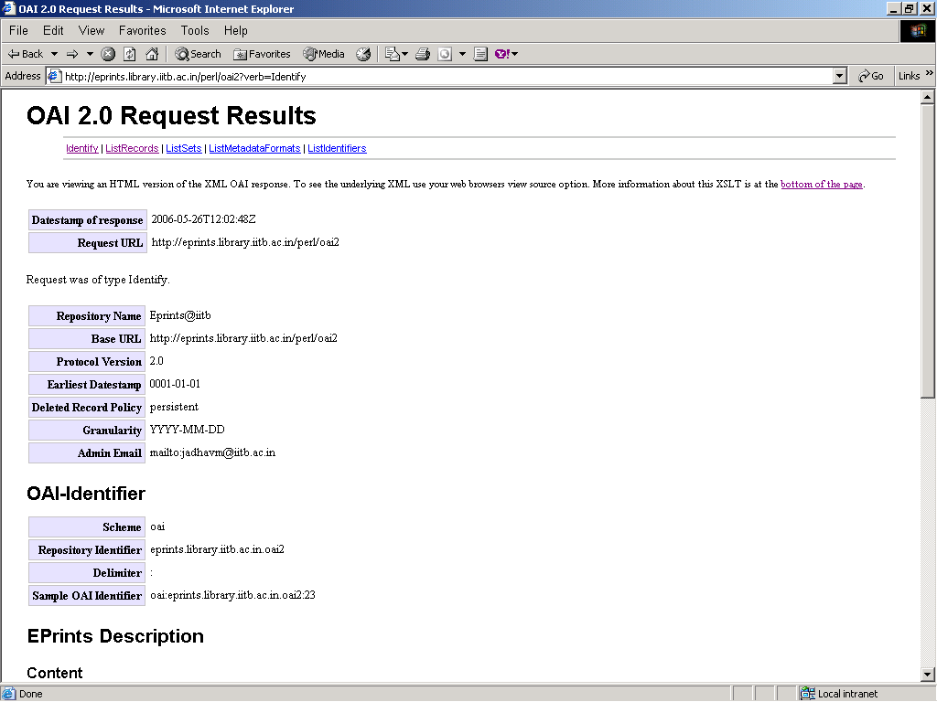
Notes:
Good Morning,
It’s a real honour to have an opportunity to speak to such a distinguished audience.
First and foremost, I’d like to thank you for taking your very precious time off to come here, but I guarantee you because of your presence here today, you and your colleagues will in the long run be saving a lot of time because we are going to introduce to you a new technology, a novel concept and an excellent tool which will revolutionalise and improve the very way to work. I know I’ve met some of you but for the benefit of those I have not, my name is Perdeep Kumar (you can call me Kumar for short) and I am the Account Manager (India) for ScienceDirect.
Today, I hope to introduce you to our company Science Direct and to keep you informed of ScienceDirect’s offerings to the academic community. Before going any further into this presentation, I would like to give you a generic definition of what Science Direct is.
I’ve divided my presentation into 7 section. [Use words like ……To start off, followed by, ….. the next topic is….]

Slide 19
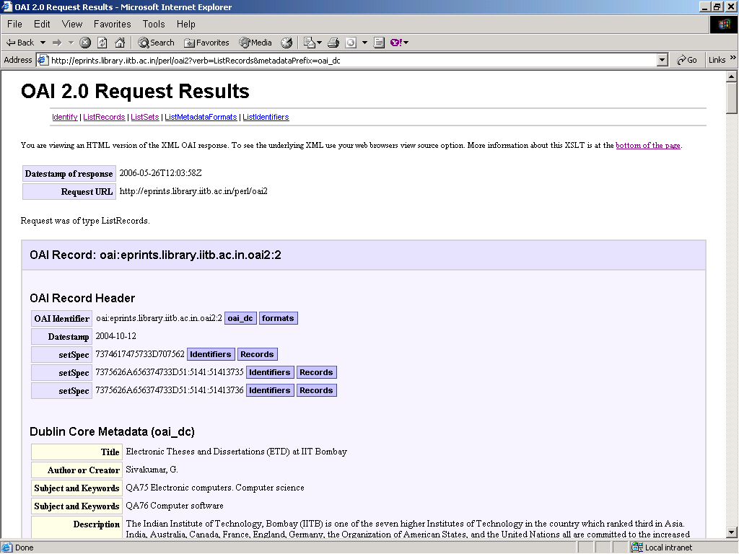
Notes:
Good Morning,
It’s a real honour to have an opportunity to speak to such a distinguished audience.
First and foremost, I’d like to thank you for taking your very precious time off to come here, but I guarantee you because of your presence here today, you and your colleagues will in the long run be saving a lot of time because we are going to introduce to you a new technology, a novel concept and an excellent tool which will revolutionalise and improve the very way to work. I know I’ve met some of you but for the benefit of those I have not, my name is Perdeep Kumar (you can call me Kumar for short) and I am the Account Manager (India) for ScienceDirect.
Today, I hope to introduce you to our company Science Direct and to keep you informed of ScienceDirect’s offerings to the academic community. Before going any further into this presentation, I would like to give you a generic definition of what Science Direct is.
I’ve divided my presentation into 7 section. [Use words like ……To start off, followed by, ….. the next topic is….]

Slide 20
Pilot study
Our focus will be on post submission of ETD, journal articles, conference proceeding papers and other institute publications.
Infrastructure was already available to carry out the pilot study using the DSpace open source software
Sample randomly selected submitted ETDs and faculty concerned were taken to deposit their articles keeping in view of SHERPA/RoMEO Publishers Copyright Policies and self archives.
Notes:
Good Morning,
It’s a real honour to have an opportunity to speak to such a distinguished audience.
First and foremost, I’d like to thank you for taking your very precious time off to come here, but I guarantee you because of your presence here today, you and your colleagues will in the long run be saving a lot of time because we are going to introduce to you a new technology, a novel concept and an excellent tool which will revolutionalise and improve the very way to work. I know I’ve met some of you but for the benefit of those I have not, my name is Perdeep Kumar (you can call me Kumar for short) and I am the Account Manager (India) for ScienceDirect.
Today, I hope to introduce you to our company Science Direct and to keep you informed of ScienceDirect’s offerings to the academic community. Before going any further into this presentation, I would like to give you a generic definition of what Science Direct is.
I’ve divided my presentation into 7 section. [Use words like ……To start off, followed by, ….. the next topic is….]

Slide 21
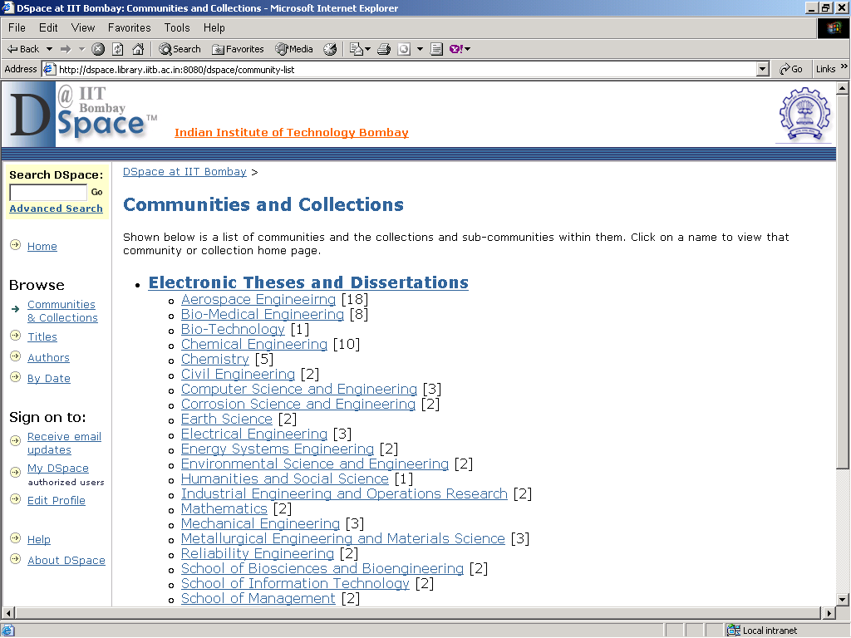
Notes:
Good Morning,
It’s a real honour to have an opportunity to speak to such a distinguished audience.
First and foremost, I’d like to thank you for taking your very precious time off to come here, but I guarantee you because of your presence here today, you and your colleagues will in the long run be saving a lot of time because we are going to introduce to you a new technology, a novel concept and an excellent tool which will revolutionalise and improve the very way to work. I know I’ve met some of you but for the benefit of those I have not, my name is Perdeep Kumar (you can call me Kumar for short) and I am the Account Manager (India) for ScienceDirect.
Today, I hope to introduce you to our company Science Direct and to keep you informed of ScienceDirect’s offerings to the academic community. Before going any further into this presentation, I would like to give you a generic definition of what Science Direct is.
I’ve divided my presentation into 7 section. [Use words like ……To start off, followed by, ….. the next topic is….]

Slide 22
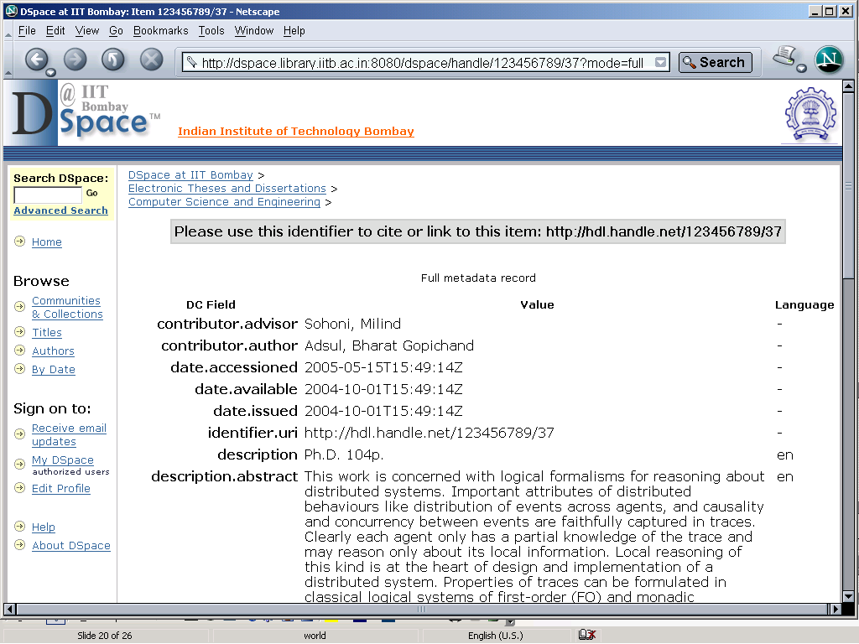
Notes:
Good Morning,
It’s a real honour to have an opportunity to speak to such a distinguished audience.
First and foremost, I’d like to thank you for taking your very precious time off to come here, but I guarantee you because of your presence here today, you and your colleagues will in the long run be saving a lot of time because we are going to introduce to you a new technology, a novel concept and an excellent tool which will revolutionalise and improve the very way to work. I know I’ve met some of you but for the benefit of those I have not, my name is Perdeep Kumar (you can call me Kumar for short) and I am the Account Manager (India) for ScienceDirect.
Today, I hope to introduce you to our company Science Direct and to keep you informed of ScienceDirect’s offerings to the academic community. Before going any further into this presentation, I would like to give you a generic definition of what Science Direct is.
I’ve divided my presentation into 7 section. [Use words like ……To start off, followed by, ….. the next topic is….]

Slide 23
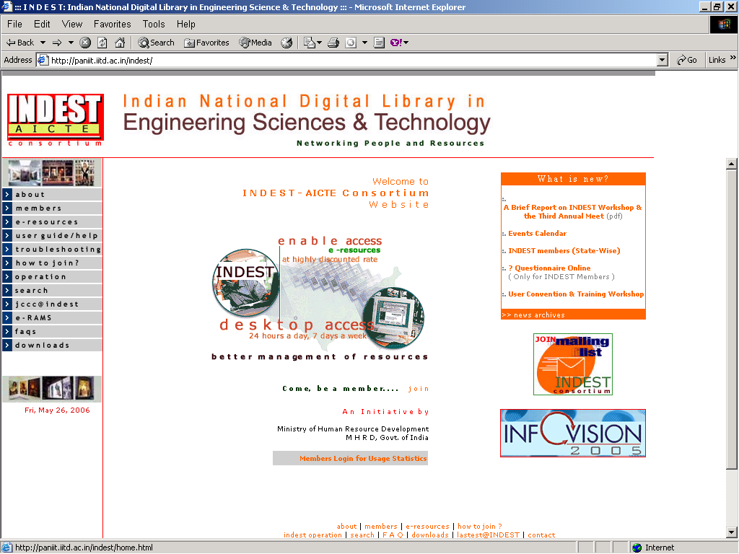
Future plan
Indian National Digital Library in Engineering Science & technology (INDEST) Consortium
Notes:
Good Morning,
It’s a real honour to have an opportunity to speak to such a distinguished audience.
First and foremost, I’d like to thank you for taking your very precious time off to come here, but I guarantee you because of your presence here today, you and your colleagues will in the long run be saving a lot of time because we are going to introduce to you a new technology, a novel concept and an excellent tool which will revolutionalise and improve the very way to work. I know I’ve met some of you but for the benefit of those I have not, my name is Perdeep Kumar (you can call me Kumar for short) and I am the Account Manager (India) for ScienceDirect.
Today, I hope to introduce you to our company Science Direct and to keep you informed of ScienceDirect’s offerings to the academic community. Before going any further into this presentation, I would like to give you a generic definition of what Science Direct is.
I’ve divided my presentation into 7 section. [Use words like ……To start off, followed by, ….. the next topic is….]

Slide 24
Future Plans
INDEST consortium -The Ministry of Human Resource Development (MHRD) provides funds required for subscription to various electronic resources subscribed by the Consortium for 38 core member institutions and 44 AICTE.
INDEST extended proposition included electronic submission of thesis and dissertation, union catalogue of books, e-print archives /institutional repositories.
The INDEST will be act as metadata harvester of all institutions.
Notes:
Good Morning,
It’s a real honour to have an opportunity to speak to such a distinguished audience.
First and foremost, I’d like to thank you for taking your very precious time off to come here, but I guarantee you because of your presence here today, you and your colleagues will in the long run be saving a lot of time because we are going to introduce to you a new technology, a novel concept and an excellent tool which will revolutionalise and improve the very way to work. I know I’ve met some of you but for the benefit of those I have not, my name is Perdeep Kumar (you can call me Kumar for short) and I am the Account Manager (India) for ScienceDirect.
Today, I hope to introduce you to our company Science Direct and to keep you informed of ScienceDirect’s offerings to the academic community. Before going any further into this presentation, I would like to give you a generic definition of what Science Direct is.
I’ve divided my presentation into 7 section. [Use words like ……To start off, followed by, ….. the next topic is….]

Slide 25
Conclusions
Successful pilot study
Copyright policy issues.
Notes:
Good Morning,
It’s a real honour to have an opportunity to speak to such a distinguished audience.
First and foremost, I’d like to thank you for taking your very precious time off to come here, but I guarantee you because of your presence here today, you and your colleagues will in the long run be saving a lot of time because we are going to introduce to you a new technology, a novel concept and an excellent tool which will revolutionalise and improve the very way to work. I know I’ve met some of you but for the benefit of those I have not, my name is Perdeep Kumar (you can call me Kumar for short) and I am the Account Manager (India) for ScienceDirect.
Today, I hope to introduce you to our company Science Direct and to keep you informed of ScienceDirect’s offerings to the academic community. Before going any further into this presentation, I would like to give you a generic definition of what Science Direct is.
I’ve divided my presentation into 7 section. [Use words like ……To start off, followed by, ….. the next topic is….]

Slide 26
Thank You
jadhavm@iitb.ac.in
Notes:
Good Morning,
It’s a real honour to have an opportunity to speak to such a distinguished audience.
First and foremost, I’d like to thank you for taking your very precious time off to come here, but I guarantee you because of your presence here today, you and your colleagues will in the long run be saving a lot of time because we are going to introduce to you a new technology, a novel concept and an excellent tool which will revolutionalise and improve the very way to work. I know I’ve met some of you but for the benefit of those I have not, my name is Perdeep Kumar (you can call me Kumar for short) and I am the Account Manager (India) for ScienceDirect.
Today, I hope to introduce you to our company Science Direct and to keep you informed of ScienceDirect’s offerings to the academic community. Before going any further into this presentation, I would like to give you a generic definition of what Science Direct is.
I’ve divided my presentation into 7 section. [Use words like ……To start off, followed by, ….. the next topic is….]

