Slide 1
From Paper to ETDs:
A Case Study of Two Institutions from the Perspective of the Graduate School
Dr. John Slattery, University of Washington
Austin McLean, ProQuest Information and Learning
ETD ‘06
June 8, 2006

Slide 2
The Importance of Publishing Graduate Works
Doctoral dissertations and master’s theses are primary literature. They are valuable contributions to the discourse in every field of inquiry.
A published dissertation/thesis provides the new scholar with a legitimate, citable c.v. entry—often their first—at a critical juncture in their career.
When publishing with ProQuest / UMI, citations, abstracts, and 24-page previews appear in the PQDT database, accessed by more than 3000 libraries around the world.

Slide 3
It’s Your Institution’s Site . . .
ProQuest / UMI
Online Submission
Custom-built
University-specific information loaded into the site
Linked to your university’s resources
One gateway to everything your students need to publish their dissertation or thesis
and everything your staff needs to administer the process
plus tech support for both students and administrators
. . .but ProQuest builds, maintains, and supports it.

Slide 4
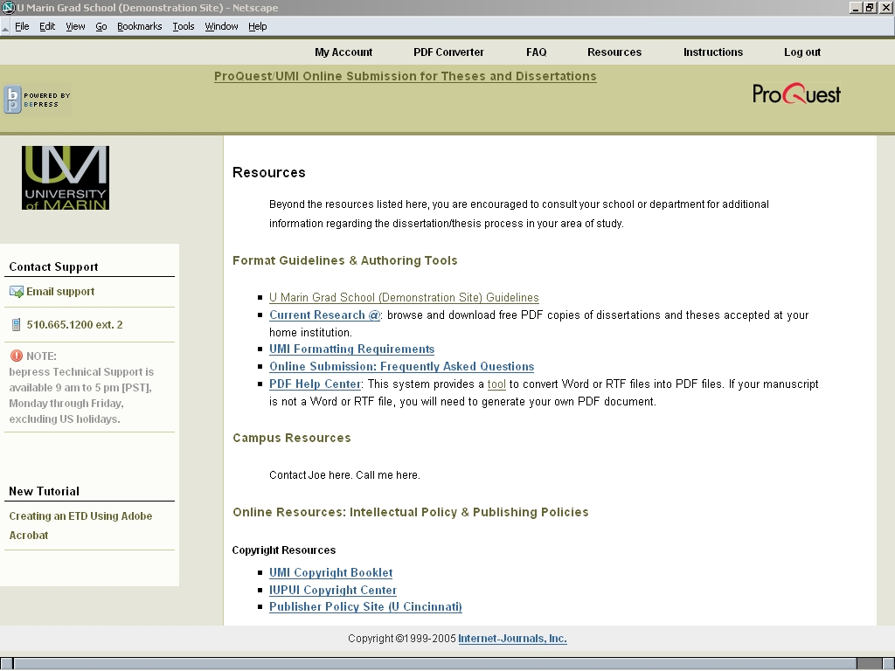
The Resources page is configurable

Slide 5
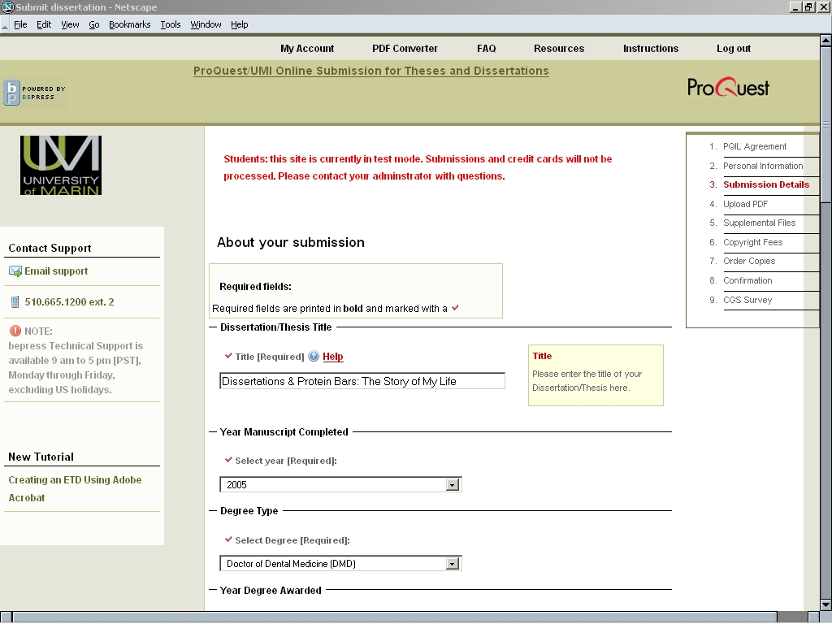

Slide 6
Experience of Implementation
University of Washington
Indiana University

Slide 7
What are the University issues
Access
Copyright
Internal Process
Cost

Slide 8
Indiana University
Availability/ archive
  Question of electronic dissertations brought to the Graduate School from the library.
  Archive guaranteed via microfilming as a backup to electronic version.
  Electronic download is fast and reliable.
  Availability without cost can be guaranteed.
    Isn’t this in the best interest of scholarship?

Slide 9
Copyright Risk
The microfilm version is already available – does it compete?
  Not in the sciences, maybe a bit in the social sciences, perhaps in the humanities.
Would the book be the same as the dissertation?
ProQuest does not care.
  If the book is a derivative or is identical, that’s fine.
Is there really any dollar risk?
  Isn’t the problem more that people, even academics, don’t buy the books?

Slide 10
Internal process
Faculty
  The “Golden Promise” can be offered: “Nothing need change.”
Department
  Want a hard copy for the department? Go ahead!
  Want to put them on a departmental server? Go ahead!
Staff
  Prefer the electronic handling process

Slide 11
Internal Process, cont.
Graduate School
  Much better than being buried in paper
Library
  Aren’t we going electronic anyway?
Students
  Forced the end of the Beta Test at IU.

Slide 12
Cost
Neutral in cash at Indiana
  The filing fee with ProQuest is unchanged
Internal cost diminished
  Avoided handling paper and mailing

Slide 13
Other Advantages
Where is academic publishing headed?
Don't we need to explore alternatives?
Isn’t electronic publication first likely alternative?
  Is this an opportunity to experiment in a way that could inform the larger enterprise without significant risk?

