Slide 1
MODS Meets Manakin: Innovations in the Texas Digital Library’s Thesis and Dissertation Collection
Brian Surratt
06/09/06
ETD 2006
Québec City, Canada
http://besurratt.com/documents/ETD2006.ppt

Slide 2
Agenda
The Texas Digital Library
Characteristics of MARC and Dublin Core
TDL’s MODS Application Profile
Outstanding issues for MODS metadata
Manakin and MODS
Conclusion

Slide 3
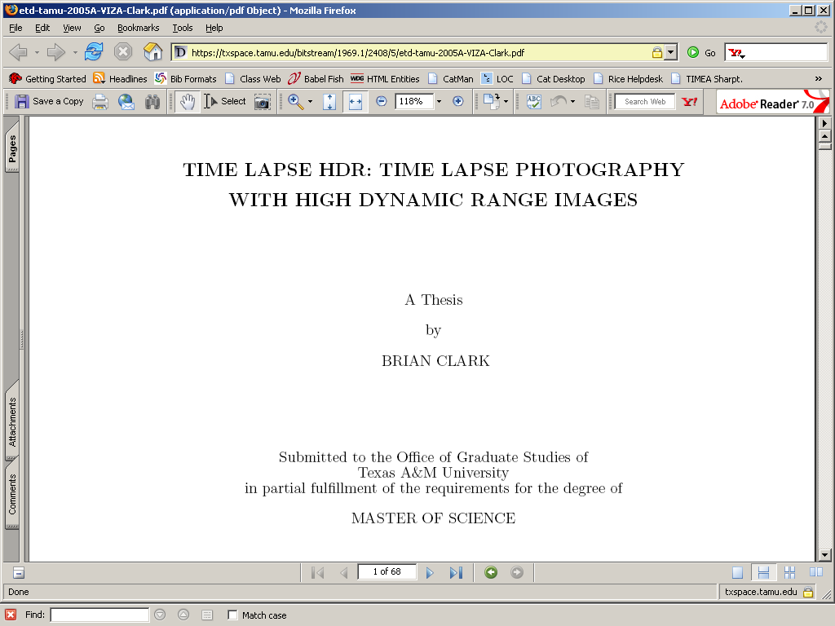

Slide 5
The Texas Digital Library
Consortium of five ARL university libraries in Texas
  U. of Texas, Texas A&M, U. of Houston, Texas Tech, Rice
Sharing technology, knowledge, and resources
Developing common standards
Investigating and implementing new technologies and scholarly communication models
Notes:
The Texas Digital Library (TDL), formed in 2005, is a consortia of the five Association of Research Libraries in Texas. The members are the University of Texas, Texas A&M University, the University of Houston, Texas Tech University, and Rice University. The mission of the TDL is to “provide a digital infrastructure for the scholarly activities of Texas universities.” It is unique in that it includes four large public university systems as well as one private research university.

Slide 6
The Metadata Working Group
Chair: Brian Surratt
Members: Alisha Little, Anne Mitchell, Jason Thomale, Mary Dabney Wilson, Melinda Flannery
Charge: Develop standards-based metadata schemas for TDL content.
Plan of work: First project is to develop a descriptive metadata standard for TDL’s first collection.
Notes:
The first project of the TDL was to develop a common repository of the electronic theses and dissertations (ETDs) published by the member libraries. At the time the project was initiated, two of the member universities, the University of Texas and Texas A&M, had ETD collections. The University of Texas provides access to the local ETD collection through MARC records in the library’s catalog and Texas A&M provides access through Dublin Core records in DSpace. The Metadata Working Group of TDL was charged with developing a common metadata standard that would allow members to share metadata in the TDL repository.

Slide 7
MARC
Syntax
Content and formatting
OPACs vs. DLs
Inconsistent application of major fields
  Genre
  Discipline
  Thesis advisor
  Subjects
Notes:
In the United States, universities have traditionally provided access to theses and dissertations through the library catalog. Since the advent of online public access catalogs (or OPACS), this has meant applying the Anglo American Cataloging Rules (AACR2) and encoding the bibliographic information in a Machine Readable Catalog (MARC) record. In terms of descriptive metadata, a recent report on the cataloging treatment of theses and dissertations in the US (Hoover and Wolverton, 2003) only acknowledges MARC cataloging and is essentially blind to other formats and standards, including Dublin Core and ETD-MS.

Slide 8
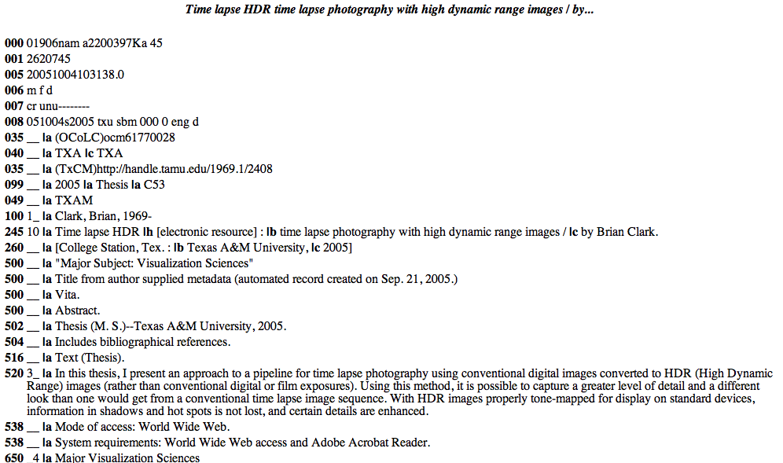
Notes:
MARC cataloguing has a rich history. Traditional OPACS have strengths, such as authority control for names, but it is becoming clear that AACR2 and MARC cataloguing are not suited to meet the descriptive metadata needs of ETDs. Developed in the 1960s, MARC is based on print catalog cards. It is an legacy standard and its shortcomings are amplified in the web environment. As a syntax for encoding bibliographic information, its characteristics are idiosyncratic (eg. fixed fields, indicators, etc.) especially compared to modern markup languages that were purpose-built for the web. Because it is so closely associated with AACR2 and ISBD punctuation, it mixes metadata content with formatting. Our OPACs, which are our primary systems for managing MARC records, are not designed to store content, but rather to point to the content somewhere else. Our digital library systems are not designed to store MARC records with our digital content. When libraries do use MARC to describe ETDs, it is applied inconsistently. Hoover and Wolverton (2003) demonstrated that MARC cataloging is inconsistent for information such as the genre, discipline, thesis advisor, and subjects. The ETD community has expressed the need for much of this information (see for example the ETD-MS, and Frodl and Korb (2005)). The major cataloging guidelines either do not address how to encode this information or provide vague and inconsistent advice. AACR2 does not address the issue of advisor names. Bibliographic Formats and Standards states that “added entries for advisors, the institution, made-up thesis collection or series titles” should be placed in locally defined fields, which encourages local policies and discourages establishing common standards.

Slide 9
Dublin Core
Not enough elements
Too broadly defined
No specified syntax
Lack of substructure
  Describing component parts
  Relating elements to component parts
  Relating descriptive elements to each other
  Attributes and qualifiers to individual elements
Notes:
ETD-MS, the descriptive metadata standard developed by the NDLTD, is valuable in terms of defining useful elements of the information that we want to know about theses, but because it is expressed through Dublin Core, it inherits Dublin Core’s flaws. Guenther (2003) points out many of these flaws. There are not a sufficient number of elements to describe digital resources and the existing elements are too broadly defined. Dublin Core lacks a sufficient structure. It does not specify a syntax, so its implementation in networked systems is inconsistent. It does not possess what Guenther calls a substructure, or a hierarchy of elements, so there are problems with describing component parts, relating elements to component parts, relating descriptive elements to each other, and providing attributes and qualifiers to individual elements. These problems emerge distinctly when Dublin Core is applied to ETDs.

Slide 10
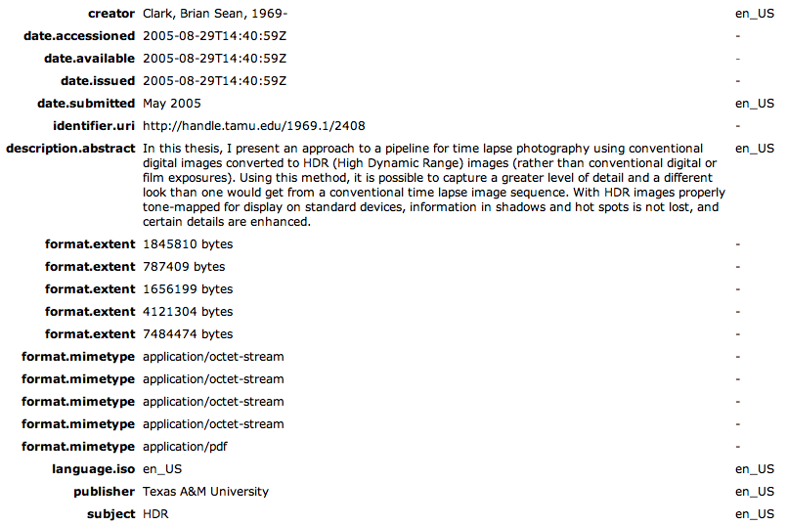
Dublin Core (2)

Slide 11
Dublin Core (3)
Who is doing what here?:
dc.contributor=Smith, John
dc.contributor=Brown, Jane
dc.contributor=Jones, Bob
dc.contributor.role=Thesis advisor
dc.contributor.role=Author
dc.contributor.role=Committee member
Notes:
The ETD-MS field “dc.contributor.role” serves as an excellent example. As written, this field is impractical to implement. If it is implemented in strict Dublin Core, elements should be represented as strict name-value pairs:
dc.contributor=Smith, John
dc.contributor.role=author
dc.contributor=Brown, Jane
dc.contributor=advisor
No order for elements is specified in Dublin Core, hence…
dc.contributor=Smith, John
dc.contributor=Brown, Jane
dc.contributor=advisor
dc.contributor.role=author
…is equally valid. If this is done, Dublin Core does not provide a way to relate the two fields together in the description. If, alternatively, the role is expressed as an attribute of the contributor field (the way it is done in the ETD-MS example on the NDLTD site…
<contributor role="chair">Joseph W. Roggenbuck</contributor>
…then it is not valid Dublin Core. Similar problems emerge when Dublin Core is used to represent various dates in the life of the ETD, as well as descriptions of component parts of ETDs. Anecdotal evidence has shown that the application of Dublin Core to ETDs has been inconsistent. Dubin Core is designed for cross-domain (or general) use, but institutions that host ETD collections often have specialized needs. MODS is better suited to address those needs.

Slide 12
Dublin Core (4)
What about this?
<contributor role="chair">Joseph W. Roggenbuck</contributor>
Better, but not really Dublin Core.

Slide 13
MODS profile for ETDs
Why MODS?
  XML based, web friendly, transportable, processible, configurable, sufficiently descriptive without being too complex, extensible
  Benefits over MARC: MARC isn’t XML based and can’t easily be output from web forms. Requires special cataloging knowledge and systems to implement
  Benefits over Dublin Core: DC doesn’t have sufficient specificity. DC doesn’t specify a syntax and is inconsistently applied. DC isn’t extensible
Notes:
The TDL found that MODS provides advantages over both MARC and Dublin Core. Developed by the Library of Congress in 2002 (Guenther 2003), it is partly based on MARC and carries forward the best features of this traditional cataloguing format in a syntax that is defined in XML. Furthermore, it avoids many of the problems associated with Dublin Core. We were able to express almost all of the elements of the ETD-MS in a satisfactory manner. For those elements that we could not express in MODS, MODS provides a <mods:extension> element that allowed us to refer directly to the ETD-MS schema. Our philosophy was to define and specify the use of mandatory elements and significant optional elements. We also allow the use of any valid MODS element, even if it is not included in our application profile.

Slide 14
MODS: Titles and names
<mods:titleInfo>
<mods:title>Critical processes and performance measures for patient safety systems in healthcare institutions </mods:title>
</mods:titleInfo>
<mods:name type="personal">
<mods:namePart type="given">Bryan R.</mods:namePart>
<mods:namePart type="family">Cole</mods:namePart> <mods:role>
<mods:roleTerm authority="marcrelator" type="text">Thesis advisor</mods:roleTerm> </mods:role>
</mods:name>
Notes:
Title information is encoded in the <mods:titleInfo> wrapper element. The <mods:title>element is mandatory and the <mods:subtitle> element is optional. The name of the author is encoded in a <mods:name> wrapper element with the type attribute set to “personal.” The given name and family name are encoded in <mods:namePart> subelements. The birth date is optional. If it is included, it is placed in a <mods:namePart> subelement with the type attribute set to date. The name of the advisor is a mandatory element and is encoded in a <mods:name> wrapper element. The role of each name is specified using the <mods:role> wrapper element. The MARC relator terms “Author” and “Thesis advisor” are used to define roles. The names of committee members are optional.

Slide 15
MODS: Dates
<mods:originInfo>
<mods:dateCreated encoding="iso8601">
200408
</mods:dateCreated>
<mods:dateIssued encoding="iso8601">
200412
</mods:dateIssued>
</mods:originInfo>
Notes:
Two dates are encoded in the <mods:originInfo> wrapper element: the creation date and publication date. The creation date is defined as “the date the student graduates or the date the degree is conferred” and is encoded the <mods:dateCreated> subelement The publication date is defined as “the date the ETD is released to the public” and is encoded in the <mods:dateIssued> subelement.

Slide 16
MODS: Type, genre, physical description
<mods:typeOfResource>text</mods:typeOfResource>
<mods:genre authority="marcgt">
Theses
</mods:genre>
<mods:physicalDescription>
<mods:form authority="marcform">electronic
</mods:form>
<mods:internetMediaType>application/pdf
</mods:internetMediaType>
<mods:digitalOrigin>born digital
</mods:digitalOrigin>
</mods:physicalDescription>
Notes:
The type of resource is mandatory. The <mods:typeOfResource> element is generally equivalent to the MARC leader/06. The values for this field come from a controlled list defined in MARC that include “text,” “sound recording,” “moving image,” and “software, multimedia” among others. Genre is mandatory and is encoded in the <mods:genre> element. All ETDs, regardless of level, are encoded with the MARC genre term “theses.” Information regarding the physical details of the ETD are mandatory and are encoded in the <mods:physicalDescription> element. The MARC format term “electronic” is encoded in the <mods:form> element. The MIME type is encoded in the <mods:internetMediaType> element. MODS also has field to record whether the item described is born digital or reformatted into a digital format and this is recorded in a <mods:digitalOrigin> element.

Slide 17
MODS: Other mandatory fields
Language
Abstract
Subjects
Information about the record
Notes:
Language is a mandatory element in the record, and can also be used as an attribute of any other MODS element. Other mandatory elements include abstracts, subjects, and information about the MODS record.

Slide 18
MODS: Extensions/ETD-MS
<mods:name type="corporate" authority="lcnaf"> <mods:namePart>Texas A &amp; M University
</mods:namePart>
<mods:namePart>Philosophy
</mods:namePart>
<mods:role>
<mods:roleTerm authority="marcrelator" type="text">Degree grantor</mods:roleTerm>
</mods:role>
</mods:name>
Notes:
The ETD-MS also includes extension elements outside of Dublin Core: thesis.degree.level, thesis.degree.discipline, and thesis.degree.grantor. TDL made these elements mandatory. The degree granting institution is represented in a <mods:name> element with the type attribute set to “corporate” and “Degree grantor” in the <mods:roleTerm> element. In order to include the degree level and degree discipline, we had to use the <mods:extension> element and refer to the ETD-MS.

Slide 19
MODS: Extensions/ETD-MS
<mods:extension>
<etd:degree>
<etd:name>Doctor of Philosophy
</etd:name>
<etd:level>Doctoral</etd:level>
<etd:discipline>Educational Administration</etd:discipline>
</etd:degree>
</mods:extension>

Slide 20
Outstanding issues
Publisher
Rights
Record information
Compound objects
Native metadata in MODS
Notes:
There are a number of outstanding issues that the MWG will continue to investigate. The application profile does not include two elements specified by ETD-MS, publisher and rights. Traditionally, print theses and dissertations have been unpublished manuscripts, so library catalog records do not publisher information in the MARC record. For this reason, one of our member libraries did not want to include this element. (The cataloguing rules are inconsistent on this. Section 3.1 of Bibliographic Formats and Standards says theses and dissertations are usually considered unpublished manuscripts, but AACR2 rule 9.4B2 says that remote access electronic resources should be considered published. Libraries seem to have a hard time thinking of themselves as publishers.) The issue of rights metadata was deemed sufficiently complex to be considered separate from the other descriptive metadata.
The consequences of using the <mods:extension> element to refer to the degree level and discipline are unclear. Related to this issue, the ETD community would benefit from a controlled vocabulary of disciplines.
Further work could be done on standardizing the information in the <mods:recordInfo> wrapper element, especially identifying the source of the content and establishing a standard identifier for MODS records. For MARC records, much of this is work is coordinated by OCLC, but the ETD environment is decentralized and standardization may be more difficult.
MODS has the capability for describing compound objects through the <mods:relatedItem> element, but it is unclear how this should be done. The problems include standardizing descriptive elements, developing systems that create metadata in an efficient manner, and managing this complex information in systems for search, retrieval, and display.
TDL is creating MODS records though crosswalks from MARC and DC records, but these crosswalks have limitations. MARC records typically do not have all of the information specified in our application profile and DC records often lack sufficient descriptive specificity. Ideally, ETD management systems will be developed that create MODS records natively during the ETD submission process. If other types of records are desired, namely MARC or DC records, they could be derived from the MODS using standardized crosswalks.

Slide 21
Manakin and MODS
Manakin: custom user interface for DSpace
  Distinct look and feel for each community
  Separate business from stylistic design
  Interface-level component architecture
  Internationalization and localization of content
  Alternative interface to existing JSP interface
Notes:
Manakin, developed by Texas A&M University, is a software package that allows institutions to customize the DSpace user interface (Phillips, et al., 2005). The Manakin project has five goals: 1) Allow each community to maintain a distinct look and feel, 2) Separate business logic from stylistic design, 3) Establish an interface-level component architecture, 4) Enable internationalisation and localization of content, and 5) Provide an alternative interface that does not replace the existing JSP interface. TDL, the first implementer, is using Manakin to extend a customized representation of the ETD collection into the general TDL website.
Given highly specific metadata encoded in MODS and the ability to customize the user interface, TDL has a great deal of flexibility in designing a portal to its ETD collection. The TDL ETD collection conforms to the general design of the overall TDL site and has features such as a pre-formatted citation for each ETD.

Slide 22
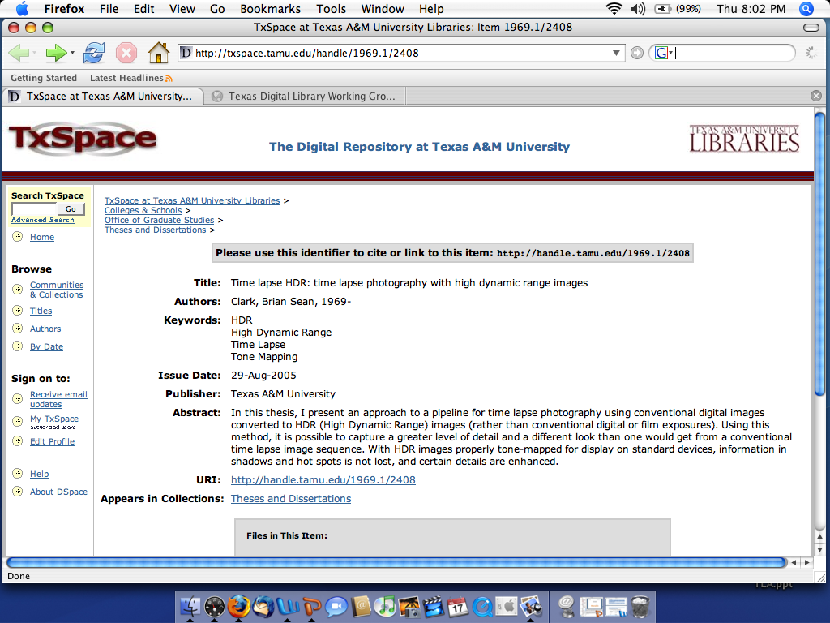
TxSpace

Slide 23
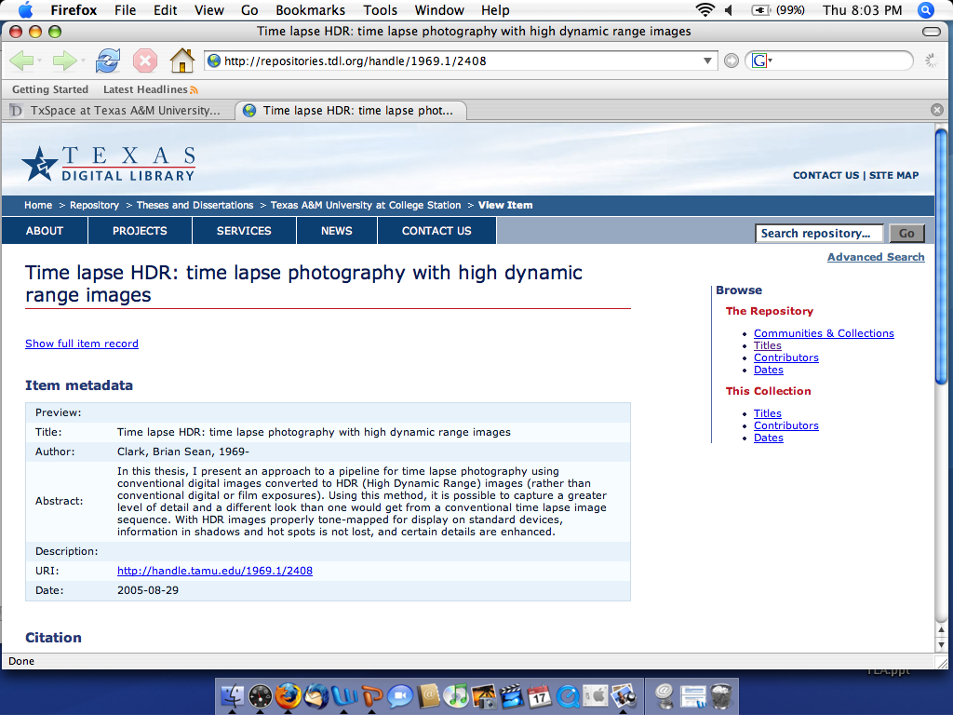
Texas Digital Library

Slide 24
Conclusion
Notes:
TDL adopted MODS as a common metadata standard for ETDs because of its benefits over MARC and Dublin Core. TDL implemented MODS in a union catalog that includes ETDs from two institutions: the University of Texas and Texas A&M University. Manakin complements this rich ETD metadata by allowing the development of customized user interfaces for DSpace collections.
Although MODS represents a step forward, challenges remain, including encoding the publisher, rights metadata, the use of non-MODS extensions, standardization of record information, the description of compound objects, and the development of ETD systems that use MODS natively. TDL will continue to investigate these issues as well as promoting the development of ETD systems in Texas universities.

