Slide 1
PAYLOOP
SQL Data Analytics & Business Insights

Slide 2
Project Evolution
SECTION 1 — ANALYTICS OVERVIEW
From Database System to Business Intelligence Platform
Original Project Included:
Database creation
Table relationships
CRUD operations
Joins
Subqueries
Views
Stored procedures
Triggers
Transaction simulation
New Expansion Focuses On:
Business intelligence
Financial analytics
Customer behavior analysis
Strategic decision support
Merchant performance analysis
Cash flow monitoring
Fraud detection support
Future business growth
Core Objective
Transform PAYLOOP into a:
A business intelligence and decision-support analytics system.

Slide 3
Why BI Matters?
SECTION 1 — ANALYTICS OVERVIEW
Key Insight
Databases are no longer only storage systems.
They are now:
analytical systems
forecasting tools
operational monitoring systems
business decision platforms
Importance of Analytics in FinTech companies
This data helps organizations:
Understand customer behavior
Improve user retention
Analyze payment activity
Detect fraud patterns
Track business growth
Monitor platform performance
Support executive decision making
Real World Examples:
EasyPaisa
JazzCash
ApplePay
all rely heavily on transaction analytics and business intelligence systems.

Slide 4
SECTION 1 — ANALYTICS OVERVIEW
Analysis Objective
The PAYLOOP database was analyzed using SQL Server — queries, views, joins, aggregations, and BI reports — to extract actionable insights from digital wallet activity.
User Behavior Analysis
Fraud Monitoring
Spending Trends
Monthly Growth Trends
Merchant Performance
Inactive User Detection
Wallet Balance Analytics

Slide 5
SCHEMA - Existing Database Structure
Entities & Attributes
Entity | Primary Key | Attributes | Purpose
Users | user_id (PK, IDENTITY) | full_name, email (UQ), phone (UQ), password, status, created_at | Stores registered user account information.
Wallets | wallet_id (PK, IDENTITY) | user_id (FK, UQ), balance, currency, status, created_at | Maintains digital wallet balance per user (1:1).
Transactions | txn_id (PK, IDENTITY) | wallet_id (FK), txn_type, amount, note, txn_date | Full log of all financial events (credit, debit, transfer_in, transfer_out).
Merchants | merchant_id (PK, IDENTITY) | merchant_name, category, email (UQ), phone, created_at | Registered business entities receiving payments.
Payments | payment_id (PK, IDENTITY) | wallet_id (FK), merchant_id (FK), amount, pay_date | Records customer-to-merchant payment events.
AuditLog | log_id (PK, IDENTITY) | event, details, log_date | System-level event trail for security and compliance.
CityTransactions | city_txn_id (PK, IDENTITY) | city_name, transaction_month, transaction_volume, transaction_count, active_users | Monthly aggregated transaction data by city for regional business intelligence.
MerchantSalesData | sales_id (PK, IDENTITY) | merchant_name, category, sales_month, revenue_generated, payment_count | Monthly revenue snapshot per merchant for performance reporting.

Slide 6
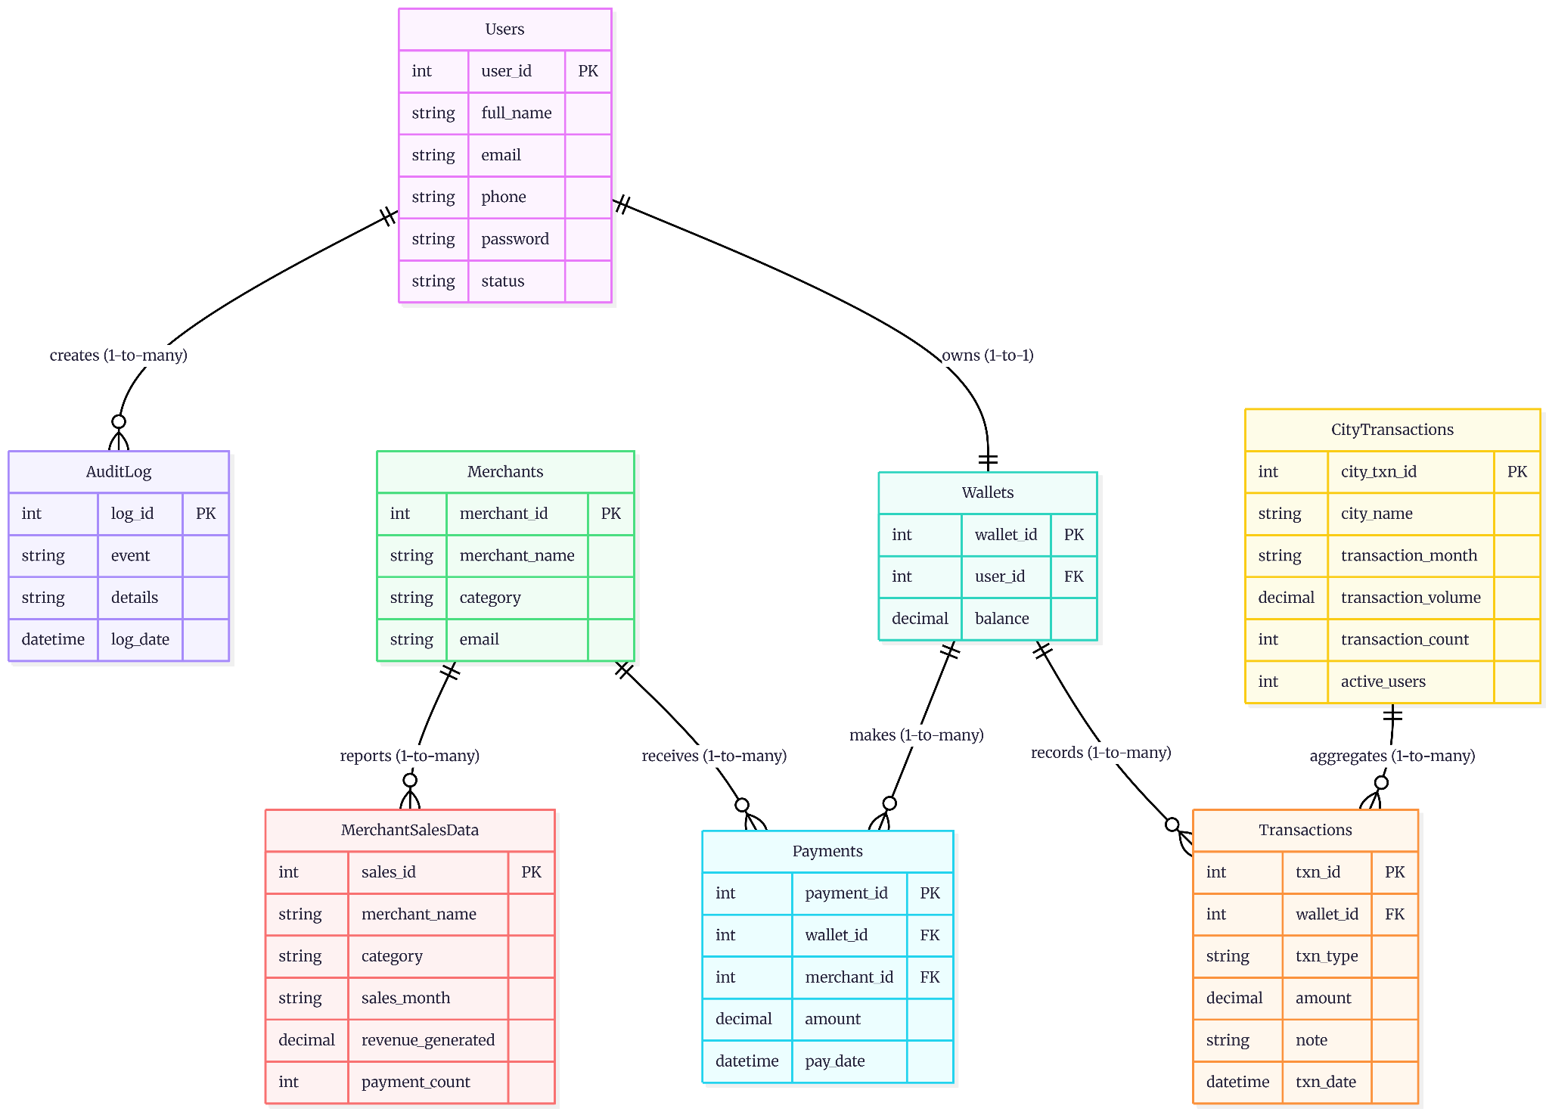
Entity-Relationship Diagram (ERD)

Slide 7

SECTION 3 — SPENDING ANALYSIS
Average Transaction Analysis
SQL
SELECT
AVG(amount) AS platform_avg_transaction,
MIN(amount) AS smallest_transaction,
MAX(amount) AS largest_transaction
FROM Transactions;
₨22,756
₨500
₨200,000
AVG TRANSACTION
MIN TRANSACTION
MAX TRANSACTION

Slide 8
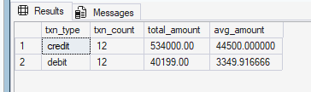
SECTION 3 — SPENDING ANALYSIS
Credit vs Debit Flow Analysis
SQL
SELECT
txn_type,
COUNT(txn_id) AS txn_count,
SUM(amount) AS total_amount
FROM Transactions
WHERE txn_type IN ('debit', 'credit')
GROUP BY txn_type;
50%
50%
CREDIT SHARE
DEBIT SHARE
Balanced inflow/outflow reflects healthy ecosystem activity
Higher credits indicate strong wallet funding behavior

Slide 9
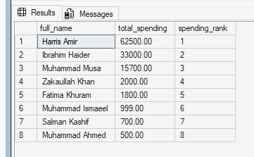
SECTION 2 — USER ACTIVITY ANALYSIS
High Value Customers
SQL - CTE
WITH CustomerSpending AS (
SELECT
u.full_name,
SUM(t.amount) AS total_spending
FROM Users u
INNER JOIN Wallets w
ON u.user_id = w.user_id
INNER JOIN Transactions t
ON w.wallet_id = t.wallet_id
WHERE t.txn_type IN ('debit', 'transfer_out')
GROUP BY u.full_name
)
SELECT
full_name,
total_spending,
RANK() OVER (ORDER BY total_spending DESC) AS spending_rank
FROM CustomerSpending
ORDER BY total_spending DESC;
KEY INSIGHTS
Business can identify top spending customers
users likely to purchase premium services
Future Business Value
Launch loyalty rewards
VIP wallet tiers
Cashback incentives
Priority support

Slide 10
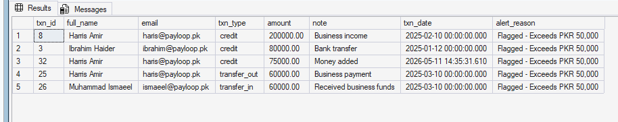
SECTION 6 — FRAUD & SECURITY
₨50K+
1
High-Risk Transfer Analysis
RISK THRESHOLD
FLAGGED TRANSFERS
SQL - VIEW
Harris's PKR 60K outgoing business transfer is the only seeded transaction that meets the high-risk threshold. This is also what triggers WarnLargeAmount to log into AuditLog (when the trigger is active for new inserts — note the trigger wasn't yet created when this row was inserted in Step 4, so no audit row exists for it; the Step 15 test deposit is what actually produces audit entries)
CREATE VIEW FraudMonitoring AS
SELECT
t.txn_id,
u.full_name,
u.email,
t.txn_type,
t.amount,
t.note,
t.txn_date,
'Flagged - Exceeds PKR 50,000' AS alert_reason
FROM Transactions t
INNER JOIN Wallets w ON t.wallet_id = w.wallet_id
INNER JOIN Users u ON w.user_id = u.user_id
WHERE t.amount > 50000;
GO
Cross Functional Benefit
Compliance - Suports regulatory benefits
Security - Improves Fraud Detection
Management - Enhances Operational oversight
Future Business Value
Large outgoing transfers are highest-risk events
Automatic fraud scoring is essential at scale
Supports:
Fraud Prevention
Compliance Monitoring
Transaction Auditing

Slide 11
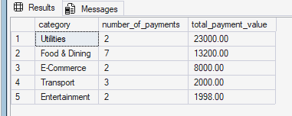
SECTION 4 — MERCHANT ANALYSIS
Most Popular Merchant Categories
SQL - CTE
WITH MerchantPerformance AS (
SELECT
m.category,
COUNT(p.payment_id) AS payment_count,
SUM(p.amount) AS category_revenue
FROM Merchants m
LEFT JOIN Payments p
ON m.merchant_id = p.merchant_id
GROUP BY m.category
)
SELECT *
FROM MerchantPerformance
ORDER BY total_payment_value DESC;
;
Food & Dining is the clear popularity winner with 7 of the 16 payments (40%), but Utilities generates almost twice the revenue from only 2 payments — that's the bill-pay effect again.
Cross Functional Benefit
Business Development - Targets profitable merchant sectors
Marketing - Creates category-specific campaigns
Finance - Track merchant-driven revenue
Target ads around top categories
Expand partnerships in high-performing sectors

Slide 12
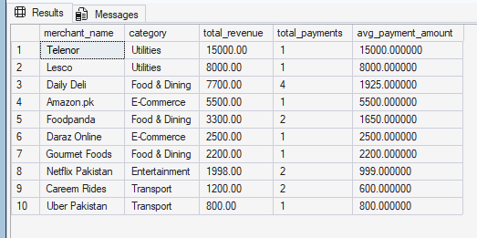
SECTION 4 — MERCHANT ANALYSIS
Merchant Revenue Performance
SQL
SELECT
merchant_name,
category,
total_revenue,
total_payments
FROM MerchantPerformance
ORDER BY total_revenue DESC;
Certain merchants dominate payment revenue
Top merchants are critical strategic partners
Utilities (Telenor, Lesco) sit at the top with high per-payment averages but low frequency — people pay bills once and they're done. Daily Deli is the opposite: small ticket sizes (~PKR 2K each) but the highest payment count of any merchant. From a platform-economics view, Daily Deli is more valuable than Lesco even though its total revenue is lower — those 3 payments show repeat-customer behavior, which is what you want.
DECISIONS
Featured Partnerships
Co-Branded Promos
Priority Onboarding

Slide 13
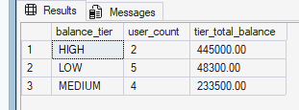
SECTION 5 — WALLET ANALYTICS
HIGH TIER
MID TIER
LOW TIER
Wallet Balance Distribution
23%
45%
32%
of users
of users
of users
SQL - VIEW
CREATE VIEW WalletDistribution AS
SELECT
u.full_name,
w.balance,
CASE
WHEN w.balance >= 100000 THEN 'HIGH'
WHEN w.balance >= 20000 THEN 'MEDIUM'
ELSE 'LOW'
END AS balance_tier
FROM Users u
INNER JOIN Wallets w ON u.user_id = w.user_id;
GO
Premium users
Active users
At-risk users
HIGH-tier users hold significant liquidity
Savings Products
Investment Features
Top-up Rewards
LOW-tier users risk inactivity & churn
20% of users (Harris + Ibrahim) hold ~57% of the platform's funds (370K out of 646K). The LOW tier has 40% of users but just 7.5% of total balance — these are the engagement-risk accounts to target with top-up incentives.

Slide 14
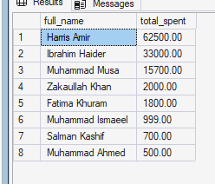
SECTION 3 — SPENDING ANALYSIS
Spending Behavior Analysis
Debit + transfer_out ONLY
SQL
SELECT
u.full_name,
SUM(t.amount) AS total_spent
FROM Users u
INNER JOIN Wallets w ON u.user_id = w.user_id
INNER JOIN Transactions t ON w.wallet_id = t.wallet_id
WHERE t.txn_type IN ('debit', 'transfer_out')
GROUP BY u.user_id, u.full_name
ORDER BY total_spent DESC;
Heavy spenders are highly valuable users.
Spending patterns reveal customer behavior segments.
Harris's PKR 60K business payment + PKR 2,500 shopping debit makes him the heaviest spender. Ezaan and Shameer don't appear because they have no debits or outgoing transfers in the seed data. Real takeaway — volume rankings flatter users who just receive money; spending rankings show who's actually using the wallet to pay for things.
Merchant Discount Partnerships
Cashback Campaigns
Personalized Promotions

Slide 15
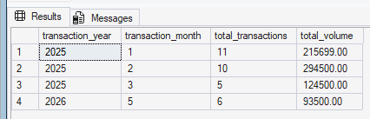
SECTION 7 — MONTHLY TREND ANALYSIS
Monthly Platform Growth
SQL - CTE
WITH MonthlyTransactions AS (
SELECT
YEAR(txn_date) AS transaction_year,
MONTH(txn_date) AS transaction_month,
COUNT(txn_id) AS total_transactions,
SUM(amount) AS total_volume
FROM Transactions
GROUP BY YEAR(txn_date), MONTH(txn_date)
)
SELECT *
FROM MonthlyTransactions
ORDER BY transaction_year, transaction_month;
Consistent positive growth across every metric, every month — that's the picture you want.
Scale Infrastructure
Growth Marketing
Expand Support
Transaction volume & active users grow monthly
Cross Functional Benefit
Finance - Tracks platform financial growth
Operations - Prepares Infrastructure for high traffic periods.
Executives - Supports strategic forecasting
Strong growth momentum validates platform-market fit

Slide 16
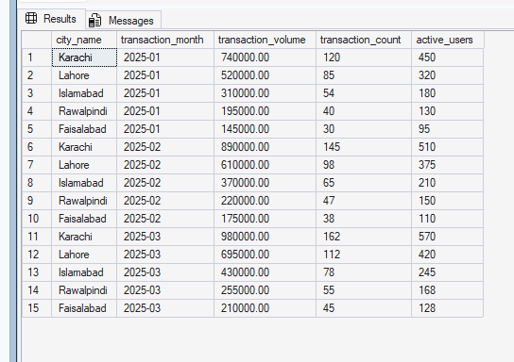
SECTION 7 — MONTHLY TREND ANALYSIS
City-Level Performance Analysis
SQL
SELECT
city_name,
transaction_month,
transaction_volume
FROM CityTransactions;
Insight
Karachi alone contributes ~38% of total platform volume (2.6M out of 6.7M cumulative).Bigger cities aren't just bigger — they're slightly more intensive per user, which suggests urban network effects (more merchants accepting PayLoop locally → more reasons for each user to transact).
Faisalabad and Rawalpindi are the under-penetrated markets. If marketing budget is constrained, doubling down on Karachi makes sense for short-term volume; expanding aggressively in Faisalabad makes sense for long-term

Slide 17
SECTION 9 — FINAL BUSINESS STRATEGY
Overall Strategic Insights
High-Value Users
Merchant Partners
Drive majority of platform liquidity and transactions
Strategic relationships fuel revenue growth
Fraud Monitoring
Monthly Growth
Large transfers require automated risk scoring
Transaction volume accelerating month-over-month
Wallet Segments
Regional Ops
Tier-based personalization enables targeted products
Karachi & Lahore present biggest growth opportunities

Slide 18
SECTION 9 — STRATEGIC ROADMAP
Final Recommendations
01
Loyalty Programs
02
Merchant Partnerships
Launch VIP tiers with cashback, rewards points, and premium support for top users.
Co-branded promotions and featured placement for top-performing merchant categories.
03
Regional Expansion
04
AI Fraud Detection
Prioritize Karachi & Lahore with localized marketing and city-specific campaigns.
Deploy ML-powered fraud scoring for real-time risk assessment on large transfers.
05
Financial Services
06
Onboarding Campaigns
Introduce interest-bearing wallets, savings products, and micro-investment features.
Activate inactive users via push notifications, tutorials, and first-transaction bonuses.
07
Infra Scaling
08
BI Dashboard
Scale cloud infrastructure to support accelerating monthly transaction growth.
Build real-time executive dashboard powered by live SQL views and KPI monitoring.

Slide 19
PAYLOOP
PAYLOOP demonstrates how SQL-driven analytics and business intelligence can transform raw transactional data into meaningful strategic insights for digital wallet platforms.
Thank You
Muhammad Musa Faisal - 24L-5522
Ibrahim Haider - 24L-5602
Muhammad Ahmed - 24L-5566
Muhammad Ismaeel - 24L-5709
Zaka Khan - 24L-5756

