Slide 1
ECO346 | ASSIGNMENT 1
Visualizing annual
earnings in urban Punjab
Data Visualization Techniques for Economists
Registration: FA24-BED-057 • Variant 1
PSLM person and household subsets | weighted analysis
ECO346 • FA24-BED-057
1 / 4

Slide 2
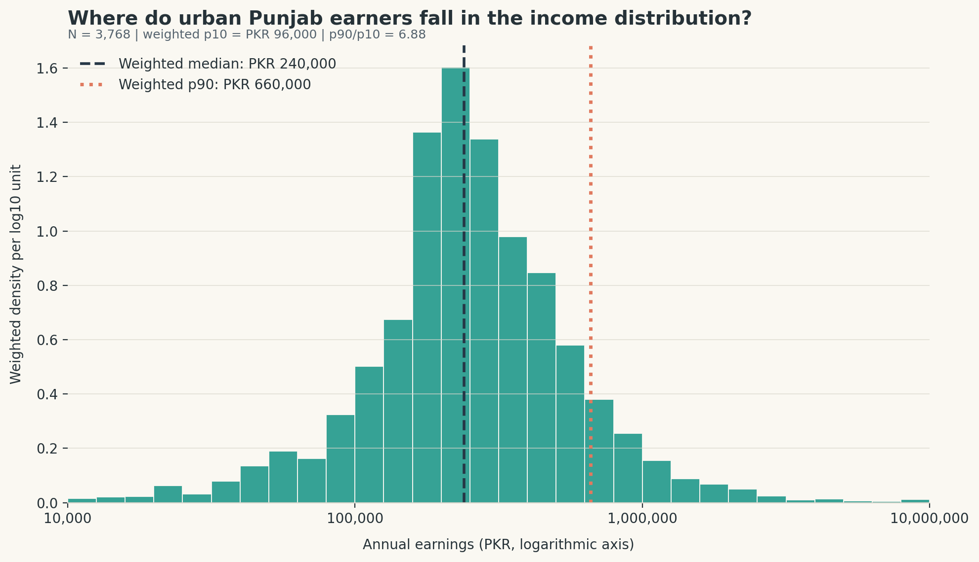
01 / DISTRIBUTION
Earnings differ substantially across the distribution
Weighted percentiles describe the retained sample; the histogram uses 0.1 log10-unit bins.
SAMPLE
3,768
WEIGHTED MEDIAN
PKR 240,000
P90 / P10
6.88
Weighted p10: PKR 96,000
Weighted p90: PKR 660,000
ECO346 • FA24-BED-057
2 / 4

Slide 3
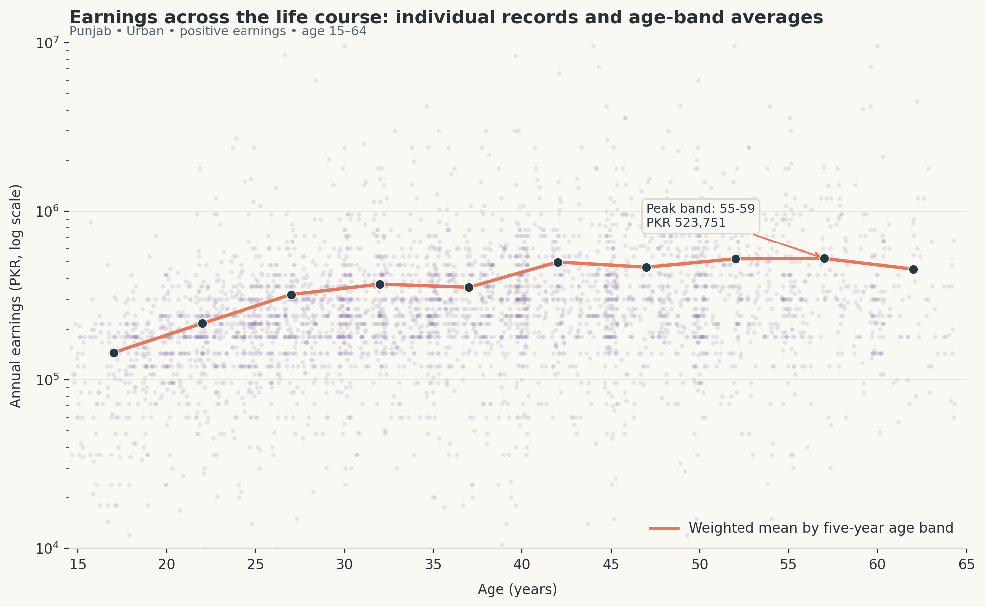
02 / AGE PROFILE
Mean earnings peak in the 55–59 age band
Points show individual records; the coral curve connects household-weighted five-year means.
AGE 25–29
PKR 320,776
AGE 45–49
PKR 465,073
HIGHEST BAND
55-59
PKR 523,751
ECO346 • FA24-BED-057
3 / 4

Slide 4
03 / TAKEAWAYS
How to read these results
DISTRIBUTION
AGE PROFILE
METHOD CHECK
The p90 threshold is 6.88 times the p10 threshold. The middle of the sample sits at PKR 240,000.
Weighted means generally rise with age, but not in a straight line. The scatter shows considerable variation within each age group.
R and Python should use the same retained rows and household weights. Compare full-precision table outputs before reporting agreement.
Sample: urban Punjab • ages 15–64 • positive annual earnings • hhweight used for weighting
ECO346 • FA24-BED-057
4 / 4

