Slide 1
Movies, do you like them?
Musa Abbasi

Slide 2
What movies do people like
Movie theaters are dying. Find out what people like to bring them back
Next big streaming platform

Slide 3
Got the data
MovieLens
100,000 ratings
3,600 tags
9,000 movies
600 users.

Slide 4
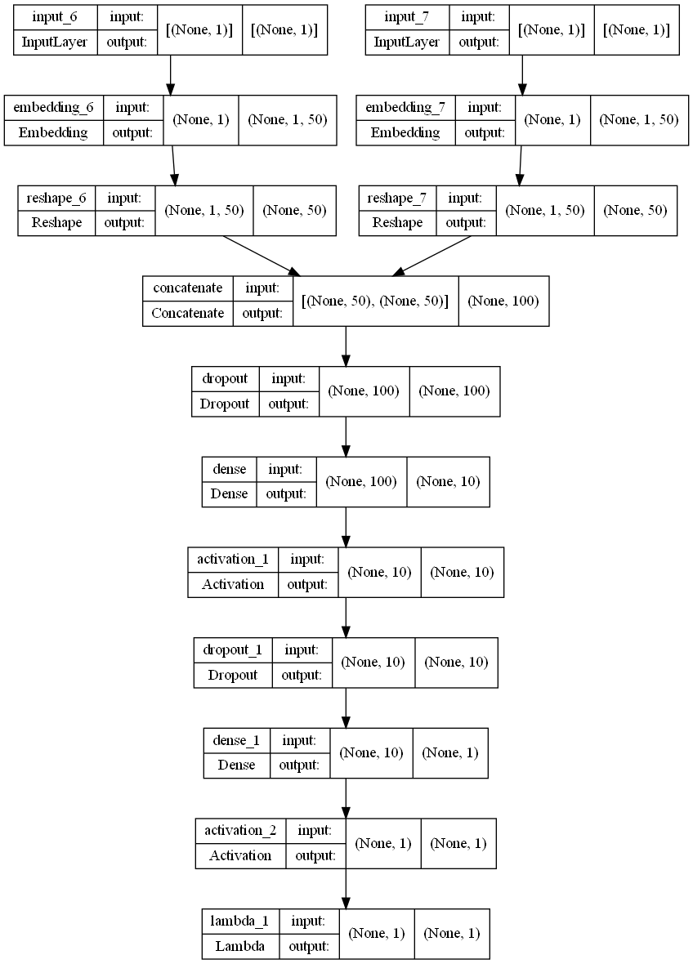
Made two model
SVD and Keras Functional API
Accuracy
FCP: 0.9307
MSE: 0.1121

Slide 5
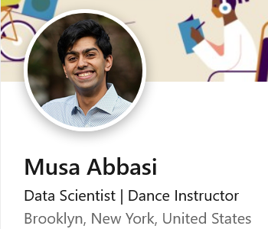
Thanks

