Slide 1

Master Thesis Topic:​ Predicting the wind condition of wind turbines using machine learning​ ​
By:​ Muhammad Musa Kaleem​ ​ Supervised By:​ Prof Martin Becker​

Slide 2
Motivation
Renewable energy demand has increased, and wind energy is a promising alternative to traditional sources of power. Machine learning algorithms can help optimize wind turbine operation by providing accurate predictions.
Key Points:
Accuracy and Efficiency: Machine learning algorithms can handle large amounts of complex data and learn from past data, leading to accurate predictions of wind conditions. This can improve the efficiency of wind turbines and reduce maintenance costs.
Scalability and Cost-effectiveness: Machine learning can be easily scaled to handle data from multiple turbines and wind farms. It can also reduce the need for expensive equipment and personnel, making it a cost-effective solution for predicting wind conditions.

Slide 3
Problem Statement:
Wind turbines rely on numerous sensors to capture a variety of data that aid in the prediction of wind speed and system features, such as yaw error and pitch angle error. However, delicate sensors and intense air currents at the height of the turbine can significantly impact the accuracy and reliability of sensor readings, leading to distorted measurements. For example, the anemometer, which measures wind conditions at the hub segmentation behind the rotor blades, can be distorted by the blades' movement.

Slide 4
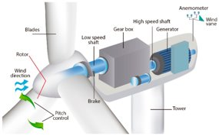
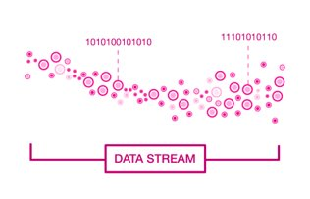



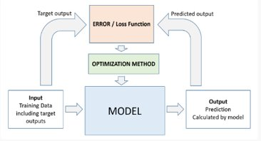

Overview
Collecting
sensors data
Processing Raw Data
EDA
Features Extraction
Documentation
Extracted Features to ML/DL models

Slide 5
Data/System Information

Slide 6

Number of Sensors
Virtually 200 sensors on simulation system study by W2E
Drop down 21 actual sensors or physically installed

Slide 7

List of Sensors
These are the sensor data inputs we will be using in our project:
Wind_Speed: measures the speed of the wind.
Yaw_Error: measures the difference between the actual and desired orientation of the turbine.
Pitch_Angle_B1: measures the angle of the first blade.
Pitch_Angle_B2: measures the angle of the second blade.
Pitch_Angle_B3: measures the angle of the third blade.
Rotorposition: measures the position of the rotor.
Generator_Speed: measures the speed of the generator.
Rotor_Speed: measures the speed of the rotor.
Generator_Torque: measures the torque generated by the generator.
Source:

Slide 8
Cont....
Power: measures the power generated by the turbine.
YAW_Bearing_THRUST: measures the thrust on the yaw bearing.
YAW_Bearing_SIDEWAYS: measures the sideways movement of the yaw bearing.
YAW_Bearing_GRAVITATION: measures the gravitational force on the yaw bearing.
YAW_Bearing_ROLL: measures the roll of the yaw bearing.
YAW_Bearing_TILT: measures the tilt of the yaw bearing.
YAW_Bearing_YAW: measures the yaw of the yaw bearing.
YAW_Bearing_FRES: measures the force on the yaw bearing.
YAW_Bearing_MRES: measures the moment on the yaw bearing.
Acceleration_CROSS: measures the acceleration in the cross-wind direction.
Acceleration_THRUST: measures the acceleration in the thrust direction.
Acceleration_RES: measures the residual acceleration.

Slide 9
Data Information
Raw Data
Folder: Yaw0
File:0001.int
File:0002.int
Folder: Yaw2
Folder: Yaw20
File:1800+.int
Record:0
Record:1
Record:1800+
…..
…..
…..
Data:
Collected from wind turbine sensors by W2E Wind to Energy GmbH
Hierarchy of Data:
Folders: Contain variations of the yaw error
Example: The folder Yaw0 contains all simulation results with the wind condition Yaw-error ~0.
Only the wind speed and the turbulence intensity vary, depending on the wind conditions.
Files: Contain set of records of specific interval

Slide 10
How sensors captured the data?
The sensor takes one data point every 0.03
In 1 second it takes 33 data points
Each file contain time series to 500s which is 8min,20s and 16.667 data points per sensor)

Slide 11
Formation of Dataset
Dataset
Wind Speed
Yaw Error
Pitch angle b1
…..
Acceleration_RES
Dataset compose of Rows, Columns
Rows
Each dataset consist of 1800+ records
Columns (represent different sensors)
Originally data set consist of 21 columns

Slide 12
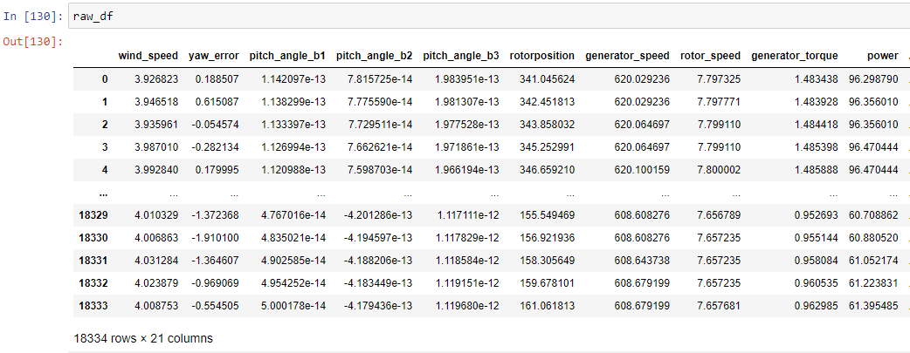
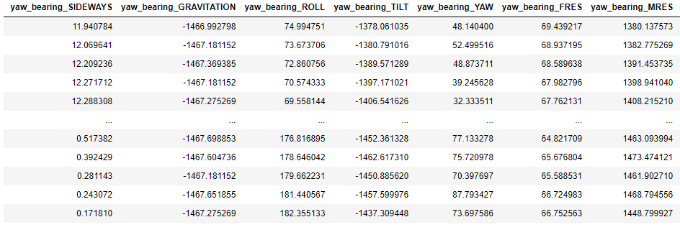
Sample of Dataset
Dataset of YAW-0, File 1 (0001.int)
Source:

Slide 13
What are the labels (targets)
In predictive modeling, labels refer to the system feature or outcome that we are trying to predict based on other features or input variable
Our targets are
Wind speed --> mean(wind speed)
Yaw error --> mean(yaw error)
Turbulence --> std(wind speed/mean(wind speed))
*std: standard deviation

Slide 14
What are the features(inputs)
In predictive modeling, features (also known as independent variables) are the measurable or observable characteristics of the system that we use to make predictions.
Inputs are:
Pitch_Angle_B1 Pitch_Angle_B2 Pitch_Angle_B3 Rotorposition Generator_Speed Rotor_Speed Generator_Torque Power YAW_Bearing_THRUST | YAW_Bearing_SIDEWAYS YAW_Bearing_GRAVITATION YAW_Bearing_ROLL YAW_Bearing_TILT YAW_Bearing_YAW YAW_Bearing_FRES YAW_Bearing_MRES Acceleration_CROSS Acceleration_THRUST Acceleration_RES

Slide 15
Labels and Features
Wind Turbine Parameters
Targets
Wind Speed
Inputs
Pitch angle
Power
Yaw Error
Turbulence
Gen Speed
Mean(wind)
Mean(yaw error)
Std(mean)/mean(wind)
…..

Slide 16
1. Preprocessing

Slide 17
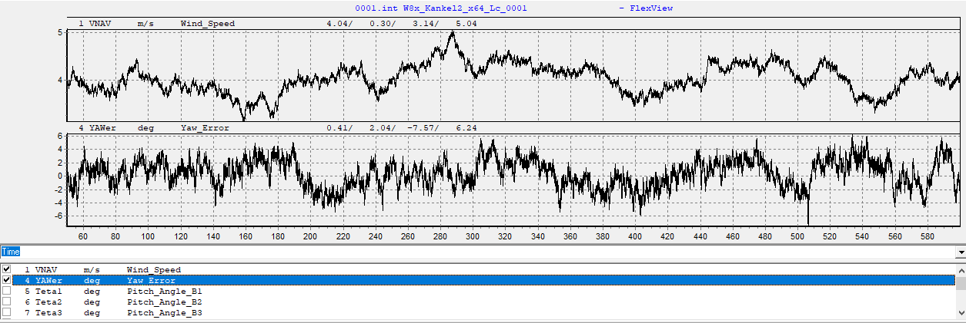
Graphical presentation of raw data
Raw data : The data captured by sensor often in binary format (.int)
Graphical representation of wind speed and yaw error of raw data
This view represent by software FLEXVIEW of binary data

Slide 18
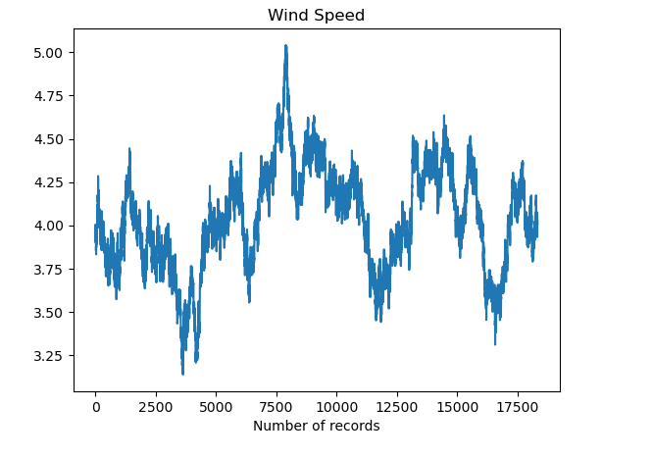
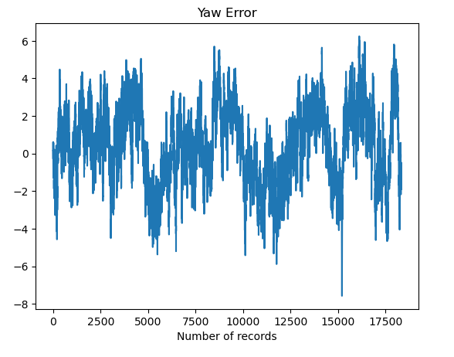
Graphical presentation of raw data
This graph belong to YAW-0, File 1 (0001.int).
Source for complete view:

Slide 19
Tabular view of Raw data (YAW-0)
Source for complete view:

Slide 20
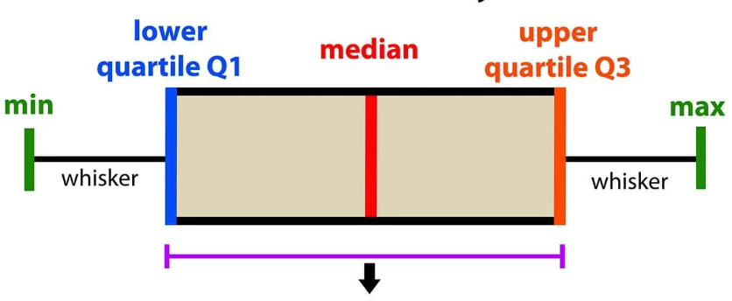
Do we perform operation on raw data?
Raw data is complex in its nature and space and time costly. First we will use extracted data separately for each YAW file example (YAW-0, YAW-10 etc.)
Mean values
Max values
Min values
Median values
Std values etc.

Slide 21
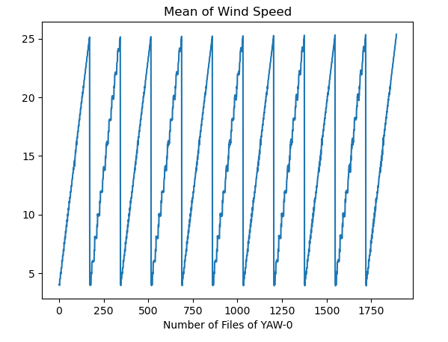
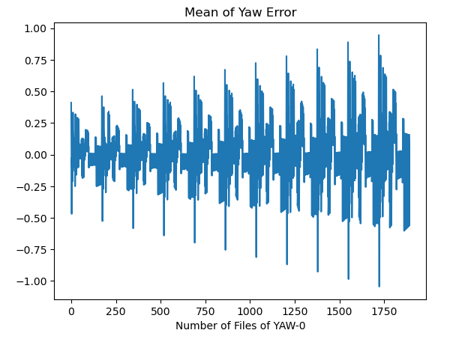
Extracted Datasets
Some graphical representation of extracted data (mean, max, min etc.)

Slide 22
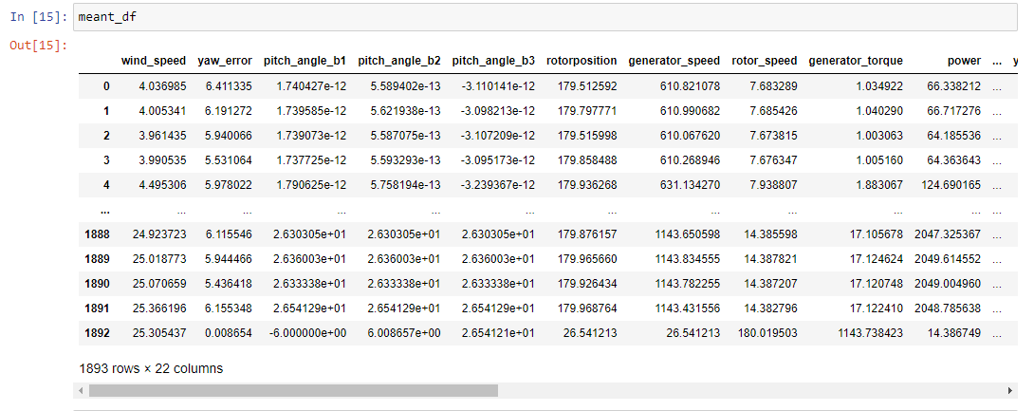
Extracted Datasets Tabular representation (cont..) All data shown here belong to YAW-0 and not possible to show all the data here but complete data available on GitLab/UniRostock
Mean dataset (YAW-0)
Source for complete view:
https://git.informatik.uni-rostock.de/bckrlab/theses/master/2023_musa-kaleem_martin/-/blob/main/src/thesis/y00-EDA.ipynb

Slide 23
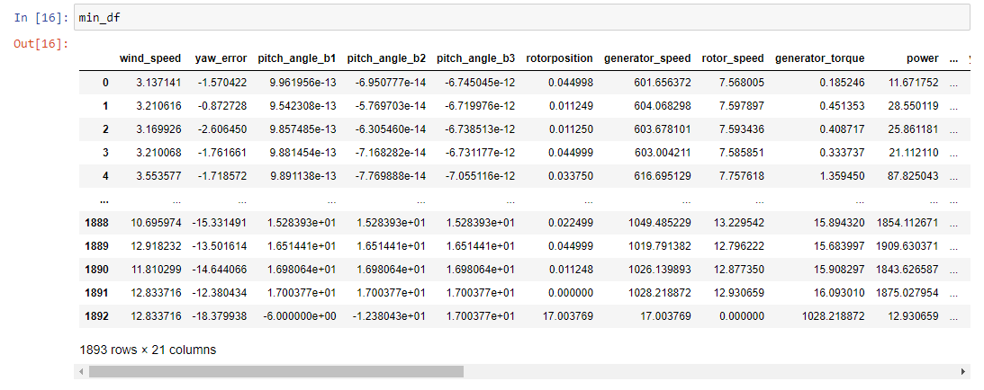
Min dataset

Slide 24
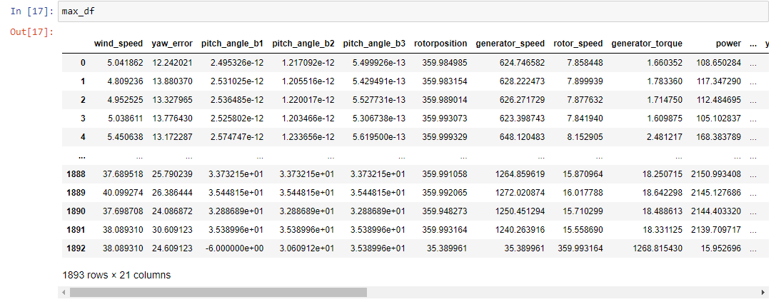
Max dataset

Slide 25
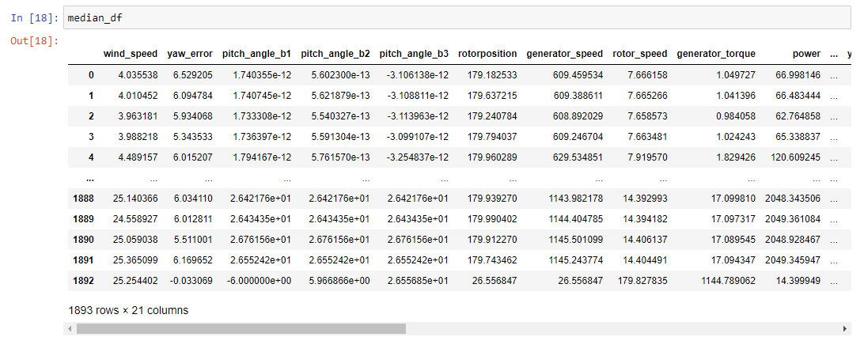
Median dataset

Slide 26
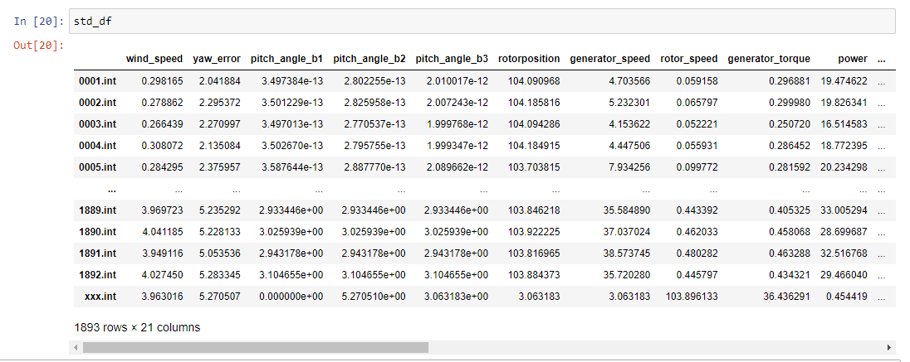
Standard deviation dataset

Slide 27
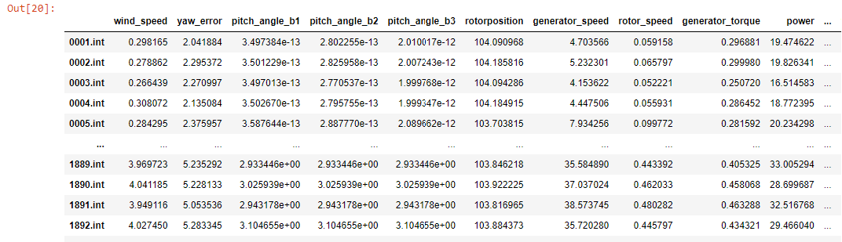
Splitting and Merging the data
All files data (Ex. 1800+) of single wind condition example (YAW-0) merged into single data set (Fig)
Each line represent individual file of YAW-0
This process of merging will repeat for all wind condition

Slide 28
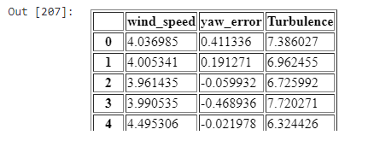
Preparing targets and inputs
After merge process we are ready to prepare targets and inputs
We will create separate data frame of targets and inputs
Targets data frame :
As we already present.
Our targets are
Mean(Wind Speed)
Mean(Yaw Error)
Turbulence (std(wind speed)/mean(wind speed))
Source for complete view:
https://git.informatik.uni-rostock.de/bckrlab/theses/master/2023_musa-kaleem_martin/-/blob/main/src/thesis/PreProcessing-YAW-0.ipynb

Slide 29
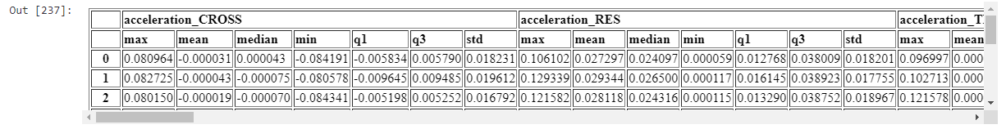
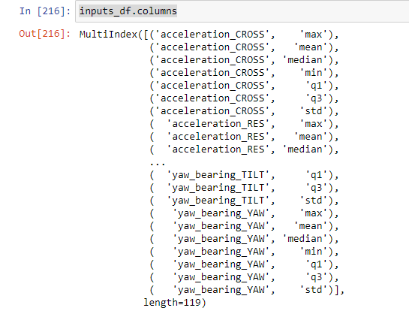
Inputs data frame :
Extracting all the dataset (mean, max, min etc.). We will merge all the dataset of single wind condition (YAW-0) into one big input dataset(Fig)
Source for complete view:
https://git.informatik.uni-rostock.de/bckrlab/theses/master/2023_musa-kaleem_martin/-/blob/main/src/thesis/PreProcessing-YAW-0.ipynb

Slide 30
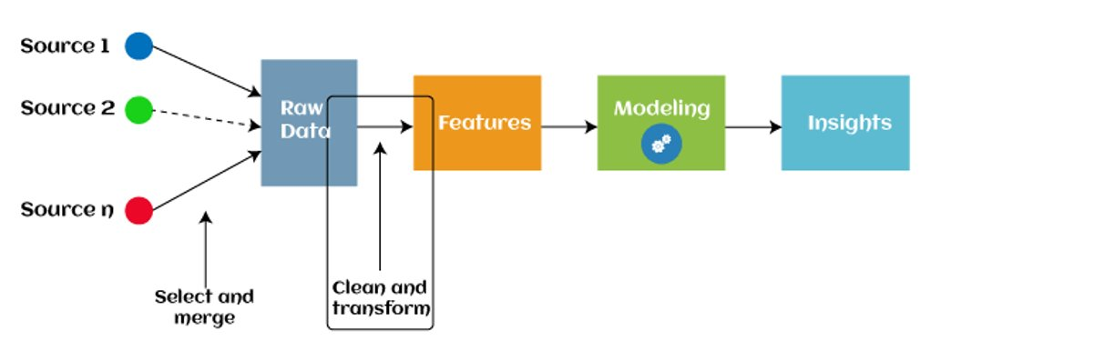

Slide 31
2. Modeling

Slide 32
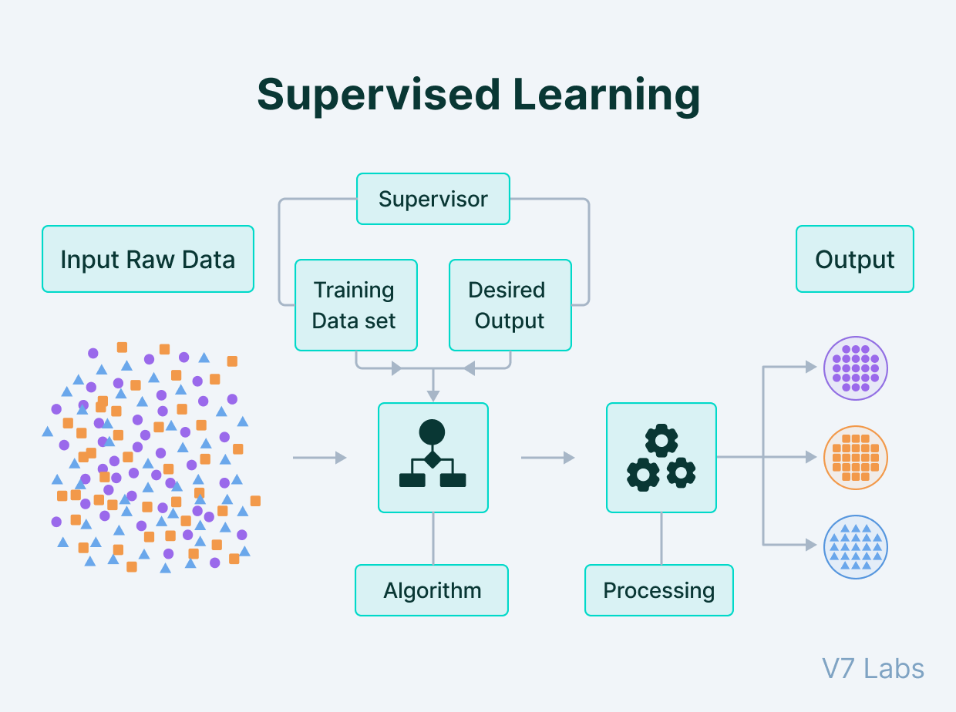
ML Modeling
After preparing targets and inputs dataset. Data is ready for ML models
We will applied supervised ML models.

Slide 33
Supervised ML algorithms
There are many ML algorithms. Our sensor data captured continuous stream of data which is suitable for regression models. Some of following models
Linear regression
Decision trees
Random Forest
SVM etc.

Slide 34
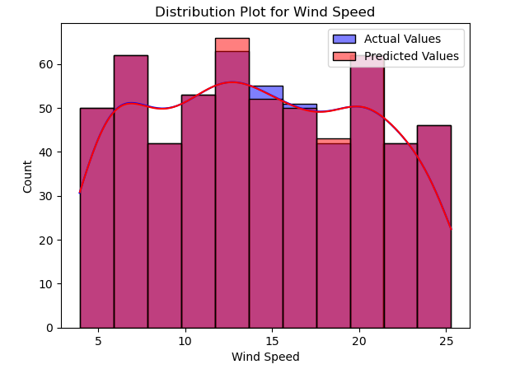
Random Forest
We applied random forest on YAW-0 according to our requirements
We will show the result for each target individually
Wind Speed(YAW-0)
The models score almost 0.99
Mean Absolute Error (MAE): 0.02399
Root Mean Squared Error (RMSE): 0.0379
R-squared (R²): 0.9999
Source for result view:
https://git.informatik.uni-rostock.de/bckrlab/theses/master/2023_musa-kaleem_martin/-/blob/main/src/thesis/randomForest-YAW-0.ipynb

Slide 35
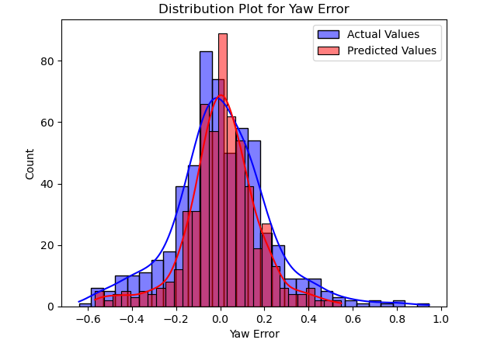
Yaw Error(YAW-0)
Model perform not good as for wind condition which required further tunning of parameters.
Model Score: 0.7926950644435057
Mean Absolute Error (MAE): 0.0587
Root Mean Squared Error (RMSE): 0.1004
R-squared (R²): 0.7926

Slide 36
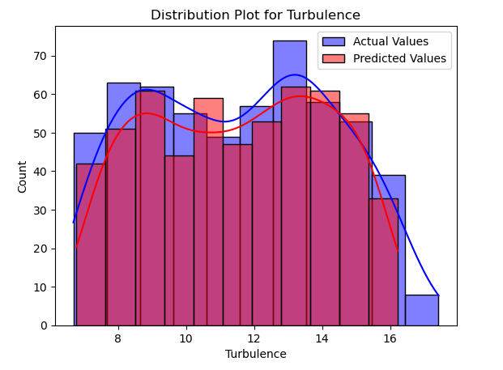
Turbulence
For Turbulence ML model perform better then Yaw error
Model Score: 0.9653
Mean Absolute Error (MAE): 0.3561 Root
Mean Squared Error (RMSE): 0.51759
R-squared (R²): 0.9653

Slide 37
3. Exploratory data analysis (EDA)

