Slide 1
EmpowerHealth – Patient‑Centric Smart EMR
A futuristic democratized EMR integrating AI, diagnostics, prescriptions, and lifestyle tracking into one patient‑centric EMR.

Slide 2
Problem & Opportunity
Health data scattered across labs, pharmacies, and clinics
Patients lack control over their records
Doctors spend time or cannot gather fragmented data
No possibility for AI-driven insights for preventive care

Slide 3
Our Solution
• Unified mobile platform for all health data
• Integrates labs, pharmacies, and doctors through APIs
• AI-powered health risk prediction
• FHIR compliant and secure access for doctors

Slide 4
How It Works
1. Mobile App: User uploads meals, activities, and views profile
2. API Layer: Connects external sources securely
3. Cloud Database: Stores FHIR‑based records
4. AI Engine: Predicts health risks and insights
5. Doctor Portal: Access via authentication

Slide 5
Data Flow
• Diagnostic labs upload reports → EMR
• Pharmacies share medicine data
• Doctors provide prescriptions
• Lifestyle uploads complete the profile
• All data exchanged via FHIR standard

Slide 6
AI Risk Prediction & Insights
• AI analyses lab results, medicines, lifestyle
• Predicts potential risks (e.g., diabetes, hypertension)
• Provides personalized health recommendations
• Early alerts for users and doctors

Slide 7
User Experience & Doctor Access
Users:
• Centralized dashboard
• Track meals, activity, and reports
Doctors:
• View full patient history
• Receive AI‑based alerts
• Gain real‑time insights

Slide 8
Security & Privacy
• End‑to‑end encryption
• Patient consent for data sharing
• Role‑based authentication
• FHIR ensures interoperability

Slide 9
Business Model & Roll‑Out
• Phase 1: Minimum viable product for individual users
• Phase 2: Partner with labs and clinics
• Phase 3: Integrate with insurance/wearables
• Monetization: Subscriptions & B2B licensing

Slide 10










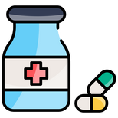





9
Stakeholders
12. Health Authorities
11. Disaster Management
10. Surveillance Programs
Clinical Research Dashboard
Federal
Provincial
District
NDMA
PDMA
NIH
PACP
HCV Prog
TBCP
AI/ML
Systems
Monitoring Dashboard
PHEOC Dashboard
9.Public Health Research
1. Patients
Data Lake
Mobile Apps
HL7 FHIR Adapter
WHO
UNICEF
2. Hospitals
Patient Portal
Pakistan
Health Information Exchange
8. Medical Education
EMR
PACS
ERP
HIE APIs
7. Pharmaceuticals
ERP
LIMS
Claims Portal
Helpline
PACS
3.Pharmacies
4. Diagnostic Labs
5. Insurance Providers
6. Emergency Response Services
Sehat Card
State Life
1122
EIDHI

Slide 11




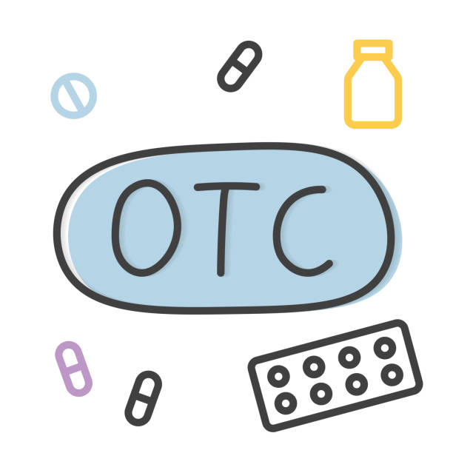


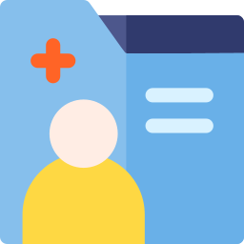


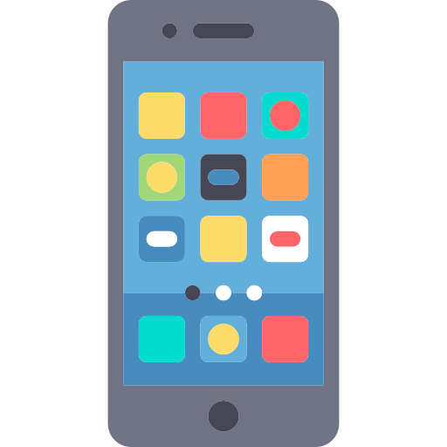








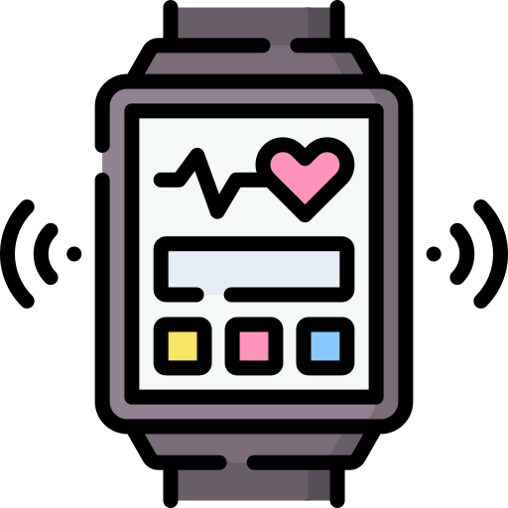



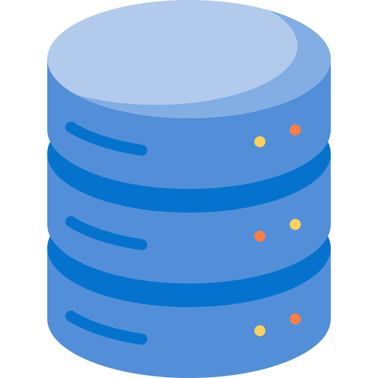
System Design
API
Medical Records
Patient Data Entry
Air
Water
Location
Clinical Notes (ICD-10)
Alerts
3rd Party Cloud Services
Hospital
Emergency Responders
Anthropometric Profile
Over-the-
Counter Medicines
Smart-on-FHIR App
Virtual Encounter
OCR
Vaccine
Reports
Multilingual
Telehealth
Vaccination
Patient
Exercise
Lab Results
Nutrition
Claims &
Approvals
Diagnostics
Speech To Text
Insurance
Medicine
Receipts
Home Testing
Wearables
Pharmacy
Empower Cloud
AI
Risk Prediction
Health Data Analytics

Slide 12

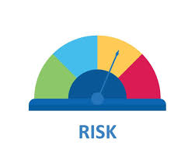
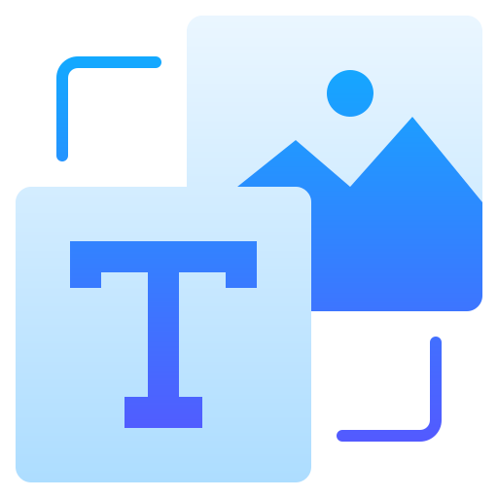





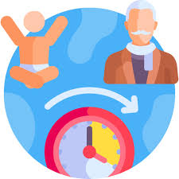
UX Elements
Risk Assessment Report
Phase 1
Data Entry
Health Data Analytics
EmpowerHealth
Speech To Text
Empower Cloud
AI
Risk Prediction
Smart on FHIR App
Health Dashboard
Patient
Image to text
Integration with people like OlaDoc, Sehat Khani etc for appointments management
Manual entry
Aging Profile
This about a hospital side of this patient-centric EMR.
Patient should be able to download his/her data

Slide 13
Authentication and Authorization
Authentication — “Who are you?”
EmpowerHealth:
Doctors, patients, and lab staff log in securely.
Prevents unauthorized people from accessing sensitive health records.
Uses OAuth 2.0 + Identity Server to confirm that the user is genuine (e.g., correct username, password, or 2FA).
Authorization — “What are you allowed to do?”
In EmpowerHealth:
A doctor can view and edit patient data.
A patient can view their own records only.
A lab can only upload results but not change diagnoses.
Both keep EmpowerHealth safe, private, and compliant with health data standards.

Slide 14
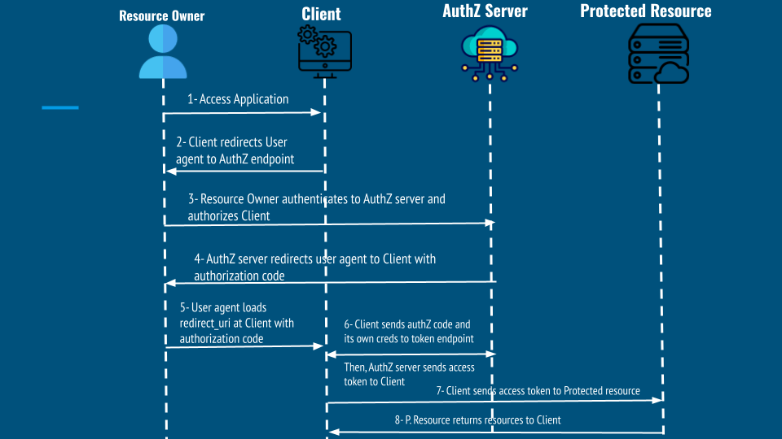
OAuth
OAuth 2.0 is a security framework that allows apps to access data safely without sharing passwords.
It is used to manage who can view, edit, or share health information.
Keeps patient data private and ensures only authorized users get access.

Slide 15
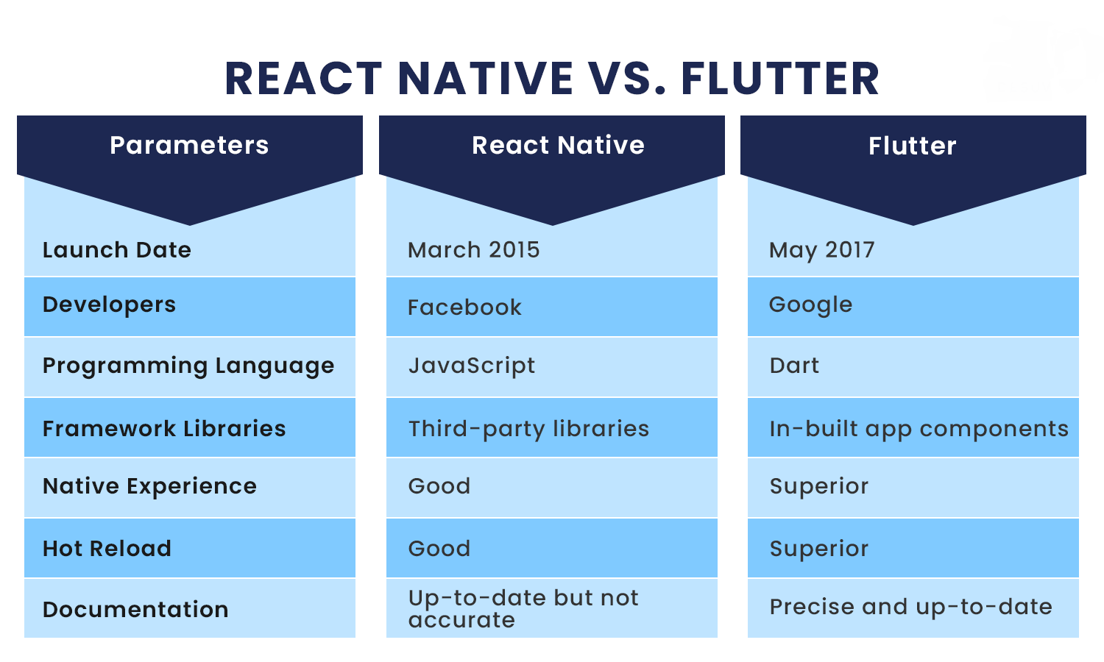
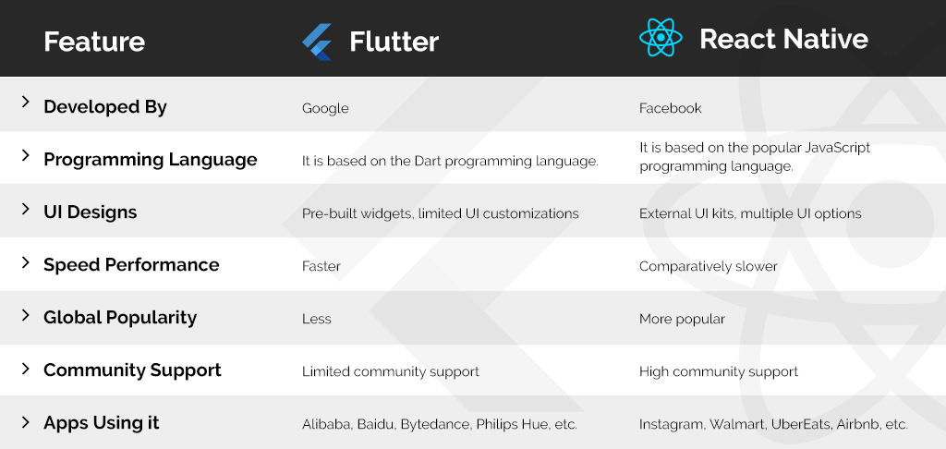
App Development Frameworks
Flutter
Angular
React Native
Comparison Table

Slide 16
 | Flutter | Angular | React Native
Language | TypeScript, HTML, CSS | Dart | JavaScript (or TypeScript)
Architecture | Component-based, relies on browser standard | Widget-based, everything is a Widget | Component-based, Uni-directional data flow
UI Rendering | WebViews | Proprietary Engine | Native Components
Performance | Good, but can be limited by WebView overhead | Excellent/Near-Nativ | Very Good
Platform Consistency | Hot Reload | Hot Reload and Hot Restart | Fast Refresh
Web & Desktop | Requires Cordova/Capacitor plugins | Uses Platform Channels | Uses the Bridge/JSI
Backing Company | Google | Google | Meta (FaceBook)
Maturity/Ecosystem | Very Mature (Web), Mature (Mobile hybrid) | Fast-Growing, rapidly maturing | Most Mature (Vast JS/NPM ecosystem)
Community Size/Activity | Moderate/Stable | Large and very active, high growth rate. | Massive and highly active, largest overall.
Job Market Demand | Good (Fueled by Angular web demand). | High/Growing Rapidly. | Highest (Due to React's ubiquity in web and mobile)
Testing Support | Excellent (Unit, integration) | Excellent (Unit, widget) | Very Good (Unit/Snapshot with Jest)
Code Sharing% | Very High (Most code is shared between web and mobile builds) | High (Can share 100% of UI/logic across mobile/web/desktop) | High (Logic is shared, UI often needs some platform-specific adjustments)
Ideal Use Case | Enterprise web applications, teams with existing Angular expertise, rapid prototypes using web technologies | Highly custom UIs, complex animations, apps prioritizing consistent design and high performance | Teams with strong JavaScript/React expertise, apps needing strong native performance and leveraging a massive third-party package ecosystem

Slide 17
No. | Task | Deadline | Remarks
 | Code Base (Flutter)
 | Github Repo
 | Authorization
 | Create User
 | Reset Password
 | Profile
 | Login

